Slide 1

Python Programming for Electrical Engineering Lab:: Lecture topic# Data Operations#Files
Dr.K.Srikanth
Assistant Professor
Dept of EEE

Slide 2
Discussion Content
Files
Exception Handling
Functions
Examples

Slide 3
Python core data types
Object type | Example Literals/Creation
Numbers | 1234, 3.14, ob1111, Decimal(), Fraction()
Strings | ‘spam’,”Bomb’s”
Lists | [1, [2, ‘three’],4.5],list(range(10))
Dictionaries | {‘food’: ‘spam’,’taste’: ‘yum’} dict(hours=10)
Tuples | (1, ‘spam’,4’ ‘U’), tuple (‘spam’), namedtuple
Files | open(‘eggs.txt’)
Sets | Set(‘abc’),{‘a’,’b’,’c’}

Slide 4
Files
Programs that we have developed so far take data from the user in an interactive manner.
Such data remain in memory only during the lifetime of the program.
Often we want to store data permanently, in the form of files that usually reside on disks, so that it is available as and when required.
For example, for login application, we would like to validate the user name and password entered by a user against the names and passwords of valid users stored permanently in a file.
By default, Python provides a standard input file and a standard output file to deal with the transitory data. The standard input file is read from the keyboard, and the standard output file is displayed on the screen.
Apart from these standard input/output files, we can also create files on disks that store data permanently for subsequent use. In
Taneja Sheetal; Kumar Naveen. Python Programming: A modular approach . Pearson Education. Kindle Edition.

Slide 5
File Handling:
Moreover, programs necessarily have to deal with exception situations like unavailability of a file we want to read from or an error like division by zero.
Files provide a means of communication between the program and the outside world.
A file is nothing but a stream of bytes, comprising data of interest.
Files can be used in any application where data is required to be stored permanently.
Before performing a read or write operation in a file, we need to open the file. Built-in function open() is used for this purpose.
Taneja Sheetal; Kumar Naveen. Python Programming: A modular approach . Pearson Education. Kindle Edition.

Slide 6
File Handling
A file may be opened in any of the three modes: r (read), w (write), and a (append).
Read mode is used when an existing file is to be read. Write mode is used when a file is to be accessed for writing data in it.
While opening a file in the read mode, if the specified file does not exist, it would lead to an error.
As opposed to this, while opening a file in write mode, if the specified file does not exist, Python will create a new file.
However, while opening a file in write mode, if the specified file already exists, this file gets overwritten. As the name suggests, append mode allows us to write into a file by appending contents at the end of the specified file.
Taneja Sheetal; Kumar Naveen. Python Programming: A modular approach . Pearson Education. Kindle Edition.

Slide 7
file is a stream of bytes .
open(): to open a file modes for opening a file:
read(r): to read the file
write(w): to write to the file
append(a): to write at the end of the file
Taneja Sheetal; Kumar Naveen. Python Programming: A modular approach . Pearson Education. Kindle Edition.

Slide 8
Syntax
f = open(file_name, access_mode) by default, a file is opened in read mode
In the following statement, the file object returned by the function open has been named f and we will be using this name for writing the contents into the file:
>>> f = open('PYTHON','w') By default, the system creates a file in the default working directory.
Instead of this relative path name, absolute (full) path name such as F:\PythonCode\Ch09 could also be specified.
The functions read and write are used for reading from and writing into the file respectively.
Taneja Sheetal; Kumar Naveen. Python Programming: A modular approach . Pearson Education. Kindle Edition.
Taneja Sheetal; Kumar Naveen. Python Programming: A modular approach . Pearson Education. Kindle Edition.

Slide 9
Syntax:
>>> f.write('''Python: Python is an interactive programming language. Simple syntax of the language makes Python programs easy to read and write.'‘’)
reading a file opened for writing yields an error
Taneja Sheetal; Kumar Naveen. Python Programming: A modular approach . Pearson Education. Kindle Edition.

Slide 10
When a file is no longer required for reading or writing, it should be closed by invoking the function close as shown below:
close(): saves and closes the opened file
>>> f.close() The function close also saves a file, which was opened for writing. Once a file is closed, it cannot be read or written any further unless it is opened again and an attempt to access the file results in an I/O (input/output) error: attempt to read/write a closed file results in an error
Taneja Sheetal; Kumar Naveen. Python Programming: A modular approach . Pearson Education. Kindle Edition.

Slide 11
To read the contents of the file f, we open the file again, but this time in read mode. Once the file has been opened in read mode, its contents can be read using read function:
>>> f = open('PYTHON', 'r’)
>>> f.read()
'Python:\nPython is an interactive programming language.
\nSimple syntax of the language makes Python programs easy to read and write.’
>>> f.close()
Taneja Sheetal; Kumar Naveen. Python Programming: A modular approach . Pearson Education. Kindle Edition.

Slide 12
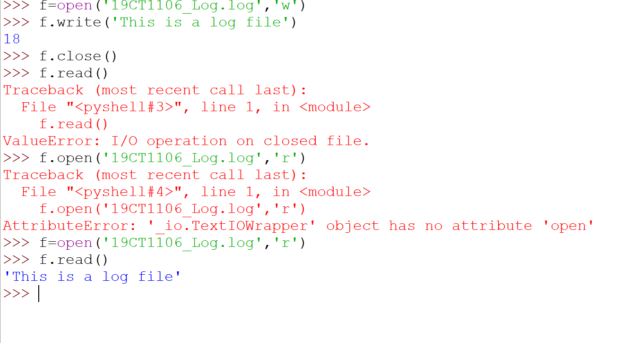
Example Code

Slide 13
Reading by number of bytes:
the read() function retrieves the contents of the entire file. More often, we need to read data in smaller chunks.
As an alternative, we can read a fixed number of bytes from the file by specifying the number of bytes as the argument to read function. For example, reading only first 4 bytes will return Pyth as output.
function read retrieves the content of the entire file
Taneja Sheetal; Kumar Naveen. Python Programming: A modular approach . Pearson Education. Kindle Edition.

Slide 14
Example:
>>> f = open('PYTHON','r’)
>>> f.tell() 0
>>> f.read(4) 'Pyth’
>>> f.tell() 4

Slide 15
Tell Function
tell to know the current position while reading the file object f.
Initially, the current position of file object f is set at 0, i.e., position of the first byte.
A subsequent read operation will read the file f from the current position of the file object. tell(): to find current position of the file object
Taneja Sheetal; Kumar Naveen. Python Programming: A modular approach . Pearson Education. Kindle Edition.

Slide 16
Readline function
Note that the readline function reads a stream of bytes beginning the current position until a newline character is encountered.
>>> f.readline()
The function seek returns the new absolute position.
The function readlines()returns all the remaining lines of the file in the form of a list: readlines(): reads and returns a list of lines read from a file
Taneja Sheetal; Kumar Naveen. Python Programming: A modular approach . Pearson Education. Kindle Edition.

Slide 17
writelines
writelines takes a list of lines to be written in the file as an argument.
writelines(): writes a list of lines to a file

Slide 18
Copying contents
>>> f1 = open('PYTHON', 'r')
>>> f2 = open('PythonCopy', 'w')
>>> data = f1.read()
>>> f2.write(data)

Slide 19
Writing a structure to file:
If we wish to write a structure such as a list or a dictionary to a file and read it subsequently, we may use the Python module pickle.
Pickling refers to the process of converting the structure to a byte stream before writing to the file.
While reading the contents of the file, a reverse process called unpickling is used to convert the byte stream back to the original structure.
Taneja Sheetal; Kumar Naveen. Python Programming: A modular approach . Pearson Education. Kindle Edition.

Slide 20
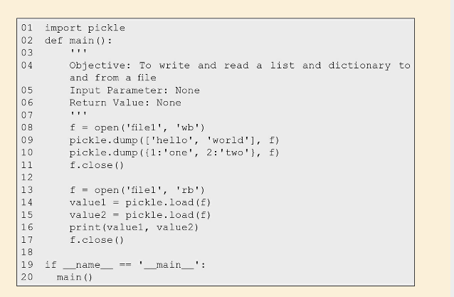
Example

Slide 21
Other functions
dump(): to convert a structure to byte stream and write it to a file
load(): to read a byte stream from a file and convert it back to the original structure
Taneja Sheetal; Kumar Naveen. Python Programming: A modular approach . Pearson Education. Kindle Edition.

Slide 22
Errors and Exceptions:
Errors occur when something goes wrong. We have encountered several errors in our program such as index out of bound, division by zero, and invalid cast operation.
The errors in Python programming may be categorized as syntax errors and exceptions.
A syntax error occurs when a rule of Python grammar is violated,
for example, a syntax error occurs in the following call to print function because of missing quote mark at the end of the string. Similarly, missing colon in the for statement results in a syntax error. syntax error: violation of Python grammar rule
>>> print('Hello)
Taneja Sheetal; Kumar Naveen. Python Programming: A modular approach . Pearson Education. Kindle Edition.

Slide 23
Another common error in Python programming is caused by incorrect indentation.
Often it leads to a syntax error, but incorrect indentation may sometimes lead to a logical error that alters the intended meaning of the program that is difficult to locate.
Taneja Sheetal; Kumar Naveen. Python Programming: A modular approach . Pearson Education. Kindle Edition.

Slide 24
Exceptions:
exceptions: errors that occur at execution time
For example, opening a non-existent file for reading, attempting to access value of a variable without assigning a value to it, and dividing a number by zero. These errors disrupt the flow of the program at a run-time by terminating the execution at the point of occurrence of the error. We have noticed that whenever an exception occurs, a Traceback object is displayed which includes error name, its description, and the point of occurrence of the error such as line number.

Slide 25
Exceptions: NameError
This exception occurs whenever a name that appears in a statement is not found globally.
For example, in the following statement, we intend to take marks as an input from the user.
For doing so, we intended to use function input but instead typed Input.
Python being case-sensitive fails to recognize the function input and the system responds with the error message NameError: name 'Input' is not defined.
This message begins with the name of the exception. Note that the following Traceback object describes that error occurred in line 1 in Python shell, in the most recent call: name not found globally
Taneja Sheetal; Kumar Naveen. Python Programming: A modular approach . Pearson Education. Kindle Edition.

Slide 26
Error Handling
>>> def Input(): #creating a function with capital I
return input('Enter your marks: ')
>>> marks = Input()
Enter your marks: 78
>>> marks '78'

Slide 27
Type Error:
This exception occurs when an operation or function is applied to an object of inappropriate type. For example, the expression 'sum of 2 and 3 is ' + 5 involves adding a number to a string which is not a valid operation resulting in an exception. Invalid type of operands for the operation
Taneja Sheetal; Kumar Naveen. Python Programming: A modular approach . Pearson Education. Kindle Edition.

Slide 28
Value Error:
This exception occurs whenever an inappropriate argument value, even though of correct type, is used in a function call, for example: Invalid argument value
Taneja Sheetal; Kumar Naveen. Python Programming: A modular approach . Pearson Education. Kindle Edition.

Slide 29
Zerodivision Error:
This exception occurs when we try to perform numeric division in which the denominator happens to be zero, for example:
>>> 78/(2+3-5)
Taneja Sheetal; Kumar Naveen. Python Programming: A modular approach . Pearson Education. Kindle Edition.
Taneja Sheetal; Kumar Naveen. Python Programming: A modular approach . Pearson Education. Kindle Edition.

Slide 30
OSError
This exception occurs whenever there is a system related error such as disk full or an error related to input/output, for example, opening a non-existent file for reading or reading a file opened in write mode:
Taneja Sheetal; Kumar Naveen. Python Programming: A modular approach . Pearson Education. Kindle Edition.

Slide 31
IndexError:
This exception occurs whenever we try to access an index that is out of a valid range. For example, let us name the list of colors ['red', 'green', 'blue'], as colors. Now the valid range of indexes for colors is [-3, -2, -1, 0, 1, 2] and the valid index range of indexes for the string colors colors[2] is [-4, -3, -2, -1, 0, 1, 2, 3].
Accessing an index outside a valid range will cause IndexError exception to occur: accessing an invalid index

Slide 32
Exception Handling:
when an exception is raised, we need to handle it by catching it and taking appropriate action using the try…except clause.
Whereas a try block comprises statements that have the potential to raise an exception, except block describes the action to be taken when an exception is raised.
In the except clause, we may specify a list of exceptions and the common action to be taken on occurrence of any of these exceptions. Alternatively, a specific action may be provided for each of the exceptions separately.
We can also specify a finally block in the try…except clause, which is executed irrespective of whether an exception is raised.

Slide 33
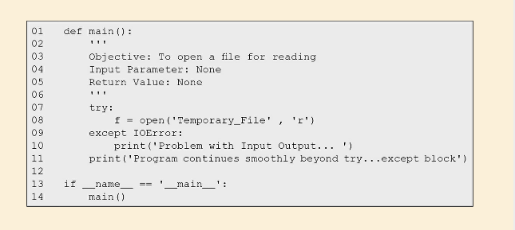
Example

Slide 34
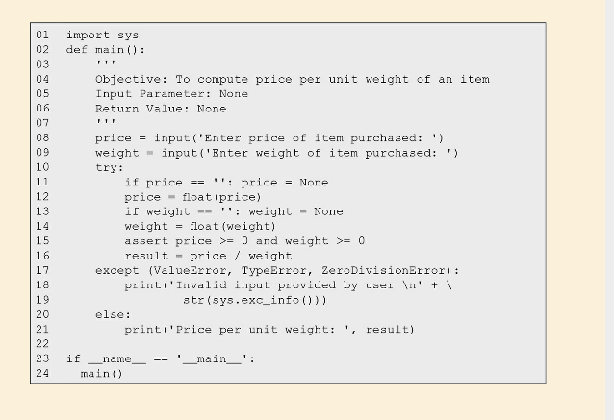
Example#2

Slide 35
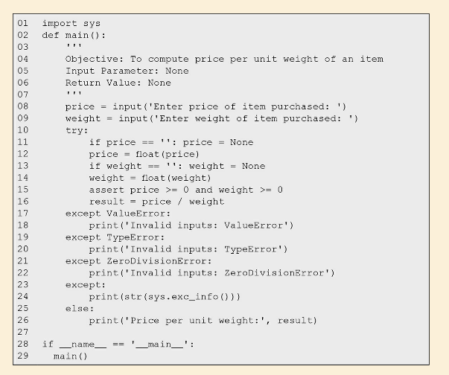
Example#3

Slide 36
Additional reading
finally block is associated with try…except clause and is executed irrespective of whether an exception is raised.
Details of the exception raised by Python can be accessed from the object: sys.exc_info().
Taneja Sheetal; Kumar Naveen. Python Programming: A modular approach . Pearson Education. Kindle Edition.

Slide 37
Books:
1. Y. Daniel Liang, Introduction to programming using Python, Pearson Publications, 2017.
2. Sheetal Taneja, Python Programming A Modular Approach, 1st edition, Pearson Publications, 2017.
3. Brett Slatkin (C), Effective Python: 59 Specific Ways to Write Better Python, I/C, 1st edition, Pearson Publications, 2015.
4. Ashok Namdev Kamathane and Amit Ashok Kamathane, Programming and Problem Solving with Python, 1st edition, McGraw Hill Education (India) Private Limited, 2017

Slide 38
References:
Taneja Sheetal; Kumar Naveen. Python Programming: A modular approach . Pearson Education. Kindle Edition.
Mark Lutz, Learning Python, O’Reilly Books
Lecture Slides on Python, Prof. Henning Schulzrrinne, Columbia University
Guido van Rossum, Tutorial Material of ZOPE Corporation, New York
https://giphy.com/explore/python-snake
Cay Hostann, Rance Necaise, Python for Everyone 2/e, Wiley Publications.

Slide 39

Thank you, Any queries?

