Slide 1

Industrial Automation and Control
Dr. Kavirayani Srikanth
Asst. Professor
Dept. of EEE

Slide 2
Course Objectives
CO1 Describe the architecture of industrial automation systems (L2)
CO2 Distinguish PID control tuning techniques (L3)
CO3 Explain time delay systems and special control structures and PLCs (L3)
CO4 Explain the working of flow control valves in hydraulic systems(L4)
CO5 Illustrate the working of Industrial Drives and Electrical Vehicle Drives (L4

Slide 3
Unit-1 Syllabus
Introduction - Architecture of Industrial Automation Systems–Classification- Examples-Pharmaceutical Industries and Measurements, Food Processing Industry, Aerospace Industry, Bioprocess Industry, Paper & Textile Industry, Automation Pyramid Measurement Systems
Characteristics –Semiconductor sensors, Smart Sensors, Microsensors, IR Radiation Sensors, Ultrasonic Sensors, Fibre Optic Sensors, Chemical Sensors, Biosensors, Data Acquisition Systems

Slide 4
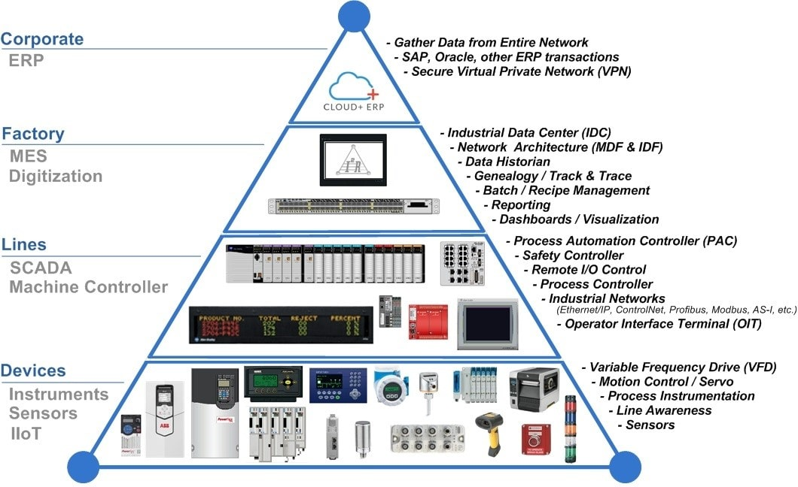

Slide 5
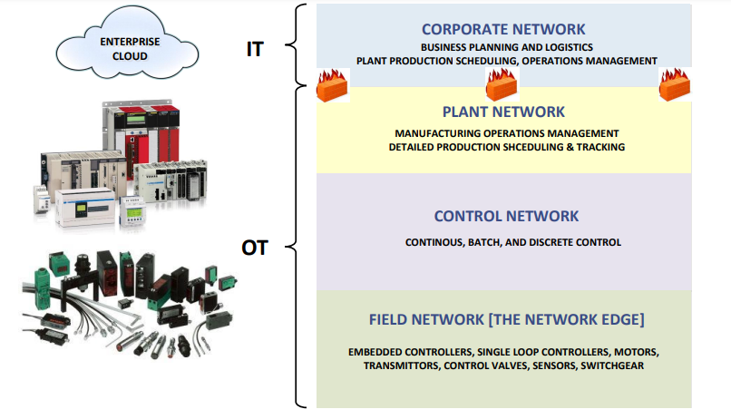
Operational Technology(OT)

Slide 6
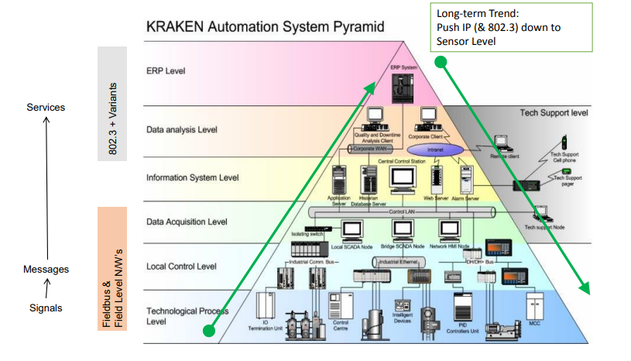

Slide 7
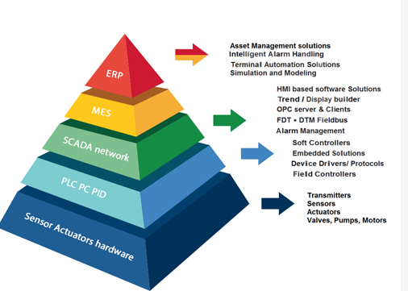

Slide 8
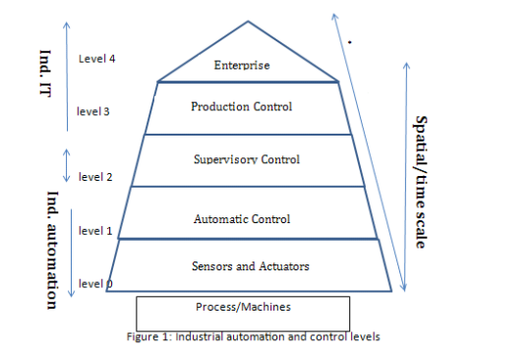
Automation Pyramid

Slide 9
Automation Pyramid
Level 0 is a sensor and actuator that directly interact with the process of the machine.
Level 1 is an automatic control and Level 2 is a supervisory control.
Level 3 production control which is responsible for maintenance, production, quality, inventory, etc.
Level 4 enterprise is mainly concerned with management functions, sales, marketing, etc

Slide 10
Why is this a pyramid
This is because as you go up the pyramid, the spatial scale and time scale of a given system at that level increase.
For example, consider one sensor system measures one process variable in the whole machine, look only at that variable, in that sense, its spatial scale is very limited.
In the whole shop floor, there are several machines, and in each machine there are several process variables at the sensor (level zero), so in that sense, its scope is very limited, but its interaction is over very small time scale (sampling time) it gives to the controller, each value represents the variable over a very short time in that sense each value which comes from a sensor has a very short time scale.

Slide 11
Why Pyramid
As you go up for example, if you go to the automatic control, the latter also watches the sampling level, it computes control input for the plant at each sample time.
Sometimes considerations are made of large duration.
For example, when you say that the settling time should be low. When considering setting time you are considering that if you make change from one operating time to another, how the output reach from one level to another. So you are typically concerning about duration of time.
If you go to supervisory control level one of the major function of this level is to change a set point. The set points change is not made every moment. Control input changes affects the plant every sample time. But set points changes are not made every sample time, Let us say some hours

Slide 12
Why pyramid?
One automatic controller may take control action over several sensors into account.
In that sense, its spatial scale increases. One supervisory controller will typically look after a number of automatically control loops and typically looks after one piece of equipment, like a boiler, a refinery or distillation column.
Typically, there will have many automatic controlling loops.
Similarly, a shop floor may be made of several set units of machines, so the production control is done typically at the shop level.
While the enterprise control is done at overall enterprise level, so as you go up, the time scale will increase and the spatial scale will also increase. That is why it is a pyramid is not a cylinder.

Slide 13
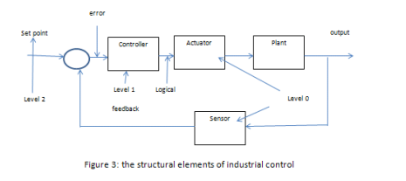

Slide 14
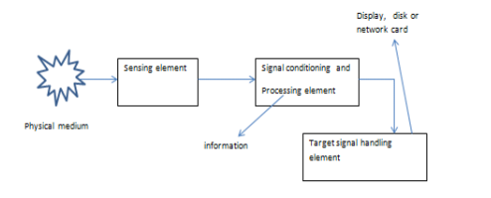
Sensor System

Slide 15
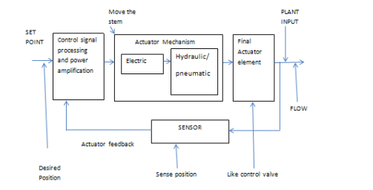
Actuator System

Slide 16
Level-0:: Sensors and actuators
• Analog electronic signal conditioning followed by Digital processing
Diagnostics/calibration/configuration
Communication
Signal protection and transmission

Slide 17
Level-1 Automatic Control
Controls analog continuous process variables
closed loop control
Track/hold set point/ (follow the set point). The set point is not constant it should hold it)
Reject disturbance
Generic PID/special purpose
Tunable
Dedicated digital RTS (microprocessor based system)
Comparatively inexpensive The second type of the automatic control is the sequence/discrete event control.
Control of discrete valued process variables (ON/OFF or High/ Medium/Low).

Slide 18
Level-2:: Supervisory Control
a- Set point computation (Impact on energy, quality, production volume)
b- Start up, shutdown, emergency operations
c- Control reconfiguration/tuning
d- Performance monitoring/diagnostics
e- Operator interface
f- Domain dependent (physical model based g- Hard/soft real time
h- Expensive

Slide 19
Level 3 Production Control
a- Process scheduling
b- Material handling
c- Maintenance management
d- Inventory management
e- Quality management
f- Resource optimization technology
g- On-line non-real time

Slide 20
Level 4:: Enterprise
Supply
Demand
Cash flow
Product Marketing

Slide 21
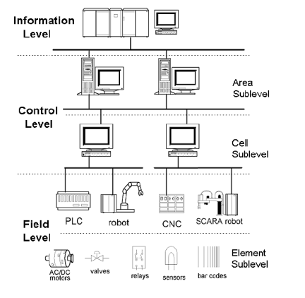

Slide 22
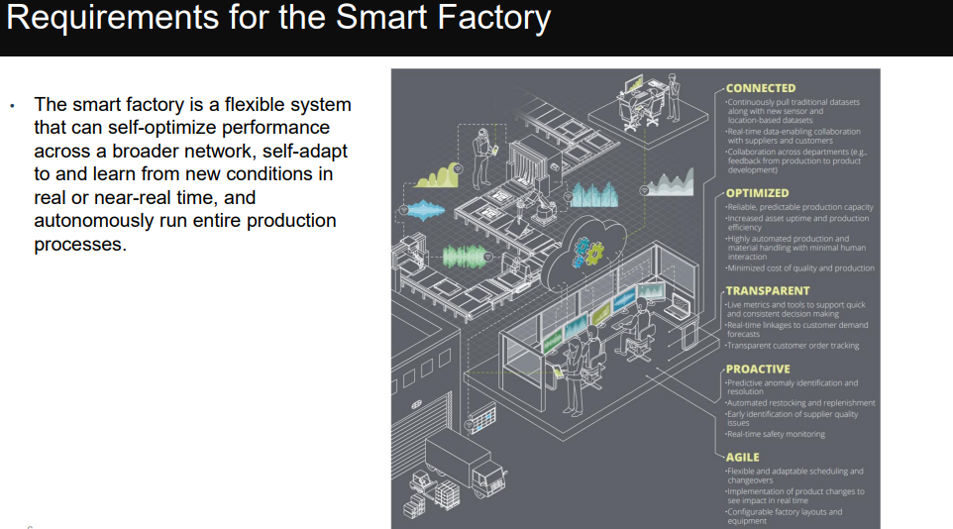

Slide 23
References
Industrial Instrumentation, Control and Automation, S. Mukhopadhyay, S. Sen and A. K. Deb, Jaico Publishing House, 2013
oai:ojs.pkp.sfu.ca:article/2628
https://www.ieee802.org/3/ad_hoc/ngrates/public/18_03/woods_nea_01_0318.pdf
http://www.atriainfotek.com/industries.html

Slide 24
Thank You
Questions?

