Slide 1
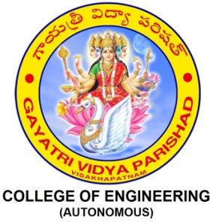
Industrial Automation and Control (20EE11Q3)
Dr. Kavirayani Srikanth
Asst. Professor
Dept. of EEE

Slide 2
Course Objectives
CO1 Describe the architecture of industrial automation systems (L2)
CO2 Distinguish PID control tuning techniques (L3)
CO3 Explain time delay systems and special control structures and PLCs (L3)
CO4 Explain the working of flow control valves in hydraulic systems(L4)
CO5 Illustrate the working of Industrial Drives and Electrical Vehicle Drives (L4)

Slide 3
Unit-III::PROGRAMMABLE LOGIC CONTROLLERS
Time Delay Systems and Inverse Response Systems-Special Control Structures, Introduction to Sequence Control, PLC, RLL-Sequence Control, Scan Cycle, Simple RLL Programs-More RLL Elements, RLL Syntax-Structured Design Approach to Sequence Control -PLC Hardware Environment.

Slide 4
Predictive Control
In a chemical process control transportation lag (time delay) comes into picture affecting the model and performance of the process.
Model of a process having a time delay τ_{d} will have a term e^{-std} in its numerator of the transfer function.
Processes having large time delays are normally difficult to control.
A change in set point or disturbance does not reach the output until a time τ_{d} has elapsed.
As a result, performance of the closed loop control system is normally sluggish and any change in set point or disturbance will give rise to large oscillations of the output before coming to a steady state value

Slide 5
Smith Predictor
In order to improve the closed loop performances of such time delay systems, O.J.M. Smith in 1957 first suggested a modification of conventional PID control schemes for processes having large time delay. The scheme for taking a predictive action in presence of transportation delay in the system is better known as Smith Predictor.

Slide 6

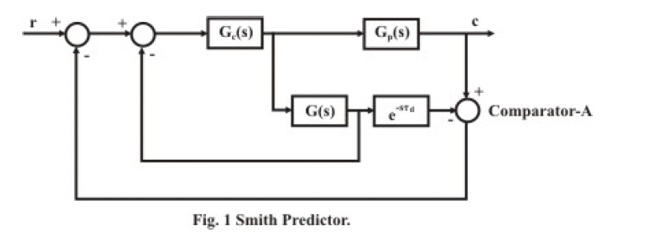
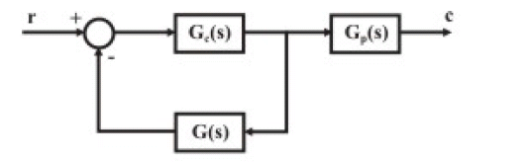
Smith Predictor

Slide 7
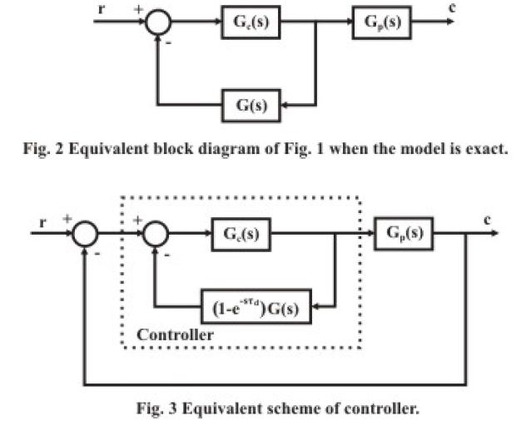

Slide 8
Design
Here G_{C}(s) is the conventional PID controller designed for the process G(s).
If the system model is exact, the output of the comparator-A would be zero and the outer loop can be ignored.
The closed loop system can be simplified as the block diagram shown in Fig. 2. Since the time delay part is absent here, the controller will see the effect of control action much earlier and the sluggish response of the system will improve.
The outer loop comes into play if the model of the process is not exact (normally that is expected). Fig. 1 can be redrawn as shown in Fig. 3 with the actual controller is shown inside the dashed line.
The performance of the Smith Predictor depends heavily on the actual knowledge of the plant model. Any change in the plant characteristics (particularly dead time) should be instantly taken care of, or otherwise, can cause deterioration of its performance. Besides, the hardware implementation of the controller using analog circuits is difficult. But the control scheme can be implemented with relative ease with a digital controller.

Slide 9
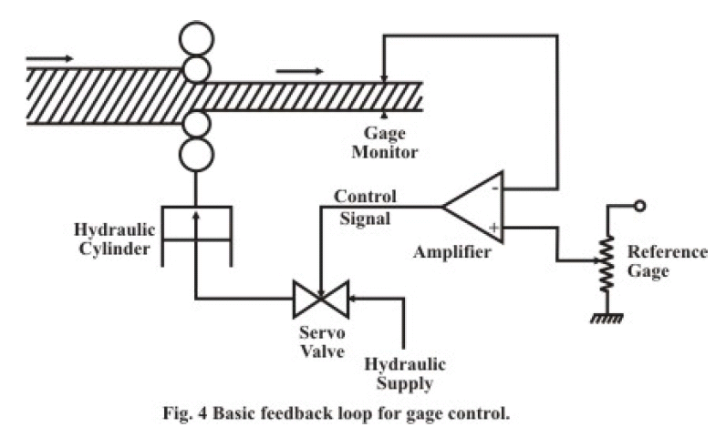
Example

Slide 10
Automatic Gage Control (AGC) is the most important control scheme in a rolling mill.
Its main objective is to maintain the thickness of the sheet steel coming out of a rolling mill constant.
The basic feedback scheme for AGC in a single stand rolling mill is shown in Fig. 4.
The gage is controlled by varying the gap between the rollers in a stand.
In fact, there are a number of stands in a rolling milling and the rolling is carried out in stages.
Hydraulic actuators are normally used for roll gap adjustment.
In this scheme, the gage of the strip is measured at the exit stand and compared with the reference gage command.
The error is amplified to operate the servo valve of the hydraulic actuator.
The basic control scheme shown here is P-type. Nucleonic detector is used for measurement of gage thickness at the exit stand.

Slide 11
But because of the fact that the thickness measuring device is installed at a distance from the roll, it will introduce transportation lag in the closed loop system.
There will be considerable time lag to detect the variation of sheet thickness at the roll stand and that will lead to oscillatory and unsatisfactory behavior of closed loop gage control.
In order to improve the performance of the closed loop scheme, Predictive Control mechanism are added with the basic feedback scheme.
Here the actual roll gap (and subsequently the gage thickness) is estimated at the roll stand. This can be achieved by two possible methods:
estimating the roll gap
estimating the gap thickness from constant mass flow principle.
In both the cases, the gap is estimated through an approximate model of the rolling stand.

Slide 12

Smith Predictor by estimating the roll gap
In this method, the gage thickness is predicted by estimating the roll gap using the expression:
where h is the exit thickness of the rolled product, C₀ is the no-load roll gap, P is the roll force in the hydraulic actuator and K_{s} is the structural stiffness of the mill. The overall scheme can be represented as in Fig

Slide 13
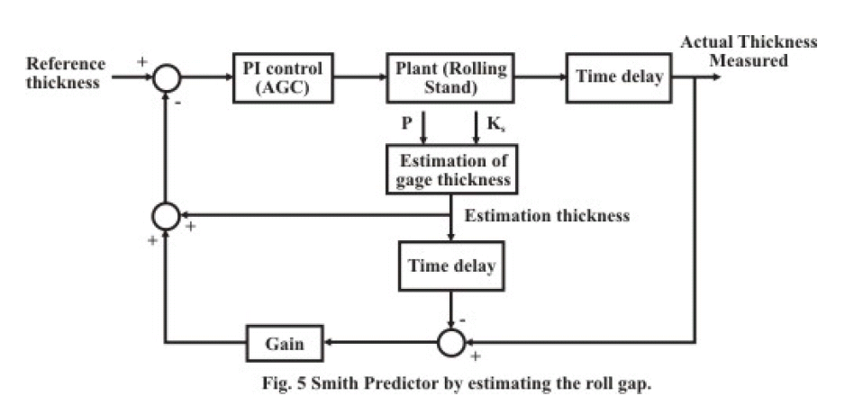

Slide 14
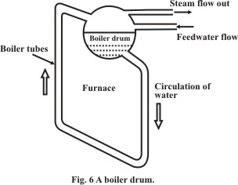

Slide 15
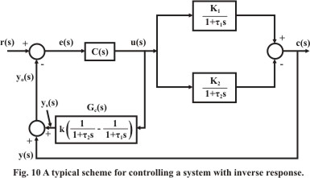
Inverse Response

