Slide 1

Topic: Unit 4 Course Name:Industrial Automation and Control
Dr. Kavirayani Srikanth
Asst. Professor
Dept. of EEE

Slide 2
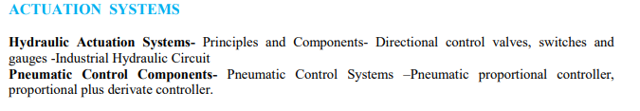
Syllabus

Slide 3
Control Valves
The control action in any control loop system, is executed by the final control element.
The most common type of final control element used in chemical and other process control is the control valve.
A control valve is normally driven by a diaphragm type pneumatic actuator that throttles the flow of the manipulating variable for obtaining the desired control action.
A control valve essentially consists of a plug and a stem. The stem can be raised or lowered by air pressure and the plug changes the effective area of an orifice in the flow path.
A typical control valve action can be explained using Figure. When the air pressure increases, the downward force of the diaphragm moves the stem downward against the spring.

Slide 4
Control valves are available in different types and shapes. They can be classified in different ways; based on: (a) action, (b) number of plugs, and (c) flow characteristics.

Slide 5
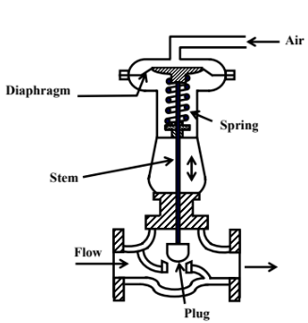
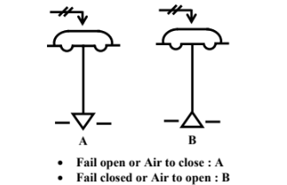
Control Valve
(a) Action: Control valves operated through pneumatic actuators can be either ( i) air to open, or ii) air to close.
They are designed such that if the air supply fails, the control valve will be either fully open, or fully closed, depending upon the safety requirement of the process.
For example, if the valve is used to control steam or fuel flow, the valve should be shut off completely in case of air failure.
On the other hand, if the valve is handling cooling water to a reactor, the flow should be maximum in case of emergency.
The schematic arrangements of these two actions are shown in Fig. 2. Valve A are air to close type, indicating, if the air fails, the
valve will be fully open. Opposite is the case for valve B.

Slide 6
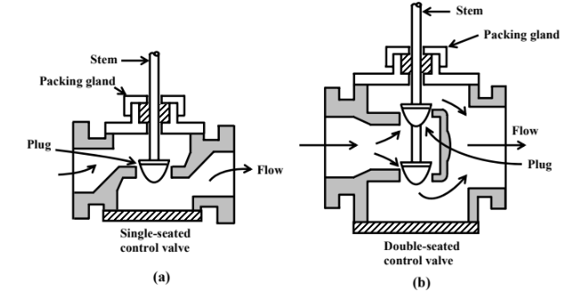
Control Valve Types

Slide 7
Control valves can also be characterized in terms of the number of plugs present, as single-seated valve and double-seated valve.
The difference in construction between a single seated and double-seated valve are illustrated

Slide 8
Single Seated and Double Seated Valves
only one plug is present in the control valve, so it is single seated valve. The advantage of this type of valve is that, it can be fully closed and flow variation from 0 to 100% can be achieved. But looking at its construction, due to the pressure drop across the orifice a large upward force is present in the orifice area, and as a result, the force required to move the valve against this upward thrust is also large. Thus this type of valves is more suitable for small flow rates.
On the other hand, there are two plugs in a double-seated valve; flow moves upward in one orifice area, and downward in the other orifice. The resultant upward or downward thrust is almost zero. As a result, the force required to move a double-seated valve is comparatively much less.
But the double-seated valve suffers from one disadvantage. The flow cannot be shut off
completely, because of the differential temperature expansion of the stem and the valve seat.
If one plug is tightly closed, there is usually a small gap between the other plug and its seat.
Thus, single-seated valves are recommended for when the valves are required to be shut off
completely. But there are many processes, where the valve used is not expected to operate
near shut off position.
For this condition, double-seated valves are recommended.

Slide 9
The shape of a valve plug is not the only deciding factor for determining its effective flow characteristics, but other equipment connected in the line along with the control valve, also affect its flow characteristics.
Thus the effective flow characteristics of a linear valve may become
nonlinear, For this reason, equal percentage valves are preferred in many cases, since their effective characteristics tend to be linear, in presence of headloss in the pipeline.
There are distinct guidelines for selecting the valve size and shape depending on load change, pipeline diameter etc. Bypass lines are sometimes used with a control valve in order to change the flow characteristics of the valve.

Slide 10
Hydraulic Actuators
Hydraulic Actuators, as used in industrial process control, employ hydraulic pressure to drive an
output member. These are used where high speed and large forces are required.
The fluid used in hydraulic actuator is highly incompressible so that pressure applied can be transmitted instantaneously to the member attached to it.
It was not, however, until the 17th century that the branch of hydraulics with which we are to be
concerned first came into use. Based upon a principle discovered by the French scientist Pascal,
it relates to the use of confined fluids in transmitting power, multiplying force and modifying
motions.
Then, in the early stages of the industrial revolution, a British mechanic named Joseph Bramah
utilized Pascal’s discovery in developing a hydraulic press. Bramah decided that, if a small force
on a small area would create a proportionally larger force on a larger area, the only limit to the
force a machine can exert is the area to which the pressure is applied.

Slide 11
Advantages of Hydraulic Systems
Variable Speed and Direction
Power-to-weight ratio
Stall Condition and Overload Protection

Slide 12
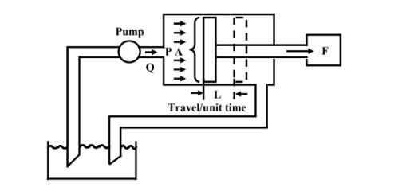

Slide 13
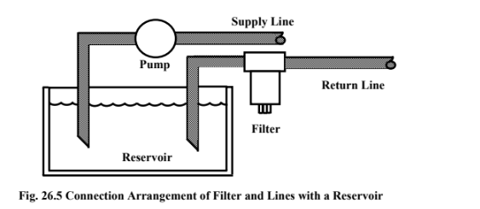

Slide 14
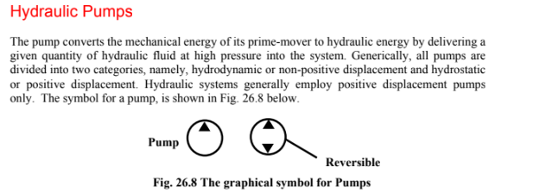

Slide 15
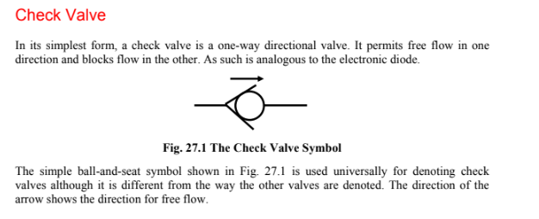

Slide 16
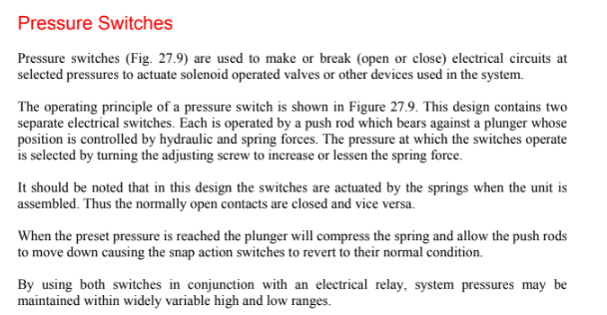

Slide 17
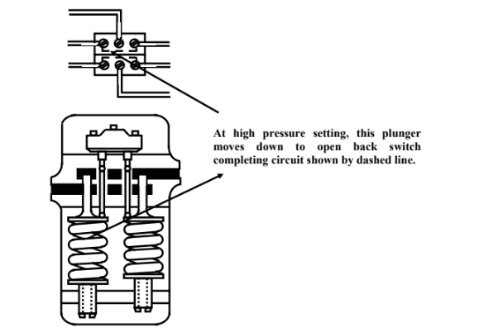

Slide 18
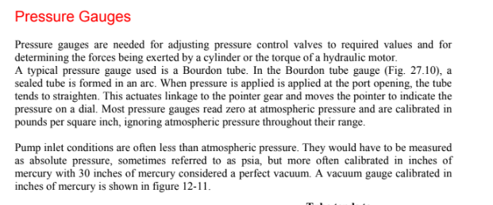
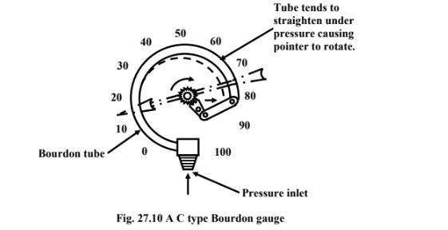

Slide 19
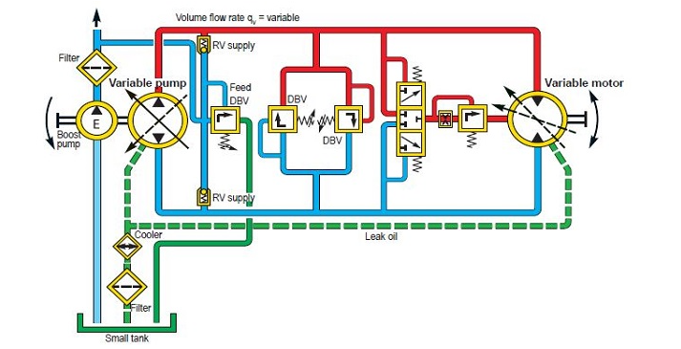
Industrial Hydraulic System

Slide 20
Industrial Hydraulic Circuit
The main components of an industrial hydraulic circuit typically include a reservoir to hold hydraulic fluid, a hydraulic pump to supply fluid to the system, control valves to direct the flow of fluid, actuators such as cylinders or motors to convert hydraulic power into mechanical power, and pipes or hoses to transport the fluid throughout the system.
Additionally, filters and accumulators may be present to remove contamination and regulate pressure, respectively. Seals, fittings, and connections are also important components to ensure that the hydraulic system is leak-free and properly joined. The specific components and their arrangement can vary depending on the application and desired system performance.

Slide 21
The industrial hydraulic symbol or just the hydraulic symbol is the first step towards an understanding of the hydraulic system. Without a basic understanding of symbols, one cannot efficiently troubleshoot the hydraulic system completely. A hydraulic system consists of cylinders, motors, valves, and pumps connected via hydraulic hoses and pipes. Due to the complexity of showing these components in a diagram we use symbols instead of absolute components.

Slide 22
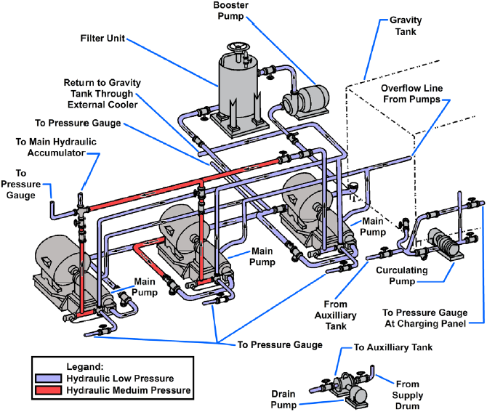

Slide 23
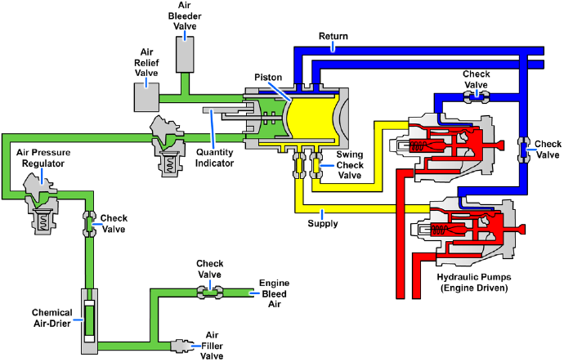

Slide 24
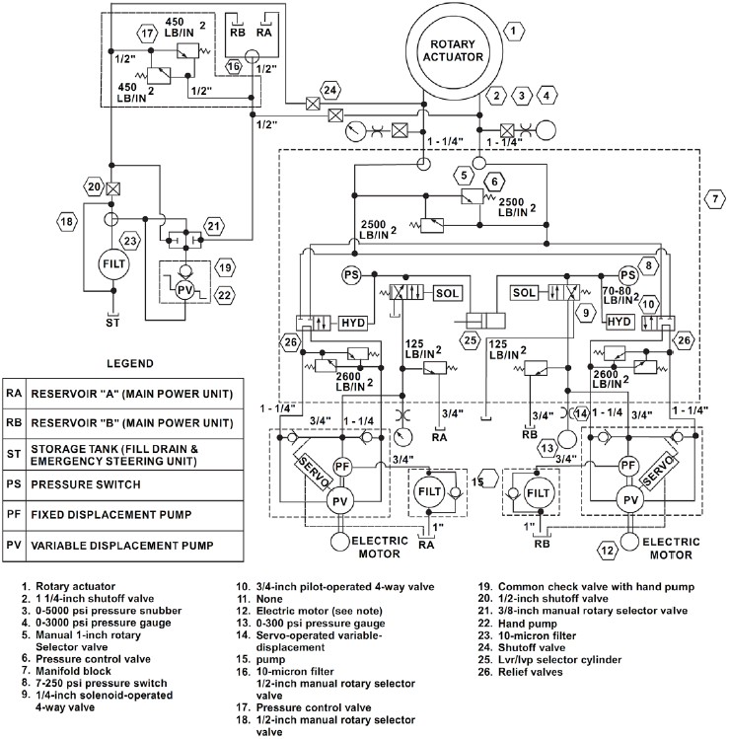

Slide 25
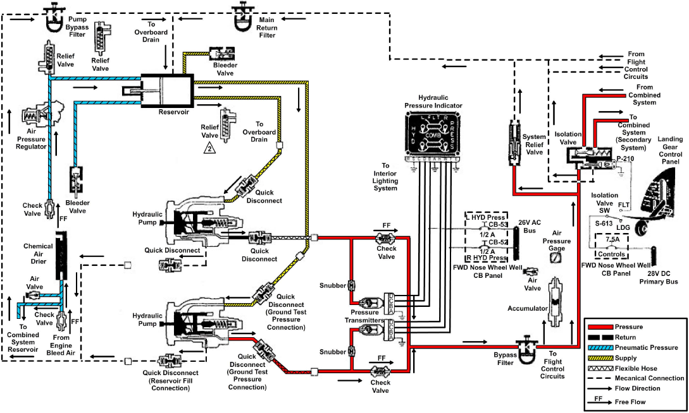

Slide 26
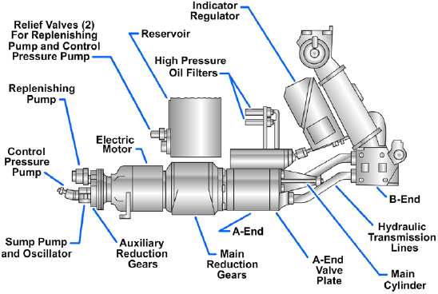

Slide 27
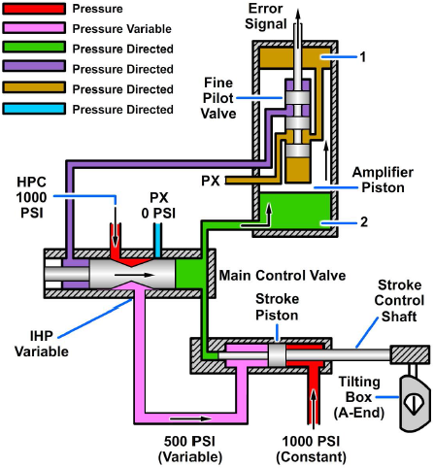

Slide 28
References
https://engineeringlibrary.org/reference/hydraulics-basic-diagrams-and-systems-navy
https://www.idc-online.com/technical_references/pdfs/mechanical_engineering/Industrial_Hydraulic_Circuits.pdf

