Slide 1

Industrial Automation and Control (20EE11Q3)
Dr. Kavirayani Srikanth
Asst. Professor
Dept. of EEE

Slide 2
Course Objectives
CO1 Describe the architecture of industrial automation systems (L2)
CO2 Distinguish PID control tuning techniques (L3)
CO3 Explain time delay systems and special control structures and PLCs (L3)
CO4 Explain the working of flow control valves in hydraulic systems(L4)
CO5 Illustrate the working of Industrial Drives and Electrical Vehicle Drives (L4)

Slide 3
Unit-III::PROGRAMMABLE LOGIC CONTROLLERS
Time Delay Systems and Inverse Response Systems-Special Control Structures, Introduction to Sequence Control, PLC, RLL-Sequence Control, Scan Cycle, Simple RLL Programs-More RLL Elements, RLL Syntax-Structured Design Approach to Sequence Control -PLC Hardware Environment.

Slide 4
Topics
Fundamentals of PLC
Programming the PLC
Allen-Bradley MicroLogix PLC
Machine Learning
Predictive Maintenance

Slide 5
Why in Industries
In production, due to changes in the nature of production, reprogramming will be required.
PLC can be programmed according to the operating requirements of the process.
To reduce manpower and unnecessary faults.
Also PLC can perform discrete and continuous functions that cannot be performed by Personal Computers.
Other advantages of using PLCs include
They’re fast,
Easy to operate and
Are considered easy to program.

Slide 6
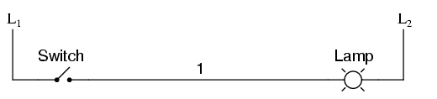
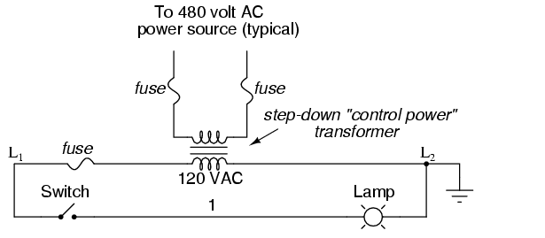
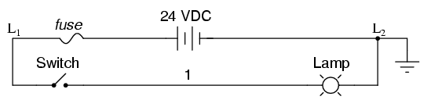
HOW?

Slide 7
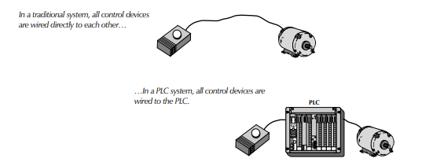
Comparison

Slide 8
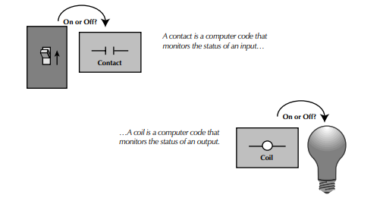
Notation

Slide 9
Why PLC?
The soft wiring advantage provided by programmable controllers is tremendous.
In fact, it is one of the most important features of PLCs.
Soft wiring makes changes in the control system easy and cheap.
If you want a device in a PLC system to behave differently or to control a different process element, all you have to do is change the control program.
In a traditional system, making this type of change would involve physically changing the wiring between the devices, a costly and time-consuming endeavor

Slide 10
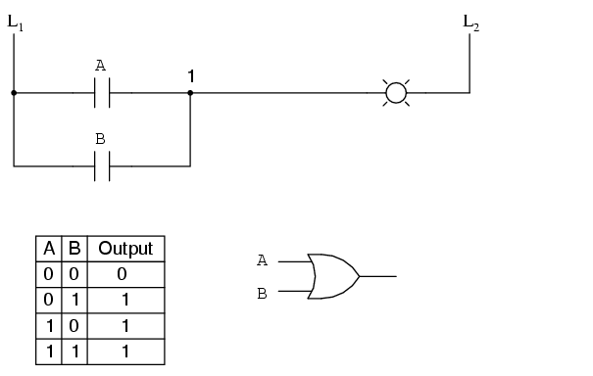
Digital Logic Function
We can construct simply logic functions for our hypothetical lamp circuit, using multiple contacts, and document these circuits quite easily and understandably with additional rungs to our original "ladder." If we use standard binary notation for the status of the switches and lamp (0 for unactuated or de-energized; 1 for actuated or energized), a truth table can be made to show how the logic works:Now, the lamp will come on if either contact A or contact B is actuated, because all it takes for the lamp to be energized is to have at least one path for current from wire L₁ to wire 1. What we have is a simple OR logic function, implemented with nothing more than contacts and a lamp.

Slide 11
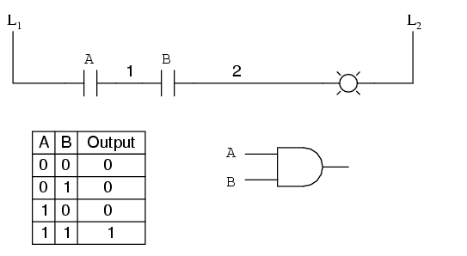
Scenario#2

Slide 12
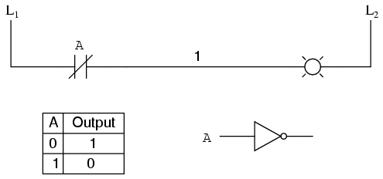
Scenario#3

Slide 13
PLC RULES
INPUTS are on the LEFT Side.
OUTPUTS are on the RIGHT side.
INPUTS can go in Series.
INPUTS can go in Parallel.
INPUTS can go in combination.
OUTPUTS can go only in parallel or Stand alone.
For every INPUT there is an OUTPUT.
Every symbol is represented by a 3 letter abbreviation.
OUTPUTS can be INPUTS.
For one action there can be more than one relation.
Every rung and every symbol needs a comment.

Slide 14
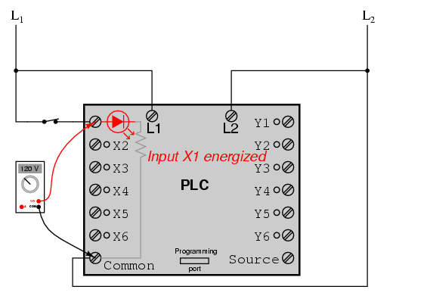
Inside PLC housing unit
Inside the PLC housing, connected between each input terminal and the Common terminal, is an opto-isolator device (Light-Emitting Diode) that provides an electrically isolated "high" logic signal to the computer's circuitry (a photo-transistor interprets the LED's light) when there is 120 VAC power applied between the respective input terminal and the Common terminal. An indicating LED on the front panel of the PLC gives visual indication of an "energized" input:

Slide 15
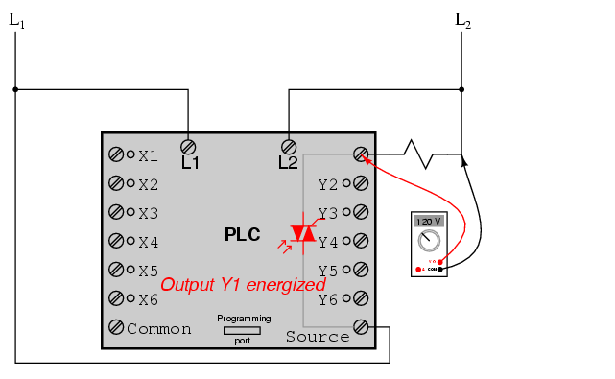
Inside PLC housing Unit
Output signals are generated by the PLC's computer circuitry activating a switching device (transistor, TRIAC, or even an electromechanical relay), connecting the "Source" terminal to any of the "Y-" labeled output terminals. The "Source" terminal, correspondingly, is usually connected to the L1 side of the 120 VAC power source. As with each input, an indicating LED on the front panel of the PLC gives visual indication of an "energized" output:

Slide 16
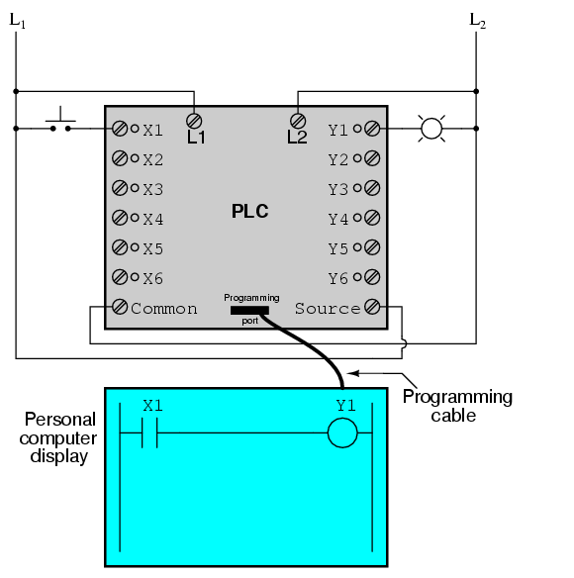
Actual Representation
When the pushbutton switch is unactuated (unpressed), no power is sent to the X1 input of the PLC. Following the program, which shows a normally-open X1 contact in series with a Y1 coil, no "power" will be sent to the Y1 coil. Thus, the PLC's Y1 output remains de-energized, and the indicator lamp connected to it remains dark.

Slide 17
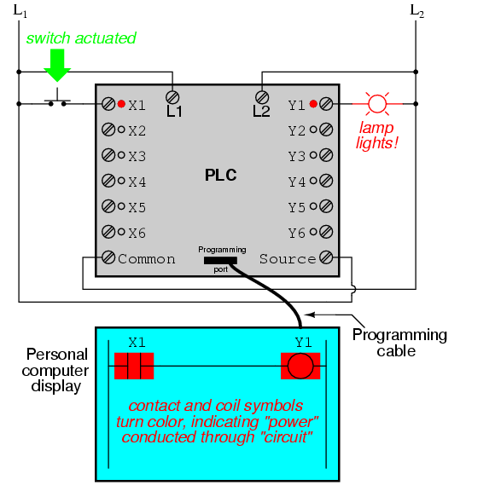
Real time

Slide 18
Important
The actual logic of the control system is established inside the PLC by means of a computer program.
This program dictates which output gets energized under which input conditions.
Although the program itself appears to be a ladder logic diagram, with switch and relay symbols, there are no actual switch contacts or relay coils operating inside the PLC to create the logical relationships between input and output.
These are imaginary contacts and coils, if you will. The program is entered and viewed via a personal computer connected to the PLC's programming port.

Slide 19
What is PLC programming?
It consists of a set of instructions either in textual or graphical form.
Represents the logic to be implemented for specific industrial real-time applications.
A dedicated PLC programming software comes from a PLC hardware of specific manufacturer that
allows entry and development of user application code, which can be finally downloaded to the PLC hardware.
Once this program gets downloaded to the PLC and if the PLC is placed in Run mode, then the PLC continuously works according to the program.

Slide 20
PLC Programming Devices
Various types of programming devices are used to enter, modify and troubleshoot a PLC program.
These programming terminal devices include-
handheld and PC based devices.
Handheld programming device method
a proprietary device is connected to PLC through a connecting cable.
This device consists of a set of keys that allows to enter, edit and dump the code into the PLC.
These handheld devices consist of small display to make the instruction that has been programmed visible.
These are compact and easy to use devices, but these handheld devices have limited capabilities.

Slide 21
PC based programming devices
Most popularly a Personal Computer (PC) is used for programming the PLC in conjunction with the software given by the manufacturer.
By using this PC, the program can be run in either online or offline mode.
Can edit, monitor, diagnose and troubleshoot the program of the PLC.
The way of transferring the program to the PLC is shown in the below figure wherein –
The PC consists of program code corresponding to control application which is transferred to the PLC CPU via programming cable.

Slide 22
Types of PLC Programming Languages
The IEC (International Electrotechnical Commission) standard allows some basic rules to standardize the PLC and its language.
According to IEC 61131–3, only 5 languages are considered standard languages used on PLCs.
Here is the most popular PLC programming language
Graphical language
Ladder Diagram (LD)
Sequential Function Chart (SFC)
Functional block diagram (FBD)
Textual language:
Structured text (ST)
Instruction list (IL)

Slide 23
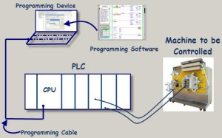

Slide 24
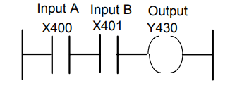
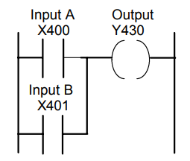
Ladder Program & Instruction List
AND
OR
LD X400
AND X401
OUT Y430
LD X400
OR X401
OUT Y430

Slide 25
Ladder diagram(LD)
Most basic and simplest form of PLC programming.
LD is a design language for describing control.
The term ladder comes from how the LD looks like a ladder.
Next an example of an LD system is shown that has
three inputs called Start, Stop, and Input
and three outputs called Out 0, Out 1, and Out 2.
In this LD, there are three rungs of a ladder
(Rung 0, Rung 1, and Rung 2 colored green, red, and blue, respectively).

Slide 26
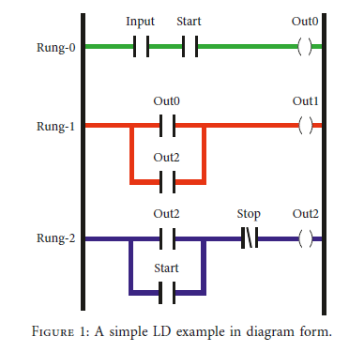
Processing of LD
Processing LD is done from top to bottom;
Rung 0, Rung 1, Rung 2 are processed in sequential order
Rung 0 can be interpreted as a logical AND,
where if both Input and Start have been pressed/activated,
then the coil Out 0 generates an on signal.
Once Rung 0 is evaluated, we next evaluate Rung 1, but the inputs for Rung 1 are the outputs of both Rung 0 and Rung 2 organized as a logical OR operation.
Since Rung 2 has not been evaluated yet, we use the value of Out 2 from the previous scan.
From a finite state machine’s perspective, we would say we use the previous state value of Out 2.

Slide 27
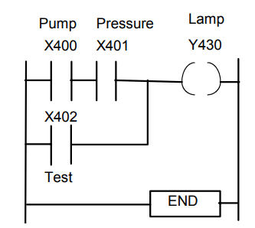
Example
A signal lamp is required to be switched on if a pump is running and the pressure is satisfactory, or if the lamp test switch is closed.
LD X400
AND X401
LD X402
ORB
OUT Y430
END

Slide 28
Top PLC programming software
Simatic step7
Tia portal
Machine expert basic
Twido suite
Ladder editor
HX CODESYS
Pro-H
GX-developer FX
Unity pro
CX programmer
Automation builder
Softmaster
Eaton easysoft
ISP soft
Widefield3

Slide 29
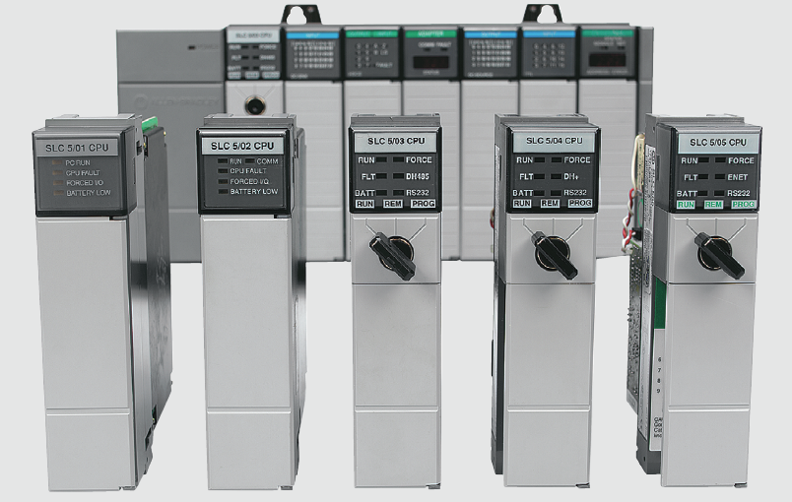
Hardwired Logic versus
Programmed Logic

Slide 30
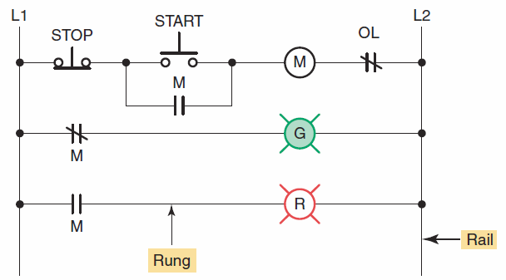
The term hardwired logic refers to logic control functions that are determined by the way devices are electrically interconnected.
Hardwired logic is fixed and changeable only by altering
the way devices are electrically interconnected.
Hardwired motor control program.

Slide 31
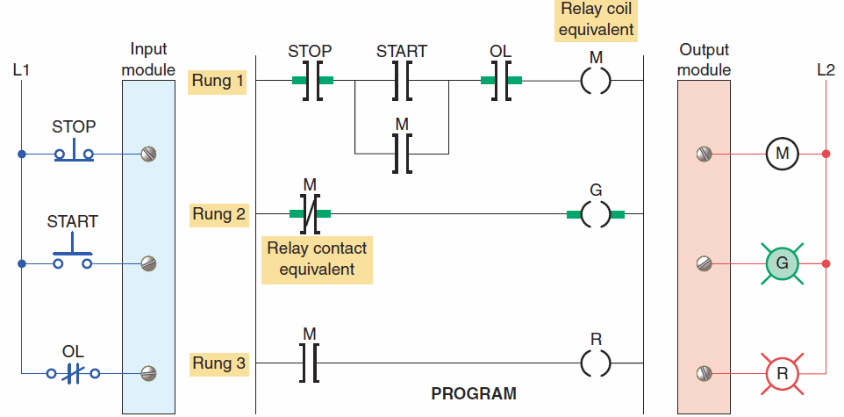
Programmable control is based on the basic
logic functions, which are programmable and easily changed.
PLC programmed motor control program.

Slide 32
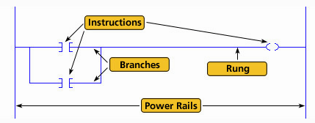
The most common PLC programming language is ladder logic .
A ladder logic program consists of several rungs, each of which controls an output.
Each rung is a combination of input conditions (symbols) connected from left to right, with the symbol that represents the output at the far right.

Slide 33
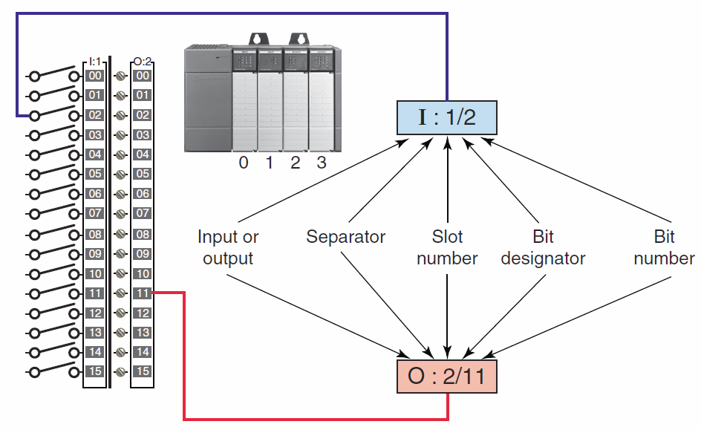
I/O address format for the MicroLogix
family of PLCs.

Slide 34
To this point we have discussed ladder diagram language and how it is a symbolic set of instructions used to create the controller program.
Representations of contacts and coils are the basic symbols of the logic ladder diagram instruction set.

Slide 35
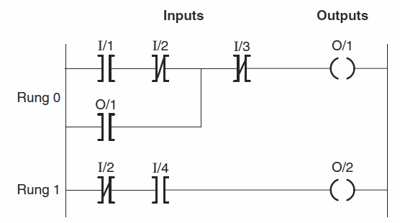
The main function of the ladder logic diagram program is to control outputs based on input conditions.
Each contact or coil symbol is referenced with an address that identifies what is being evaluated and what is being controlled.
The same contact instruction can be used throughout the program whenever that condition needs to be evaluated.

Slide 36
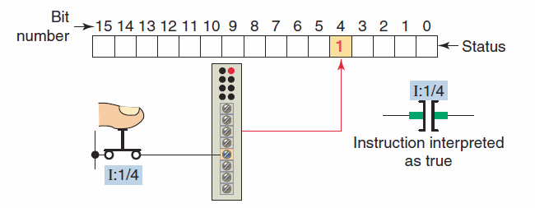
The memory bit is set to 1 or 0 depending on the
status of the input.
A 1 corresponds to a true status or on condition.
If the instruction memory bit is a 1 (true) this instruction will allow rung continuity through itself, like a closed relay contact.

Slide 37
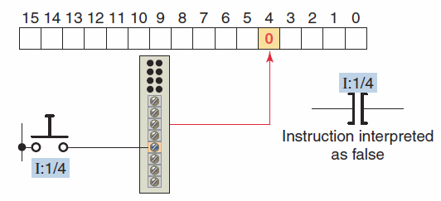
A 0 corresponds to a false status or off condition.
If the instruction memory bit is a 0 (false) this
instruction will not allow rung continuity through
itself and will assume a normally open state just like
an open relay contact.

Slide 38
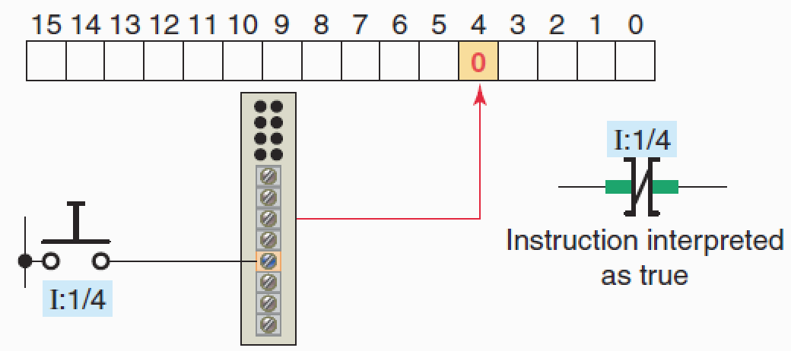
A 0 corresponds to a off condition.
The instruction is interpreted as true when the bit is 0 and will not allow rung continuity through itself.

Slide 39

The Output Energize (OTE) instruction looks and operates like a relay coil.
This instruction signals the PLC to energize
(switch on) or de-energize (switch off ) the output.
The instruction is associated with a memory bit that energizes the output when set to 1 and de-energizes the output when reset to 0.

Slide 40


Allen-Bradley Discrete Addressing
XIC
OTE
Colon
Hyphen
File Type
Bit #
X:Y/Z
XIO
Word #
Hyphen
Colon
Hyphen
Colon
File Type
Bit #
File Type
Bit #
I:0/0
O:1/10
Word #
Word #

Slide 41
XIC
Hyphen
Colon
File Type
Bit #
XIO
I:0/7
Input Image Table Word 0
Word #
0
0
0
0
0
0
0
0
1
0
0
0
0
0
0
0
15
14
13
12
11
10
9
8
7
6
5
4
3
2
1
0
Colon
Hyphen
OTE
File Type
Bit #
O:0/10
Output Image Table Word 0
Word #
0
0
0
0
0
1
0
0
0
0
0
0
0
0
0
0
15
14
13
12
11
10
9
8
7
6
5
4
3
2
1
0

Slide 42
Allen-Bradley Discrete Addressing
XIC
XIO
OTE
OTE
Contacts
Coil
Allowable File Types
0 - Output
1 - Input
3 –Internal Bit
0 - Output
3 – Internal Bit

Slide 43
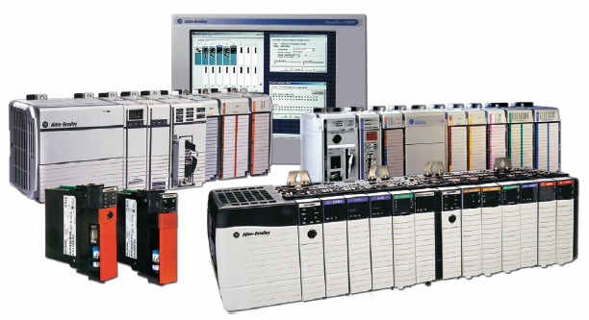
Program Scan

Slide 44
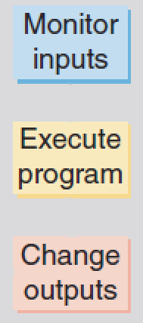
When a controller executes a program, it must know—in real time—when external devices controlling a process are changing.
During each operating cycle, the processor reads all the inputs, takes these values, and energizes or de-energizes the outputs according to the user program.
This process is known as the
program scan.

Slide 45
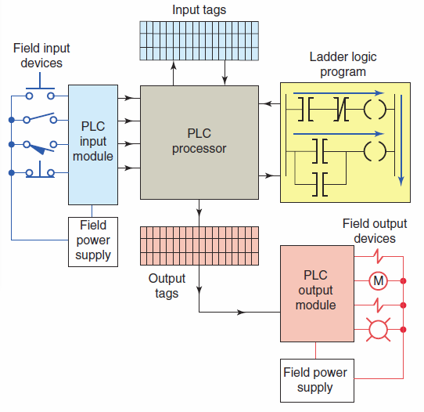
Logix controller operating cycle.

Slide 46
Program is scanned one rung at a time.
As the program is scanned, the status of inputs are checked for True (1 or ON) or False (0 of OFF) conditions.

Slide 47
The status signals from the inputs are sent to the input tags where they are stored.

Slide 48
As the program is scanned by the processor, inputs are checked for True or False conditions and the ladder logic is evaluated based on these values.
The resulting ON or OFF action, as a result of
evaluating each rung, is then sent to the output tags
for storage.

Slide 49
During the output update portion of the scan, corresponding output values are sent to the process or machine by way of the output module.

Slide 50
I/O updates occur asynchronously to the scan of the logic.
With a ControlLogix processor two separate 32-bit unsynchronized processes go on simultaneously - that is, asynchronously.
This means that the module can update the input
tag from the field and write the output tag to the field at any point (or at several points) during the processor’s execution of the ladder rungs.
The result is more efficiency and control over when the input field device data are updated and when the output data resulting from the solved logic are sent to the output modules and their respective field devices.

Slide 51
Machine Learning
Machine is not learning.

Slide 52
Machine Learning
Machine learning (ML) is a type of artificial intelligence (AI) that allows software applications to become more accurate at predicting outcomes without being explicitly programmed to do so. Machine learning algorithms use historical data as input to predict new output values.

Slide 53
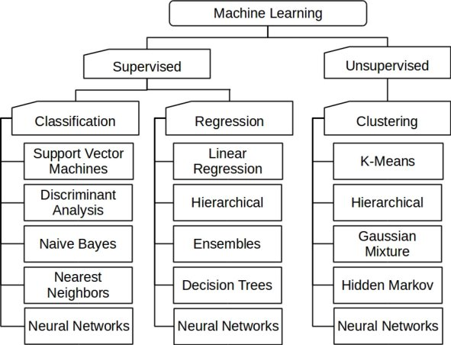

Slide 54
Types of Machine Learning
Supervised
Unsupervised
Reinforcement learning

Slide 55
Popular Classification Algorithms:
Logistic Regression
Naive Bayes
K-Nearest Neighbors
Decision Tree
Support Vector Machines

Slide 56
Differences Briefly
Logistic regression is a calculation used to predict a binary outcome: either something happens, or does not. This can be exhibited as Yes/No, Pass/Fail, Alive/Dead, etc.
Naive Bayes calculates the possibility of whether a data point belongs within a certain category or does not. In text analysis, it can be used to categorize words or phrases as belonging to a preset “tag” (classification) or not. For example:
Text:: " A great game“ ;Tag:: Sports
K-nearest Neighbors:
K-nearest neighbors (k-NN) is a pattern recognition algorithm that uses training datasets to find the k closest relatives in future examples.

Slide 57
Differences Briefly
Decision Tree:
A decision tree is a supervised learning algorithm that is perfect for classification problems, as it’s able to order classes on a precise level. It works like a flow chart, separating data points into two similar categories at a time from the “tree trunk” to “branches,” to “leaves,” where the categories become more finitely similar. This creates categories within categories, allowing for organic classification with limited human supervision
Support Vector Machines
A support vector machine (SVM) uses algorithms to train and classify data within degrees of polarity, taking it to a degree beyond X/Y prediction.

Slide 58
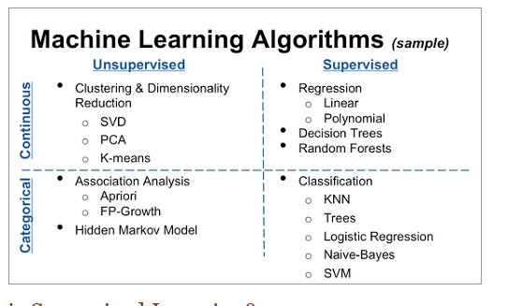

Slide 59
Naïve Bayes algorithm
Naïve Bayes algorithm is a supervised learning algorithm, which is based on Bayes theorem and used for solving classification problems.
It is mainly used in text classification that includes a high-dimensional training dataset.
Naïve Bayes Classifier is one of the simple and most effective Classification algorithms which helps in building the fast machine learning models that can make quick predictions.
It is a probabilistic classifier, which means it predicts on the basis of the probability of an object.
Some popular examples of Naïve Bayes Algorithm are spam filtration, Sentimental analysis, and classifying articles.

Slide 60
The Naïve Bayes algorithm is comprised of two words Naïve and Bayes, Which can be described as:
Naïve: It is called Naïve because it assumes that the occurrence of a certain feature is independent of the occurrence of other features. Such as if the fruit is identified on the bases of color, shape, and taste, then red, spherical, and sweet fruit is recognized as an apple. Hence each feature individually contributes to identify that it is an apple without depending on each other.
Bayes: It is called Bayes because it depends on the principle of Bayes' Theorem.

Slide 61
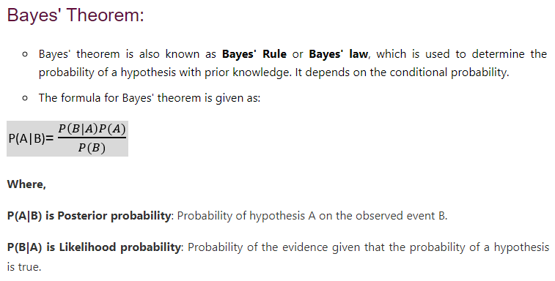

Slide 62
Applications of Naïve Bayes Classifier
It is used for Credit Scoring.
It is used in medical data classification.
It can be used in real-time predictions because Naïve Bayes Classifier is an eager learner.
It is used in Text classification such as Spam filtering and Sentiment analysis.

Slide 63
Types
There are three types of Naive Bayes Model, which are given below:
Gaussian: The Gaussian model assumes that features follow a normal distribution. This means if predictors take continuous values instead of discrete, then the model assumes that these values are sampled from the Gaussian distribution.
Multinomial: The Multinomial Naïve Bayes classifier is used when the data is multinomial distributed. It is primarily used for document classification problems, it means a particular document belongs to which category such as Sports, Politics, education, etc. The classifier uses the frequency of words for the predictors.
Bernoulli: The Bernoulli classifier works similar to the Multinomial classifier, but the predictor variables are the independent Booleans variables. Such as if a particular word is present or not in a document. This model is also famous for document classification tasks.

Slide 64
Reinforcement Learning
Reinforcement learning is a machine learning training method based on rewarding desired behaviors and/or punishing undesired ones. In general, a reinforcement learning agent is able to perceive and interpret its environment, take actions and learn through trial and error.

Slide 65
Scikit-Learn (Sklearn)
It is the most useful and robust open source library for machine learning in Python. It provides a selection of efficient tools for machine learning and statistical modeling including classification, regression, clustering
Initially developed by David Cournapeau as a Google summer of code project in 2007.
Prerequisites−
Python ,
NumPy,
Matplotlib,
Pandas
Demo on Basic operations of Scikit-Learn

Slide 66
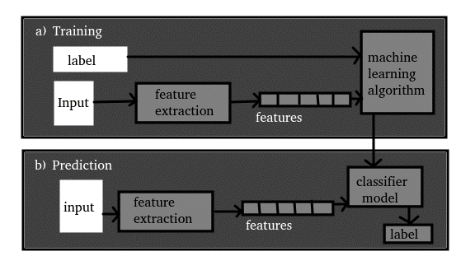
Machine Learning Training & Prediction

Slide 67
Machine learning Workflow
work flow diagram of whole process
Steps in ML Process
Implementation of 6 classification techniques
Compare and contrast predictive behaviour of the classification techniques
Tabulate and interpret results

Slide 68
Text Summarization
Text summarization is the technique for generating a concise and precise summary of voluminous texts while focusing on the sections that convey useful information, and without losing the overall meaning
Extractive text Summarize the news articles done using Supervised Learning Algorithm such as Decision Tree Classifier (DT), K nearest Neighbors Classifier(KNN), Gaussian Naive Bayes(NB) , Logistic Regression(LR), Support Vector Machines (SVM) , Linear Discriminate Analysis(LDA)
Dataset used: Scrapped news articles from urls provided by UCI Machine Learning repository link

Slide 69
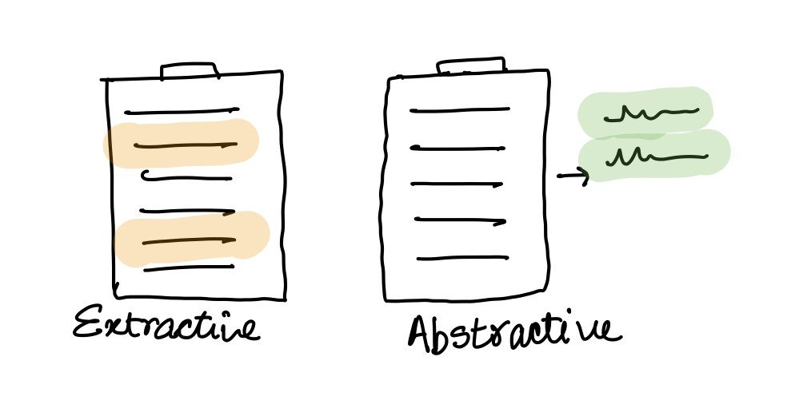
Extractive vs Abstractive
Extractive summarization
Copying important sentences of the source text and then combine those sentences together to render a summary.
Importance of sentence is based on linguistic and statistical features
Abstractive summarization
These methods try to first understand the text and then rephrase it in a shorter manner, using possibly different words
Much harder than extractive.
Has complex capabilities like generalization, paraphrasing and incorporating real-world knowledge.

Slide 70
Work flow Diagram of whole process
(Extractive Text Summarization)
Raw Document
(News
Dataset)
SVM
Tokenization
PreProcessed
Data
Feature
Extractor
(Feature Vector)
KNN
Stop word Removal
LR
Lemmatization
MLP
DT
Normalization
LDA
Pre-Processing Pipeline
Machine Learning Model for Classification

Slide 71
Steps to Perform Machine Learning Process
1 - Data collection and preparation: everything from choosing where to get the data, up to the point it is clean and ready for feature selection/ engineering
2 - Feature selection /feature engineering: this includes all changes to the data from once it has been cleaned up to when it is ingested into the machine learning model
3 - Choosing the machine learning algorithm and training our first model: getting a "better than baseline" result upon which we can (hopefully) improve
4 - Evaluating our model: this includes the selection of the measure as well as the actual evaluation; seemingly a smaller step than others, but important to our end result
5 - Model tweaking, regularization, and hyperparameter tuning: this is where we iteratively go from a "good enough" model to our best effort

Slide 72
Data collection and preparation
Scrapped news articles from urls provided by UCI Machine Learning repository link
Data pre-processing:
Converting to lower case
Removal of stop words (the ,a ,I ,our ,me, with ,to, below, above etc)
Tokenize (Hello world ! →i)hello ii)world iii)! )
Removing contractions (does'nt -> does not)
Stemming/Lemmatization (running →run+ing)
Normalization

Slide 73
Feature selection and feature engineering
Text summarization using supervised learning needs training data which contains input features(x) and output feature (y)
For each sentence in a document is categorized as part of summary or not a part of summary by observing given golden summary
The matrix of features consists of a row for each sentence and 6 columns, the columns contains information as
The word frequency metric corresponds to the number of frequent words in a particular sentence
Five most frequent words were computed considered as important word if any of these word present in sentence then add 1 in imp word column
sentence length metrics corresponds to length of sentence which is less than 15 then record is filled as 1, else 0.
proper noun is present then we fill 1, else 0
The occurrence of sentence is the first or last sentence in the article then we fill 1, else 0
Code on Feature selection

Slide 74
The following figure is an example of a sample Matrix of Feature Representation
Feature Table
 | Word Freq (Count) | Imp word (1/0) | Sentence Length >15 (1/0) | Proper Noun (1/0) | Sentence Position (1/0) | In Summary (1/0)
s1 | 21 | 1 | 1 | 1 | 1 | 1
s2 | 23 | 1 | 1 | 1 | 0 | 1
s3 | 14 | 1 | 0 | 1 | 0 | 1
s4 | 13 | 1 | 0 | 1 | 0 | 0
s5 | 16 | 1 | 1 | 1 | 0 | 0
s6 | 18 | 1 | 1 | 1 | 0 | 0
s7 | 28 | 1 | 1 | 1 | 1 | 0
S1,s2 ….Sm are the sentences in given document
Demo on applying ML algo on these preprocessed dataset

Slide 75
Evaluating of model
We used the following metrics to assess the different methods
1. Accuracy = TP/TP + TN
2. Precision = TP/ TP + FP
3. Recall = TP/TP + FN
4. F measure = 2*Precision*Recall/ Precision +Recall

Slide 76
Evaluating of Different Baseline Model
Training Data consists of 100 documents
 | accuracy | precision | recall | f1-score
Logistic Regression | 0.76 | 0.76 | 0.98 | 0.85
Naive Bayes | 0.72 | 0.75 | 0.93 | 0.83
KNeighbours | 0.61 | 0.71 | 0.77 | 0.74
Decision Tree | 0.76 | 0.76 | 0.98 | 0.85
SVM | 0.76 | 0.76 | 0.98 | 0.85
LDA | 0.75 | 0.76 | 0.97 | 0.85
MLP | 0.71 | 0.71 | 0.97 | 0.82

Slide 77
Chart:Evaluating of Different Baseline Model
Training Data consists of 100 documents

Slide 78
Evaluating of Different Baseline Model
Training Data consists of 400 documents
 | accuracy | precision | recall | f1-score
Logistic Regression | 0.73 | 0.73 | 0.95 | 0.83
Naive Bayes | 0.71 | 0.73 | 0.92 | 0.81
KNeighbours | 0.68 | 0.77 | 0.77 | 0.77
Decision Tree | 0.73 | 0.73 | 0.95 | 0.83
SVM | 0.73 | 0.73 | 0.95 | 0.83
LDA | 0.73 | 0.73 | 0.94 | 0.82
MLP | 0.73 | 0.73 | 0.95 | 0.83

Slide 79
Chart:Evaluating of Different Baseline Model
Training Data consists of 400 documents

Slide 80
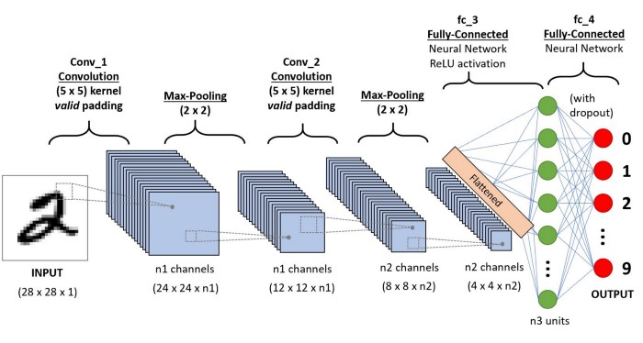
Convolution Neural Network

Slide 81
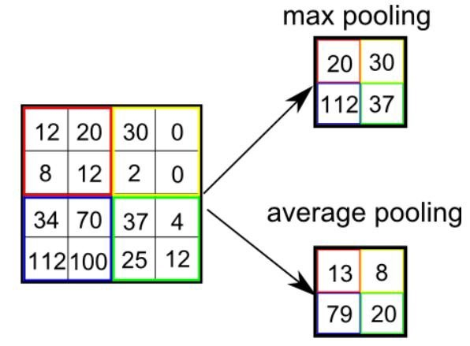
Convolution & Pooling

Slide 82
Convolutions are a set of layers that go before the neural network architecture. The convolution layers are used to help the computer determine features that could be missed in simply flattening an image into its pixel values.

Slide 83
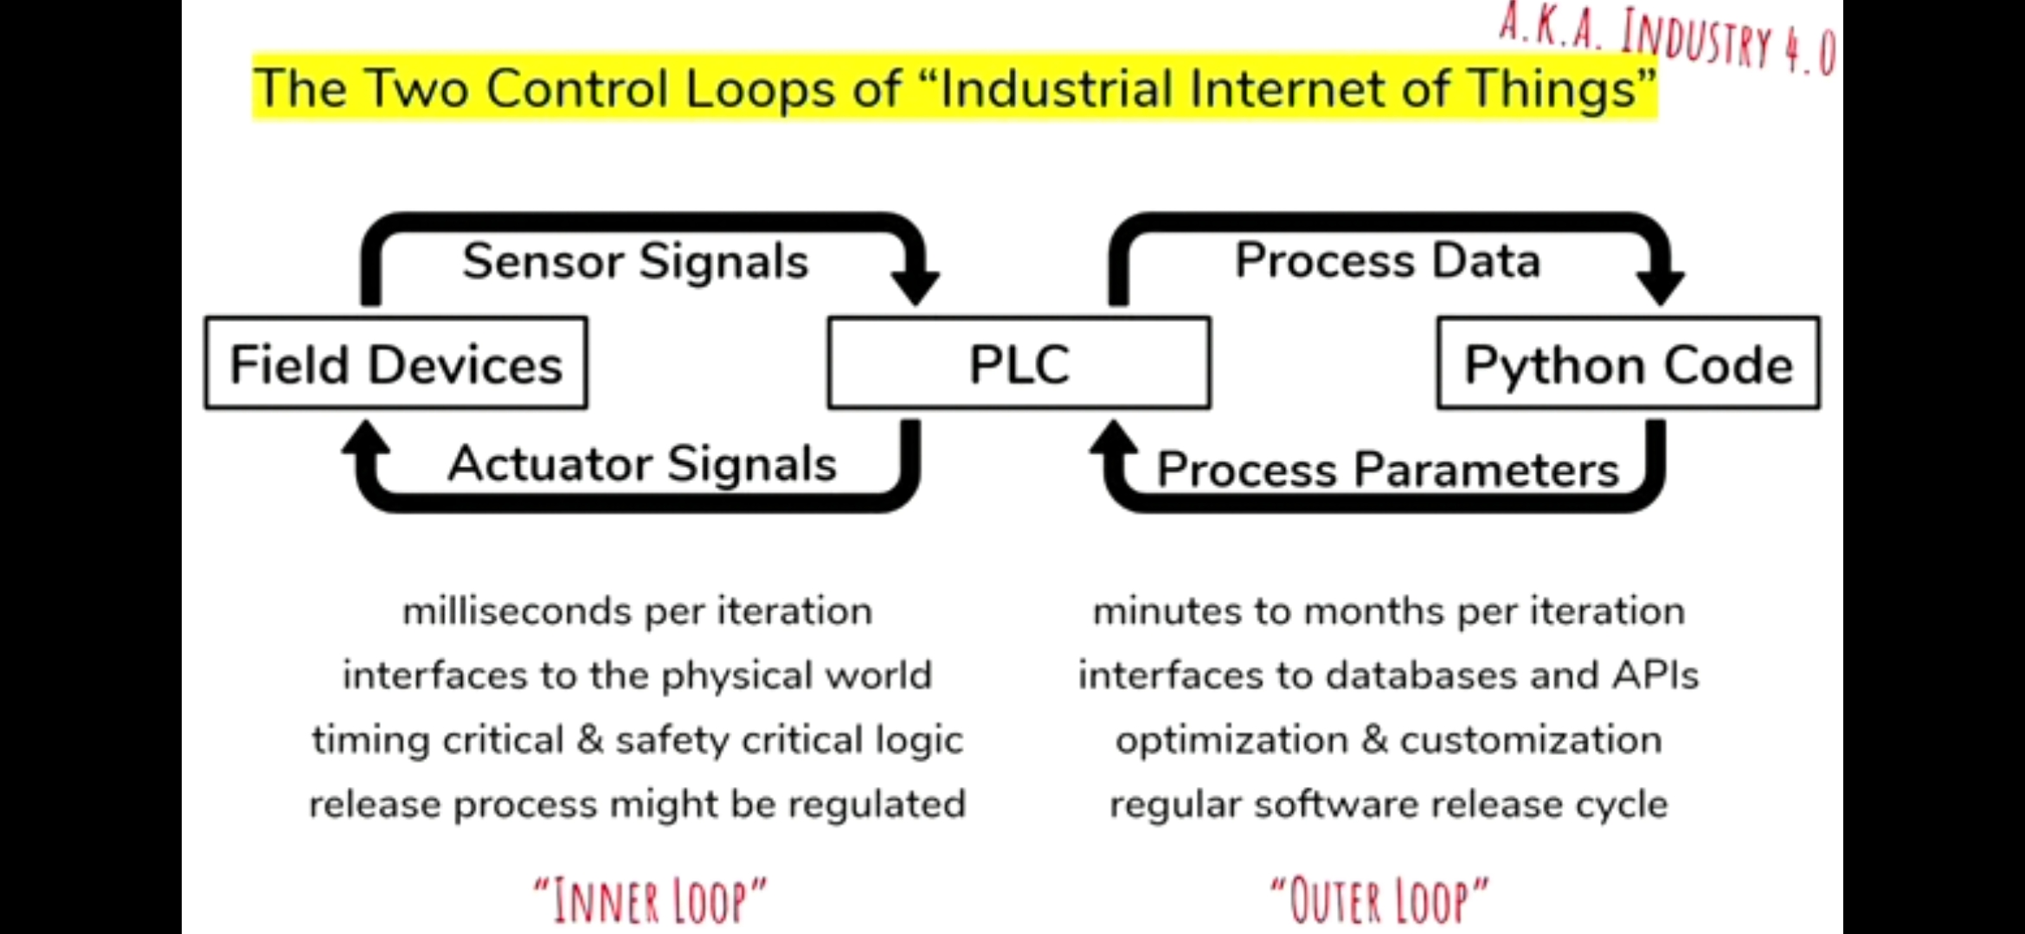
ML Position in PLC applications

Slide 84
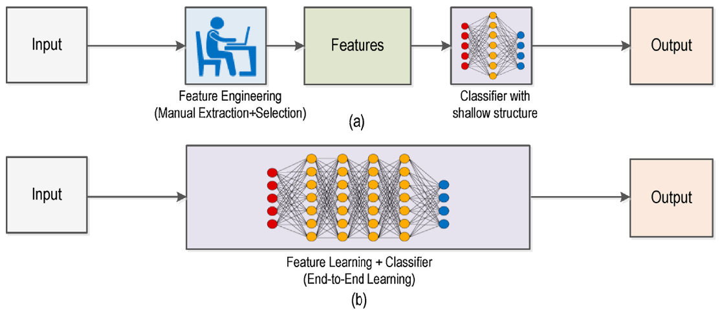
Machine Learning Vs Deep Learning
Machine learning uses algorithms to parse data, learn from that data, and make informed decisions based on what it has learned. Deep learning structures algorithms in layers to create an “artificial neural network” that can learn and make intelligent decisions on its own

Slide 85
Machine Learning Vs Deep Learning
With ML techniques, we need to
Extract and analyze features
Select precise algorithm for best results
Tune hyper-parameters
DL overcome these problems and have advantages including
Suitability to real-time data
Self-learning capability

Slide 86
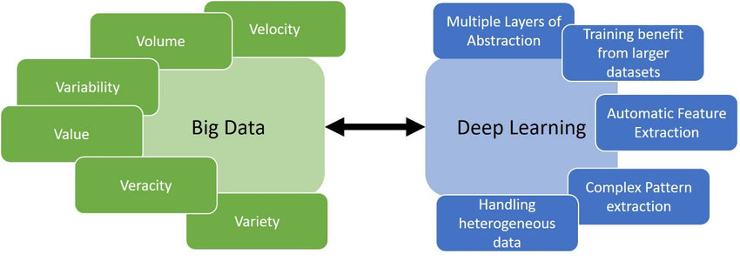
Why DL for PLC’s?
With enormous amount of data available, automation can be easily made with DL techniques.

Slide 87
Why DL for PLCs?
Measuring and predicting a greater number of parameters
Streaming more machine data
These makes PLCs more powerful tool.

Slide 88
DL for PLC
Smart manufacturing / Process Control
Robot Grasping
Predictive Analytics for defect prognosis
Smart Traffic Systems

Slide 89
Smart Manufacturing
Smart manufacturing refers to using advanced data analytics to complement physical science for improving system performance and decision making.
Manufacturing machines are fully connected through wireless networks, monitored by sensors, and controlled by advanced computational intelligence – DL Techniques
Data at different stages of product’s life is collected and processed for

Slide 90
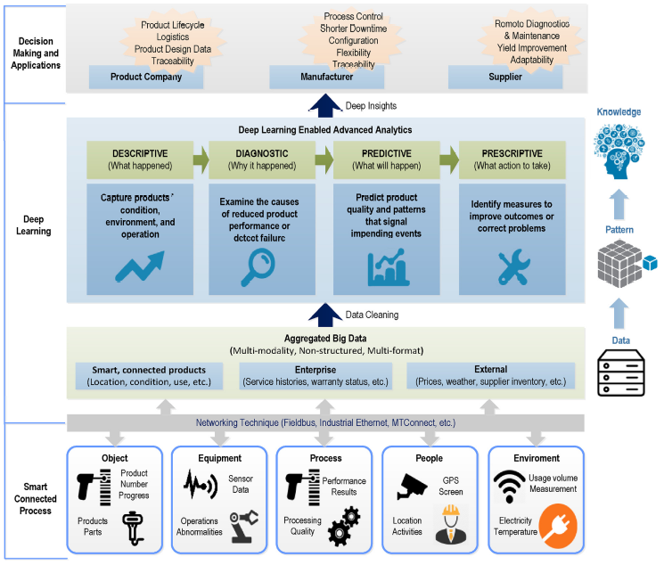
DL enabled Smart Manufacturing

Slide 91
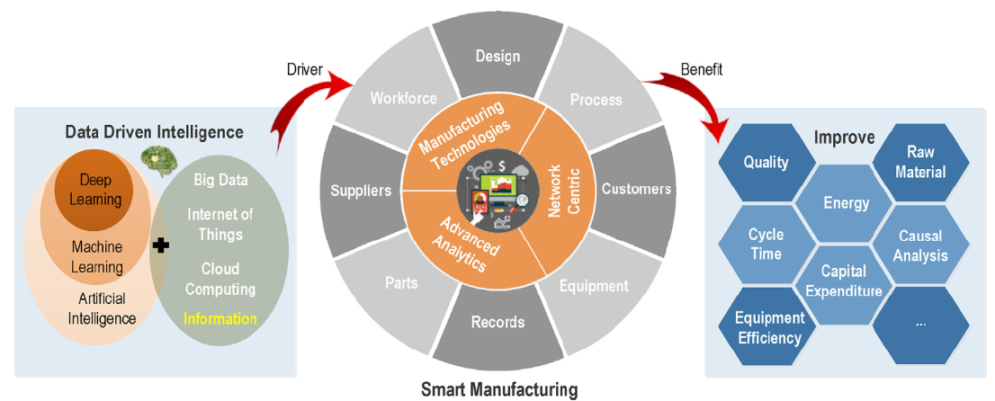
Smart Manufacturing with DL

Slide 92
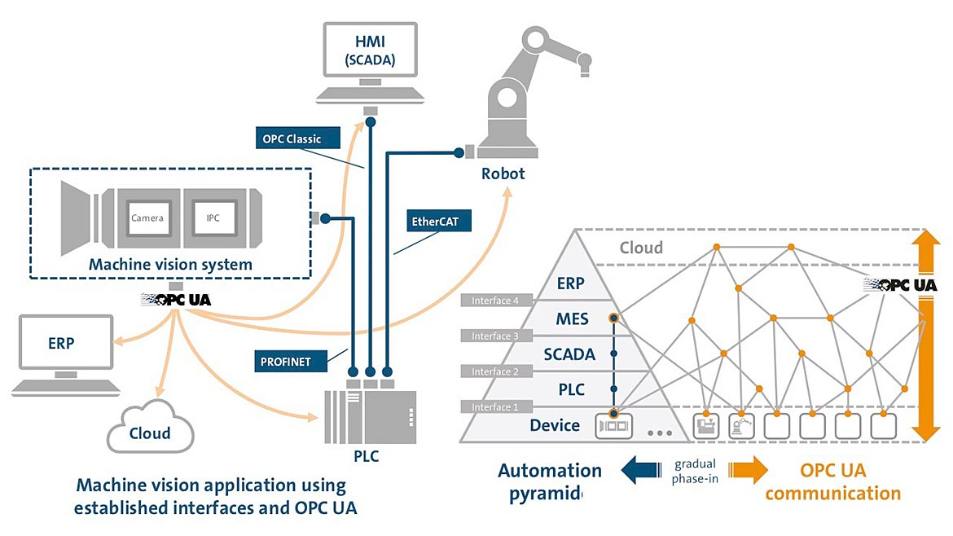
Smart Manufacturing with DL
DEEP LEARNING MODELS

Slide 93
Malfunction Detection with PLCs using Neural Networks
Neural network has capabilities such as
monitoring the system, error detection, and predictions
Merged with PLC, it can improve the fault tolerance and error detections in automation systems.
A malfunction can be detected when the outputs generated by the PLC and the outputs generated by the neural network are compared.
While the PLC program is being tested before implementation,
The values of PLC’s I/O ports, timers and critical variables can be used to train a neural network and prepare it to monitor the system.

Slide 94
Machine Vision with DL
DL techniques makes vision to machines and helps in
Defect identification in manufacturing
Monitor machine conditions
Diagnose manufacturing production failures
Fault assessment
Tools: CNN – Image analysis
Applications:
Fault diagnosis of aircraft engine, chemical process, wind turbines etc.

Slide 95
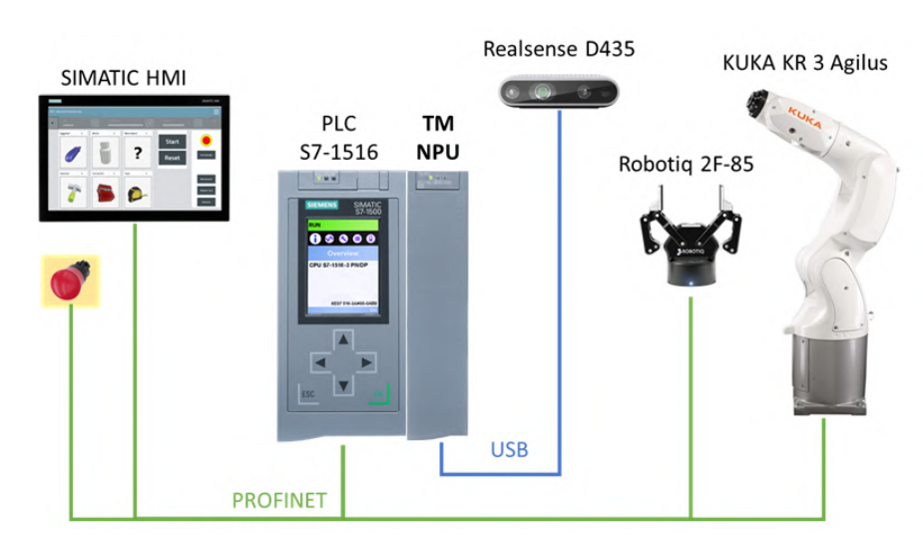
Robotic object grasping
DL algorithms used to detect objects and inform PLCs the exact co-ordinates to pickup the object.
Steps involved:
Object Detection
Object Selection
Bounding box alignment
Grasp coordinates computation

Slide 96
Predictive maintenance (PdM)
A culture,
Fostered by forward-thinking executives and a dedicated, trained team of technicians
A philosophy,
Focuses on using your actual asset operating conditions to optimize your facility as a whole.
The foundation for PdM efforts is a well-developed preventive maintenance system with smooth processes and high schedule compliance
PdM can often be viewed as panacea of maintenance issues

Slide 97
PdM Program
A PdM programme can be
difficult to launch,
expensive, and
not appropriate for all facilities.
A strong foundation must be followed by a methodical plan of action in order to succeed.
Here is a guide to aid in breaking the procedure down into manageable steps for your facility.

Slide 98
Predictive Analysis for Defect Prognosis
Historical data is important for prediction temporal behavior of manufacturing processes, such as maintenance, tools and machine lifetime.
Wear and tear of tools can be predicted with CNNs when trained with images of tools.
Machine health can be monitored using RNNs and CNNs with input data as the information about the machines (images, logs etc.)

Slide 99
References
F. Jaensch, A. Csiszar, A. Kienzlen and A. Verl, "Reinforcement Learning of Material Flow Control Logic Using Hardware-in-the-Loop Simulation," 2018 First International Conference on Artificial Intelligence for Industries (AI4I), 2018, pp. 77-80, doi: 10.1109/AI4I.2018.8665712.
J. Zinn, B. Vogel-Heuser and P. Ockier, "Deep Q-learning for the Control of PLC-based Automated Production Systems," 2020 IEEE 16th International Conference on Automation Science and Engineering (CASE), 2020, pp. 1434-1440, doi: 10.1109/CASE48305.2020.9216863.
T. Alves, R. Das and T. Morris, "Embedding Encryption and Machine Learning Intrusion Prevention Systems on Programmable Logic Controllers," in IEEE Embedded Systems Letters, vol. 10, no. 3, pp. 99-102, Sept. 2018, doi: 10.1109/LES.2018.2823906.
Yau, Ken, et al. "Detecting anomalous behavior of PLC using semi-supervised machine learning." 2017 IEEE Conference on Communications and Network Security (CNS). IEEE, 2017.
http://hdl.handle.net/10415/6838
Solowjow, Eugen, et al. "Industrial robot grasping with deep learning using a programmable logic controller (plc)." 2020 IEEE 16th International Conference on Automation Science and Engineering (CASE). IEEE, 2020.

Slide 100
References
GIAN Training Material, NIT Tirchy, 2022
https://www.javatpoint.com/machine-learning-naive-bayes-classifier

Slide 101
Thank You
Queries

Slide 102
References
D.V.S. Murthy, Transducers and Instrumentation, PHI,2013

Slide 103
Thank you
Queries?

