Slide 1

Industrial Automation and Control (20EE11Q3)
Dr. Kavirayani Srikanth
Asst. Professor
Dept. of EEE

Slide 2
Course Objectives
CO1 Describe the architecture of industrial automation systems (L2)
CO2 Distinguish PID control tuning techniques (L3)
CO3 Explain time delay systems and special control structures and PLCs (L3)
CO4 Explain the working of flow control valves in hydraulic systems(L4)
CO5 Illustrate the working of Industrial Drives and Electrical Vehicle Drives (L4)

Slide 3
Unit-III::PROGRAMMABLE LOGIC CONTROLLERS
Time Delay Systems and Inverse Response Systems-Special Control Structures, Introduction to Sequence Control, PLC, RLL-Sequence Control, Scan Cycle, Simple RLL Programs-More RLL Elements, RLL Syntax-Structured Design Approach to Sequence Control -PLC Hardware Environment.

Slide 4
Topics
Fundamentals of PLC
Programming the PLC
Allen-Bradley MicroLogix PLC

Slide 5
Why in Industries
In production, due to changes in the nature of production, reprogramming will be required.
PLC can be programmed according to the operating requirements of the process.
To reduce manpower and unnecessary faults.
Also PLC can perform discrete and continuous functions that cannot be performed by Personal Computers.
Other advantages of using PLCs include
They’re fast,
Easy to operate and
Are considered easy to program.

Slide 6
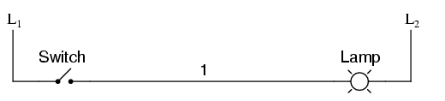
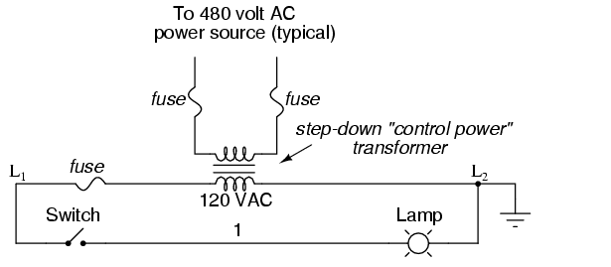
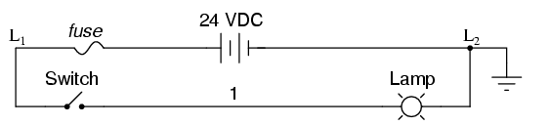
HOW?

Slide 7
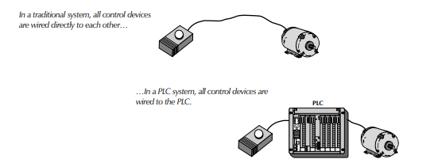
Comparison

Slide 8
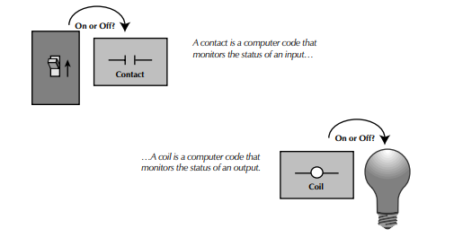
Notation

Slide 9
Why PLC?
The soft wiring advantage provided by programmable controllers is tremendous.
In fact, it is one of the most important features of PLCs.
Soft wiring makes changes in the control system easy and cheap.
If you want a device in a PLC system to behave differently or to control a different process element, all you have to do is change the control program.
In a traditional system, making this type of change would involve physically changing the wiring between the devices, a costly and time-consuming endeavor

Slide 10
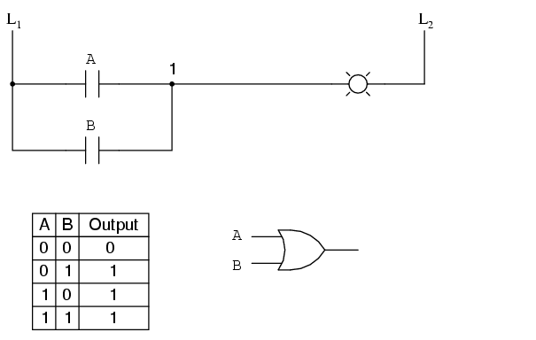
Digital Logic Function
We can construct simply logic functions for our hypothetical lamp circuit, using multiple contacts, and document these circuits quite easily and understandably with additional rungs to our original "ladder." If we use standard binary notation for the status of the switches and lamp (0 for unactuated or de-energized; 1 for actuated or energized), a truth table can be made to show how the logic works:Now, the lamp will come on if either contact A or contact B is actuated, because all it takes for the lamp to be energized is to have at least one path for current from wire L₁ to wire 1. What we have is a simple OR logic function, implemented with nothing more than contacts and a lamp.

Slide 11
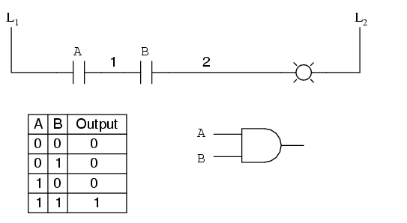
Scenario#2

Slide 12
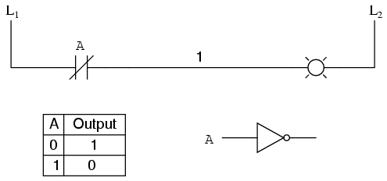
Scenario#3

Slide 13
PLC RULES
INPUTS are on the LEFT Side.
OUTPUTS are on the RIGHT side.
INPUTS can go in Series.
INPUTS can go in Parallel.
INPUTS can go in combination.
OUTPUTS can go only in parallel or Stand alone.
For every INPUT there is an OUTPUT.
Every symbol is represented by a 3 letter abbreviation.
OUTPUTS can be INPUTS.
For one action there can be more than one relation.
Every rung and every symbol needs a comment.

Slide 14
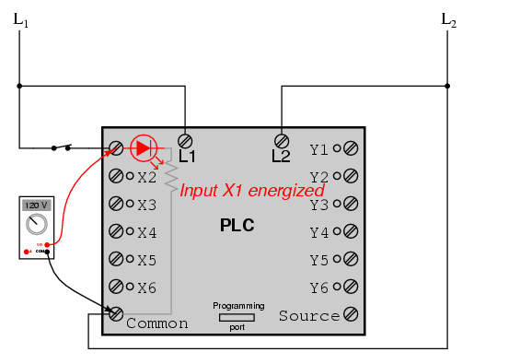
Inside PLC housing unit
Inside the PLC housing, connected between each input terminal and the Common terminal, is an opto-isolator device (Light-Emitting Diode) that provides an electrically isolated "high" logic signal to the computer's circuitry (a photo-transistor interprets the LED's light) when there is 120 VAC power applied between the respective input terminal and the Common terminal. An indicating LED on the front panel of the PLC gives visual indication of an "energized" input:

Slide 15
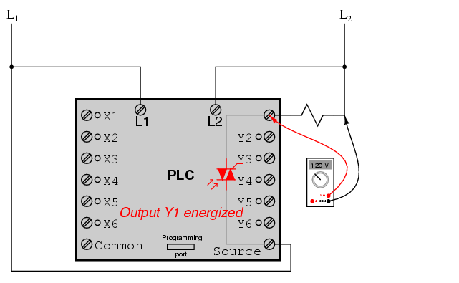
Inside PLC housing Unit
Output signals are generated by the PLC's computer circuitry activating a switching device (transistor, TRIAC, or even an electromechanical relay), connecting the "Source" terminal to any of the "Y-" labeled output terminals. The "Source" terminal, correspondingly, is usually connected to the L1 side of the 120 VAC power source. As with each input, an indicating LED on the front panel of the PLC gives visual indication of an "energized" output:

Slide 16
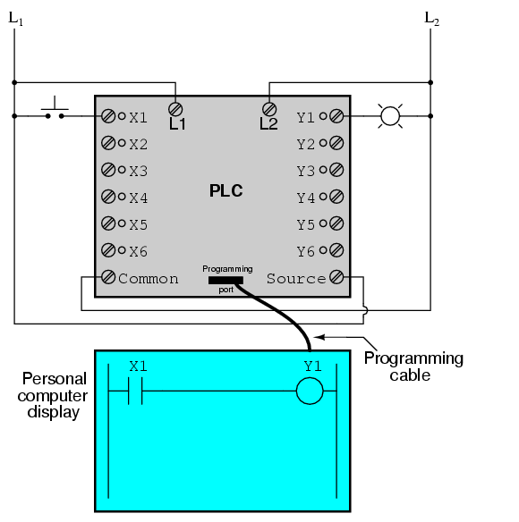
Actual Representation
When the pushbutton switch is unactuated (unpressed), no power is sent to the X1 input of the PLC. Following the program, which shows a normally-open X1 contact in series with a Y1 coil, no "power" will be sent to the Y1 coil. Thus, the PLC's Y1 output remains de-energized, and the indicator lamp connected to it remains dark.

Slide 17
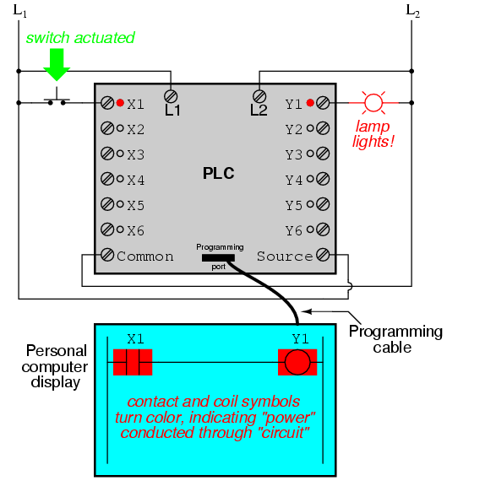
Real time

Slide 18
Important
The actual logic of the control system is established inside the PLC by means of a computer program.
This program dictates which output gets energized under which input conditions.
Although the program itself appears to be a ladder logic diagram, with switch and relay symbols, there are no actual switch contacts or relay coils operating inside the PLC to create the logical relationships between input and output.
These are imaginary contacts and coils, if you will. The program is entered and viewed via a personal computer connected to the PLC's programming port.

Slide 19
What is PLC programming?
It consists of a set of instructions either in textual or graphical form.
Represents the logic to be implemented for specific industrial real-time applications.
A dedicated PLC programming software comes from a PLC hardware of specific manufacturer that
allows entry and development of user application code, which can be finally downloaded to the PLC hardware.
Once this program gets downloaded to the PLC and if the PLC is placed in Run mode, then the PLC continuously works according to the program.

Slide 20
PLC Programming Devices
Various types of programming devices are used to enter, modify and troubleshoot a PLC program.
These programming terminal devices include-
handheld and PC based devices.
Handheld programming device method
a proprietary device is connected to PLC through a connecting cable.
This device consists of a set of keys that allows to enter, edit and dump the code into the PLC.
These handheld devices consist of small display to make the instruction that has been programmed visible.
These are compact and easy to use devices, but these handheld devices have limited capabilities.

Slide 21
PC based programming devices
Most popularly a Personal Computer (PC) is used for programming the PLC in conjunction with the software given by the manufacturer.
By using this PC, the program can be run in either online or offline mode.
Can edit, monitor, diagnose and troubleshoot the program of the PLC.
The way of transferring the program to the PLC is shown in the below figure wherein –
The PC consists of program code corresponding to control application which is transferred to the PLC CPU via programming cable.

Slide 22
Types of PLC Programming Languages
The IEC (International Electrotechnical Commission) standard allows some basic rules to standardize the PLC and its language.
According to IEC 61131–3, only 5 languages are considered standard languages used on PLCs.
Here is the most popular PLC programming language
Graphical language
Ladder Diagram (LD)
Sequential Function Chart (SFC)
Functional block diagram (FBD)
Textual language:
Structured text (ST)
Instruction list (IL)

Slide 23
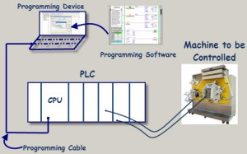

Slide 24
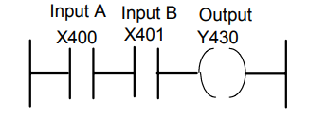
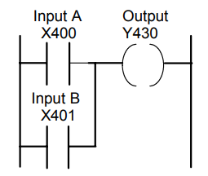
Ladder Program & Instruction List
AND
OR
LD X400
AND X401
OUT Y430
LD X400
OR X401
OUT Y430

Slide 25
Ladder diagram(LD)
Most basic and simplest form of PLC programming.
LD is a design language for describing control.
The term ladder comes from how the LD looks like a ladder.
Next an example of an LD system is shown that has
three inputs called Start, Stop, and Input
and three outputs called Out 0, Out 1, and Out 2.
In this LD, there are three rungs of a ladder
(Rung 0, Rung 1, and Rung 2 colored green, red, and blue, respectively).

Slide 26
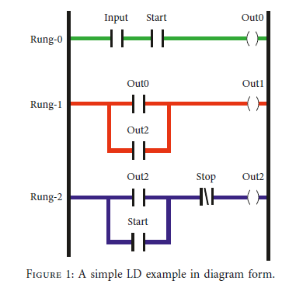
Processing of LD
Processing LD is done from top to bottom;
Rung 0, Rung 1, Rung 2 are processed in sequential order
Rung 0 can be interpreted as a logical AND,
where if both Input and Start have been pressed/activated,
then the coil Out 0 generates an on signal.
Once Rung 0 is evaluated, we next evaluate Rung 1, but the inputs for Rung 1 are the outputs of both Rung 0 and Rung 2 organized as a logical OR operation.
Since Rung 2 has not been evaluated yet, we use the value of Out 2 from the previous scan.
From a finite state machine’s perspective, we would say we use the previous state value of Out 2.

Slide 27
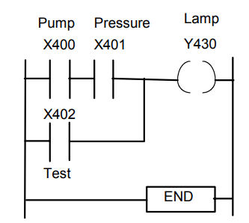
Example
A signal lamp is required to be switched on if a pump is running and the pressure is satisfactory, or if the lamp test switch is closed.
LD X400
AND X401
LD X402
ORB
OUT Y430
END

Slide 28
Top PLC programming software
Simatic step7
Tia portal
Machine expert basic
Twido suite
Ladder editor
HX CODESYS
Pro-H
GX-developer FX
Unity pro
CX programmer
Automation builder
Softmaster
Eaton easysoft
ISP soft
Widefield3

Slide 29
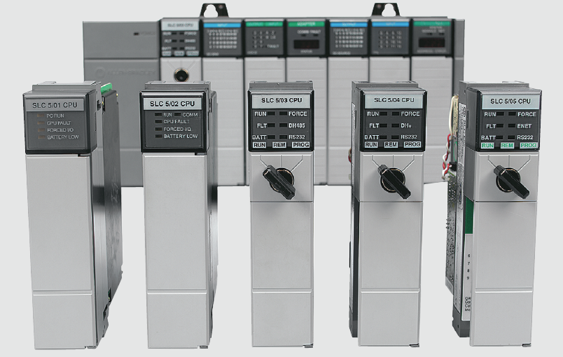
Hardwired Logic versus
Programmed Logic

Slide 30
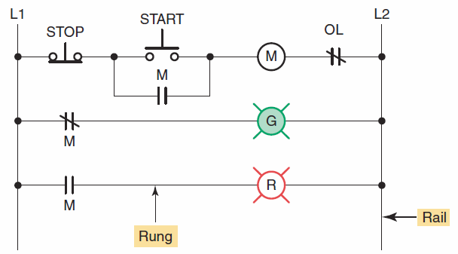
The term hardwired logic refers to logic control functions that are determined by the way devices are electrically interconnected.
Hardwired logic is fixed and changeable only by altering
the way devices are electrically interconnected.
Hardwired motor control program.

Slide 31
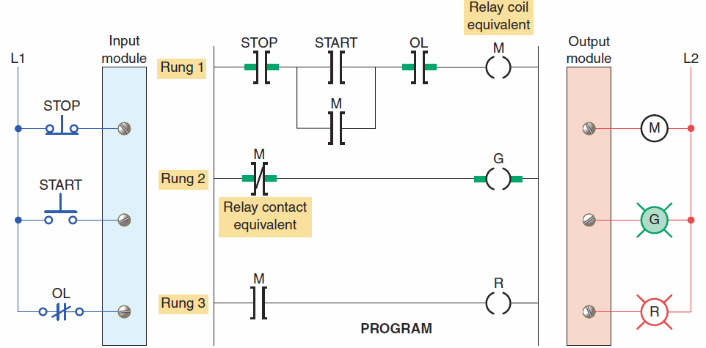
Programmable control is based on the basic
logic functions, which are programmable and easily changed.
PLC programmed motor control program.

Slide 32
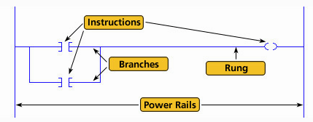
The most common PLC programming language is ladder logic .
A ladder logic program consists of several rungs, each of which controls an output.
Each rung is a combination of input conditions (symbols) connected from left to right, with the symbol that represents the output at the far right.

Slide 33
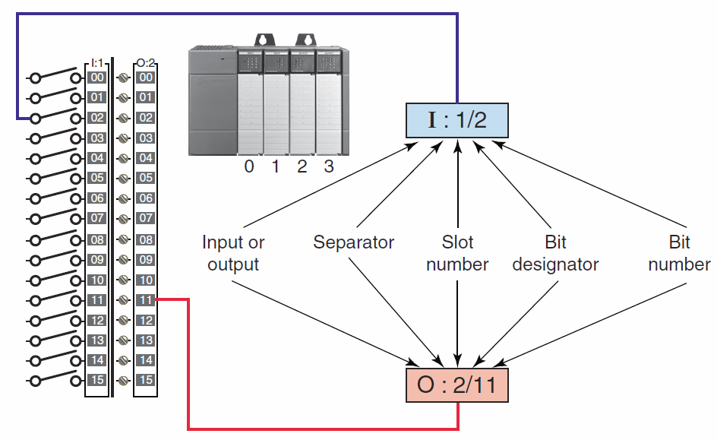
I/O address format for the MicroLogix
family of PLCs.

Slide 34
To this point we have discussed ladder diagram language and how it is a symbolic set of instructions used to create the controller program.
Representations of contacts and coils are the basic symbols of the logic ladder diagram instruction set.

Slide 35
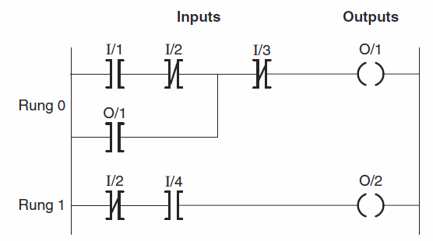
The main function of the ladder logic diagram program is to control outputs based on input conditions.
Each contact or coil symbol is referenced with an address that identifies what is being evaluated and what is being controlled.
The same contact instruction can be used throughout the program whenever that condition needs to be evaluated.

Slide 36
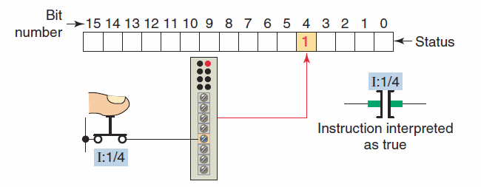
The memory bit is set to 1 or 0 depending on the
status of the input.
A 1 corresponds to a true status or on condition.
If the instruction memory bit is a 1 (true) this instruction will allow rung continuity through itself, like a closed relay contact.

Slide 37
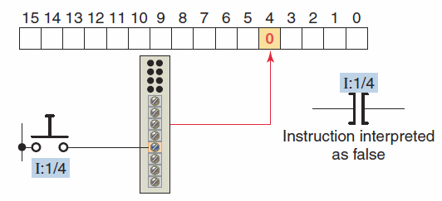
A 0 corresponds to a false status or off condition.
If the instruction memory bit is a 0 (false) this
instruction will not allow rung continuity through
itself and will assume a normally open state just like
an open relay contact.

Slide 38
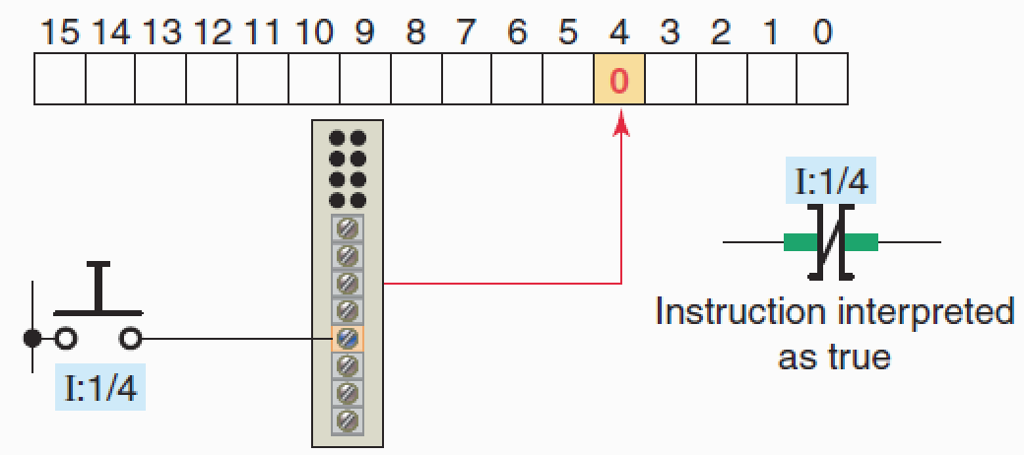
A 0 corresponds to a off condition.
The instruction is interpreted as true when the bit is 0 and will not allow rung continuity through itself.

Slide 39

The Output Energize (OTE) instruction looks and operates like a relay coil.
This instruction signals the PLC to energize
(switch on) or de-energize (switch off ) the output.
The instruction is associated with a memory bit that energizes the output when set to 1 and de-energizes the output when reset to 0.

Slide 40


Allen-Bradley Discrete Addressing
XIC
OTE
Colon
Hyphen
File Type
Bit #
X:Y/Z
XIO
Word #
Hyphen
Colon
Hyphen
Colon
File Type
Bit #
File Type
Bit #
I:0/0
O:1/10
Word #
Word #

Slide 41
XIC
Hyphen
Colon
File Type
Bit #
XIO
I:0/7
Input Image Table Word 0
Word #
0
0
0
0
0
0
0
0
1
0
0
0
0
0
0
0
15
14
13
12
11
10
9
8
7
6
5
4
3
2
1
0
Colon
Hyphen
OTE
File Type
Bit #
O:0/10
Output Image Table Word 0
Word #
0
0
0
0
0
1
0
0
0
0
0
0
0
0
0
0
15
14
13
12
11
10
9
8
7
6
5
4
3
2
1
0

Slide 42
Allen-Bradley Discrete Addressing
XIC
XIO
OTE
OTE
Contacts
Coil
Allowable File Types
0 - Output
1 - Input
3 –Internal Bit
0 - Output
3 – Internal Bit

Slide 43
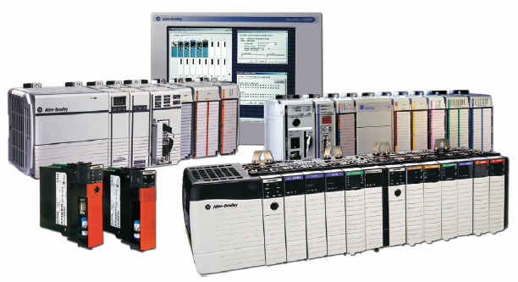
Program Scan

Slide 44
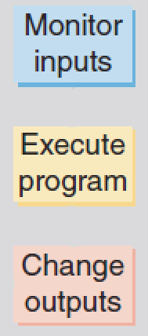
When a controller executes a program, it must know—in real time—when external devices controlling a process are changing.
During each operating cycle, the processor reads all the inputs, takes these values, and energizes or de-energizes the outputs according to the user program.
This process is known as the
program scan.

Slide 45
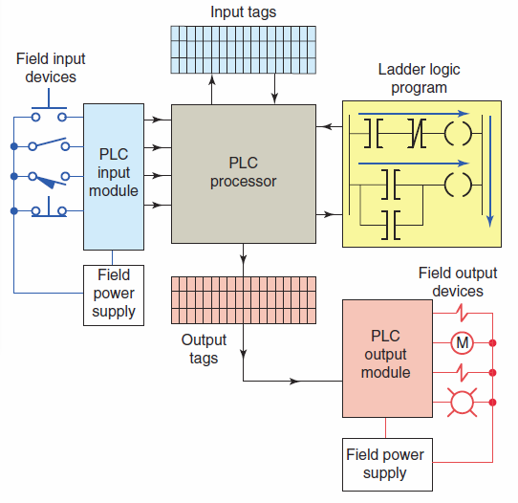
Logix controller operating cycle.

Slide 46
Program is scanned one rung at a time.
As the program is scanned, the status of inputs are checked for True (1 or ON) or False (0 of OFF) conditions.

Slide 47
The status signals from the inputs are sent to the input tags where they are stored.

Slide 48
As the program is scanned by the processor, inputs are checked for True or False conditions and the ladder logic is evaluated based on these values.
The resulting ON or OFF action, as a result of
evaluating each rung, is then sent to the output tags
for storage.

Slide 49
During the output update portion of the scan, corresponding output values are sent to the process or machine by way of the output module.

Slide 50
I/O updates occur asynchronously to the scan of the logic.
With a ControlLogix processor two separate 32-bit unsynchronized processes go on simultaneously - that is, asynchronously.
This means that the module can update the input
tag from the field and write the output tag to the field at any point (or at several points) during the processor’s execution of the ladder rungs.
The result is more efficiency and control over when the input field device data are updated and when the output data resulting from the solved logic are sent to the output modules and their respective field devices.

Slide 51
References
GIAN Training Material, NIT Tirchy, 2022

Slide 52
Thank You
Queries

