Slide 1


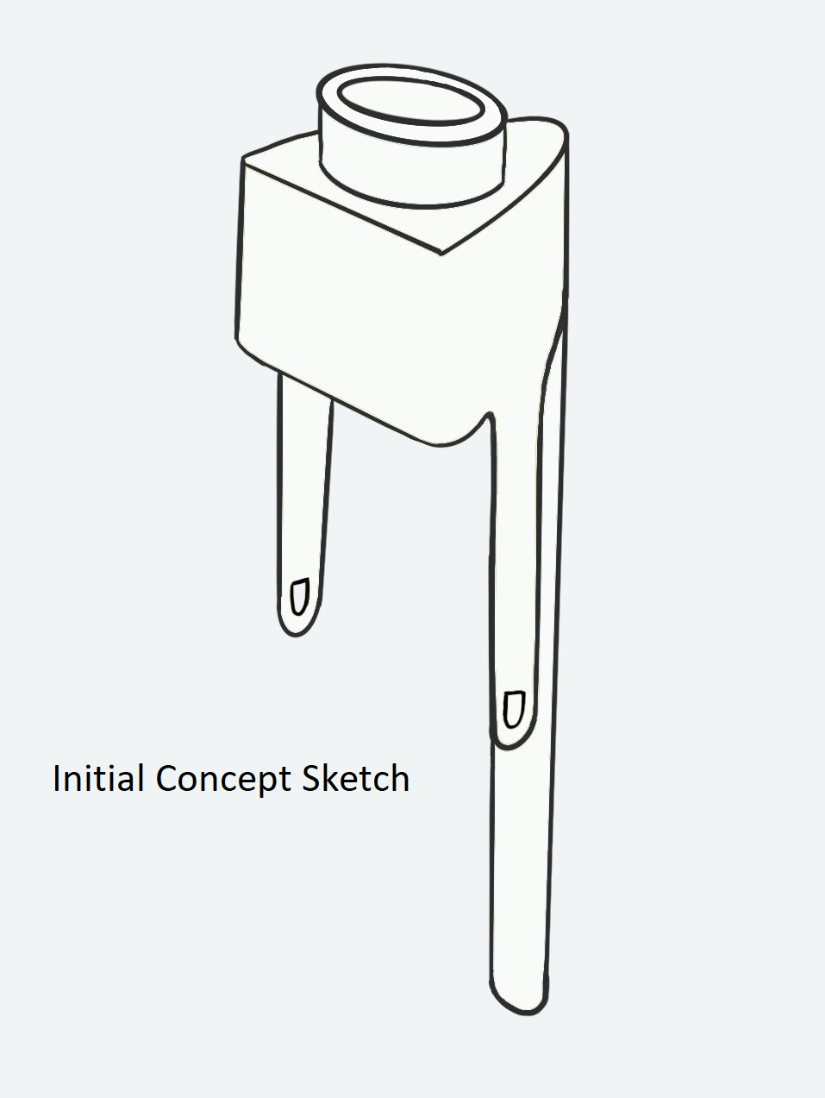
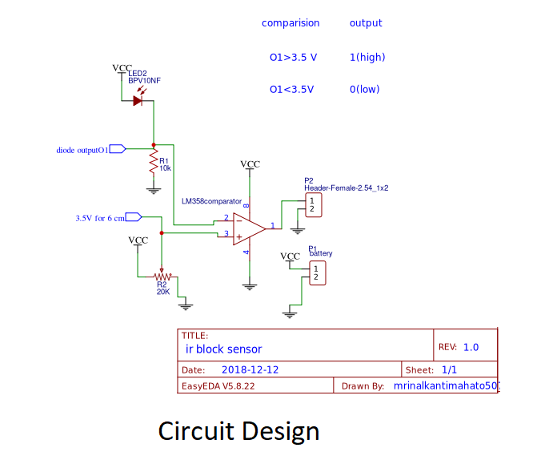
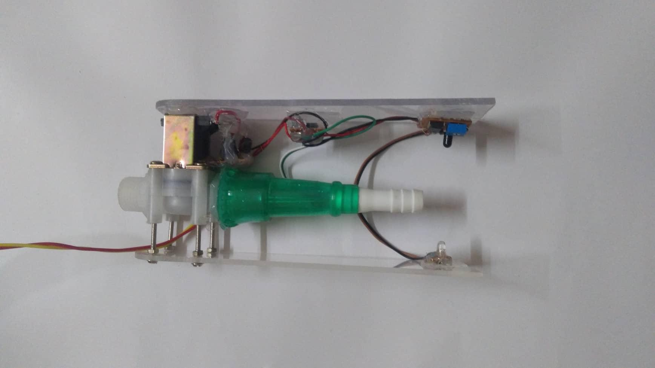
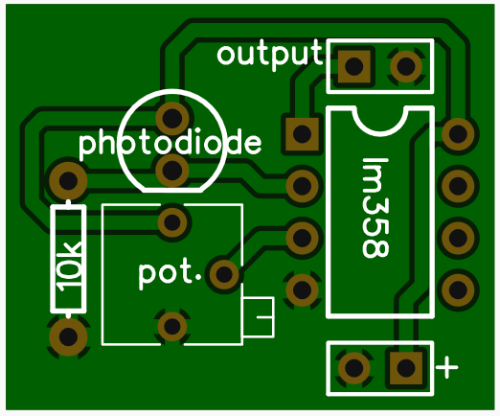
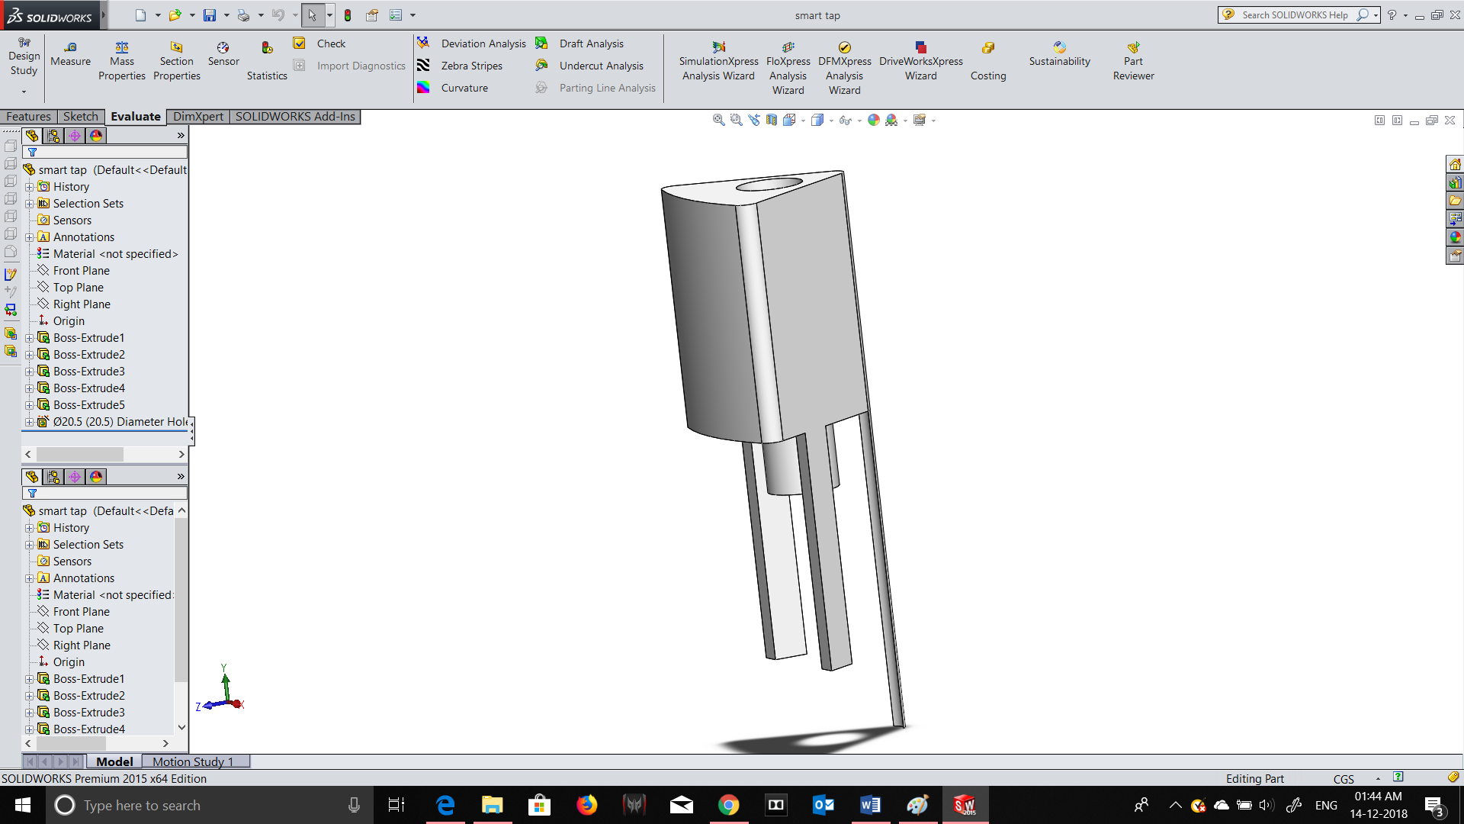
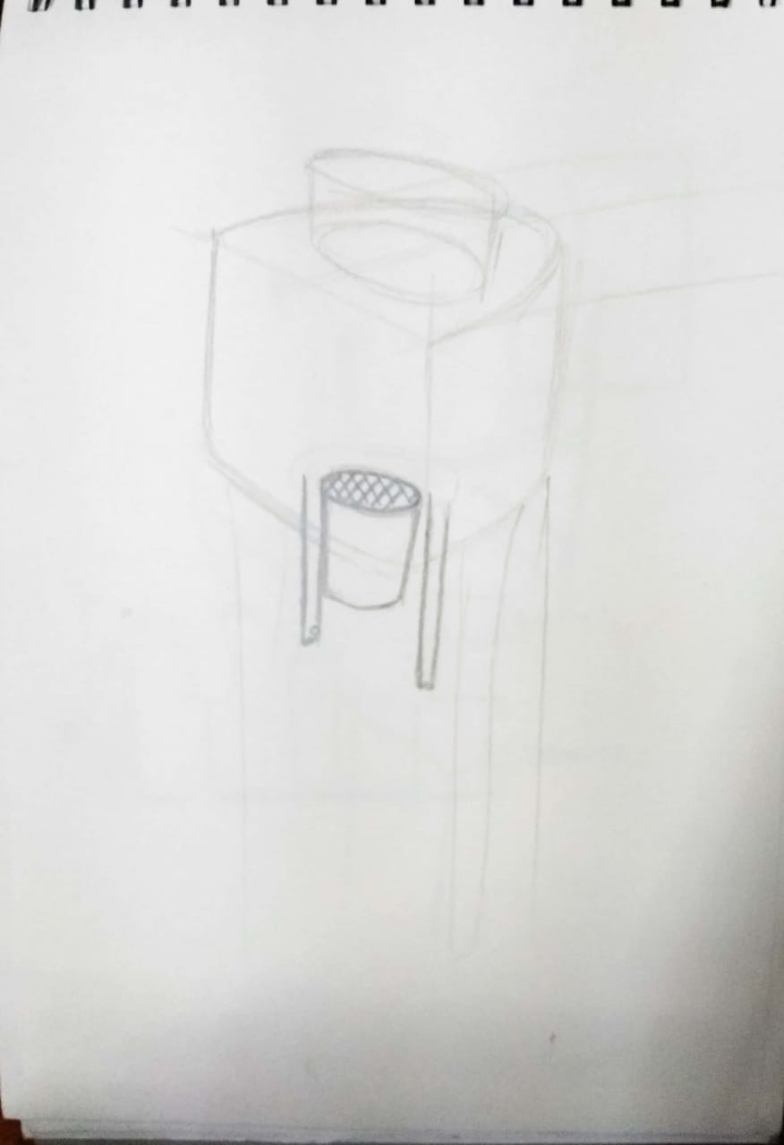
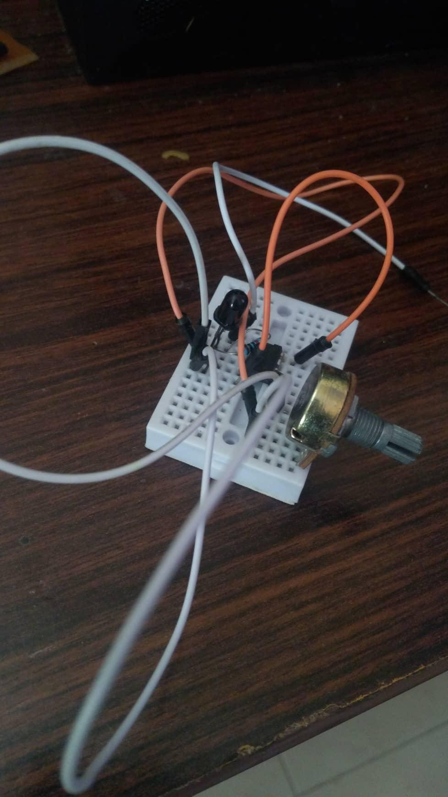
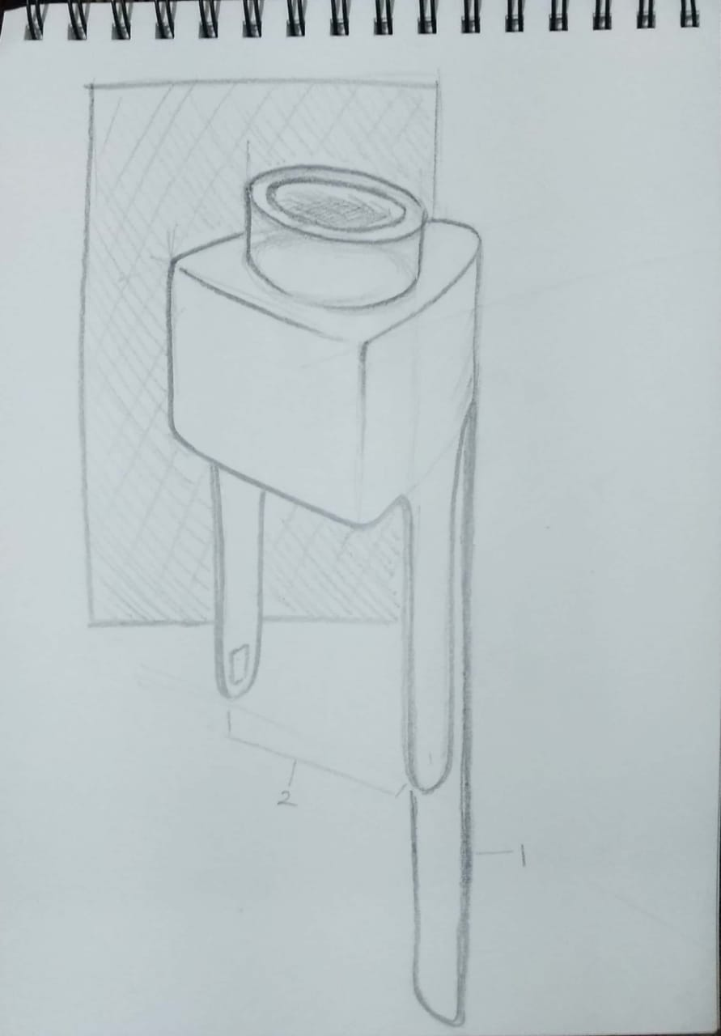
Lazy Fill(smart tap)
Mrinal Kanti Mahato & Anant Ajaideep
Indian Institute of Technology, Guwahati
Abstract/Introduction
We looked into the simple, everyday task of filling the water bottles and realised that a task this simple and frequent, still isn’t as easy and efficient as it should have been. The number of steps involved to have this task done can be reduced with help of technology and innovation, plus current way involves a considerable amount of wastage of usable water if the user isn’t careful. Seeing this we tried to use our engineering and design knowledge to make this task done more efficiently. We came up with an idea of making a snap on device for kitchen taps which will convert a basic simple tap into a Smart Tap. This device will sense a bottle kept under it and will turn on the water supply and cut it as soon as it detects that the bottle is filled completely. Along with these things the device is supposed to be ergonomically fit and should be easy to approach and use for any user.
Results
Finally we have a device(product) which snaps on a tap with the help of a rubber cup, holds a bottle in place with the help of one of it’s limb, detects it’s presence with help of light sensors present on the other 2 limbs which opens the solenoid valve hence allowing the flow of water in the bottle. The nozzle of the device has a mesh inside it to provide a proper undisturbed stream, and the nozzle has two limbs on opposite side in order hold the sensors which detect the level of water and close the solenoid valve.
Methodology
After some research we decided on fixing two things initially : That we will have to use a solenoid valve to control the flow of water That a scale body will have to be made by using a 3D printer. After some series of thoughts on implementing techniques we decided that we will use two types of sensors, one for detecting the placement of bottle and second to detect the level of water. These sensors will eventually control the solenoid valve and control the flow of water. An ultra low power infrared light from the LED is when incident on the photo diode a potential of 4.2 V is generated across the 10k ohm resistor(R1). We compare this potential(using comparatorLM358) with 3.5 V (generated using 10k potentiometer), so now in this case the output of the comparator is high (according to the table). Now, if any obstacle come in between the LED and the photo diode, we will get a potential across R1 to be 0V hence, turning the comparator output to ‘low’. We use this output to drive a NPN high current transistor BD139 which switches on 12V 4.8W power to normally closed solenoid valve, which controls the water flow. For switching the circuit off we are using a ground trigger mechanism using 2 PNP transistors (BC557) in saturation mode(as a switch). In our prototype the current consumption is 8.4mA in normal off state and 0.48A in on State. From design point of view this device should have been able to do two things correctly, first holding the bottle right under the nozzle and second placing at the right place in such a way that it doesn’t affect the in and out movement of the bottle. We cruised through few ideas and decided upon having a main unit which will be attached to the tap having 3 limbs coming down from it, one to stop the bottle in place and other 2 to hold the sensors which will detect the bottle kept under it.
Conclusion
After all the efforts, we have a touch less water filling device. Hundreds of people in hospitals, offices, schools, factories, malls and other public places touch the same drinking water dispenser and spread infections that cause diarrhoea, fever, fatigue, vomiting, abdominal pain, flu and even pimples. The taps on drinking water dispensers are among the most commonly touched surfaces. This device will also prevent wasting of precious drinkable water and make this task of filling up water bottles really quick and easy, owing to these characteristics this device is perfect for places like railway stations, tourist places, hospitals, malls etc. because of its modular design it can be fit into existing water supply system easily It is small, easy to use.
References
1.Wikipedia 2.EasyEda (for simple and powerful electronic circuit design tools) 3.IEEE 4.www.electronicsforu.com
Initial pencil sketches and circuits.

