Slide 1

Cryptoverse
A modern, real-time web application for tracking the cryptocurrency market — prices, market cap, exchanges, and news, all in one place.
WEB APP
REAL-TIME DATA

Slide 2
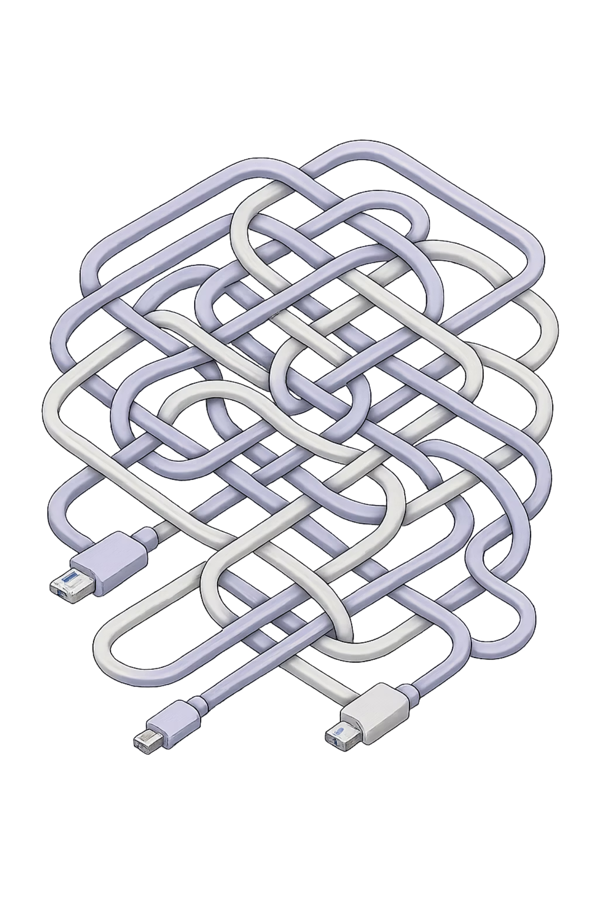
The Problem
The crypto market never sleeps — and neither does its complexity. Investors struggle to find a single, intuitive platform that combines live prices, historical performance, and verified news without overwhelming complexity or poor mobile experience.
24/7 Volatility
Data Overload
Prices shift constantly, demanding always-on monitoring tools.
Existing platforms are cluttered and difficult to navigate.
Poor Visualisation
Lack of clean, readable charts for quick trend analysis.

Slide 3
Core Objectives
Real-Time Data
Intuitive Visualisation
Live asset prices, volumes, and market cap via external APIs — always up to date.
Interactive charts and a clean UI that make complex data instantly readable.
Comprehensive Insights
Cross-Platform First
Trusted exchange rankings and curated crypto news to support smarter decisions.
A fully responsive, mobile-first experience across all devices and screen sizes.

Slide 4

Key Features & Highlights
Live Market Monitoring
Real-time feeds for prices, market caps, and trading volumes.
Currency Toggle (USD / INR)
Dynamically recalculates the entire dashboard on user selection.
7-Day Price Charts
Responsive Chart.js graphs for immediate trend visualisation.
Interactive Search
Filter and explore any asset instantly from the dashboard.

Slide 5
Technology Stack
HTML5 + Tailwind CSS
Vanilla JS (ES6+)
Mobile-first structure with Glassmorphism and Dark Mode styling.
Asynchronous data fetching, state management, and DOM rendering — no frameworks needed.
Chart.js
CoinGecko + CryptoCompare APIs
Aesthetic, canvas-rendered 7-day historical price graphs.
Market data, exchange rankings, and live news aggregation.

Slide 6
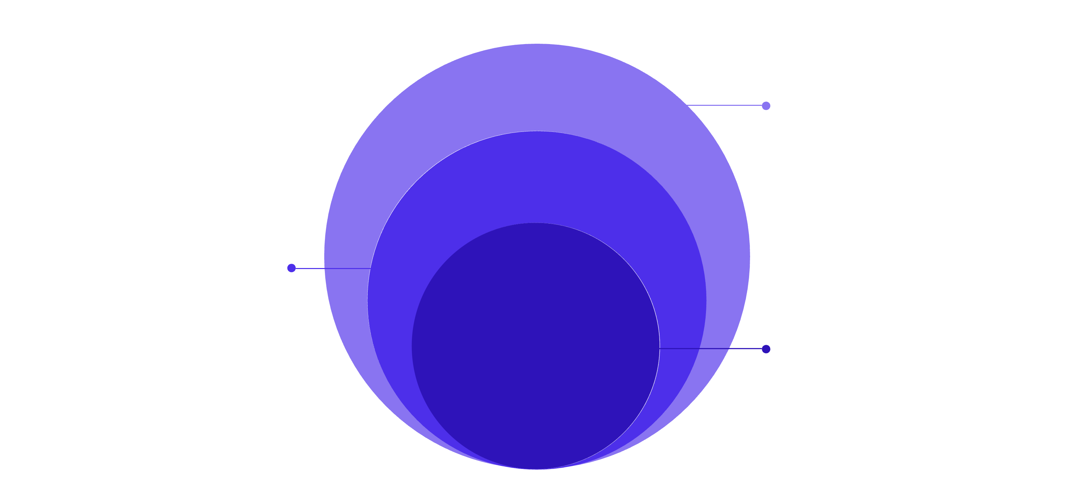
System Architecture
Client & UI
JavaScript engine handling inputs with HTML/Tailwind UI
State & API
AppState manages data from CoinGecko and CryptoCompare
Core Rendering
DOM injection and Chart.js for interactive visuals
Each layer is modular and decoupled — enabling smooth data flow from raw API responses to polished, interactive UI components without redundant network calls.

Slide 7

Built for Reliability
Error Handling
State Caching
CDN-Only Deps
Gracefully alerts users to API rate limits or network failures — the DOM never crashes.
AppState prevents redundant API calls, keeping the experience fast and smooth.
No node_modules required — runs directly from CDN links in any modern browser.

Slide 8


Designed to Scale
Cryptoverse's modular architecture — built on AppState and reusable rendering functions — makes it straightforward to extend with new features like portfolio tracking, advanced charting, or alert systems, without rewriting the core logic.
Its educational value is equally significant: the app demonstrates real-world asynchronous JavaScript, API integration, and responsive design in a single, clean codebase.

Slide 9

Conclusion
Cryptoverse delivers a lightweight yet highly capable solution for navigating the fast-moving world of digital assets. Combining modern web techniques — asynchronous JS, Tailwind CSS, and HTML5 Canvas — it is both a practical investor tool and a showcase of clean front-end architecture.
Real-Time & Reliable
Responsive & Accessible
Scalable by Design
Live data with fallback error handling.
Flawless on mobile, tablet, and desktop.
Modular codebase ready for future features.

Slide 10
Thank You
References :
https://cryptocurrencytrackerreport.netlify.app/

