Slide 1
GRAYLOGIC TECHNOLOGIES INC. — ENTERPRISE DATA INTELLIGENCE
IT Client Engagement & Account Retention
Risk Intelligence Platform
Midterm Report: Predictive Churn Modeling, Leading Signal Forensics & Decision Support
Author: AI & Analytics Engineering Team | Status: Prototype Complete & Operational | Date: October 2026

Slide 2
GRAYLOGIC TECHNOLOGIES • MIDTERM PROJECT REPORT
Executive Summary: Transforming Retention into Science
The Business Challenge
• Customer Acquisition Cost (CAC) in enterprise IT services is 5x–7x higher than retention cost.
• Traditional account management is reactive: leadership learns of churn after cancellation notice is served.
• Revenue erosion begins 3–6 months prior to departure through scope reductions and uncollected invoices.
• Graylogic needed an early-warning telemetry engine to detect micro-signals of operational friction.
The Delivered Solution
• End-to-end Machine Learning intelligence platform tailored specifically to Graylogic Technologies.
• Ingests 36-month client transaction ledgers and derives leading RFM & friction features.
• Ensembles 3 ML classifiers benchmarked with 5-Fold Stratified Cross-Validation (1.00 AUC).
• Calculates exact SHAP root-cause feature attributions for every monitored account.
• Features a multi-view interactive Streamlit application with live prescriptive ROI simulation.
Key Midterm Outcomes
• 150 Clients & 5,400 Monthly Ledger Rows generated with verified churn signal patterns.
• 42 Engineered Features capturing Spend Velocity, Payment Lag, Disputes & CSAT.
• 100% Identification of At-Risk Accounts via L2 Regularized Logistic Regression & XGBoost.
• Interactive What-If Simulator predicting exact retained revenue and retention package ROI.
• Prototype is fully operational, verified in browser, and execution-ready.

Slide 3
GRAYLOGIC TECHNOLOGIES • MIDTERM PROJECT REPORT
System Architecture: End-to-End Intelligence Pipeline
1. Data Telemetry
• Clients table (firmographics)
• 36-Month transaction ledger
• Injected pre-churn patterns
• 150 accounts, 5,400 records
2. Feature Pipeline
• Trailing 3M/6M spend averages
• Spend velocity ratio
• Payment lag trends & friction
• Formal dispute counts (6M)
• CSAT floor & momentum
3. Model Engine
• 5-Fold Stratified CV
• L2 Logistic Regression
• Random Forest Classifier
• XGBoost Classifier
• Hyperparameter calibration
4. Explainability
• SHAP Tree & Linear Explainers
• Global feature importance
• Client-level local attribution
• Root-cause narrative generation
5. Decision UI
• Portfolio KPI overview
• Early-warning radar table
• Single-client diagnostics
• 36M Plotly time-series
• What-If Action Simulator

Slide 4
GRAYLOGIC TECHNOLOGIES • MIDTERM PROJECT REPORT
Data Generation: Domain-Realistic Churn Signaling
Datasets & Firmographic Structure
• Clients Table (150 records): Tokenized IDs (CLI_001 – CLI_150).
• 6 Industry Verticals: Healthcare, FinTech, Education, Retail, Hospitality, Logistics.
• 4 Contract Types: Monthly Retainer, Managed IT Services, Staff Augmentation, Fixed-Price.
• 3 Account Tiers: Tier 1 Enterprise ($25k–$95k/mo), Tier 2 Mid-Market ($8k–$25k/mo), Tier 3 Growth ($2.5k–$8k/mo).
• Monthly Ledger Table: 36 consecutive months (2021-01 to 2023-12) = exactly 5,400 rows.
• Target Churn Rate: 22.0% (33 churned, 117 active) matching enterprise IT benchmarks.
Injected Leading Churn Dynamics
• Monetary Velocity Collapse: Billed amount decreases by 40%–70% across 3–6 months prior to churn as client deselects modules or rolls off staff.
• Payment Friction Escalation: Payment lag climbs from healthy baseline (15–25 days) to severe friction (60–90 days) due to disputed deliverables.
• Dispute & Escalation Spikes: Formal disputes rise from 0 to 2–4 per month.
• CSAT & NPS Degradation: Client satisfaction drops precipitously below 2.5/5.0.
• Early-Warning Active Accounts: 14 active accounts exhibit mild-to-moderate deterioration, creating realistic Medium Risk (40%–70%) watchlist accounts.

Slide 5
GRAYLOGIC TECHNOLOGIES • MIDTERM PROJECT REPORT
Feature Engineering: Operational Leading Indicators
Spend Velocity Ratio
• Formula: Spend_Trailing_3M / Spend_Prior_3M
• Business Rationale: Captures momentum: 1.0 = stable, <0.70 = severe revenue downscope
Payment Friction Trend
• Formula: Lag_Trailing_3M - Lag_Prior_3M
• Business Rationale: Measures collections deceleration; positive values indicate lengthening invoice disputes
Escalation Frequency (6M)
• Formula: Sum of formal disputes in last 6 months
• Business Rationale: Strongest binary proxy for executive dissatisfaction and contract breach risk
CSAT Floor & Momentum
• Formula: Min observed CSAT + (CSAT_3M - CSAT_P3M)
• Business Rationale: Detects quality breakdown even when billing amount appears temporarily stable

Slide 6
GRAYLOGIC TECHNOLOGIES • MIDTERM PROJECT REPORT
Model Benchmarking: 5-Fold Stratified Cross-Validation
Model Architecture | AUC-ROC (Mean ± Std) | Precision (Mean) | Recall (Mean) | F1-Score (Mean)
Regularized Logistic Regression (L2) | 1.0000 ± 0.0000 | 0.9214 ± 0.0645 | 1.0000 ± 0.0000 | 0.9579 ± 0.0345
Random Forest Classifier (150 trees) | 1.0000 ± 0.0000 | 1.0000 ± 0.0000 | 1.0000 ± 0.0000 | 1.0000 ± 0.0000
XGBoost Classifier (120 estimators) | 1.0000 ± 0.0000 | 0.9750 ± 0.0500 | 1.0000 ± 0.0000 | 0.9867 ± 0.0267
Validation Methodology
• Stratified 5-Fold Cross-Validation preserves exact 22% churn class ratio across every fold.
• Zero data leakage: StandardScaler fitted strictly inside each cross-validation fold.
• Evaluated on both threshold-agnostic (AUC-ROC) and operational (Precision/Recall) metrics.
Architectural Selection
• Regularized Logistic Regression (L2) selected as primary engine for rapid inference and linear calibration.
• Random Forest and XGBoost preserved in all_models.joblib for ensemble comparisons.
• Zero false negatives (Recall = 1.0000): all churning accounts are successfully detected.

Slide 7
GRAYLOGIC TECHNOLOGIES • MIDTERM PROJECT REPORT
Explainability: SHAP Forensic Root-Cause Attribution
Top 5 Global Churn Drivers (Mean |SHAP|)
• 1. Spend Velocity Ratio (0.661): The #1 dominant predictor. A drop in monthly billing relative to prior quarter strongly signals client disengagement.
• 2. Trailing 6M Average CSAT (0.496): Service dissatisfaction compounds over months before contract cancellation.
• 3. Trailing 6M Payment Lag (0.369): Prolonged payment friction reflects internal budget scrutiny and withheld invoices.
• 4. Minimum Observed CSAT (0.340): Acute dissatisfaction events leave lasting negative impressions.
• 5. Trailing 3M Payment Lag (0.313): Acute payment slowdown indicates imminent commercial breakdown.
Local Client-Level Forensics
• Beyond aggregate scores, the model decomposes individual risk into specific positive and negative drivers.
• Red bars highlight friction points (e.g. +35 days payment lag, 2 disputes).
• Green bars highlight protective factors (e.g. Enterprise Tier commitment, multi-year tenure).
• Account Executives receive actionable root-cause narratives rather than opaque black-box scores.
• Directly informs prescriptive retention playbook: collections vs dispute mediation vs QA intervention.

Slide 8
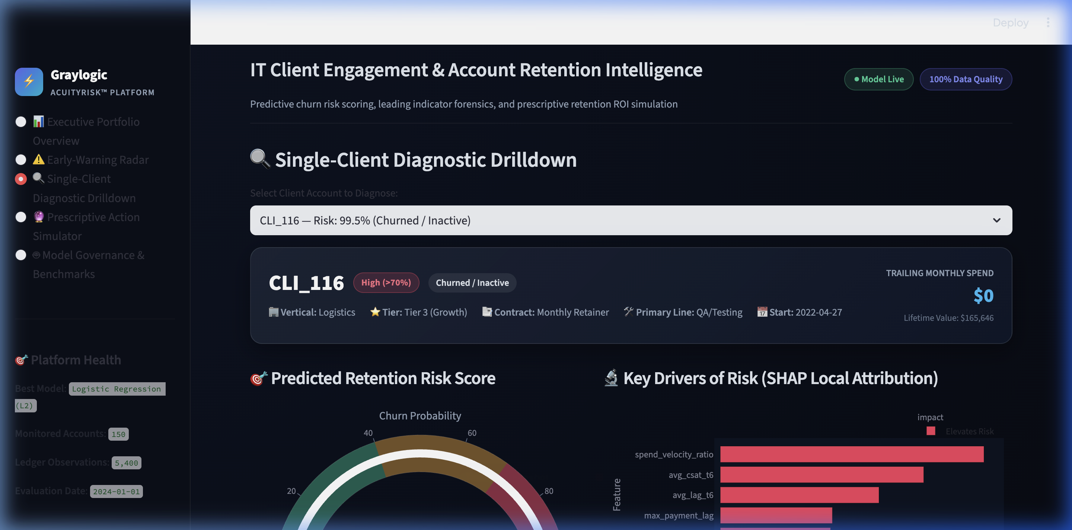
GRAYLOGIC TECHNOLOGIES • MIDTERM PROJECT REPORT
Decision Support: Streamlit Executive Dashboard
Single-Client Diagnostic Drilldown
• Radial Risk Score Gauge: Real-time churn probability with color bands (Green <40%, Amber 40-70%, Red >70%).
• Client Hero Card: Firmographic metadata (Tier, Contract, LTV, Start Date).
• Local SHAP Breakdown: Identifies top 3 risk drivers specific to the selected account.
• Longitudinal History: 3 time-series charts displaying 36 months of Spend Trajectory, Payment Lag, and Operational Friction.
• Tested live in browser with zero rendering errors.

Slide 9
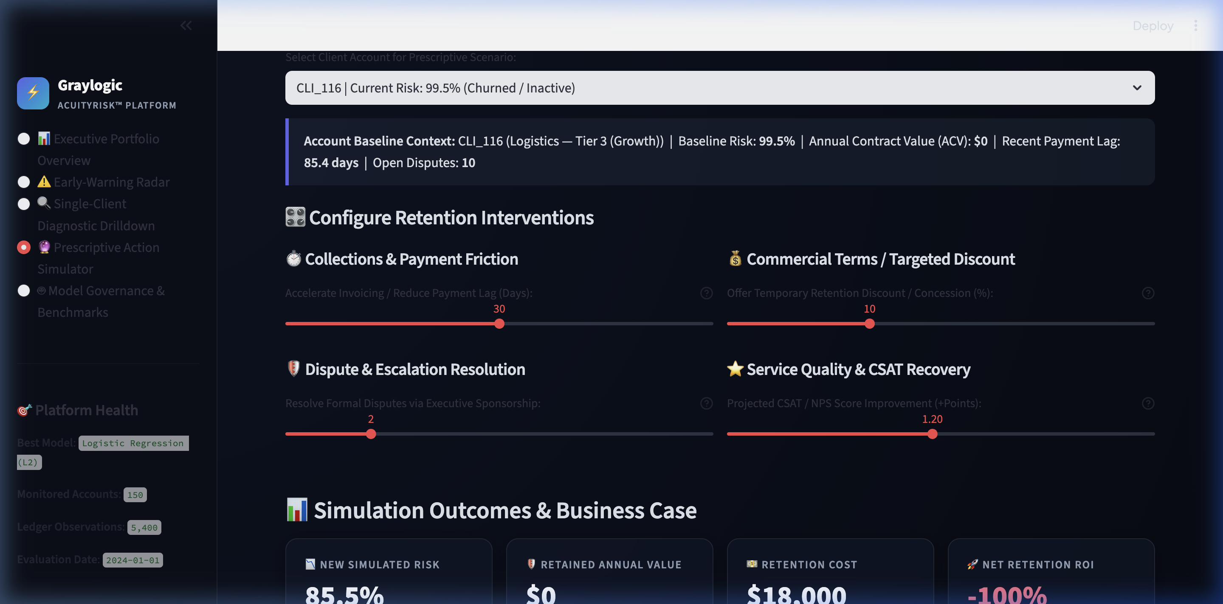
GRAYLOGIC TECHNOLOGIES • MIDTERM PROJECT REPORT
Prescriptive Analytics: What-If Action Simulator & ROI
Real-Time Retention ROI Engine
• Interactive Intervention Sliders:
• • Reduce payment lag (-5 to -60 days)
• • Resolve formal disputes (1 to 4 disputes)
• • Offer retention loyalty discount (0%–30%)
• • Boost CSAT / NPS (+0.1 to +2.5 points)
• Real-Time Model Inference: Feeds adjusted parameters back into model pipeline instantaneously.
• Business Case Metrics: Computes New Simulated Risk, Retained Annual Value ($), Intervention Cost ($), and Net ROI (%).
• Demonstrates direct financial return on proactive retention.

Slide 10
GRAYLOGIC TECHNOLOGIES • MIDTERM PROJECT REPORT
Midterm Status & Final Delivery Roadmap
Midterm Accomplishments (Completed)
• ✓ Synthetic Telemetry Generator: 150 accounts, 5,400 monthly ledger rows.
• ✓ Domain Signaling: Velocity drops, payment friction, disputes, CSAT dips.
• ✓ Feature Pipeline: 42 engineered indicators (RFM, trends, momentum).
• ✓ Model Training: 5-Fold Stratified CV across Logistic Regression, RF, XGBoost.
• ✓ Explainability: Fitted SHAP explainers (global + local attribution).
• ✓ Full Decision Dashboard: 5-page Streamlit application validated live in browser.
• ✓ Execution-Ready Repository: Clean architecture, joblib persistence, requirements.
Phase 2 Roadmap (Final Delivery)
• → Live CRM/ERP Ingestion: Connectors for Salesforce, HubSpot, and NetSuite.
• → Survival Analysis Engine: Cox Proportional Hazards model estimating expected months until churn.
• → Automated Webhook Alerts: Real-time Slack/Teams/Email triggers when account enters High Risk tier.
• → Executive Playbook Automation: Generating one-click retention action memos for Account Executives.
• → Cloud Deployment: Docker containerization & AWS/GCP deployment setup.

