Slide 1



JAI SHREE GANESH
WELCOME TO DAX

Slide 2

DAX overview Data Analysis Expressions (DAX) is a formula expression language used in Analysis Services, Power BI, and Power Pivot in Excel. DAX formulas include functions, operators, and values to perform advanced calculations and queries on data in related tables and columns in tabular data models.

Slide 3


What is DAX?
DAX helps us to return values after making calculations from the already available data
To understand DAX, you just need to be amiliar with Microsoft Excel formulas

Slide 4
What is DAX?
• DAX formulas are just like the ones we issue in Microsoft excel
• However, DAX functions and excel functions differ in certain aspects
• Excel allows its users to reference cells or arrays. If the users need to perform such behaviour in Power Bi, they would require the use of DAX Functions
• DAX provides more data types than Microsoft Excel does

Slide 5
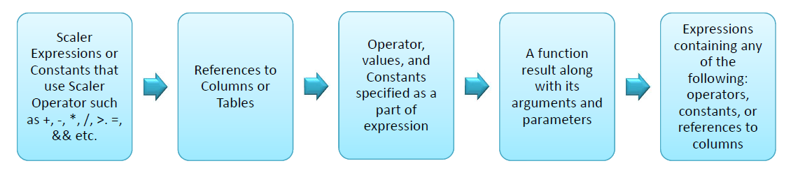
Syntax
• DAX formulas begin with an = sign after which any scalar value can be provided
The scalar value can be an expression that evaluates to a scalar or an expression that can be converted to a scalar

Slide 6
Syntax
• DAX requires that all its objects whether tables or columns must have unique names
Also, names of objects are case insensitive, i.e. Products and PRODUCTS would refer to the same table or column
A column name should always be fully qualified, i.e. it must be preceded by the table name and should be written in square brackets, e.g. SALES.[Prodcut_Id]
Sometimes table names will contain spaces in which case they must be enclosed insingle quotations

Slide 7
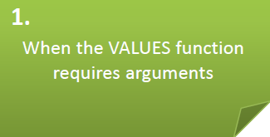
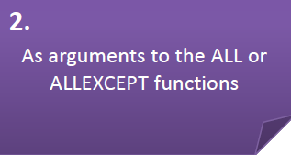
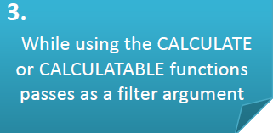
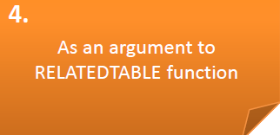
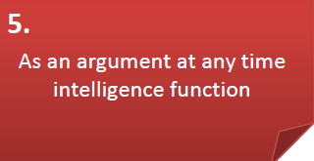
Syntax
• A fully qualified name is required in the following circumstances:

Slide 8




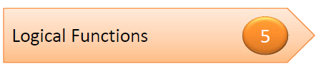



Functions
• Functions in DAX can be categorised into the following:

Slide 9
Functions
• DAX functions always point to either a column or a table
• To specify only selected values you will need to filter them
• DAX is also capable of returning a whole table rather than a column only
• DAX works with Time Intelligence functions to perform dynamic calculations

Slide 10
Row Context
• Row context is much easier to understand as compared to filter context
• The simplest way to visualise row context is to take a table and add a calculated column
• Each row in a table contains its own row context
• For instance, if a table has two columns a and b and row 1 values are 1 and 2
respectively
• Similarly, row 2 values are 3 and 4 respectively
• If you add a column c that sums the value of columns a and b, then the column c value for row 1 would be 3, and the value for row 2 would be seven

Slide 11
Calculated Columns
• With calculated columns, you can append new data to the existing table in your table
• You can create a data analysis expressions (DAX) formula that defines the columns
values rather of querying and loading values in your new column from a data source
• In Power BI desktop, calculated columns are generated by using the new column feature
in Report view
• Calculated columns that you create appear in the fields list just like any other field

Slide 12
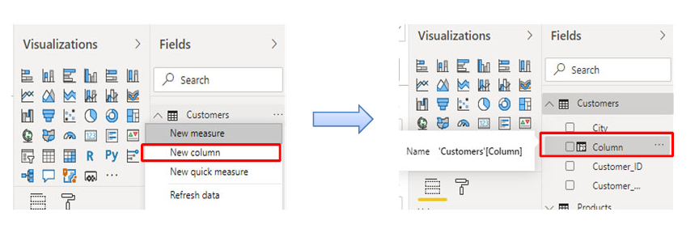
Calculated Columns
• But they will contain a special icon showing its values are the result of a formula:
You can name new columns whatever you want, and add them to a report visualisation
just like other fields

Slide 13
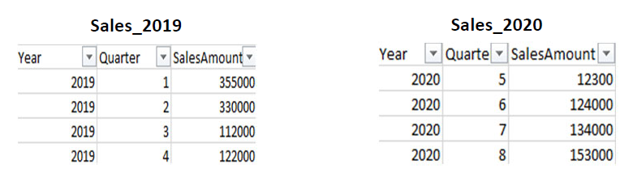
Calculated Tables
• You can create a calculated table by using the New Table feature in a data view or report view of Power BI desktop
For instance, suppose you are a personnel manager who has a table of Sales_2019 and another table of Sales_2020, and you want to combine both tables into a single table called Sales

Slide 14
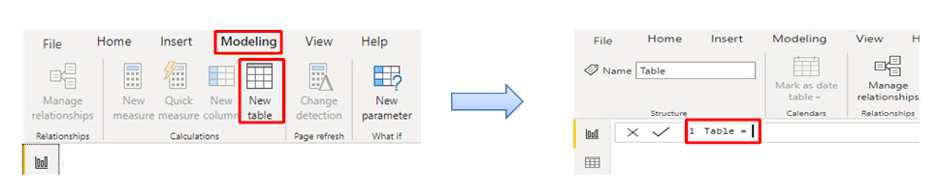
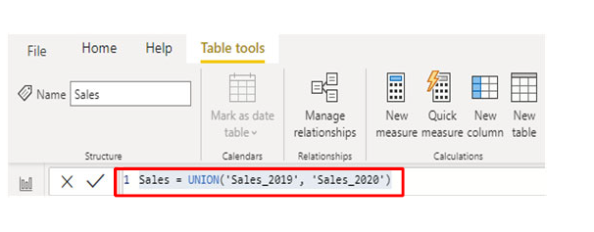
Calculated Tables
The following are the steps to create a calculated table:
Step 1: Click on the Modeling Tab and then select New Table
Step 2: Enter the following formula in the formula bar

Slide 15
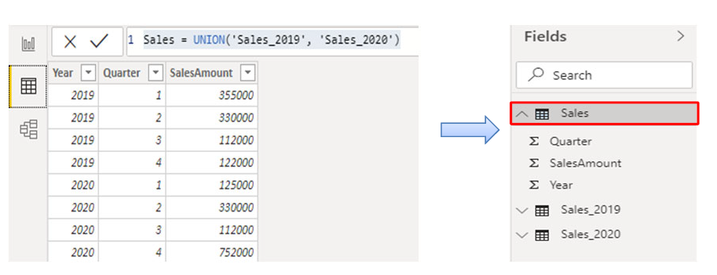
Calculated Tables
Step 3: A new table named Sales is created and appears just like any other table inthe Fields pane:

Slide 16
Measures
Measures are generally used for data analyses
Simple summarisations such as sums, averages, counts and minimum, maximum can be set through the Fields well
The calculated results of measures are always varying according to your interaction with your reports, allowing for fast and dynamic ad‐hoc data exploration
In the Power BI desktop, measures are created in a data view or report view
The measures that you are created appear in the Fields list with a calculator icon

Slide 17
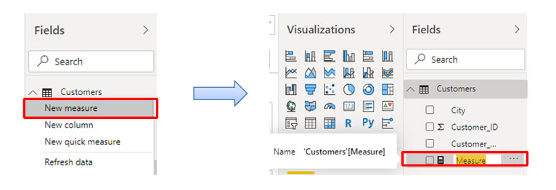
Measures
You can enter the name for measures whatever you want and add them to a new or existing visualisation just like any other field

Slide 18
Measures
You can enter the name for measures whatever you want and add them to a new or existing visualisation just like any other field

Slide 19

What are the Relationships ?
In Power BI, a relationship is used to describe the connections or the relation between two or more tables
• The relationship is used to perform an analysis based on multiple tables
• The relationship helps to display the data as well as correct information between multiple tables
• The relationship is also used to calculate the accurate results

Slide 20
Viewing Relationships ?
The model view displays all of the tables, columns, and relationships in your model
This view can be mainly useful when your model contains complex relationships between many tables
Click on the Model icon placed at the left side of the window to see a view of the existing model
Your cursor over a relationship line represent the columns that are used as shown in the next slide:

Slide 21
Viewing Relationships ?

Slide 22
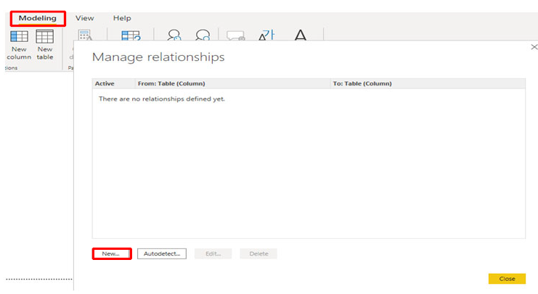
Creating Relationships
• The following are the steps to create a relationship manually:
Step 1: On the Modeling tab, select Manage Relationships > New

Slide 23
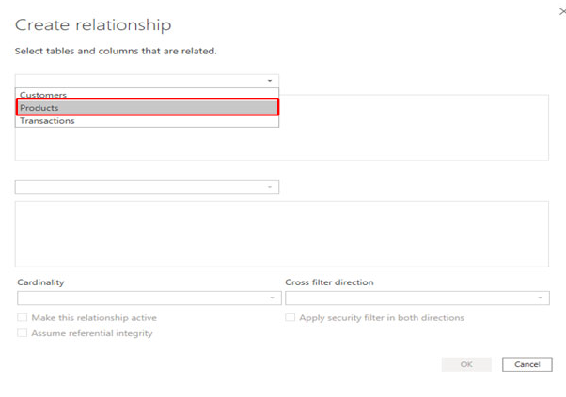
Creating Relationships
Step 2: In the Create relationship dialog box, select a Products table in the first table dropdown list, and then choose the column you want to use in the relationship

Slide 24
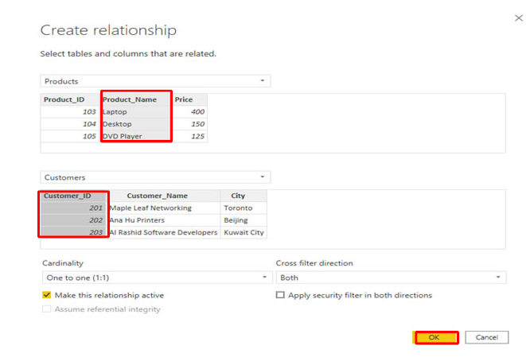
Creating Relationships
Step 3: In the second table drop‐down list, choose the other table you want in the
relationship and then select the other column you want to use, press OK

Slide 25




Cardinality
• While creating a relationship between two tables, you get two values that can be 1 or * on the two ends of the relationship among two tables, known as Cardinality of the Relationship
• There are four types of cardinality, as follows:

Slide 26
Cardinality
1. Many to one (*:1)
• A many‐to‐one relationship is a vital type of cardinality and default type of relationship
• In many to one relationship, the column in a given table can have more than one
instance of the value, and the other related table is known as the lookup table and
contained only one instance of a value
2. One to one (1:1)
• In a one‐to‐one (1:1) relationship, the column in one table has only one example of a
specific value, and the different related table also contains only one instance of a
specific value

Slide 27
Cardinality
3. One to many (1:*)
• In a one‐to‐many (1:*) relationship, the column in one table has only one instance of a
specific value, and the other related table contains more than one instance of a value
4. Many to many (*:*)
• You can develop a many‐to‐many relationship between tables with composite models
that removes the requirements for unique values in tables
• It also eliminates the previous workarounds, such as introducing new tables only to
build relationships

Slide 28
Cross Filter Direction
• Each model relationship must be described with a cross filter direction
• Your selection decides the direction(s) that filters will propagate
• The possible cross filter options are dependent on the type of cardinality
• Single cross filter direction indicates single direction, and both show both directions
• A relationship that filters in both directions are commonly defined as bi‐directional

Slide 29
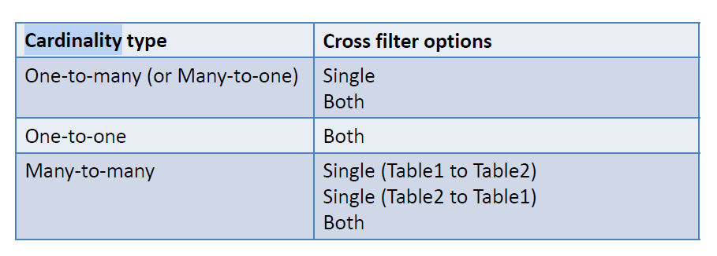
Cross Filter Direction

Slide 30






