Slide 1
Random forest

Slide 2
Random forest
Random Forest is a supervised learning technique used for classification and regression. It is an ensemble method.
How is a tree built?
From the N samples pick n cases at random with replacement.
From M input features, m features will be selected at random. One feature that best splits is considered.
Each tree is grown without pruning.
Repeat steps 1-3 for S number of trees.

Slide 3
How does it work for both regression and classification?
Regression: To make prediction, average of the values across all the trees is calculated.
Classification: Majority vote.

Slide 4
Advantages of Random Forest
It doesn’t overfit data.
It can handle thousands of input features.
It provides a method for studying the interaction of different features.

Slide 5
Disadvantages of Random Forest
Since it has to build several decision trees, it is slower
Harder to interpret compared to decision tree.

Slide 6
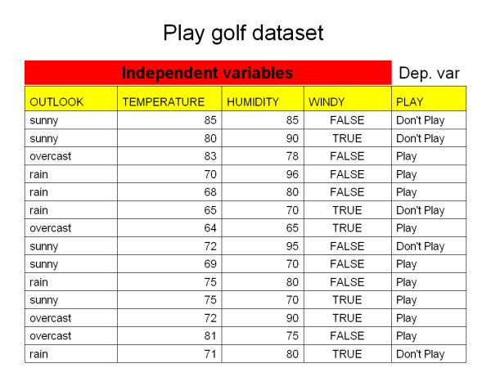
Let us consider a dataset

Slide 7
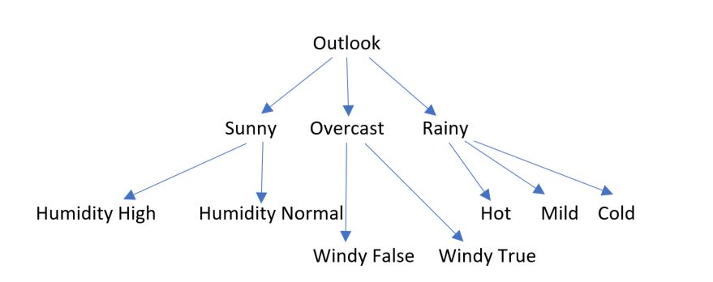
Steps to build Random Forest
Out of the 14 data points, let us consider 5 cases.
Out of 4 features let us consider 3 features at every stage.

Slide 8
