Slide 1

Go, change the world
RV College of
Engineering
BLOCKCHAIN ARCHITECTURE DESIGN AND USE CASE
18IS7F2
Decentralized KYC verification
Faculty :
Prof Sharadadevi K.S.
Assistant Professor (Dept. of ISE)
Dept. of ISE, RVCE
Submitted By :
Kanupriya Anand-1RV20IS067

Slide 2
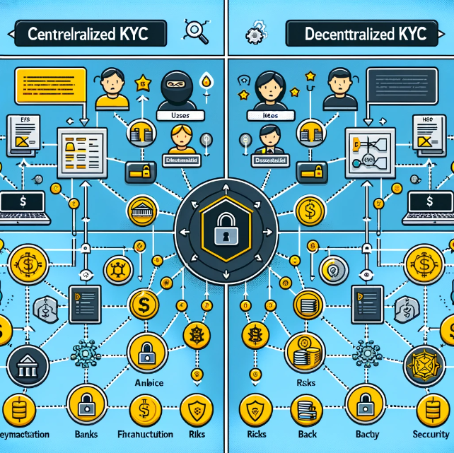
Introduction
Know Your Customer is a mandatory process for banks and financial institutions to verify the identity of their clients.
Essential for preventing fraud, money laundering, and terrorist financing.
Traditional KYC processes are centralized, creating a single point of failure that hackers can target, leading to privacy breaches and data theft.
A decentralized system reduces the risk of data breaches by distributing data across a network, rather than storing it in a central database.

Slide 3
Relevance of Topic to the course
Foundational Blockchain Concepts:
Decentralization: This project illustrates the core principle of blockchain by moving away from centralized systems to a distributed ledger approach.
Consensus Mechanisms: Demonstrates how transactions and data verifications are validated on the blockchain, ensuring integrity and security without a central authority.
Smart Contracts and Ethereum:
Smart Contracts Utilization: Showcases how Ethereum's smart contracts automate processes, in this case, KYC verifications, making them more efficient and tamper-proof.
Ethereum's Flexibility: Highlights Ethereum's capabilities beyond just transactions—supporting DApps (Decentralized Applications) that can transform industries.
Application in Financial Services:
Regulatory Compliance: Addresses how blockchain can meet global KYC compliance needs more efficiently, reducing costs for financial institutions and improving the customer experience.
Privacy and Security: Demonstrates solving critical industry challenges like data security and privacy through encryption and decentralized data storage.

Slide 4
Objectives:
To implement an Ethereum-based decentralized KYC system for identity verification
To provide functionality for registering financial institutions like banks and their customers
To utilize blockchain's inherent security features to ensure that personal information is encrypted and only accessible via permissioned access, thereby enhancing privacy and data protection.

Slide 5




Technology Used
Solidity
Javascript
CSS
HTML
Metamask
Ganache Server

Slide 6
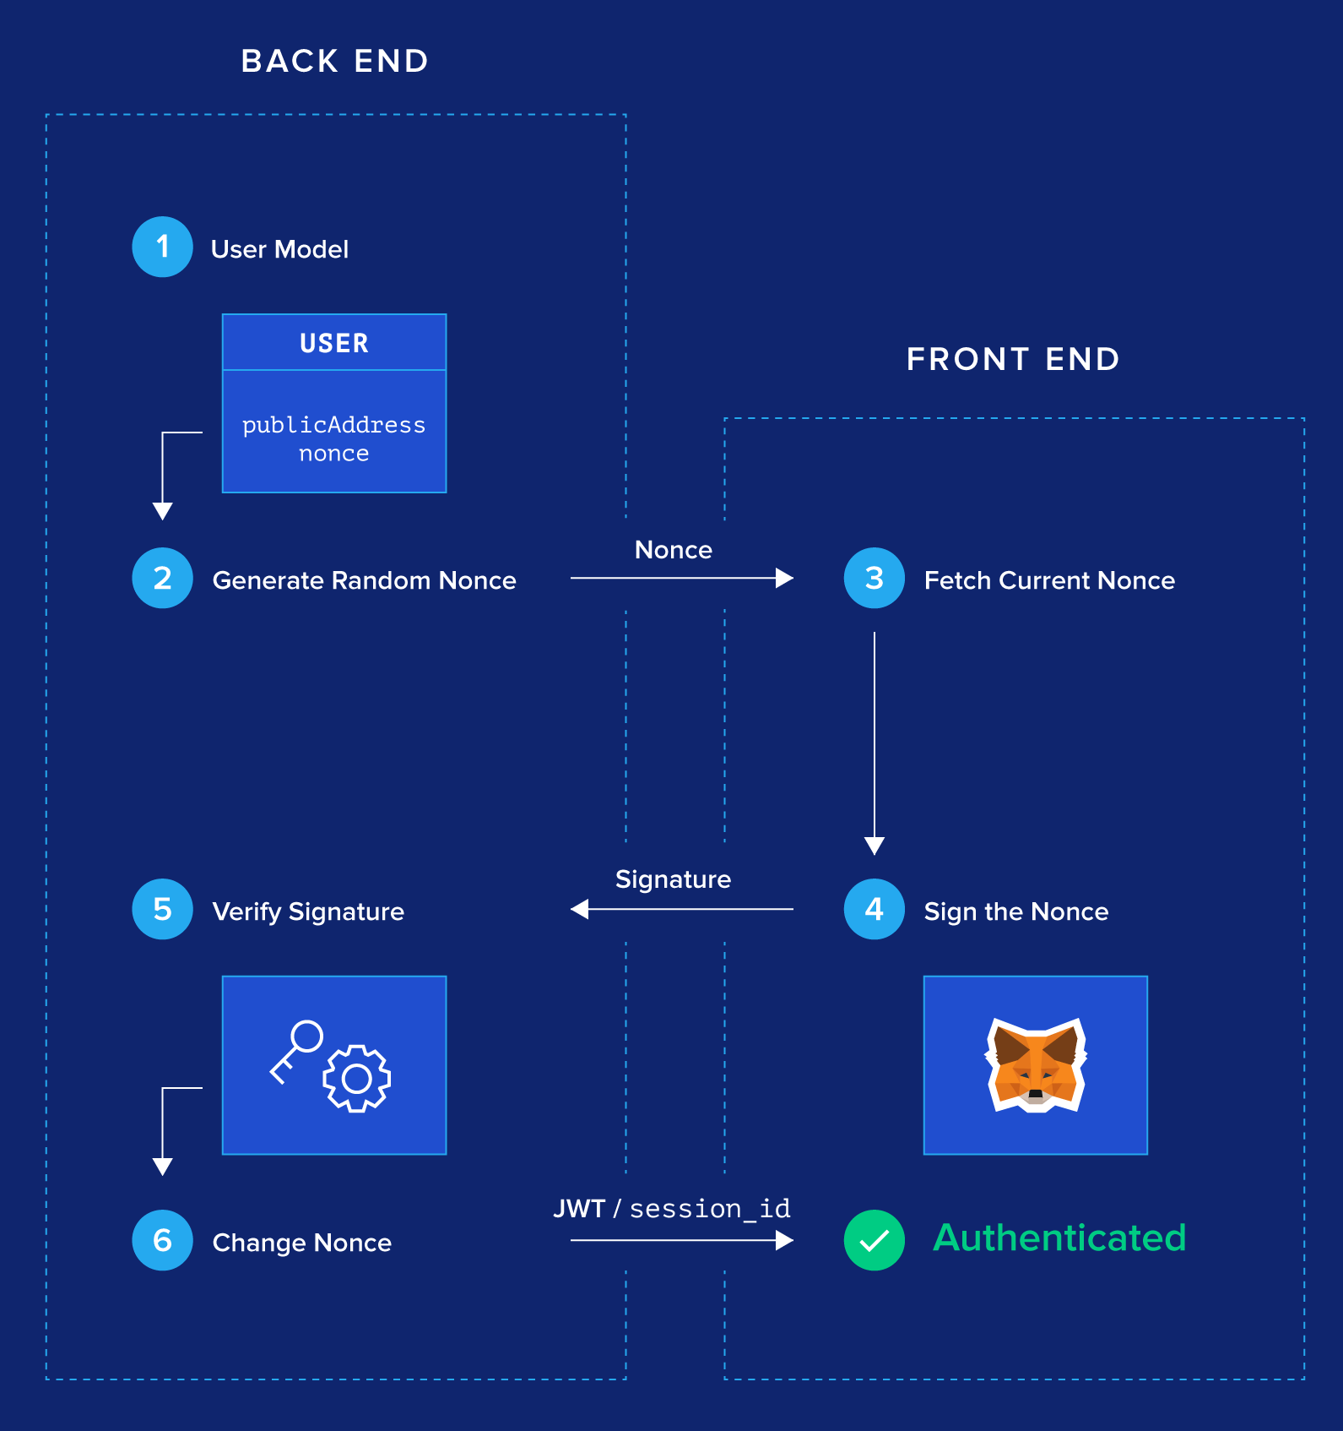
Architecture
Login flow initiates by generating one time nonce from the backend and storing the public address to nonce pair in cache.
User interacts with Metamask to sign this one time nonce. Metamask uses the user's public address and sings the nonce.
The signature generated using metamask is then send to the backend to verify the signature.
Over the backend, given the signature from the front-end and the nonce stored in cache in the step 1, the signature is verified using the elliptic curve digital signature algorithm giving back the public address of the user.
The required authentication is done using the retrieved public address and a jwt token is being generated.
Once the user is authenticated, the nonce for that user is updated for security reasons as it should not be reused to sign the transaction again.

Slide 7
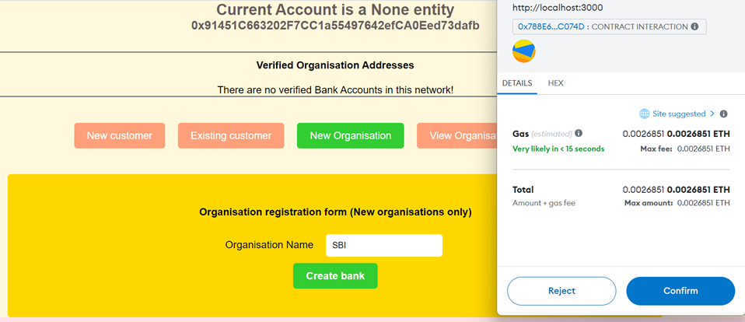
Working of Website
Step 1: Register a bank

Slide 8
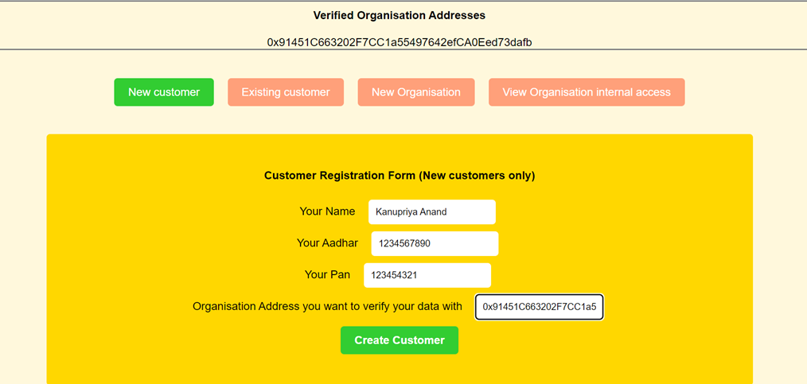
Working of Website
Step 2: Customer Registration

Slide 9
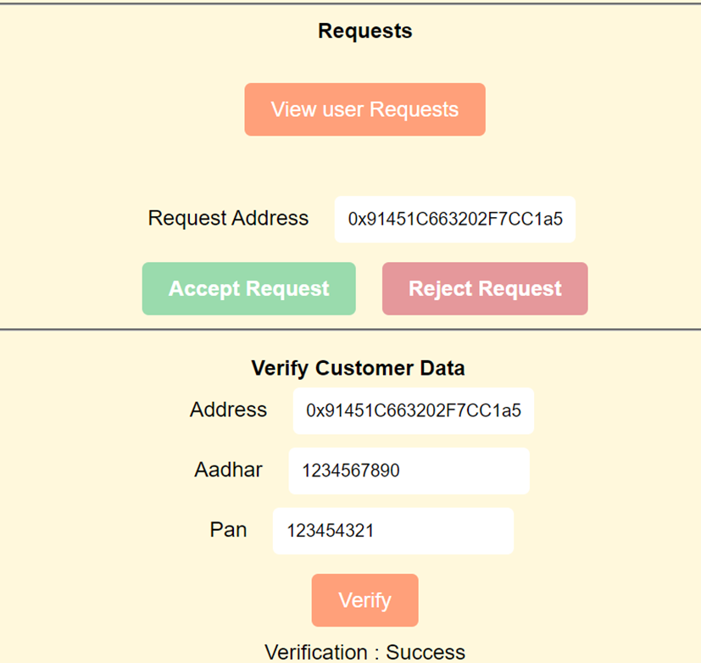
Working of Website
Step 3: Bank Verification

Slide 10
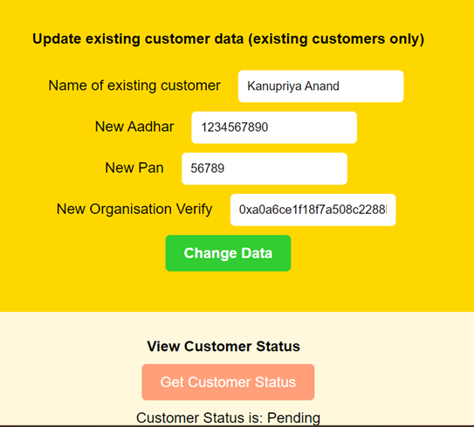
Working of Website
Step 4: Checking Status and Updating Profile

Slide 11
References
[1] https://www.sciencedirect.com/science/article/pii/S1877050922021263
[2] https://www.researchgate.net/publication/333827703_Decentralized_KYC_System
[3] https://ieeexplore.ieee.org/document/9936486
[4] https://www.sciencedirect.com/science/article/pii/S2772918422000091

Slide 12


