Slide 1

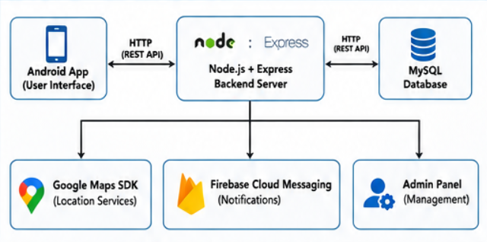
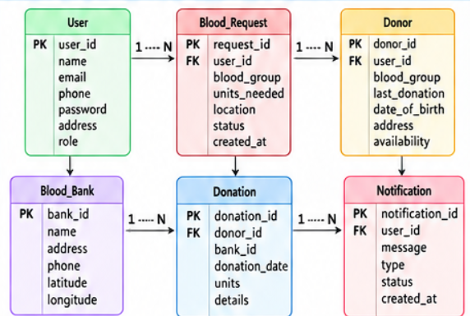
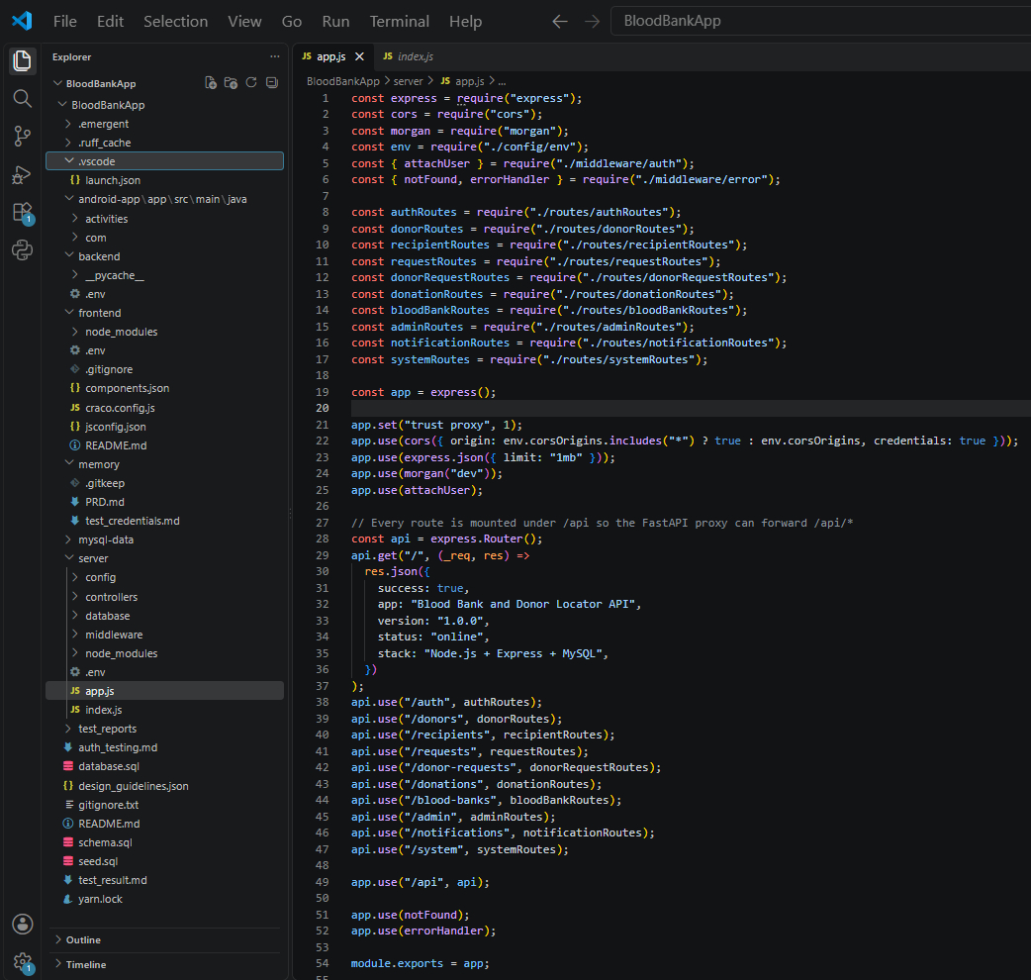
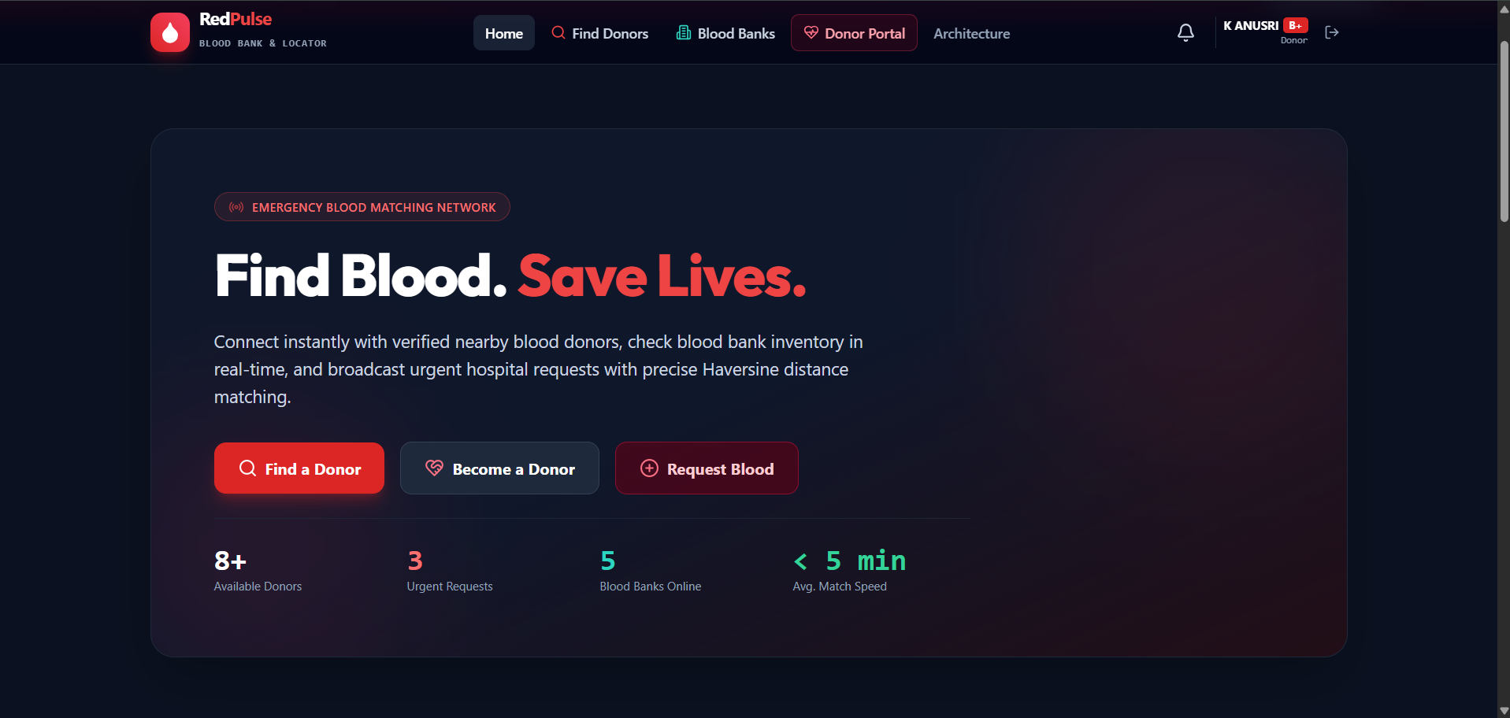
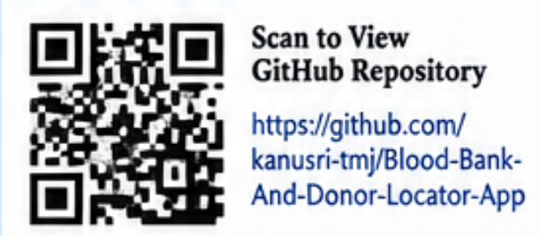
KLH Logo
BLOOD BANK AND DONOR LOCATOR APP
Members: K. Anusri – 2520030432 | V. Rukesh– 2520030519 |J. Simran – 2520030166
Guide: Dr. Y. Subbarayudu
Department of Computer Science and Engineering
Database Systems Engineering and Distributed Backend Development (25CS1302E) | PBL 2026–27
Abstract
Tools & Technologies
Blood Bank and Donor Locator App connects blood donors and recipients through an Android application.
Uses Node.js, REST APIs, MySQL, Google Maps, and Firebase Cloud Messaging.
Outcome: Enables faster identification of suitable nearby blood donors.
Front-End: React / HTML-CSS-JS
Back-End: Node.js + REST APIs
Database: MySQL
Tools: Git & GitHub, Postman, VS Code, Draw.io
Problem Statement & Objectives
System Architecture
Problem: Difficulty in finding compatible donors quickly.
Objective 1: Connect donors and recipients.
Objective 2: Enable nearby donor search.
Objective 3: Provide blood requests and instant notifications.
Scope: Donor registration, requests, search, notifications, and admin management.
[Insert architecture diagram: Front-End – REST API – Database]
Existing vs Proposed System
Feature | Existing System | Proposed System
Donor Information | Scattered / difficult to access | Centralized donor database
Donor Search | Manual or limited search | Blood group + location-based search
Availability | Difficult to verify | Updated donor availability
Communication | Delayed communication | Instant notifications
Limitation / Gap | Time-consuming donor identification | Faster matching and communication
ER Diagram & Database Design
[Insert ER diagram with entities, keys and relationships]
Feasibility Study
Implementation Screenshots
Technical: Uses Android Studio, Java, Node.js, REST APIs, MySQL, Google Maps, and Firebase Cloud Messaging.
Economic: Uses commonly available development tools and open-source technologies, reducing development cost.
Operational: Simple donor registration, blood request, search, and notification features support easy user interaction.
Schedule: The system can be developed, tested, and documented within the semester timeline.
Results & Testing
Conclusion
Future Scope
CRUD Operations: Successfully implemented for donor and request data.
Database Testing: Verified storage and retrieval of donor, recipient, request, and donation information.
Search Testing: Tested blood-group and location-based donor search.
Notification Testing: Verified notification delivery for blood requests.
The proposed system provides a centralized platform for connecting blood donors and recipients.
It supports donor registration, blood requests, location-based donor search, notifications, donation history, and administrative management.
The system helps make compatible donor identification and communication more organized and time-efficient.
AI-based donor matching based on blood group, location, and availability.
Hospital and blood-bank integration for improved coordination.

