Slide 1
CODESPARK HACKATHON 2026 | Track 4 – Workforce & Enterprise | Problem Statement 25
Smart Leave Management System
Team Members
K Anusri – 2520030432
J Simran – 2520030166
V Rukesh – 2520030519
A role-based web platform for leave applications, approvals, balance tracking and leave analytics
Notes:
Introduce the project, the problem statement and the team.

Slide 2




Problem Statement
Manual leave handling
Inconsistent policies
Emails, spreadsheets and verbal approvals cause delays
Rules are not enforced the same way for every request
Inaccurate balances
Poor team visibility
Leave balances are hard to track and often wrong
Managers cannot easily see who is available
Need: one structured, transparent and role-based workflow for employees, managers and HR
Notes:
Leave handled over email, spreadsheets and verbal approvals causes delays and errors.

Slide 3



Project Abstract
Full-stack web platform for leave management
Employees apply for leave and track status
Managers approve or reject with remarks
Backend validates dates, overlaps and balances
Balances are updated automatically
Complete leave history for every employee
HR configures leave types and views analytics
Employee
Apply, track requests, view balance
Manager
Review team requests, add remarks
HR Administrator
Users, departments, policies, balances
Keywords: Leave Management · Approval Workflow · Spring Boot · REST API · Role-Based Access
Notes:
Summarise the abstract: full-stack platform, three roles, automatic business rules.

Slide 4






Objectives
Digital leave workflow
Role-based access
Automatic rules
Apply, approve and reject in one system
Separate access for Employee, Manager and HR
Validate dates, overlaps and available balance
Accurate balances
Instant communication
Better planning
Reserve, deduct and restore days automatically
In-app notifications and optional email alerts
HR reports and leave analytics
Notes:
Six main goals of the project.

Slide 5




Proposed Solution
Structured approval workflow
Smart Leave Management
Pending → Approved / Rejected / Cancelled
Automated business rules
One web application where leave requests, approvals, balances and history live together.
Backend checks every request before saving
Live balances and history
Per leave type, per year, per employee
HR control and analytics
Policies, balances, users and reports
Notes:
How each part of the problem is solved.

Slide 6



Technologies Used
Frontend
Backend
Database & Security
React 19 + TypeScript
Vite build tool
Tailwind CSS 4
React Router 7
Axios (REST calls)
Lucide icons
Java 25
Spring Boot 4.1.2
Spring MVC REST APIs
Spring Security + JWT (jjwt)
Spring Data JPA / Hibernate
Bean Validation, Spring Mail
MySQL (smart_leave_db)
Hibernate ddl-auto: update
BCrypt password hashing
Stateless JWT sessions
Role-based URL rules
Maven (build tool)
Notes:
Technologies taken from package.json and pom.xml.

Slide 7
System Architecture
Presentation
Application (Spring Boot)
Data
Employee UI
Dashboard, Apply, Requests
Security: JwtAuthenticationFilter + role rules
Controllers (REST /api/...)
Manager UI
Pending approvals
MySQL
smart_leave_db
8 tables
Services (business rules)
HR UI
Management, Policies, Analytics
Repositories (Spring Data JPA)
React + TypeScript (Vite)
Java 25 + Spring Boot 4.1.2
HTTPS/JSON + JWT token
JPA / Hibernate (SQL)
Also: in-app notifications stored in DB; optional SMTP email (off by default via app.mail.enabled)
Notes:
Three-tier architecture. Requests carry a JWT; the filter checks it before controllers run.

Slide 8





Main Modules and Features
Authentication
Employee Portal
Manager Dashboard
Register and login
JWT token, BCrypt hashing
Protected routes by role
Dashboard and leave balance
Apply for leave, cancel
Requests, calendar, reports
Team overview counts
Pending requests list
Approve / reject with remarks
HR Management
Policies & Balances
Notifications & Analytics
User roles and status
Employee onboarding
Department management
Leave types and holidays
Allocate leave balances
Per employee, per year
In-app notifications
Optional email alerts
HR leave analytics
Notes:
Each module maps to controllers and services in the backend and pages in the frontend.

Slide 9
Database Design
departments
employees
users
id (PK)
name (unique)
description
created_at
id (PK)
employee_code (unique)
user_id (FK) · department_id (FK)
manager_id (FK → employees)
designation, phone
joining_date, active
id (PK)
full_name, email (unique)
password (BCrypt)
role: EMPLOYEE/MANAGER/HR
active, created_at
N : 1
1 : 1
1 : N
1 : N
1 : N
leave_balances
leave_types
leave_requests
notifications
id (PK)
employee_id (FK)
leave_type_id (FK)
leave_year
allocated_days
used_days
pending_days
updated_at
id (PK)
name, code (unique)
description
annual_quota
carry_forward
active
created_at
id (PK)
employee_id (FK)
leave_type_id (FK)
start_date, end_date
total_days, reason
status, manager_remarks
applied_at
id (PK)
user_id (FK)
title, message
type
is_read
created_at
employees.manager_id points back to employees (reporting manager). leave_types connect to balances and requests (1 : N).
holidays (id, date, name, description): standalone table used to exclude public holidays from working days.
Notes:
Eight JPA entities. users to employees is one-to-one; employees link to departments, managers, balances and requests.

Slide 10




Application Workflow
1. Login
2. Apply
3. Validate
4. Notify
5. Decide
6. Update
JWT issued, role-based redirect
Employee picks type, dates, reason
Backend checks rules; days go to pending
Manager gets in-app and email alert
Manager approves or rejects with remarks
Balance updated; employee notified
Validation rules applied by the backend
End date cannot be before start date
Leave cannot start in the past or span two years
Weekends and HR holidays are not counted
Inactive employees or leave types are rejected
Request must not exceed available balance
Overlapping pending/approved leave is blocked
Employees can cancel pending or approved leave
Cancellation restores balance automatically
Notes:
Walk through the six steps, then the validation rules.

Slide 11
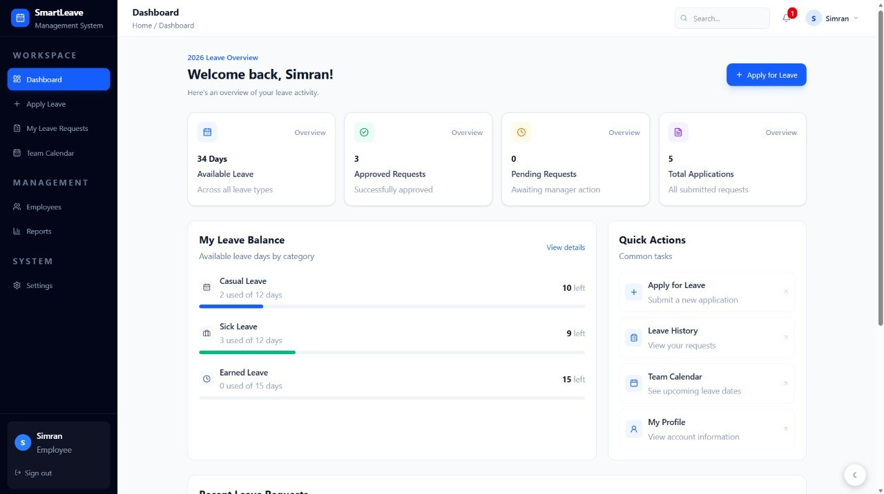
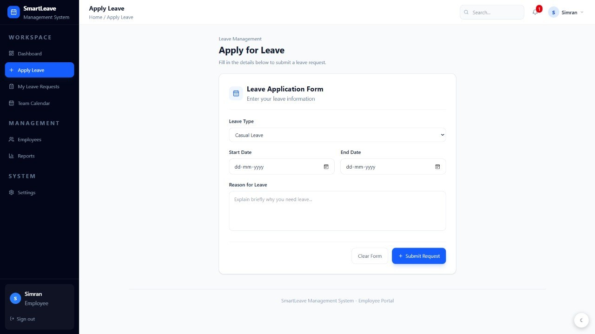
Website Screenshots: Employee Dashboard & Apply
Dashboard
Apply Leave
Shows available leave, approved, pending and total requests
Leave balance by type with Quick Actions
Select leave type, start and end date, and reason
Backend validates dates and balance on submit
Notes:
Describe what each page does and who uses it.

Slide 12
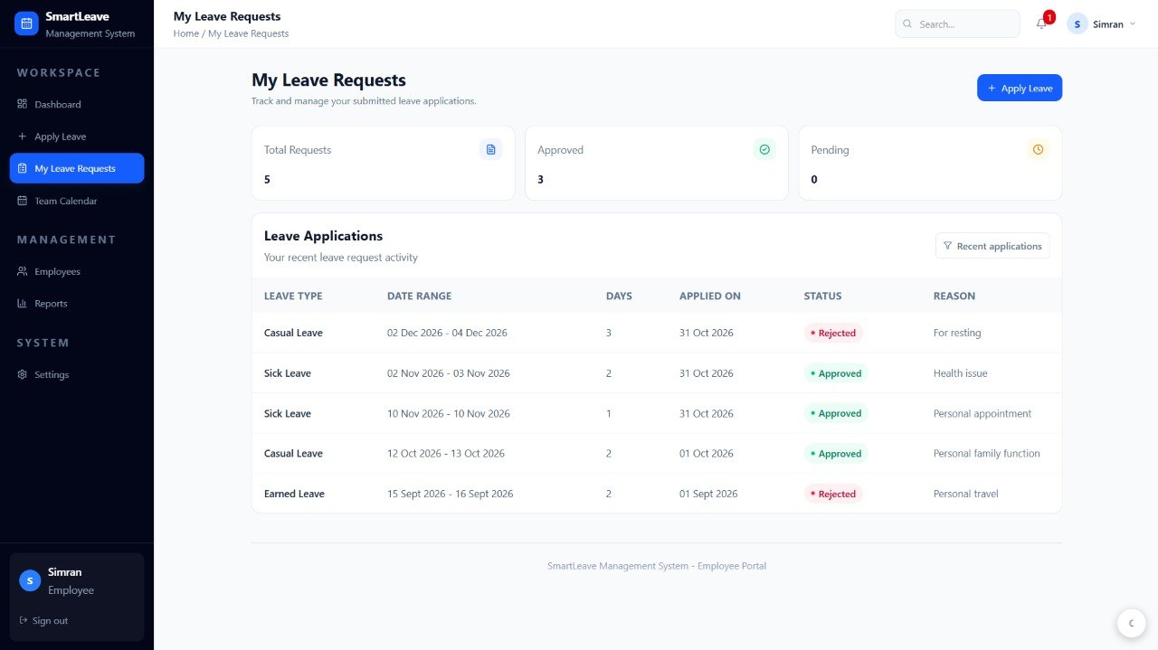
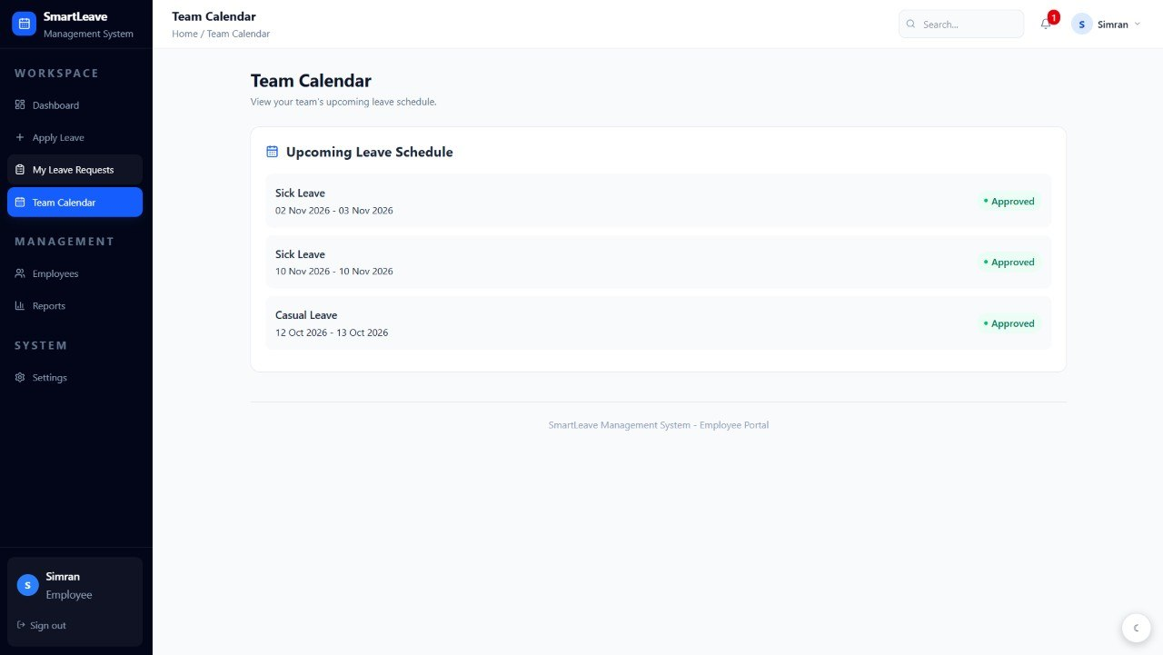
Website Screenshots: Requests & Team Calendar
My Leave Requests
Team Calendar
Lists type, dates, days, applied date, status and reason
Approved and Rejected requests are colour coded
Upcoming leave schedule with dates
Shows approved status for each entry
Notes:
Describe what each page does and who uses it.

Slide 13
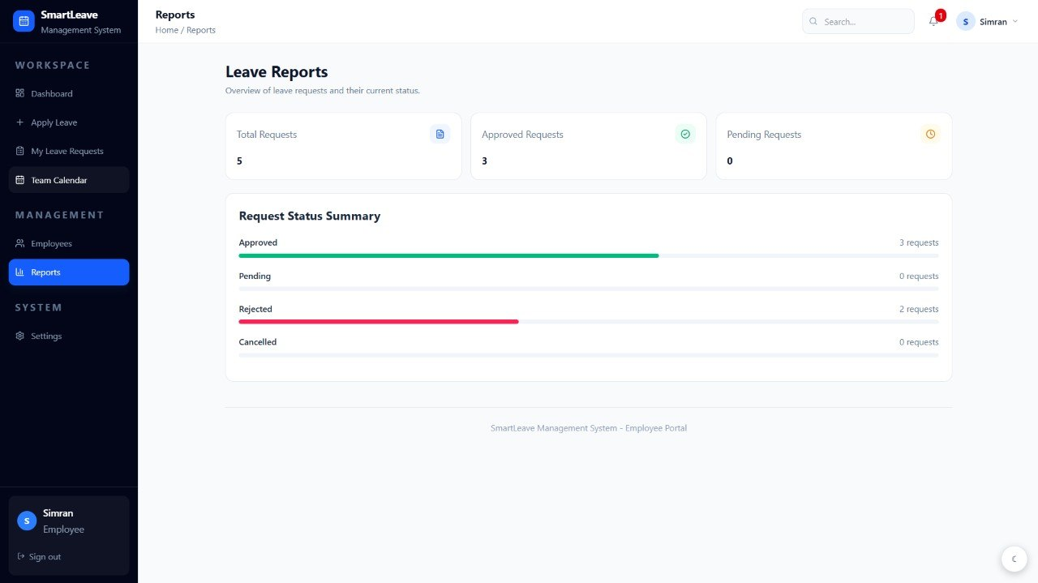
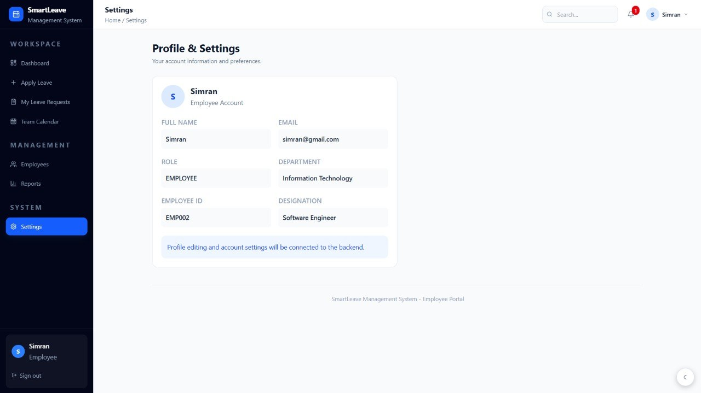
Website Screenshots: Reports & Settings
Leave Reports
Profile & Settings
Total, approved and pending request counts
Status summary bars: approved, pending, rejected, cancelled
Name, email, role, department, employee ID, designation
Profile editing is not yet connected to the backend
Notes:
Describe what each page does and who uses it.

Slide 14
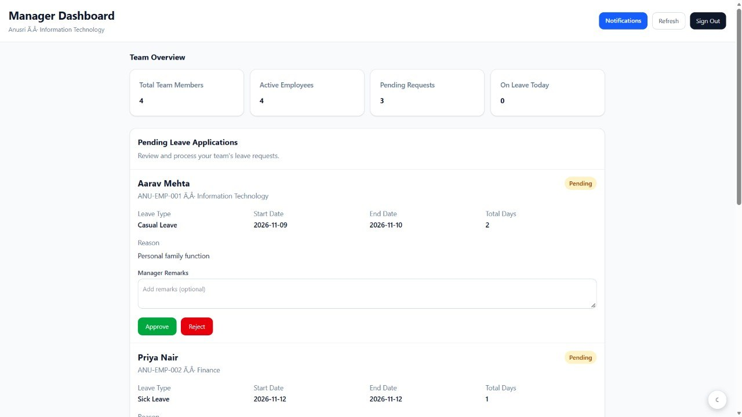
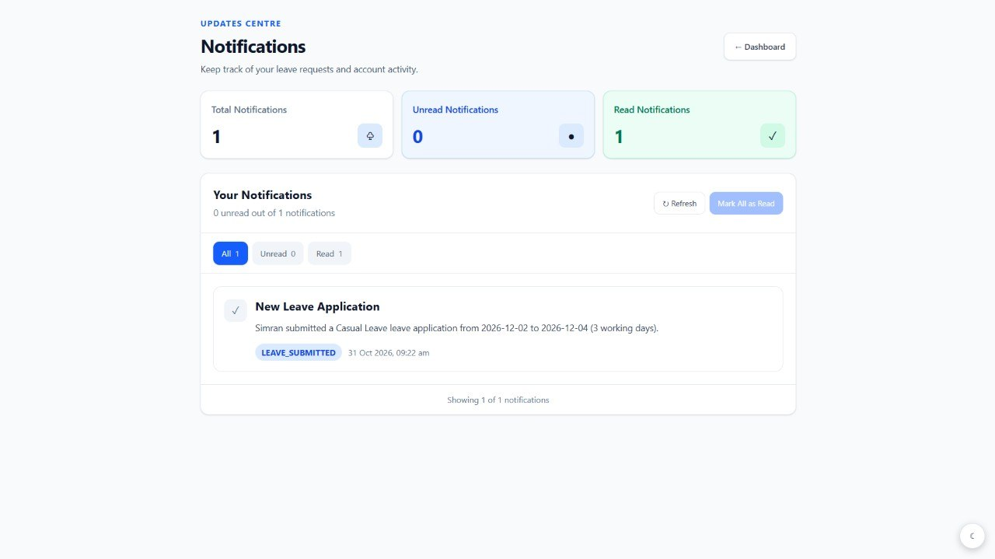
Website Screenshots: Manager & Notifications
Manager Dashboard
Notifications
Team overview: members, active, pending, on leave today
Pending requests with remarks, Approve and Reject buttons
Total, unread and read counts with filters
Leave submissions create a LEAVE_SUBMITTED alert
Notes:
Describe what each page does and who uses it.

Slide 15
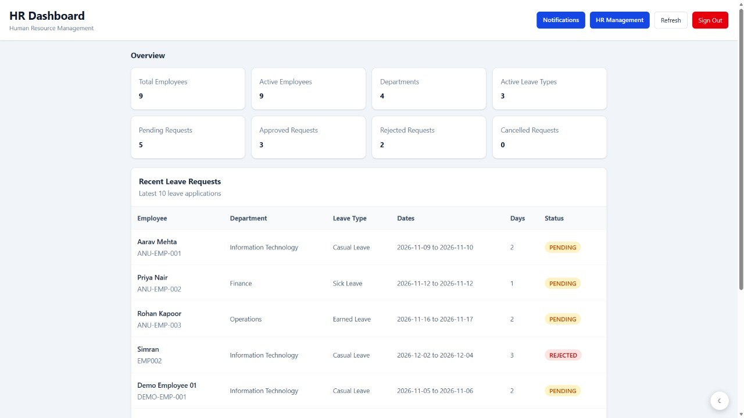
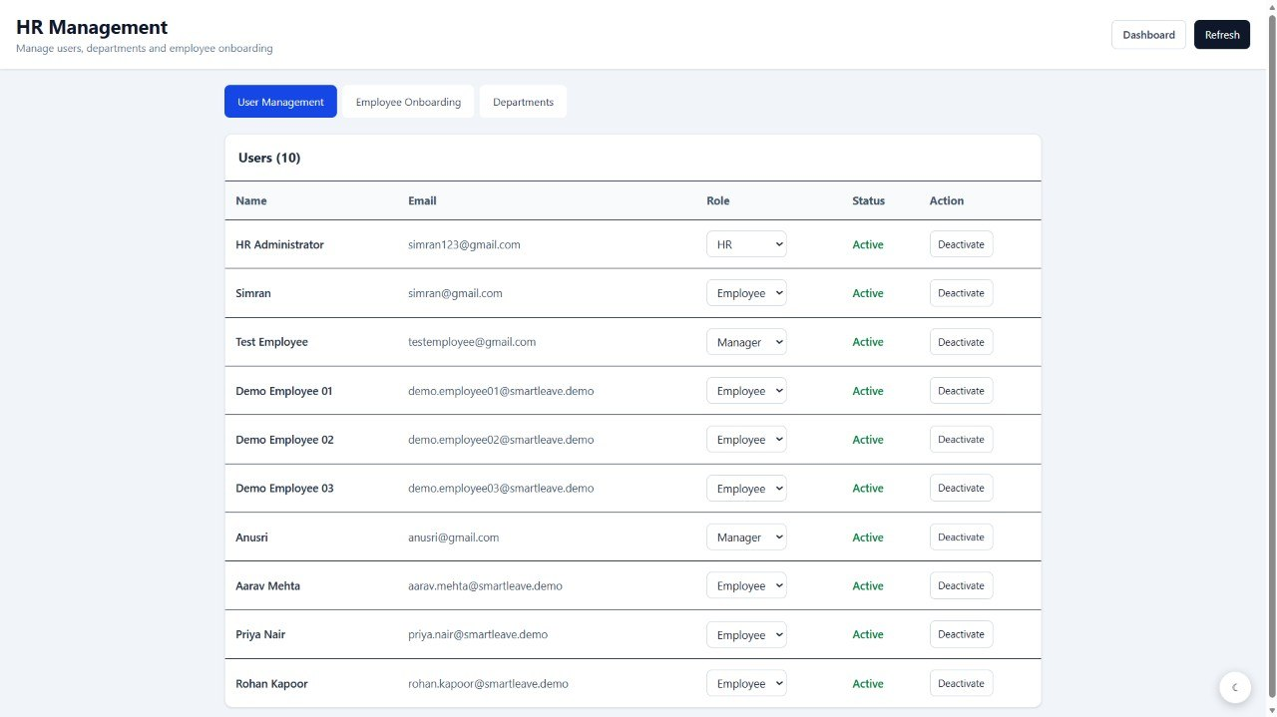
Website Screenshots: HR Dashboard & Users
HR Dashboard
User Management
Employee, department and leave type totals
Request status counts and latest leave applications
Lists all users with email, role and status
HR can change roles and deactivate accounts
Notes:
Describe what each page does and who uses it.

Slide 16
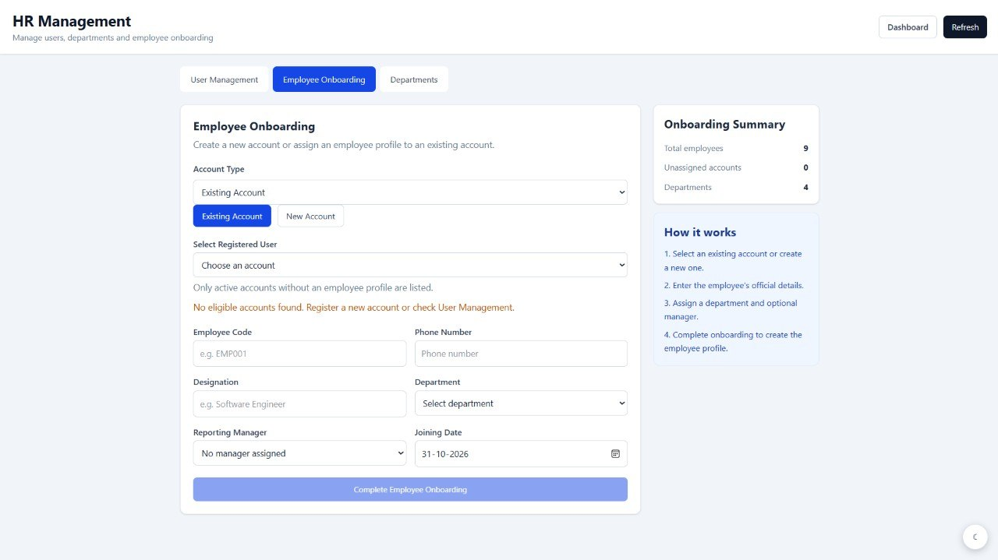
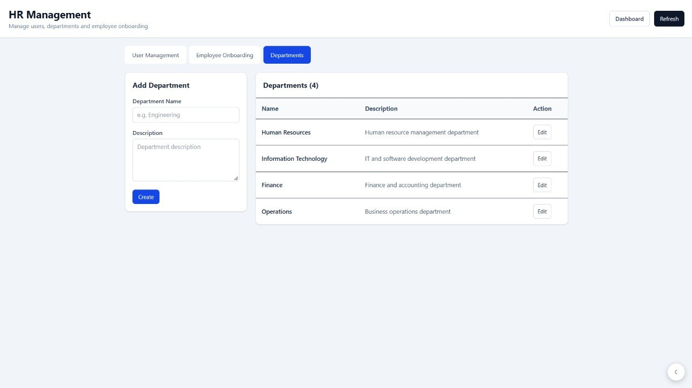
Website Screenshots: HR Onboarding & Departments
Employee Onboarding
Departments
Create an account or use an existing one
Set code, designation, department, manager, joining date
Add a department with name and description
Edit existing departments from the list
Notes:
Describe what each page does and who uses it.

Slide 17
Implementation
Backend structure
Leave balance lifecycle (LeaveBalance: allocated, used, pending)
controller: REST endpoints
service: business rules
repository: Spring Data JPA
entity / dto: data models
security: JwtService, JwtAuthenticationFilter
config: SecurityConfig (CORS, BCrypt)
exception: GlobalExceptionHandler
Action | Effect on balance
Apply for leave | pending days + total days
Manager approves | pending − days; used + days
Manager rejects | pending − days (released)
Cancel pending request | pending − days
Cancel approved request | used − days
Security flow
API groups: /api/auth (public), /api/employee/*, /api/manager/*, /api/hr/*, /api/notifications
Login returns a JWT carrying role, userId and name
Stateless sessions; filter checks the token on each call
/api/hr/** needs HR; /api/manager/** needs Manager or HR
Notes:
Layered Spring Boot design. Balance changes happen inside the service layer.

Slide 18
Results and Output
34
5
9
4
Days available (employee)
Total applications (employee)
Employees (HR view)
Departments
Working outputs
Balances: Casual 10 left, Sick 9 left, Earned 15 left
Employee leave: 3 approved, 2 rejected
Submitted leave created a LEAVE_SUBMITTED notification
Manager sees pending requests with Approve / Reject
HR manages users, onboarding and departments
Notes:
All numbers come from the real screenshots of the running application.

Slide 19


Advantages and Applications
Advantages
Applications
Faster, transparent approvals
Policies enforced the same way for everyone
Accurate, automatically updated balances
Complete leave history for each employee
Secure role-based access
Less manual paperwork for HR
Companies and IT organisations
Educational institutions and offices
Departments with reporting managers
HR teams managing leave policies
Any organisation with approval-based leave
Notes:
Practical benefits for employees, managers, HR and organisations.

Slide 20





Future Enhancements
Python analytics module
Profile editing
Peak-period and short-notice absence patterns, as proposed in the abstract
Settings page currently shows a note that this will connect to the backend
Team availability view
Email in production
Show overlapping team leave to managers before approving
Enable the existing SMTP email service through configuration
Automated testing
Mobile-friendly app
Add unit and integration tests for leave rules
Improve small-screen experience or add a mobile client
Notes:
These are planned improvements, not features of the current build.

Slide 21
Conclusion
Smart Leave Management replaces manual leave handling with one digital workflow
React frontend and Java Spring Boot backend, secured with JWT and roles
Automatic validation and balance updates keep data accurate
Employees, managers and HR each get a focused interface
Built on MySQL with eight related tables
Notes:
Summarise impact and thank the judges.

Slide 22
Conclusion
Smart Leave Management replaces manual leave handling with one digital workflow
React frontend and Java Spring Boot backend, secured with JWT and roles
Automatic validation and balance updates keep data accurate
Employees, managers and HR each get a focused interface
Built on MySQL with eight related tables
Notes:
Summarise impact and thank the judges.

Slide 23
Thank You!
Notes:
Summarise impact and thank the judges.

