Slide 1
INSTRUCTIONS
Use Font size 22 to 28 and Font Style Times New Roman (body)
Do not change the Template: Heading / Title of the slides
Do not change font style or colours
Do not copy paste paragraphs: use only Bullet Points
Maximum slide Limit is 20 only
As per the number of supervisor allotted adopt slide-2 or slide-3
Please display the required meaningful Content or images or tables
Change the footer accordingly using insert tab then click on header & footer tab and edit it
Save the PPT with Register No, Dept and Review no, example: 23xxxxxxxxx_CSE

Slide 2

Title: Student Personal Profile Web Portal
Student Name: K ANUSRI
Student ID: 2520030432
Cluster: 3
Section: 12
Under the Guidance
of
Supervisor Name: Dr. N Chaitanya Kumar
Assistant Professor
Department of CSE

Slide 3
OUTLINE
Abstract
Existing System
Proposed System
System Architecture
Project Modules
Objectives
Co’s Attainments - FWD
Co1
Co2 …….. 5. Co5
Co’s Attainments - DSA
Co1
Co2 …….. 5. Co5
Screen Shots for FWD & DSA
Conclusion
Geo-Tagged Photos

Slide 4
Abstract
The Student Personal Profile Web Portal is a console-based application developed using Java to display and manage student information such as personal, academic, contact, address, qualification & dependent details, timetable, and attendance calculator.
This project demonstrates the implementation of Data Structures concepts such as Searching for a specific information, HashMap for storing student credentials & records, Stack for menu navigation history, & Queue for handling attendance calculation requests. It also uses classes and objects to represent student data in an organized manner.
The project helps in understanding how Java programming and basic data structures can be used to manage and retrieve student information efficiently in a simple system.

Slide 5
Existing System
Student’s Portals such as Power School, openSIS, School Tool does not include a tool to calculate student attendance percentage.
Students need to manually track attendance or refer to separate reports.
It’s also a time taking process to calculate.

Slide 6
Proposed System
The proposed system is a JAVA-based and used Data Structures concepts to built this Student Personal Profile Web Portal that allows students to securely log in using their student ID and password to access their personal and academic information.
The system provides organized sections such as Personal Information, Academic Details, Contact Details, Address Details, Qualification Details, Dependent Details, and Timetable, making student data easy to view.
An Attendance Calculator is included for students to calculate their attendance percentage based on the number of classes conducted and attended.
The system also includes an Admin Login, where the administrator can view student details by entering the student roll number.
This system improves data accessibility, organization, and efficiency, making it easier for students and administrators to manage student information.

Slide 7
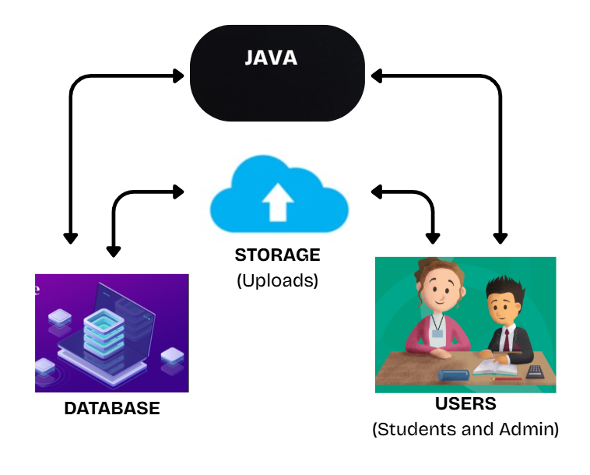
System Architecture

Slide 8
Project Modules
My Web portal contains
A Dashboard with : Student’s Login
Admin’s login
When we login we can access the pages like :
Student’s personal details
Student’s timetable
Student’s contact details
Student’s dependent details
Student’s qualification details
Student’s address details
Student’s attendance calculator

Slide 9
Objectives
To develop a Student Personal Profile Web Portal that allows students to securely log in and view their personal and academic information.
To organize student information into structured sections such as Personal Details, Contact Details, Address Details, Qualification Details, Dependent Details, and Timetable for easy access.
To implement an Integrated Attendance Calculator that automatically calculates the student’s attendance percentage.
To provide a quick and easy input system where students can enter the total number of classes conducted and attended to get immediate attendance results.
To design a simple admin access system that enables administrators to view student details using the student roll number.

Slide 10
Co’s Attainments - FWD
1. CO1: Web Application Development Using HTML, CSS & JavaScript
HTML structure, CSS styling, fonts, responsive design, and JS basics for interactivity
2. Co2: Dynamic Data Display and Dashboard Design
Student & admin dashboards, section panels, profile cards, tables, badges, and timetable display
3. Co3: User Authentication and Access Control
Student & admin login modals, password validation, error handling, and role-based display
4. Co4: Interactive User Interface and UX Enhancements
Animations, hover effects, floating SVG figures, modal popups, responsive sidebar, and intuitive navigation
5. Co5: Data Management and Functional Tools and Functional Tools
Attendance calculator, search student records, structured data storage in objects, and potential for future database integration

Slide 11
Co’s Attainments - DSA
1. Co1: Problem Analysis and Algorithmic Efficiency
Sequential search (login), menu-based logic, attendance calculation
2. Co2: Abstract Data Types (ADTs)
Student class as ADT, dynamic storage using HashMap
3. Co3: Stacks, Queues, and Workflow Modeling
Stack for menu navigation, Queue for attendance requests
4. Co4: Hash-Based Data Structures and Java Collections
HashMap for credentials and student details, fast lookup

Slide 12
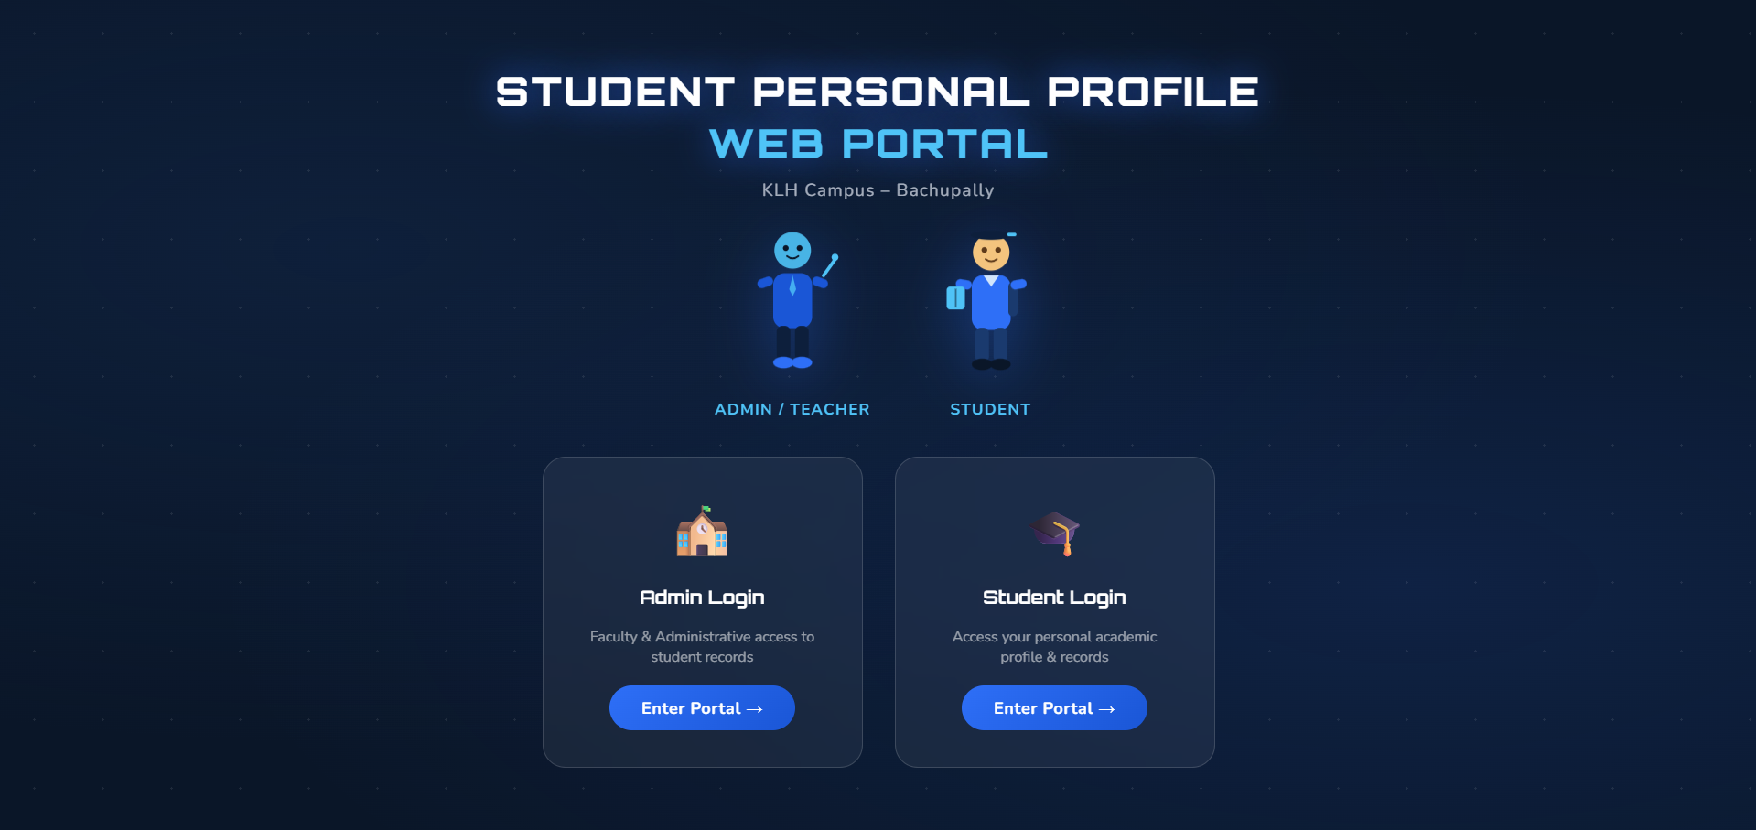
Screenshots for FWD & DSA

Slide 13
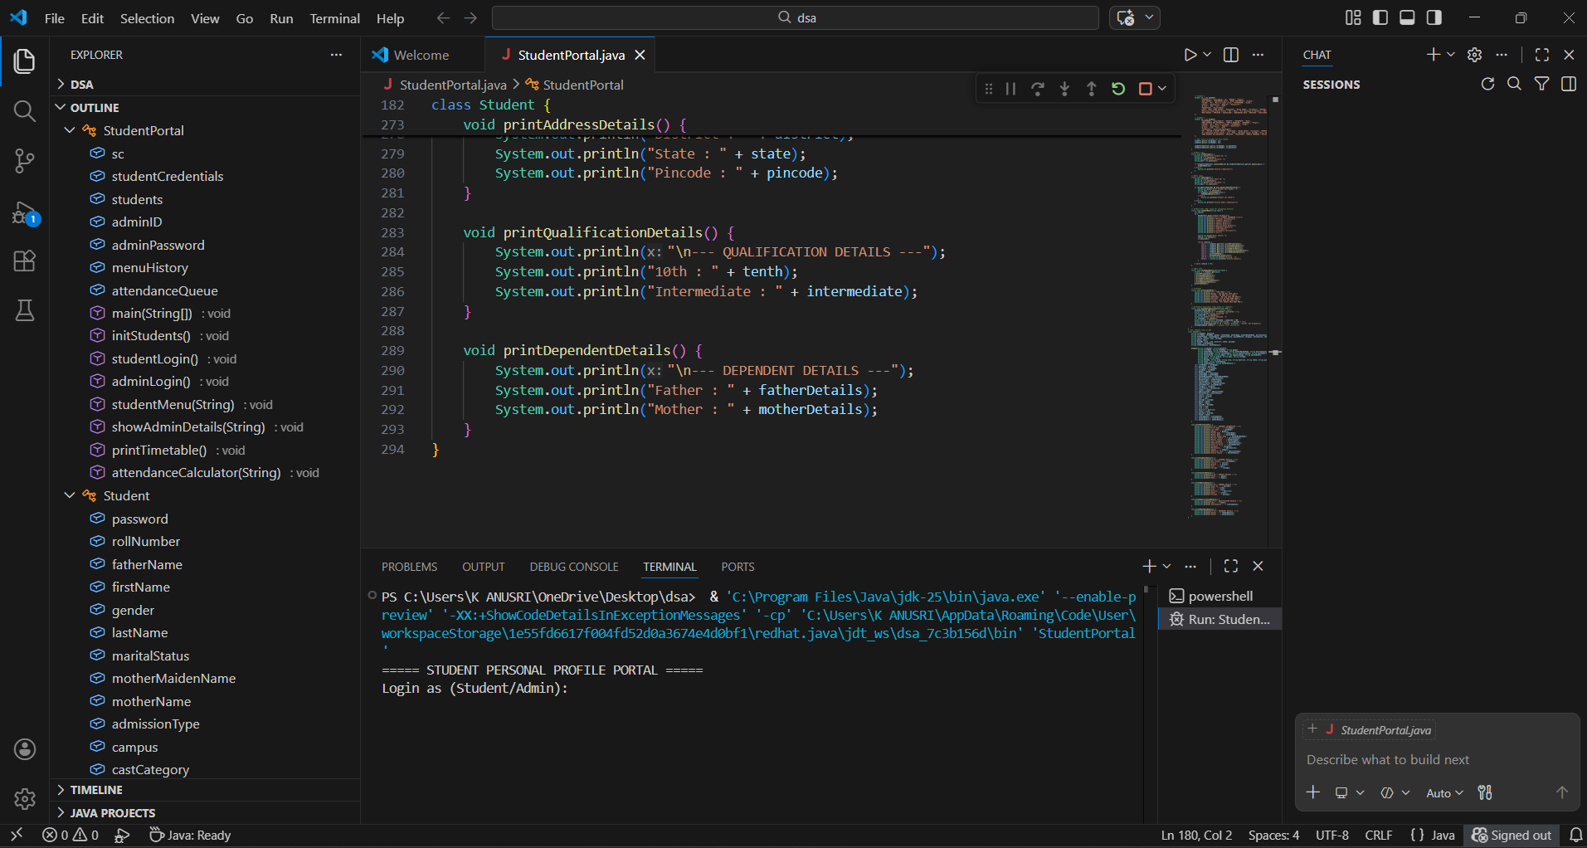

Slide 14
Conclusion
Developed a student personal profile web portal with organized, step-by-step navigation.
Maintains all student details including personal, academic, dependent, and contact information.
Attendance Calculator added for easy calculation of attendance percentage.
User-friendly interface provides a more interactive and accessible experience.
Acts as a complementary tool to existing systems like Student portals like Power School, openSIS, School Tool for students.
Enhances efficiency in tracking and managing student data in a modern way.

Slide 15
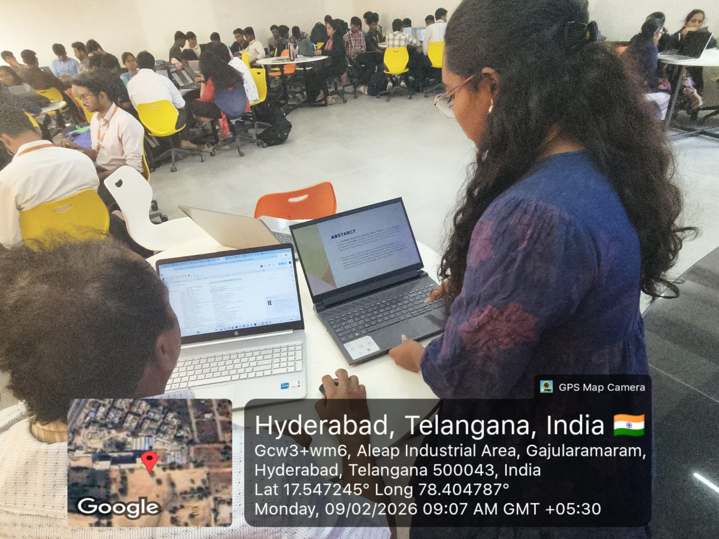
Geo- Tag Photos

Slide 16
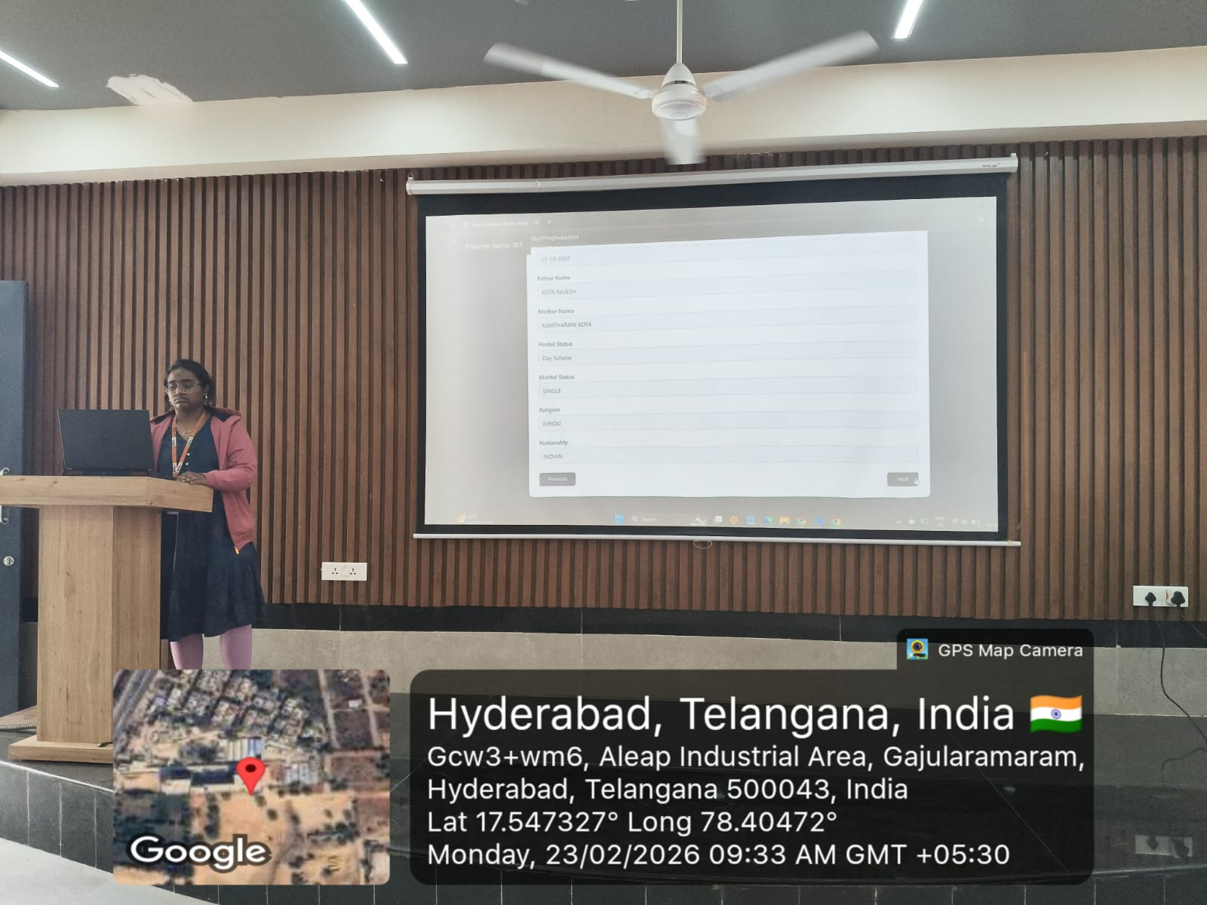

Slide 17
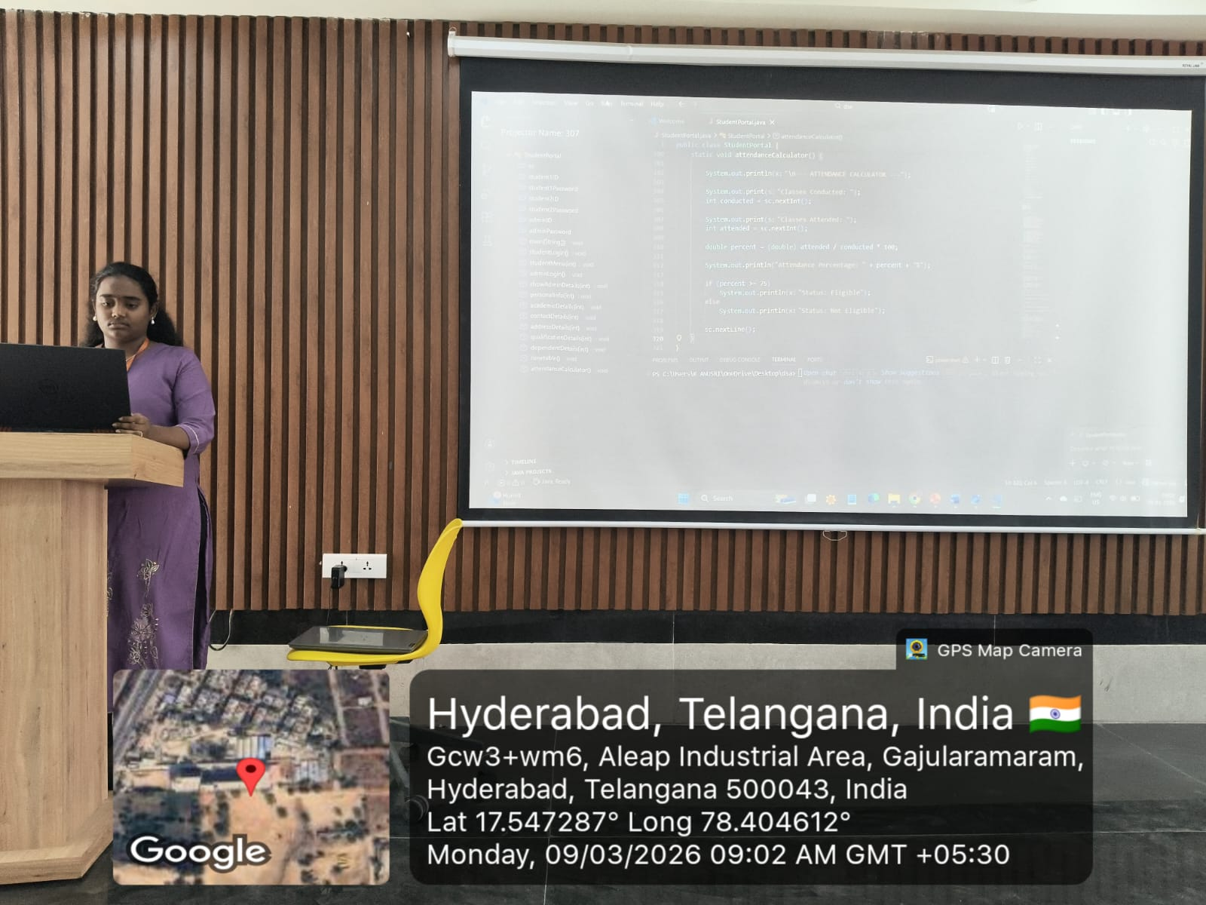

Slide 18
THANK YOU

