Slide 1
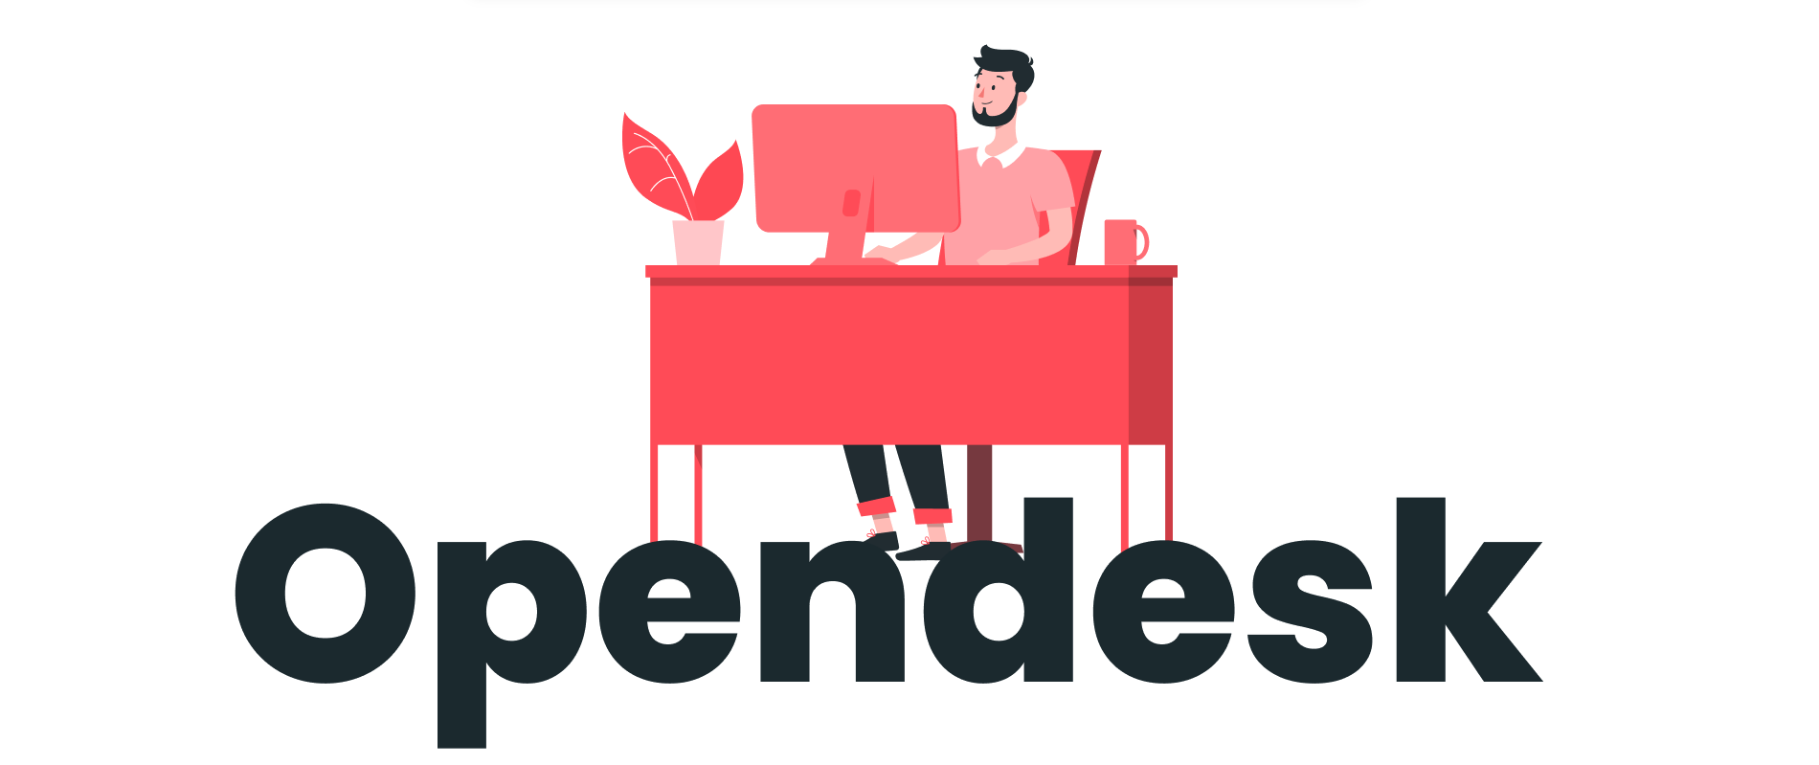
OpenDesk
Docker
Kubernetes
Deploying Open Desk
Q&A
Kanwal Nain Singh

Slide 2
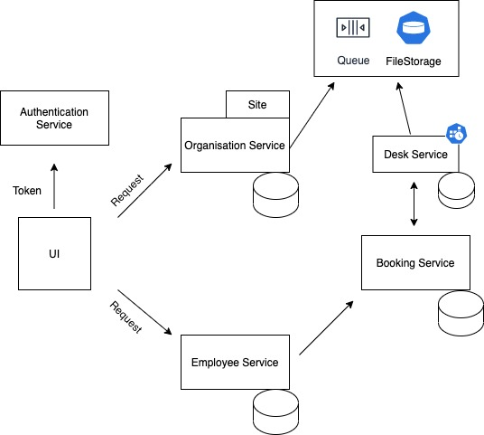
Architecture

Slide 3
Docker
Container is a standard unit of software that packages up code and all its dependencies so the application runs quickly and reliably from one computing environment to another.
Docker container image is a lightweight, standalone, executable package of software that includes everything needed to run an application: code, runtime, system tools, system libraries and settings.

Slide 4
OpenDesk DockerFile
Micro Service
https://github.com/kanwalnainsingh/OpenDesk/tree/main/code_base/micro-services
Web UI
https://github.com/kanwalnainsingh/OpenDesk/tree/main/code_base/web-ui
DockerHub
https://hub.docker.com/

Slide 5
Docker Commands
docker build . -t kanwalnainsingh/opendesk-web-ui:latest
1
docker push kanwalnainsingh/opendesk-web-ui:latest
2

Slide 6
Kubernetes
Kubernetes, also known as K8s, is an open-source system for automating deployment, scaling, and management of containerized applications.
Run K8s Anywhere
Kubernetes is open source giving you the freedom to take advantage of on-premises, hybrid, or public cloud infrastructure, letting you effortlessly move workloads to where it matters to you.

Slide 7
Kubernetes Pipeline
Deployment YAML
Service YAML
Ingress YAML
https://github.com/kanwalnainsingh/OpenDesk/tree/main/pipeline/kubernetes

Slide 8
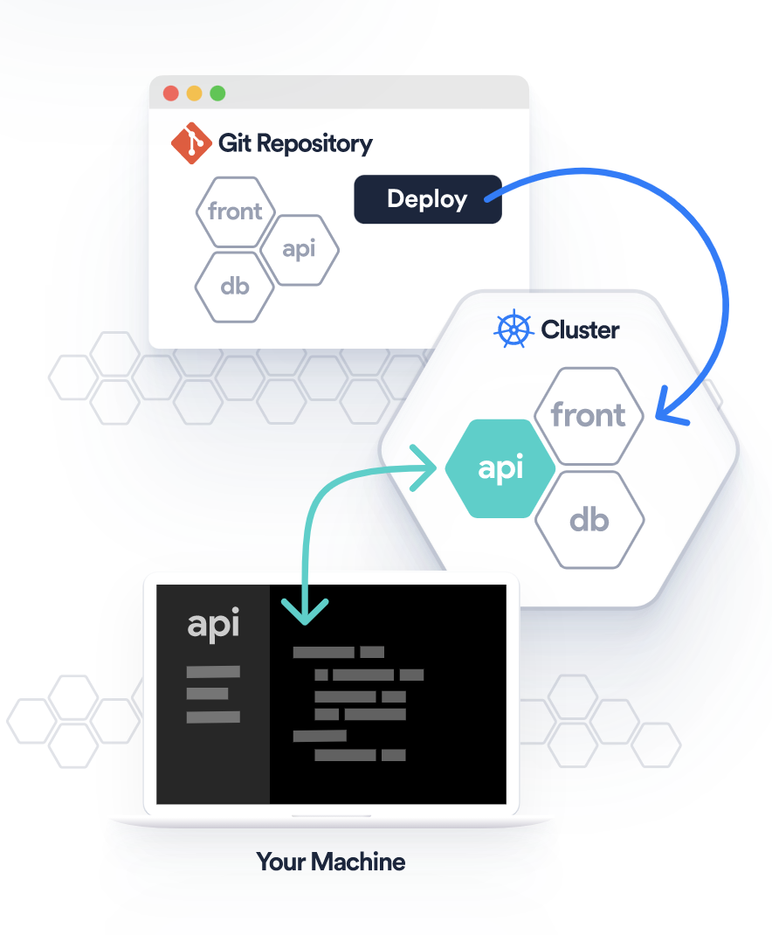
Deployment on Okteto

Slide 9
Deployment on Okteto
https://github.com/kanwalnainsingh/OpenDesk/blob/main/okteto-pipeline.yml
https://github.com/kanwalnainsingh/OpenDesk/blob/main/code_base/web-ui/okteto.yml

Slide 10

Q&A

