Slide 1

Deadlock Avoidance Algorithms: A Java Implementation
Deadlocks, a common challenge in operating systems, can lead to system crashes and inefficiencies. This presentation dives into two deadlock-avoidance algorithms, the Banker’s Algorithm and the Resource-Request Algorithm, implemented in Java. We will examine their roles in managing resources effectively, preventing deadlocks, and maintaining system safety.

Slide 2
The Problem: Deadlock
Process A
Process B
Process C
Process A requests resource R1 but is blocked because it is held by Process B.
Process B requests resource R2 but is blocked because it is held by Process C.
Process C requests resource R3 but is blocked because it is held by Process A. This circular dependency leads to a deadlock.

Slide 3

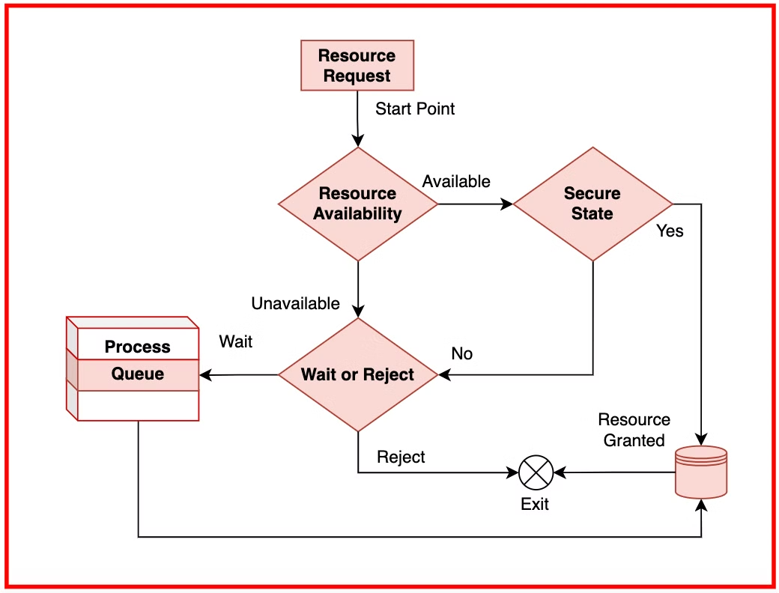
Banker’s Algorithm: A Safe State
Available Vector
Max Matrix
Tracks the number of resources currently available.
Defines the maximum number of resources each process might need.
Allocation Matrix
Need Matrix
Tracks the resources currently allocated to each process.
Represents the remaining resource needs for each process, calculated as Max - Allocation.

Slide 4
Resource-Request Algorithm: Dynamic Checks
1
Request Arrives
A process requests resources.
2
Check Limits
Verify that the requested resources are within the process’s declared need.
3
Check Availability
Ensure that the requested resources are currently available.
4
Trial Allocation
Temporarily allocate resources to the process.
5
Safety Check
Recalculate system safety.
6
Grant or Reject
If the system remains safe, grant the request; otherwise, reject it.

Slide 5




Implementation in Java
Java
IntelliJ IDEA
Data Structures
Object-oriented programming and data handling capabilities were used to implement the algorithms efficiently.
Used as the Integrated Development Environment (IDE) for code development and debugging.
Key data structures such as the Available Vector, Max Matrix, Allocation Matrix, and Need Matrix were implemented to represent resource information.

Slide 6

Conclusion: Achieving Deadlock-Free Systems
Implementing the Banker’s and Resource-Request Algorithms in Java provides a practical understanding of how operating systems manage resources to avoid deadlocks. This project showcases their effectiveness in maintaining system stability, preventing circular resource dependencies, and ensuring efficient system operation. These algorithms play a vital role in the development of robust and reliable operating systems.

