Slide 1
Database Management System
Presented by:
Kanya Kumari Bikram

Slide 2
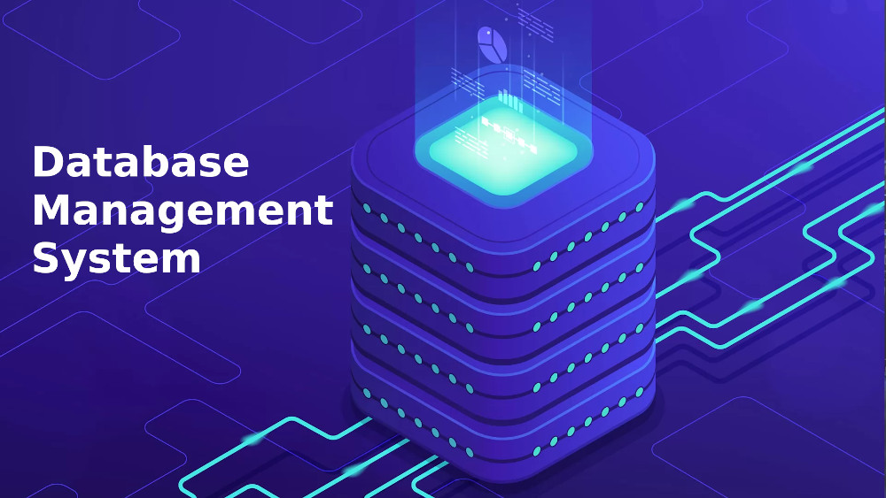
Database Management System
A Database Management System (DBMS) is software that allows users to create, manage, and access databases, ensuring data integrity, security, and efficient organization.

Slide 3
Problem Statements
Challenges in managing data without a DBMS.
Issues such as data redundancy, inconsistency, and security concerns.

Slide 4
Proposed Solution
Introduction of DBMS as a solution
How DBMS addresses data-related issues
Advantages over traditional file systems

Slide 5
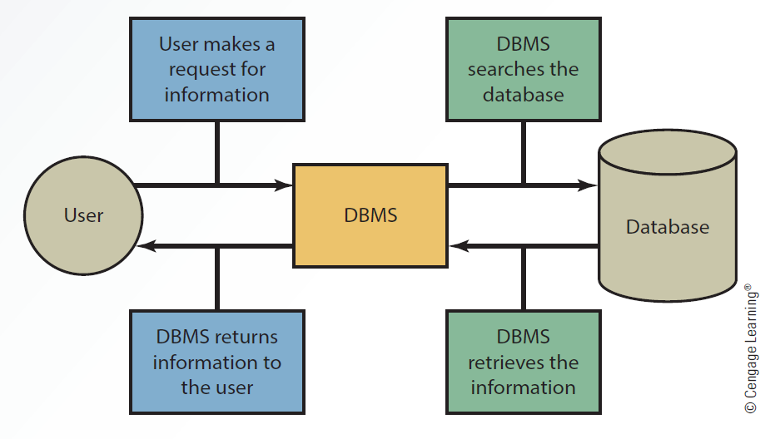
Solution Design - UML

Slide 6
Technology Stack and Requirements
Software requirements (DBMS software, programming language, tools)
Hardware requirements (Storage, Memory, Processing Power)
Example technology stack for an AI-driven DBMS

Slide 7
Result

Slide 8
Limitations
Potential drawbacks of DBMS (Cost, Complexity, Maintenance)
How to mitigate these limitations

Slide 9
Demo

Slide 10
Future Scope
Trends in DBMS (Cloud databases, AI integration, NoSQL growth)
How DBMS will evolve in the coming years

Slide 11
Thank You

