Slide 1
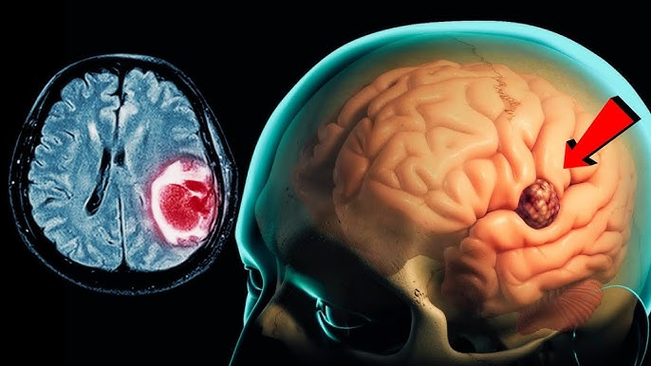
Brain Tumor Detection and Classification
Presented by:
Kanya Kumari Bikram

Slide 2
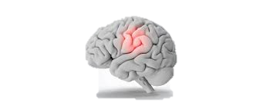
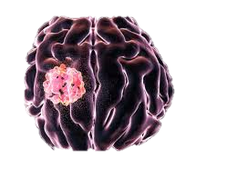
Agenda
Introduction
Problem Statement
Problem Solution
Classification of Brain Tumor
CNN Model
Reason for using CNN Model
Dataset used
Project outcomes
Component Required
Block Diagram & Flow Chart
Accuracy and loss during epochs
Confusion Metrix
Model Accuracy and Loss
Future Scope
Conclusion

Slide 3
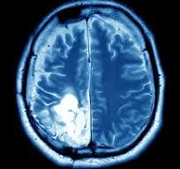
Introduction
A brain tumor is a collection, or mass, of abnormal cells in your brain. Your skull, which encloses your brain, is very rigid. Any growth inside such a restricted space can cause problems.
Brain tumors can be cancerous (malignant) or noncancerous (benign). When benign or malignant tumors grow, they can cause the pressure inside your skull to increase. This can cause brain damage, and it can be life-threatening.

Slide 4
Problem Statement
Brain tumors are abnormal growths of cells within the brain that can be life-threatening if not diagnosed and treated early. Manual diagnosis using MRI scans is time-consuming, prone to human error, and requires expert radiologists, which may not be available in all regions.
Neurological Consequences
Treatment Challenges
Diagnostic Difficulties
Variability in Tumor Characteristics
Need for Improved Diagnosis and Classification
Impact on Quality of Life

Slide 5
Problem Solution
Develop a convolutional neural network (CNN) model that can accurately predict the presence of brain tumors in medical images and classify the tumors into different types.
Train the CNN model on a dataset of medical images of brains with and without tumors. and learn to identify patterns in the images that correspond to the presence of tumors.
Optimize the CNN architecture and hyperparameters to improve the accuracy and efficiency of the model.
Test and validate the CNN model on new, unseen medical images to ensure that it can accurately predict the presence of brain tumors and classify them into different types.

Slide 6
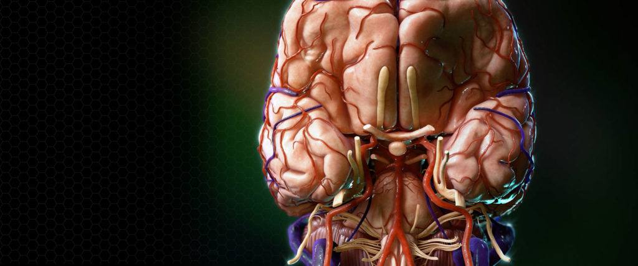
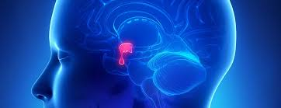
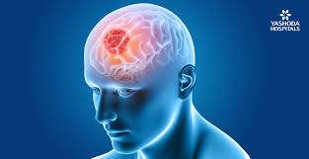
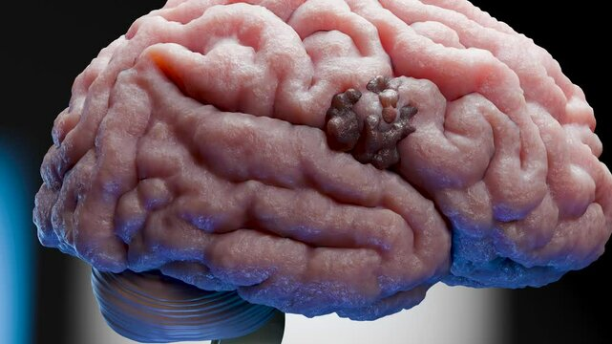
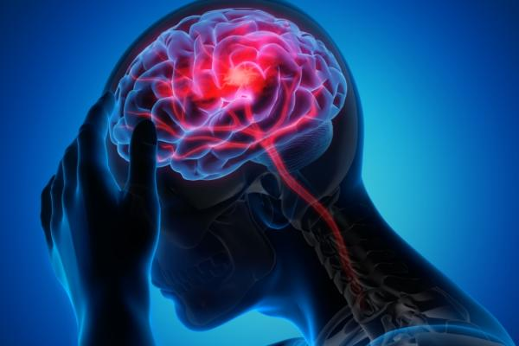
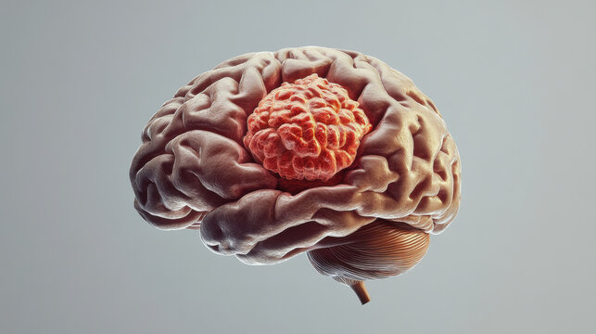
Classification of Brain Tumor
Pituitary tumor:- This type of tumor occurs in the anterior body of the pituitary gland. This is a pea-sized gland that is located behind the bridge of your nose.
Meningioma tumor:-A meningioma develops on the brain's meninges and is a tumor of leptomeningeal origin. The meninges are the three layers of membrane that cover the brain and spinal cord.
Glioma tumor:- Glioma is a growth of cells that starts in the brain or spinal cord. The cells in a glioma look similar to healthy brain cells called glial cells. Glial cells surround nerve cells and help them function. As a glioma grows it forms a mass of cells called a tumor.

Slide 7
CNN Model :-
One kind of deep learning model made especially for processing and analysing visual input, such photos and videos, is the convolutional neural network (CNN). It has demonstrated remarkable effectiveness in a range of computer vision applications, such as object identification, segmentation, and picture classification, owing to their inspiration from the human visual system. It is a class of deep learning models specifically designed for processing structured grid data, such as images. CNNs are capable of automatically learning and extracting relevant features from images. It is composed of multiple layers such as -
1. Convolutional layers - These layers generate a feature map by sliding a filter over the input image and recognizing patterns in images.
2. Pooling Layer - Its purpose is to reduce the size and dimentions of feature maps, which in turn makes computation faster because the number of training parameters is reduced.
3. Fully Connected Layer - Its main purpose is to connect neurons between two different layers.

Slide 8
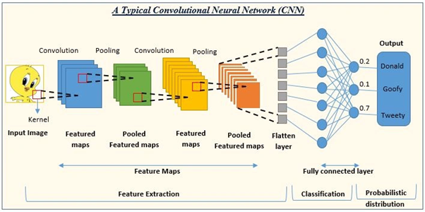
Input Layer: The input layer receives the input image, which is typically represented as a three-dimensional tensor with dimensions (width, height, channels).
Convolutional Layer: The convolutional layer applies a series of filters to the input image. Each filter is a small window that extracts features from the image. The output of the convolutional layer is a feature map, which contains the activations of the filters at each location in the image.

Slide 9
Pooling Layer: The pooling layer reduces the size of the feature map by applying a pooli operation to each region of the map. Common pooling operations include max pooling and average pooling.
Fully Connected Layer: The fully connected layer takes the flattened output of the poolin layer and transforms it into a probability distribution over the possible classes.
Output Layer: The output layer outputs the probability distribution over the possible classes. The class with the highest probability is the detected class for the input image

Slide 10
Reason for using CNN Model
CNNs are relatively robust to variations in image data, such as changes in lighting, pose, and scale.
CNNs excel at extracting high-level features from images, which are essential for accurate image classification.
CNNs can be trained efficiently using specialized techniques such as stochastic gradient descent with momentum.
CNNs are well-suited for parallel processing, which allows them to be trained on large datasets in a reasonable amount of time.
CNNs can also be used for other tasks, such as image segmentation, object detection, and image generation

Slide 11
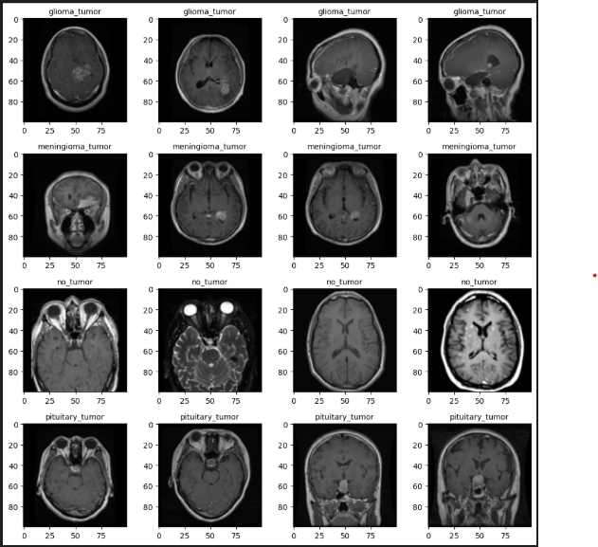
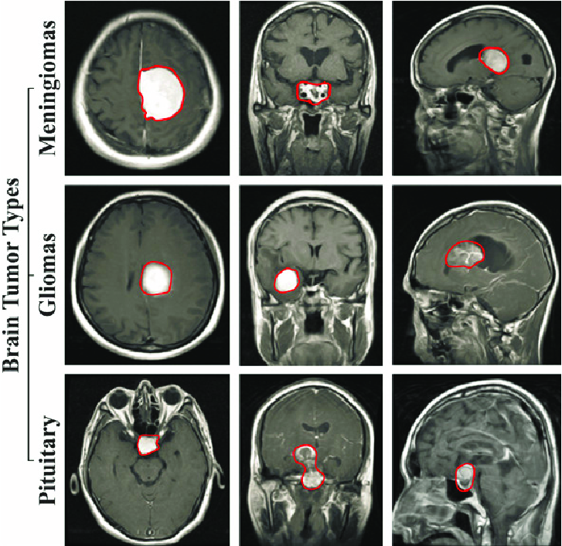
Dataset used

Slide 12
Project outcome
The expected outcomes from a project on brain tumor detection using deep learning may vary depend on the specific goals and objectives of the project. However, some potential outcomes include:
Improved accuracy and efficiency of brain tumor detection: By using deep learning algorithms, the accuracy and efficiency of brain tumor detection can be improved. This could lead to earlier detection of tumors, better treatment planning, and improved patient outcomes.
Development of new algorithms and methods: A project in this field may involve the development of new deep learning algorithms and methods that can be used to improve brain tumor detection. These algorithms could have broader applications in medical imaging and other fields.

Slide 13
Component Required
NumPy
NumPy module works with the numerical da NumPy is a Python library used for working with arrays.
Pandas
for data analysis and associated manipulation of tabular data in DataFrames.
Matplotlib and Seaborn
Is used to Create a graph or we can say used for 2d visualization.
Tensorflow
Used to do deep learning and also develop CNN Model.
OS
Provides the facility to establish the interaction between the user and the operating system.

Slide 14
Block Diagram & Flow Chart
Dataset
Pre-processing
Split the data
Build CNN Model to train deep neural netwSplit the dataork for epochs
Classification

Slide 15
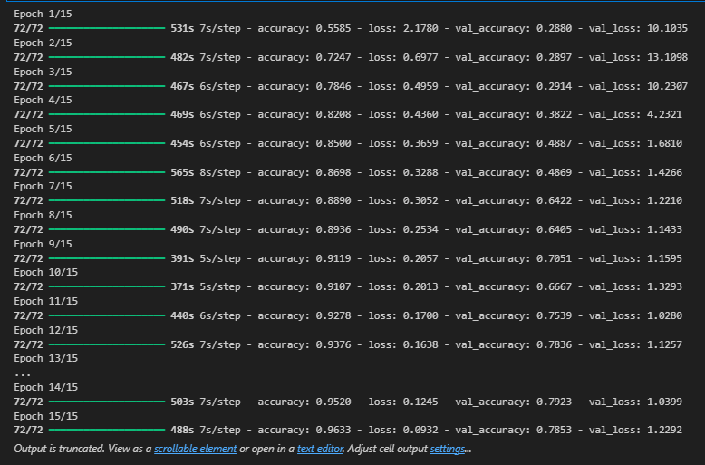
Accuracy and loss during epochs

Slide 16
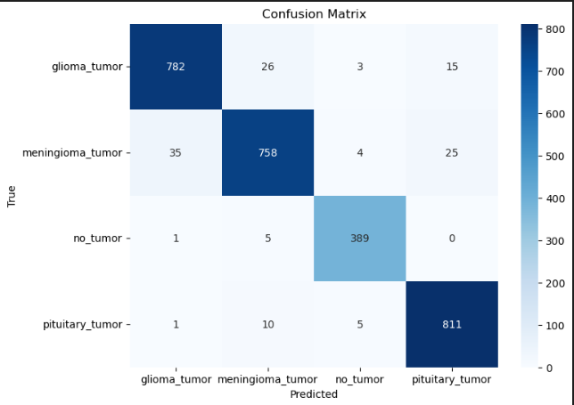
Confusion Metrix

Slide 17
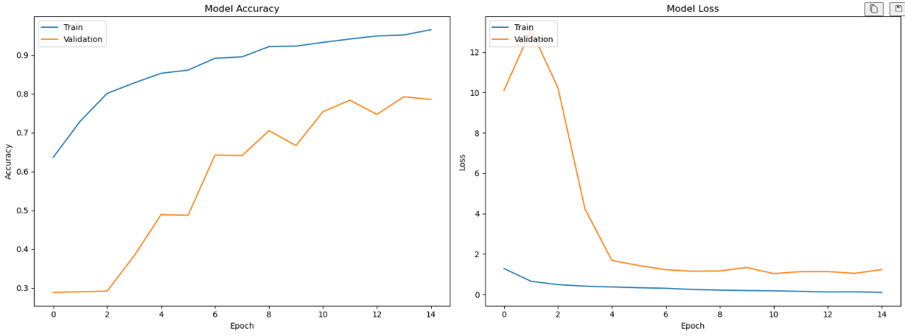
Model Accuracy and Loss

Slide 18
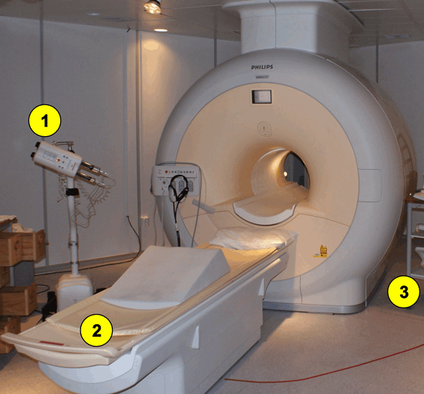
Future Scope
Improved Accuracy with Advanced CNN Architectures
Multi-Modal Data Fusion
Integration into Clinical Workflow
Explainability and Interpretability
Personalized Medicine and Tumor Subtyping
Cloud-based and Federated Learning
Continual Learning and Model Updating
Synthetic Data and Augmentation
Synthetic Data and Augmentation
Open Datasets and Collaboration

Slide 19
Conclusion
Brain tumor detection using deep learning has become a promising area of research in medical image analysis. Recent studies have demonstrated the effectiveness of deep learning-based approaches in accurately detecting and segmenting brain tumors, as well as predicting patient survival. Various CNN architectures have been utilized along with transfer learning techniques to improve model performance. However, there are still challenges and limitations that need to be addressed, such as the lack of annotated data and interpretability of deep learning models. Therefore, further research is needed to develop more robust and accurate models that can be used in clinical practice.

Slide 20
Thank You

