Slide 1
Rule Engine – Customer Interaction
Multi-Brand, Multi-Tenant, Cloud Based Mobility-Finance Platform
Service Ops View
Feb 2020

Slide 2
Vision
Build a business friendly configurable rule engine that can be used in Digital Customer Interaction domain.
The business rules should be available as re-usable API.
Changing business rule configuration should be simple and regression proof
The rule engine should be scalable and highly available
All rule execution details should be auditable

Slide 3
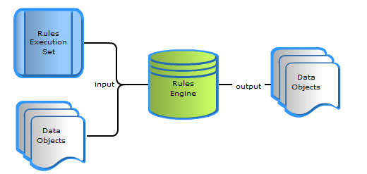
Rule Service Conceptual Model
Core Domains
(Service Operation)
Core Domains
(Digital Interaction)
Micro Services
Micro Services
Supporting Domain
(Rules)
Rule Service
Rule Service
Rule Service
Rule Service
Core Domains
(Dealers)
Rule Service
Rule Service
Rule Service
EA’s direction is to have decentralized Rule Micro Services based on Domain’s requirement
There can be Supporting Domains of rules that can be accessed by multiple domains
Rule Services are stateless.
Rule Services will execute the pre-configured rules on request data and respond with the decision.
Micro Services
Anatomy of a Rule Service

Slide 4






Rule Services Eco System
Access and API Services
Illustrative
Driver / Consumer
Dealer / Businesses
Team Member (Customer Facing)
Native mobile app / Web
case
New Salesforce instances (Agent, Insurance, DSC and DFT, Dealer)
Micro service
Micro service
Rule service
Rule Service
Data Service
Rule Aggregates
Micro service
Micro service
1
2
3
Shaw
LeMans
ITS
Collection Host
Insurance Host
CIMS
defi
(MFS,TFS,LFS)
Stone Eagle
(MFS,TFS,LFS)
Data lake
# | Key Components | Description
1 | Rule Service | Rule Services are Micro Services built to support business rules Rule Services are domain specific and use domain specific data to evaluate rules Each Rule Service should have a configurable rules
2 | Data Service | Data Services are Micro Services built to support the data requirements for the Rule Services Data Services will collect the rule evaluation data from various sources and populate the rule facts. Data Services can be standard re-usable enterprise data services.
3 | Rule Aggregate Service | Rule Aggregate Services are Micro Services built to orchestrate Data Service and Rule Service and returns the final decision
4

Slide 5
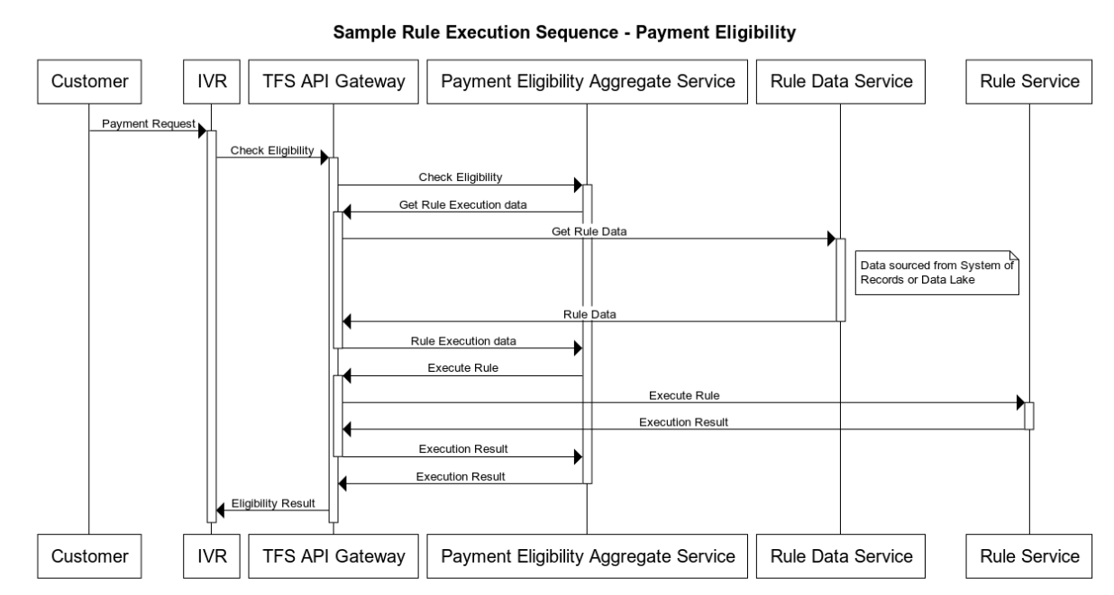
Sample Integration - Architecture
Customer request for payment in IVR
IVR will call a Payment Eligibility Aggregate service on TFS API Gateway and pass minimum information like account id and or customer id. IVR expects a eligibility decision to be returned by this service.
Payment Eligibility Aggregate Service will first collect the data required for the Rule Service by Invoking an API on TFS API Gateway.
TFS API Gateway will use Rule Data Service ( could be already available Data Service) to return the Rule data.
Payment Eligibility Aggregate Service will then populate the Rule service contract and invoke the rule service.
Rule service will execute the pre-configured rule using the rule contract data and returns a decision back
The Aggregate service returns the rule execution decision back to TFS API Gateway
TFS API Gateway in turn returns the rules execution decision back to IVR

Slide 6
Steps To build a rule service – TDD way
Business develops the rule book and ensure all rule facts are clearly defined and mapped to EDC Data Concept Names
Foundation
Build Rule Engine Microservice with empty rule and valid contract.
Setup DevOps pipelines
Deploy to AWS as microservice.
Build automated test harness - TDD
Build automated test harness of all rules and ensure all tests fails as there no rules defined.
Codify Payment Eligibility rule
Code all the rules (either in Drools decision table or pure java beans) one at a time and ensure that automated tests are passing for each rule

Slide 7
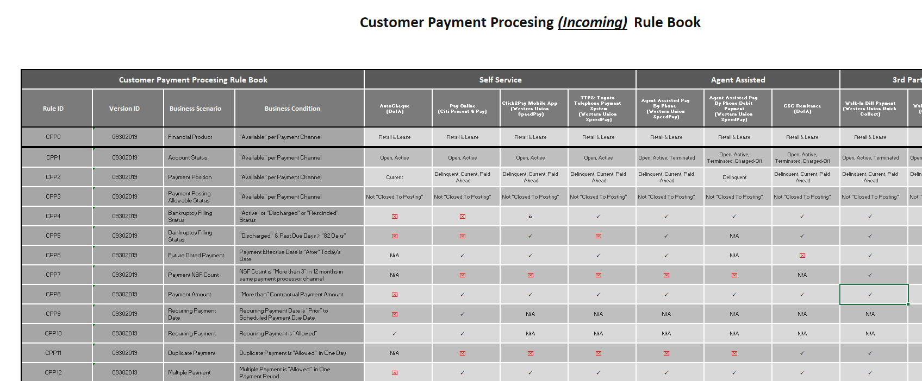
Appendix - Payment Rule Book Requirement Sample

