Slide 1


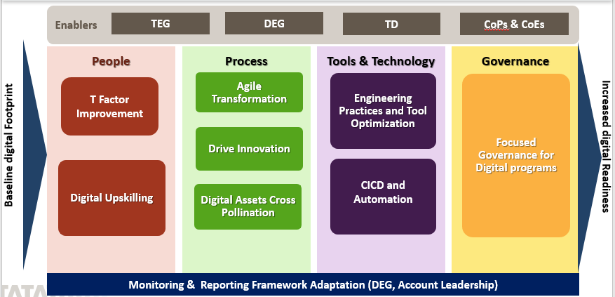
Digital Transformation Framework
The Digital Transformation Framework consists of environment agnostic key transformational components driving increased digital readiness and adoption at scale
Fosters growth and transformation of enterprises embracing Business 4.0
TCS Confidential

Slide 2
Digital Transformation Framework-Key Elements
Enablers
TEG
DEG
TD
CoPs & CoEs
People
Process
Tools & Technology
Governance
T Factor Improvement
Agile Transformation
Engineering Practices and Tool Optimization
Focused Governance for Digital programs
Drive Innovation
Baseline digital Footprint
T Factor improvement
Increased digital Readiness
Digital Upskilling
CICD and Automation
Digital Assets Cross Pollination
Monitoring & Reporting Framework Adaptation (DEG, Account Leadership)
TCS Confidential
TCS Confidential

Slide 3
Key Elements of Digital Transformation Framework
People
T factor improvement - Drive initiatives to improve associates Digital competency.
Process
Innovation – Innovation events to be conducted to create new ideas in the digital space and transform the ideas to implementations
Tools & Technology
Governance
Digital Upskilling - Enable upskilling of the associates who are currently working in the traditional technology landscape by conducting boot camps, workshops and improve digitally trained associates deployment in digital projects.
Digital Assets Cross Pollination - Enable creation of reusable assets from Digital programs and socialize and cross pollinate
Engineering Practices and Tool Optimization – Understand, Automate and Optimize existing engineering processes to minimize the engineering overhead.
Governance for Digital programs - Set up additional Cadence and Governance for Digital technology programs and leverage CoEs and other wider TCS capabilities to help in mitigating the risks involved during technology transformation.
CICD and Automation - Enabling integration of Jira, Jenkins and other allied tools for seamless orchestration of CI/CD tools and frameworks. Automation of regression test cases for key applications that undergo frequent changes and frequent testing
Agile Transformation- Transform the ways of working and adopt agile. Create awareness regarding about Agile ways of working ,sharing best practices across portfolios, coach the team by taking the session on scum orientation
TCS Confidential

