Slide 1

Soteria
An ML based cyber-bully notification system

Slide 2
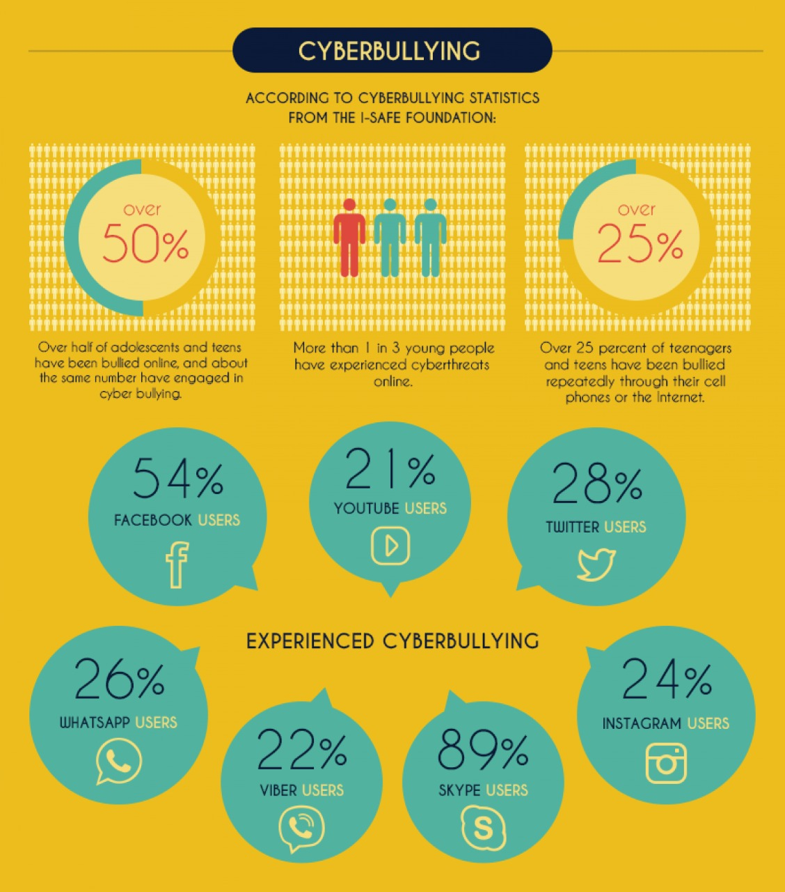
Motivation
According to a study conducted in 2020, it was found that about 73 percent of the students have faced bullying in their lives, thereby making suicide the second-leading cause of death among US residents aged 10-24.
In this fast-paced world of technology, it gets rather hard to track the social lives of your loved-ones. Having to browse through their content and analyze it takes a toll, both mentally and physically.
.

Slide 3
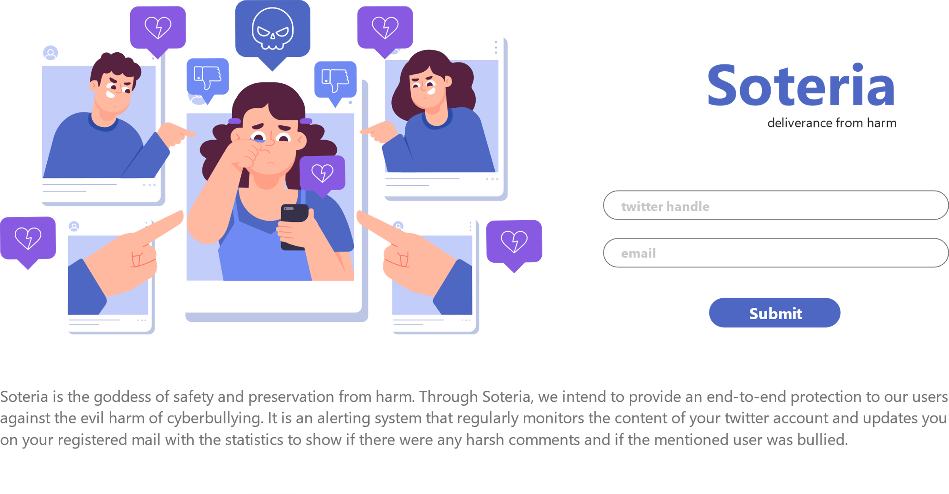

Slide 4
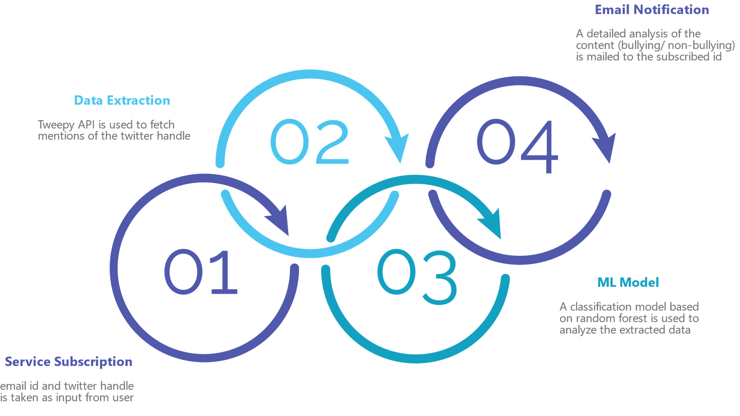
But you might be wondering how does it work, here's how...
* The data extraction script, ML model have been developed, the integration is yet to be done.

Slide 5

To take this project further, we aim to increase the accuracy of the prediction using deep learning and incorporate auto-reporting of abusive content on the social media platforms. With this, cyber-bullying could be curbed to an extent.
Future
Scope

Slide 6
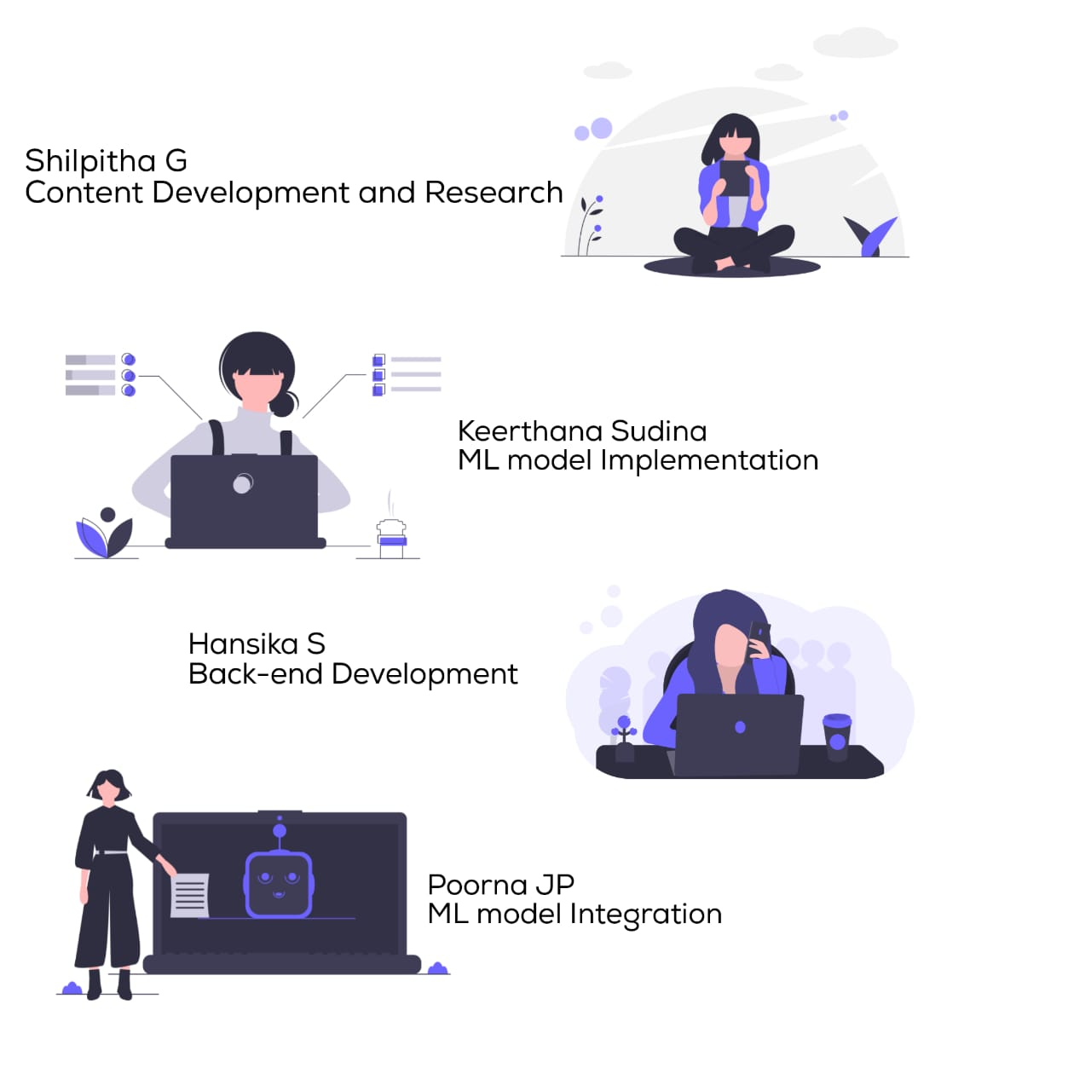
Our Team

Slide 7
Thank You

