Slide 1
House Price Prediction: Insights & Modeling
Key factors influencing residential property values
Gabriel Kanyi – 2025

Slide 2
Objective
Predict house prices based on property features.
Identify key factors that drive residential property values.
Provide actionable insights for real estate stakeholders.

Slide 3
Data Overview
Dataset: Ames Housing Dataset (Kaggle).
~1460 houses, 80+ features.
Features include LotArea, Neighborhood, OverallQual, YearBuilt, GarageCars, etc.

Slide 4
Exploratory Data Analysis (EDA)
SalePrice distribution: right-skewed, log-transform applied.
Strong correlations: OverallQual, GrLivArea, GarageCars, TotalBath.
Neighborhood and house quality show clear price differences.

Slide 5
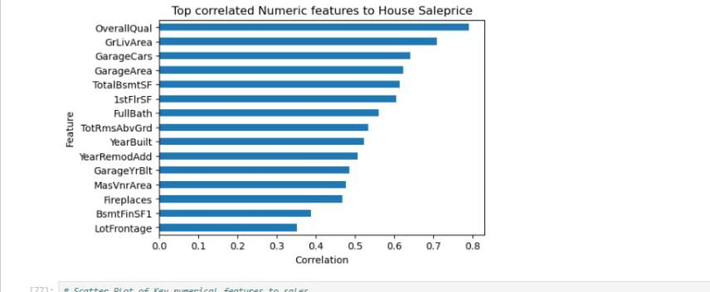
Top correlated Features to salesprice

Slide 6
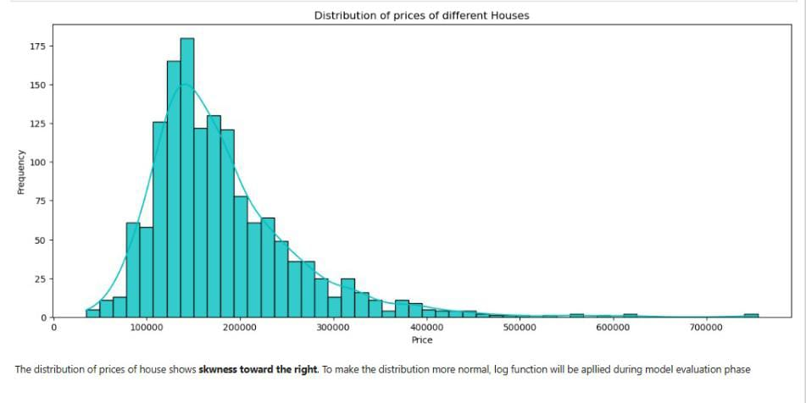
Distribution of Sales price(skwed)

Slide 7
Feature Engineering
Created TotalBath = Full + 0.5*Half + Basement baths.
Binary amenities: HasGarage, HasPool, HasFireplace, etc.
Log-transformed SalePrice for better model fit.

Slide 8
Modeling Approach
Algorithms: Linear Regression, Random Forest, XGBoost.
Evaluation metric: RMSE on log-transformed SalePrice.
5-fold cross-validation ensures robust estimates.

Slide 9
Model Results
Best performing models: XGBoost, Random Forest.
Linear models underperform but provide interpretability.
Feature importances reveal drivers of house prices.

Slide 10
Key Insights
OverallQual (construction quality) is the most important predictor.
GrLivArea (above-ground living area) strongly affects price.
Neighborhood and TotalBath significantly influence values.
GarageCars and YearBuilt are also key contributors.

Slide 11
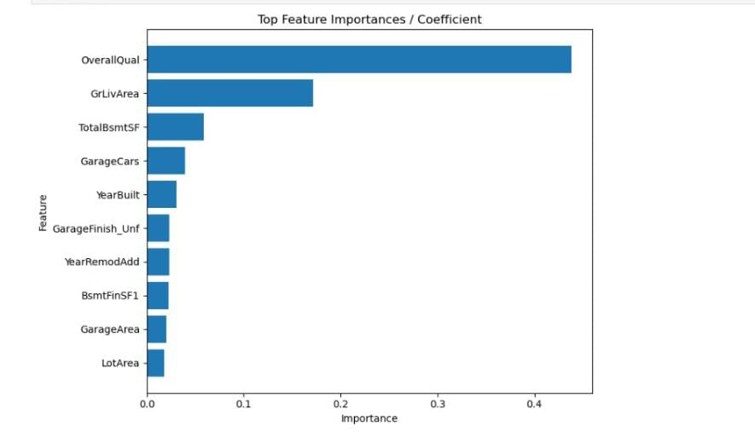
Rank of Features by Importance

Slide 12
Conclusion
House prices depend primarily on quality, size, and location.
Feature engineering improved model accuracy.
Tree-based models (XGBoost, RF) capture complex interactions well.

