Slide 1
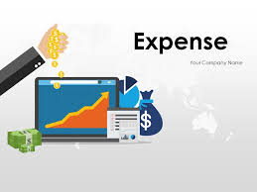

EXPENSE TRACKER APPLICATION WITH ANALYSIS

Slide 2

INTRODUCTION
PLAN
CONTEXT AND PROBLEMATIC
METHODOLOGY
TOOLS AND TECHNOLOGIES USED
DEMONSTRATION
PERSPECTIVE
CONCLUSION

Slide 3
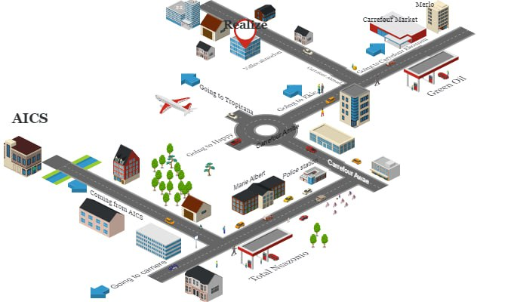
INTRODUCTION

Slide 4

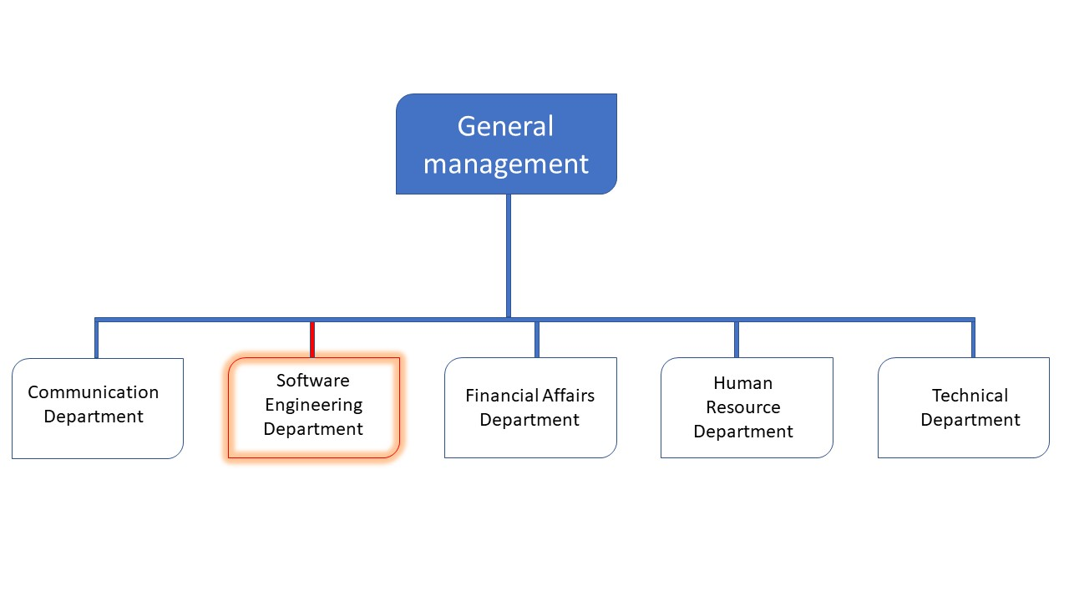
INTRODUCTION
REALIZE

Slide 5

CONTEXT

Slide 6

PROBLEM STATEMENT
How to solve the problem lack of financial clarity, difficulty in making informed decisions, and potential overspending?

Slide 7

SOLUTION

Slide 8

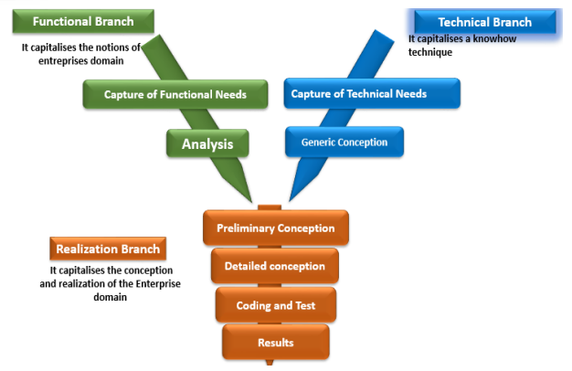
METHODOLOGY
An object oriented modeling language mainly used to model or analyze a system which focuses on user’s need

Slide 9
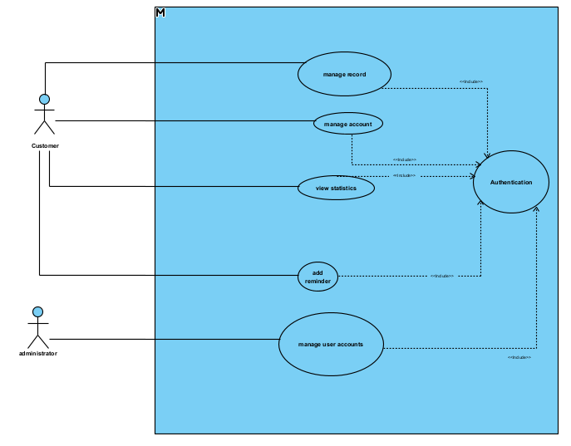
USE CASE DIAGRAM

Slide 10
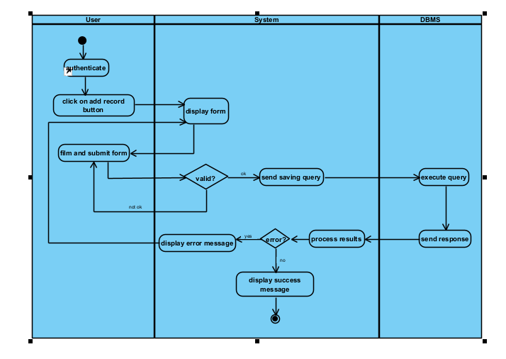
ACTIVITY DIAGRAM

Slide 11
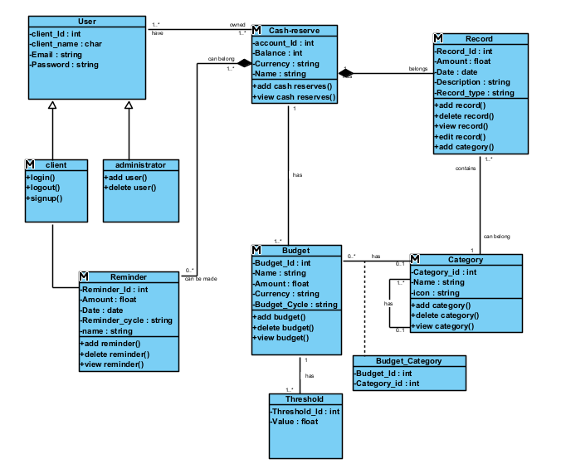
CLASS DIAGRAM

Slide 12



TOOLS USED

Slide 13

DEMONSTRATION
DEMONSTRATION OF THE APPLICATION

Slide 14
PERSPECTIVES

Slide 15


Slide 16
CONCLUSION

