Slide 1


REPUBLIC DU CAMEROON
Peace-work-fatherland
INTERNSHIP REPORT
conception and realization of a personal budget management application
Internship carried out from 01st July to 30th September 2024
In view of obtaining a Higher Technical Diploma in computer sciences(A/L +2)
With a major in Software Engineering
Written by:
KANJOUH ESTHER NKWENTI
Second year student in software engineering
ACADEMIC SUPERVISOR
Mr. MESSIO Ulrich
Lecturer of AICS Cameroun
PROFESSIONAL SUPERVISOR
Mr. Nguh Prince
Computer Engineer at Realize
ACADEMIC YEAR 2023-2024

Slide 2
INTRODUCTION
PLAN
CONTEXT AND PROBLEMATIC
METHODOLOGY
TOOLS AND TECHNOLOGIES USED
DEMONSTRATION
PERSPECTIVE
CONCLUSION

Slide 3
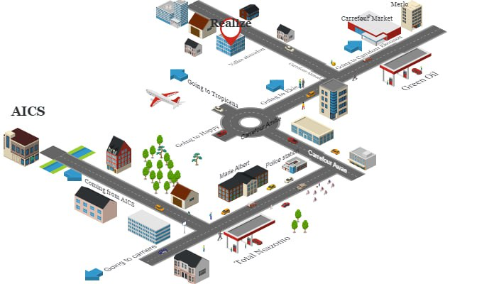
INTRODUCTION
Mr. NDELOGAKEH DANIEL NDABOSE
CEO of REALIZE

Slide 4
INTRODUCTION
MISSION
SOFTWARE DEVELOPMENT
NETWORK INSTALLATION AND ADMINISTRATION
IT CONSULTING
CONCEPTION AND REALIZATION OF A PERSONAL BUDGET MANAGEMENT APPLICATION
KEY REALIZATIONS
Asappay
thekafe

Slide 5
CONTEXT

Slide 6
INTRODUCTION
Mr. NDELOGAKEH DANIEL NDABOSE
CEO of REALIZE

Slide 7

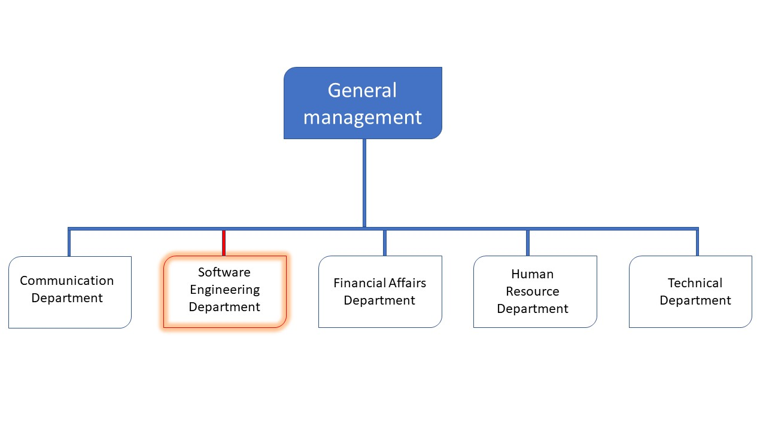
INTRODUCTION
REALIZE

Slide 8

CONTEXT

Slide 9

PROBLEM STATEMENT
How to solve the problem lack of financial clarity, difficulty in making informed decisions, and potential overspending?

Slide 10
Proposed SOLUTION

Slide 11

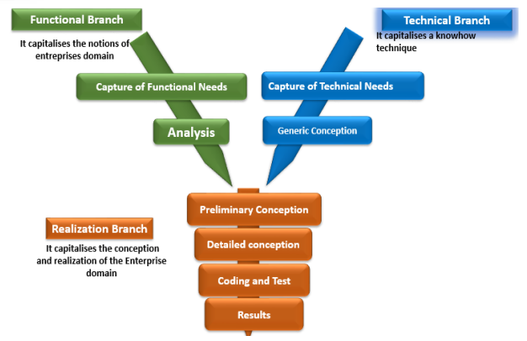
METHODOLOGY
An object oriented modeling language mainly used to model or analyze a system which focuses on user’s need

Slide 12
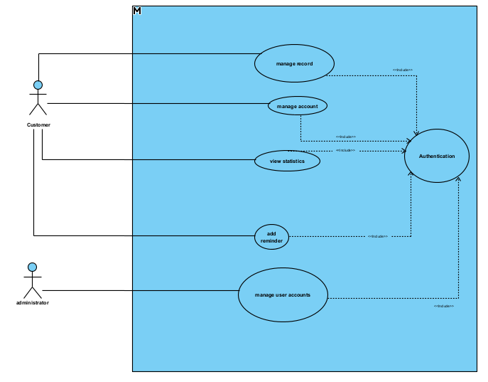
USE CASE DIAGRAM

Slide 13
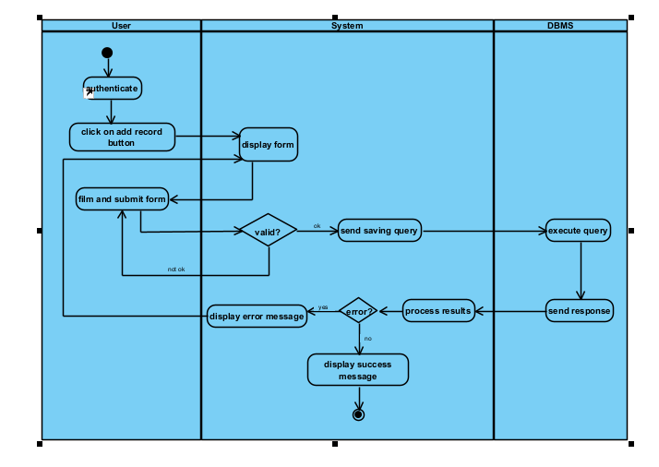
ACTIVITY DIAGRAM

Slide 14
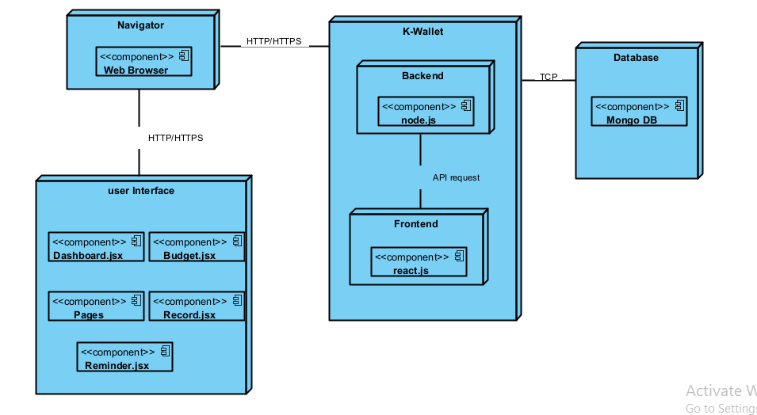
Deployment DIAGRAM

Slide 15
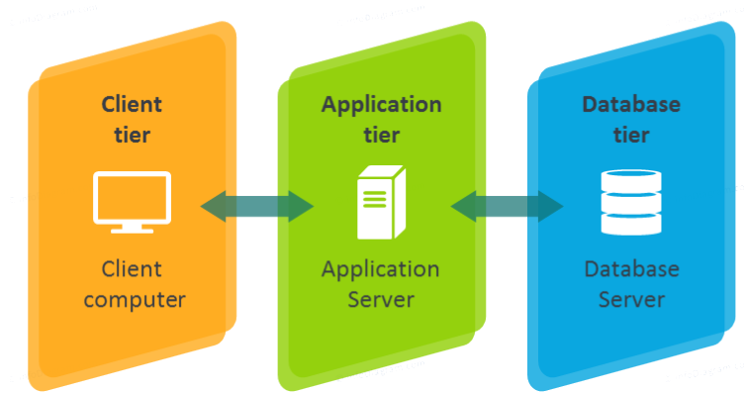
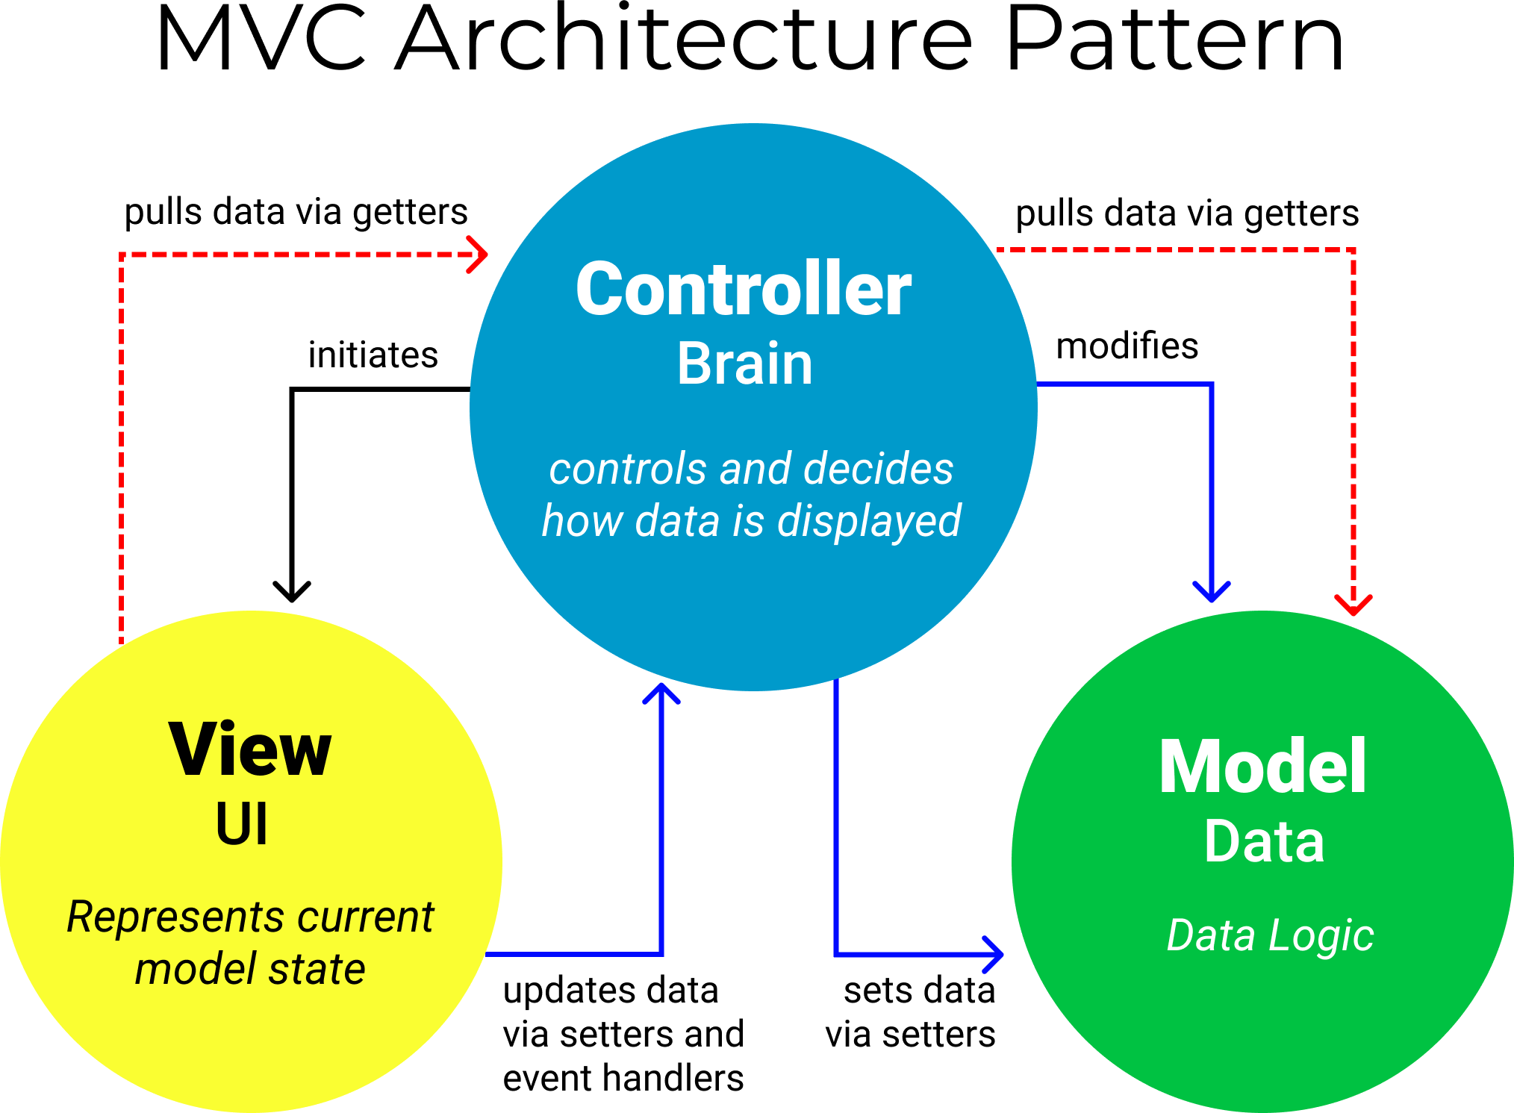
System Deployment diagram
Logical architecture
Physical architecture

Slide 16






TOOLS USED

Slide 17

DEMONSTRATION
DEMONSTRATION OF THE APPLICATION

Slide 18
PERSPECTIVES
The user can be able to email the administrator incase they forget their passwords
Being able to dispatch the different savings into sections so as to be able to properly save

Slide 19


Slide 20
CONCLUSION

