Slide 1


REPUBLIC DU CAMEROON
Peace-work-fatherland
INTERNSHIP REPORT
conception and realization of a personal budget management application
Internship carried out from 01st July to 30th September 2024
In view of obtaining a Higher Technical Diploma in computer sciences(A/L +2)
With a major in Software Engineering
Written by:
KANJOUH ESTHER NKWENTI
Second year student in software engineering
ACADEMIC SUPERVISOR
Mr. MESSIO Ulrich
Lecturer of AICS Cameroun
PROFESSIONAL SUPERVISOR
Mr. Nguh Prince
Computer Engineer at Realize
ACADEMIC YEAR 2023-2024

Slide 2
INTRODUCTION
PLAN
CONTEXT AND PROBLEMATIC
METHODOLOGY
TOOLS AND TECHNOLOGIES USED
DEMONSTRATION
PERSPECTIVE
CONCLUSION

Slide 3
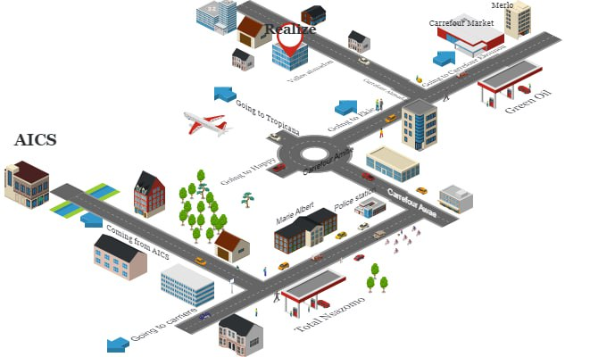
INTRODUCTION
Mr. NDELOGAKEH DANIEL NDABOSE
CEO of REALIZE

Slide 4
INTRODUCTION
MISSION
SOFTWARE DEVELOPMENT
NETWORK INSTALLATION AND ADMINISTRATION
IT CONSULTING
CONCEPTION AND REALIZATION OF A PERSONAL BUDGET MANAGEMENT APPLICATION
KEY REALIZATIONS
Asappay
thekafe

Slide 5



CONTEXT
Goal: Purchasing a plot of land

Slide 6

PROBLEM STATEMENT
How can we solve the problem of financial indiscipline and potential overspending?

Slide 7

Proposed SOLUTION
Record functionality
Budget functionality
Reminder functionality
K-wallet

Slide 8

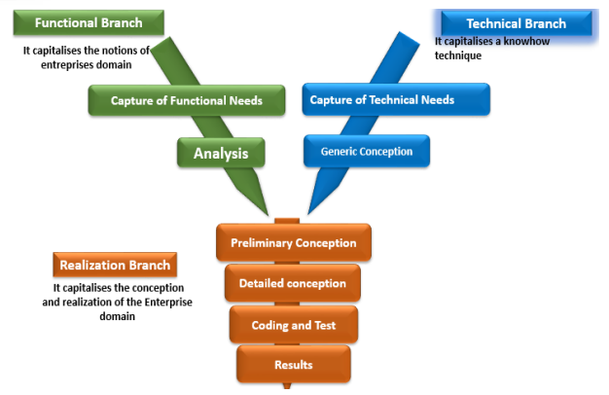
METHODOLOGY
An object oriented modeling language mainly used to model or analyze a system which focuses on user’s need

Slide 9
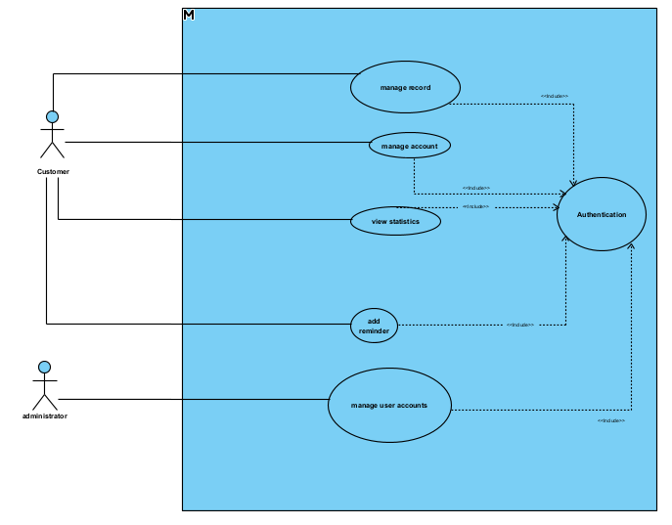
USE CASE DIAGRAM

Slide 10
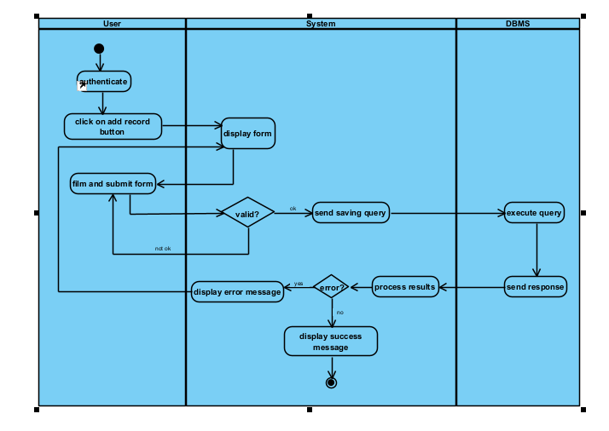
ACTIVITY DIAGRAM

Slide 11
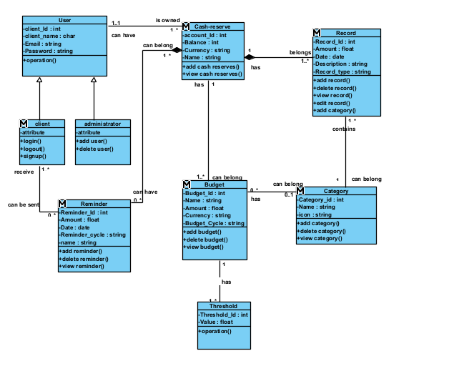
CLASS DIAGRAM

Slide 12
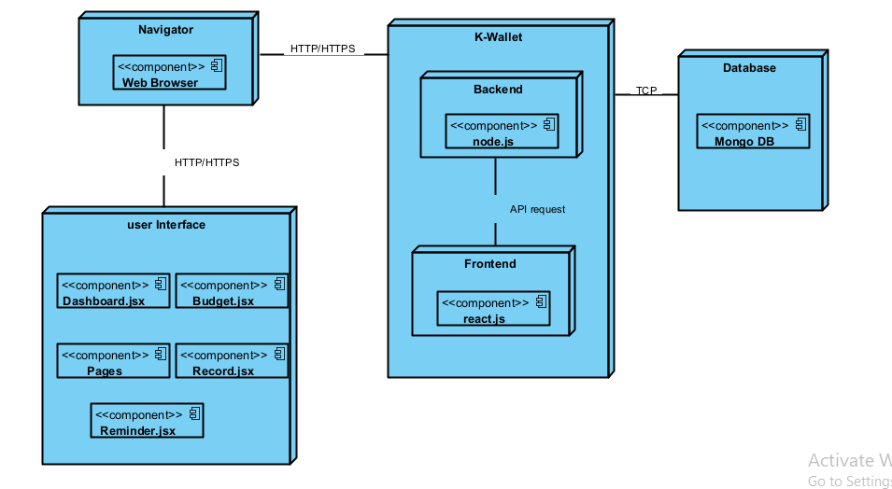
Deployment DIAGRAM

Slide 13
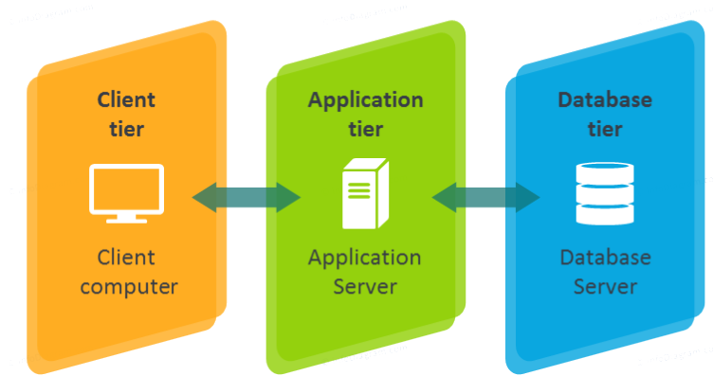
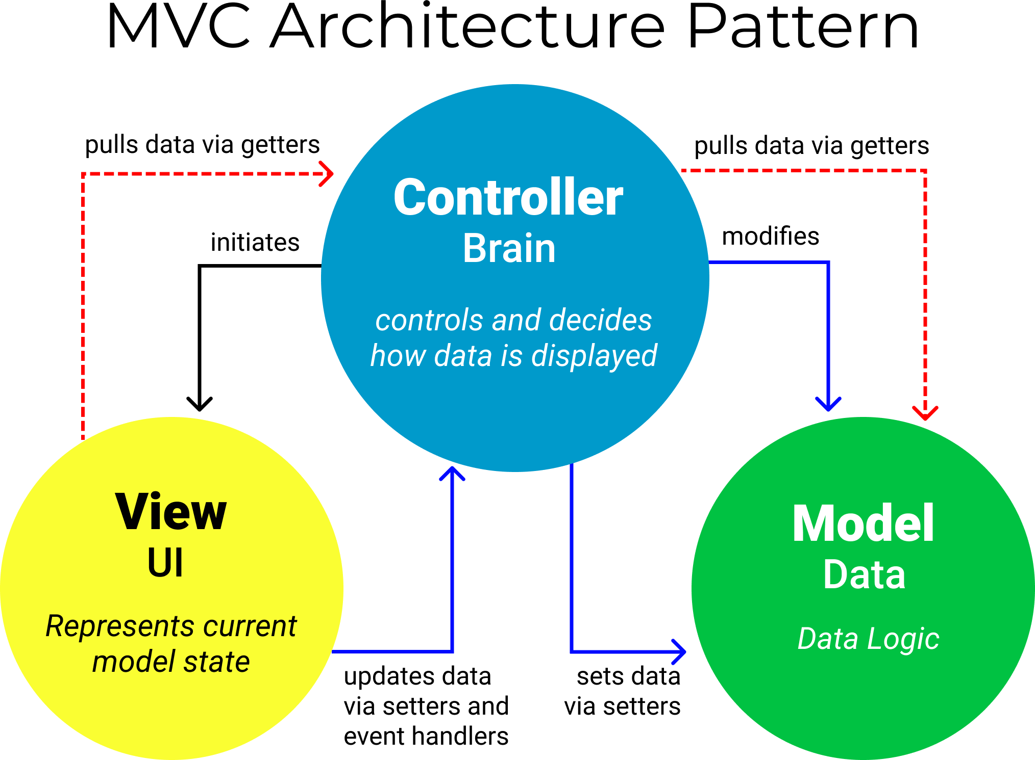
Architecture of our system
Logical architecture
Physical architecture

Slide 14






TOOLS USED

Slide 15

DEMONSTRATION
DEMONSTRATION OF THE APPLICATION

Slide 16
PERSPECTIVES
The user can be able to email the administrator incase they forget their passwords
Being able to generate the statistics of the pie chart daily, weekly, monthly or yearly depending on the user
Budget alerts to notify the user incase of overspending
The admin can disable a user’s account after a long period of inactivity (3months and above)

Slide 17


Slide 18
CONCLUSION
Using the K-wallet application, enables users to have control over their finances and spending habits by providing an overview of the users’ income and expenses , with features such as Records , Budget, Reminders and Categorization

