Slide 1
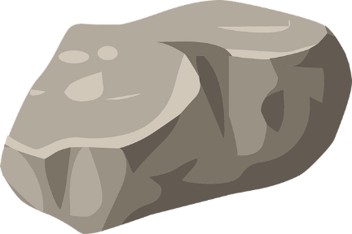


Rock
Paper
Scissors

