Slide 1
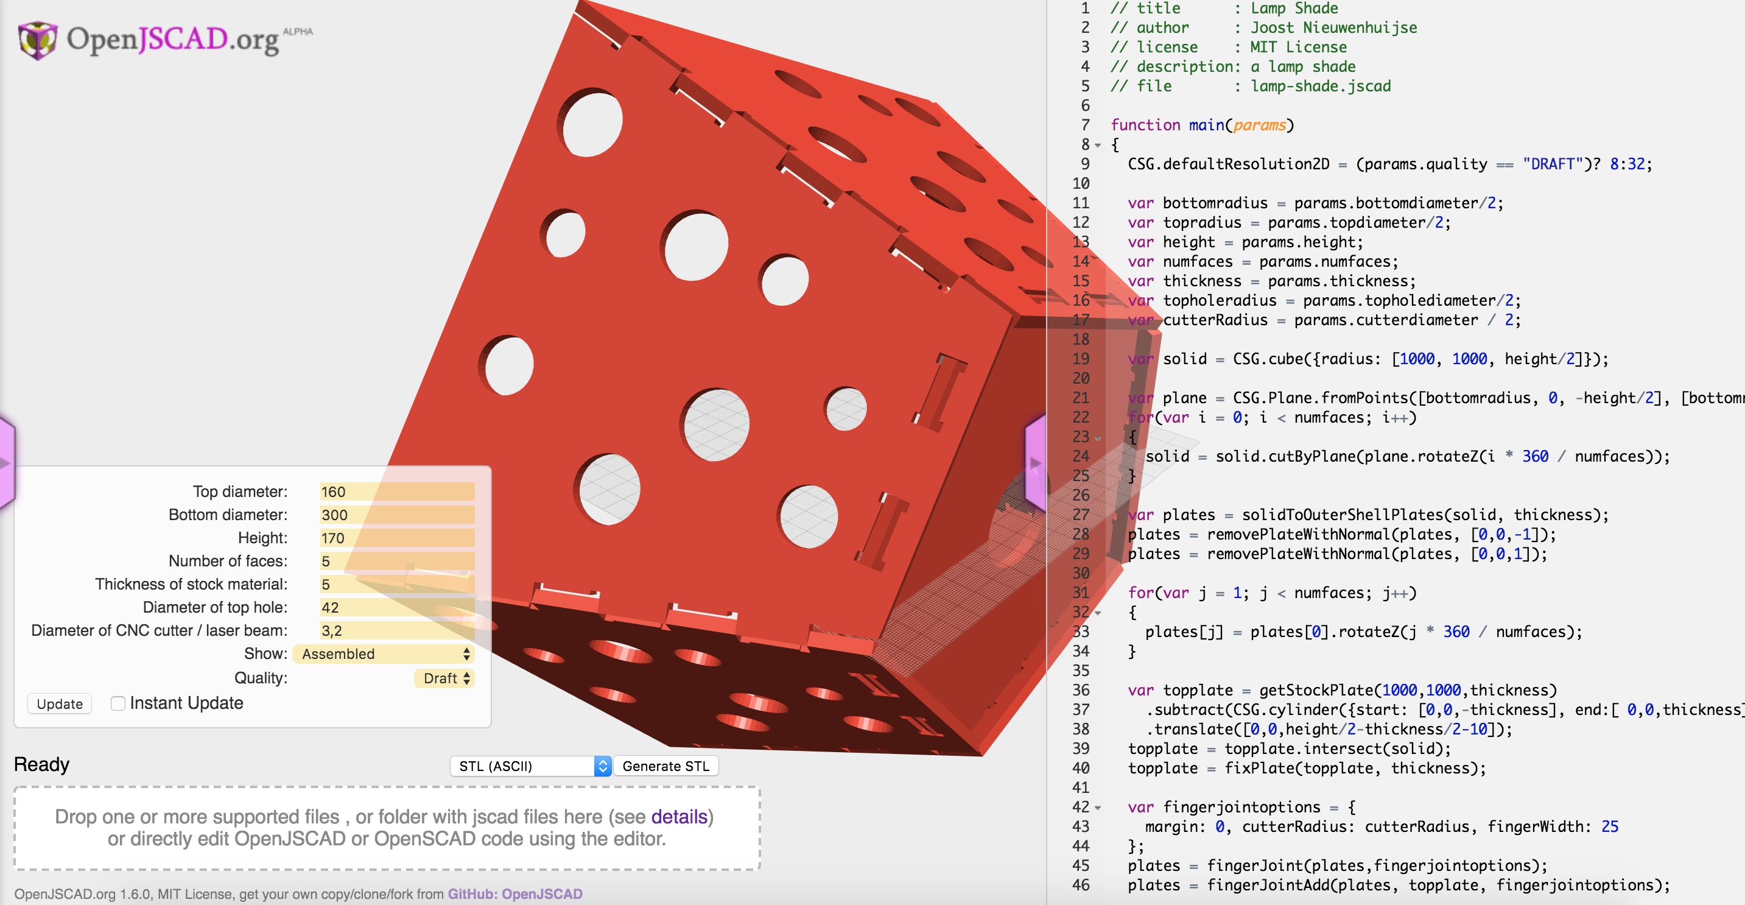
JSCAD : 2D/3D parametric CAD (in JavaScript)
Mark Moissette (github.com/kaosat-dev)
https://github.com/jscad
https://openjscad.org

Slide 2
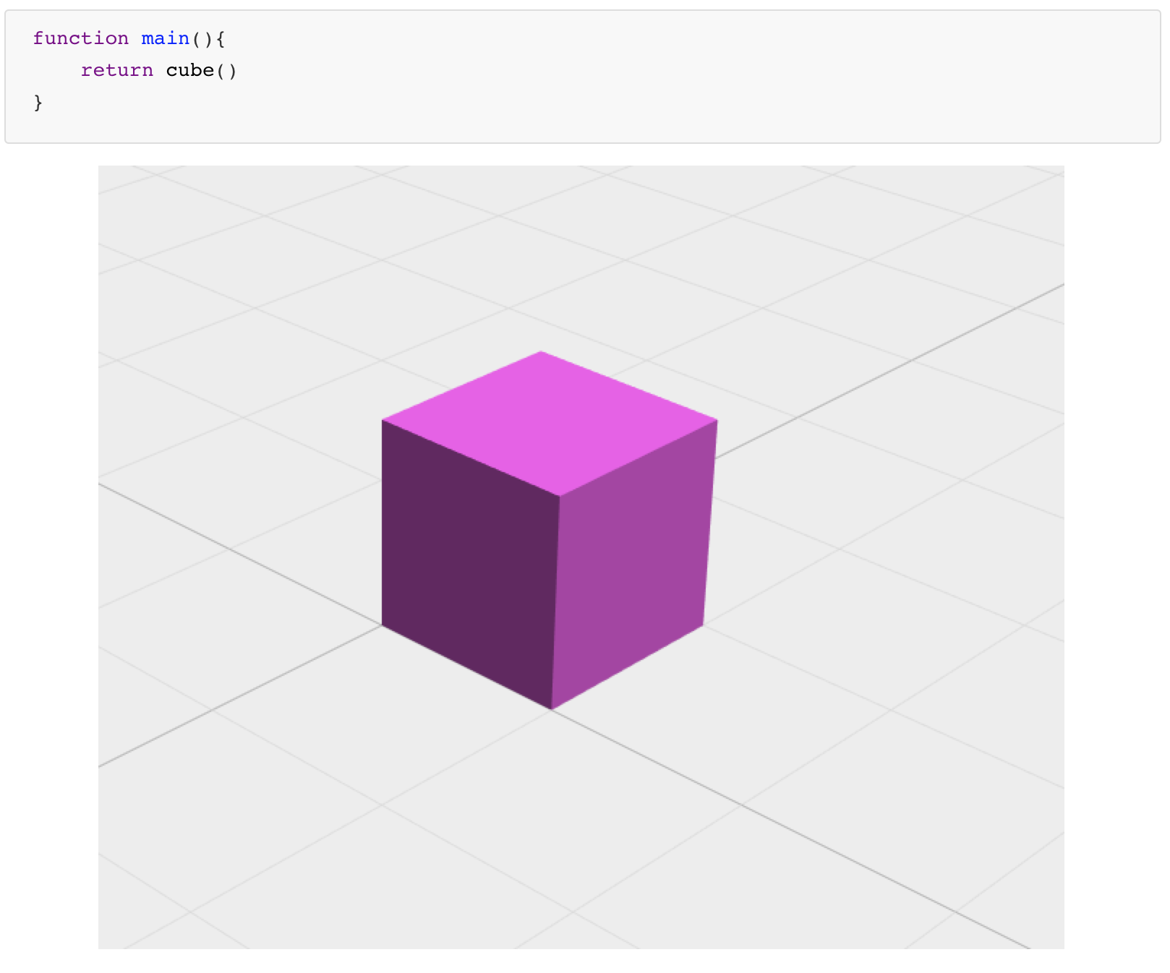
CODE => DESIGN

Slide 3
Use any code editor
Change code => recompute geometry

Slide 4
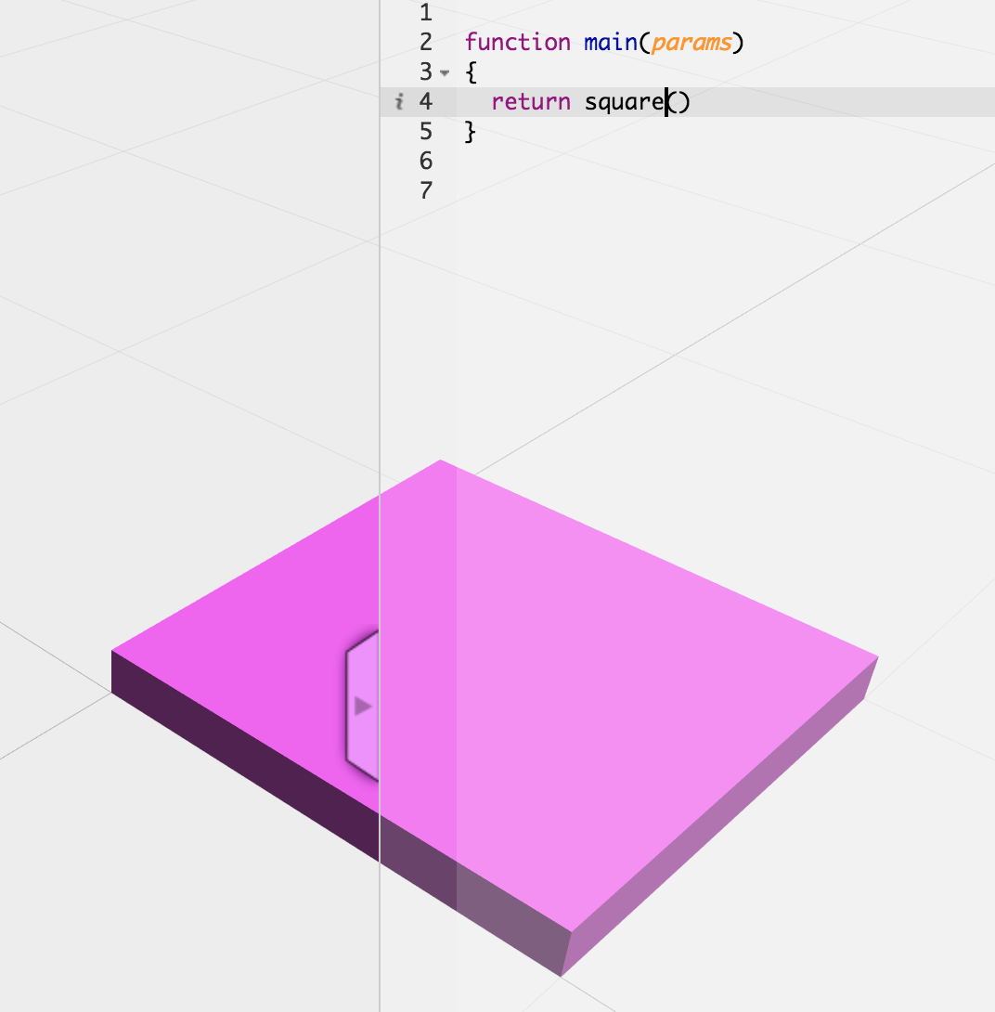
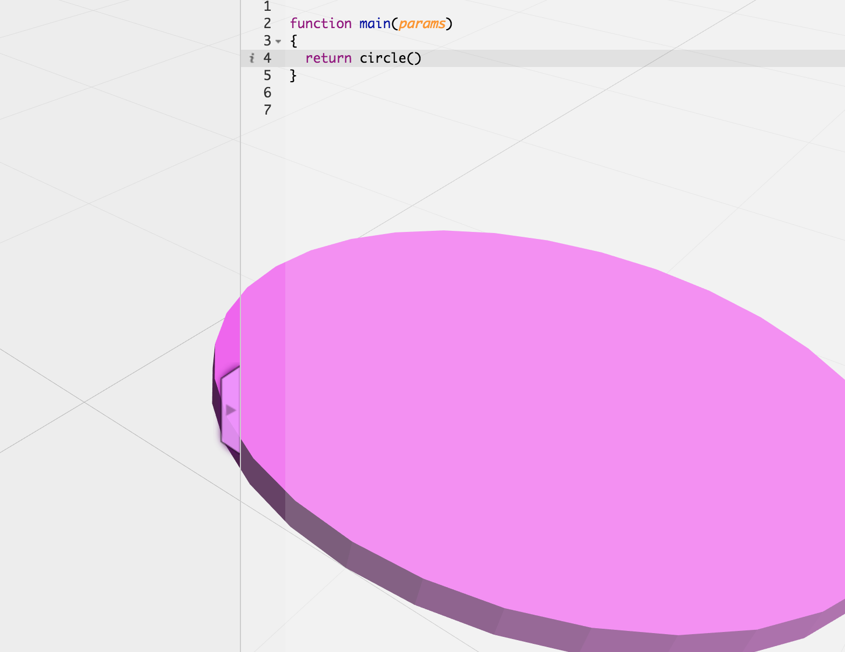
Primitives (2D)
- rectangle
- circle
- polygons
- paths

Slide 5
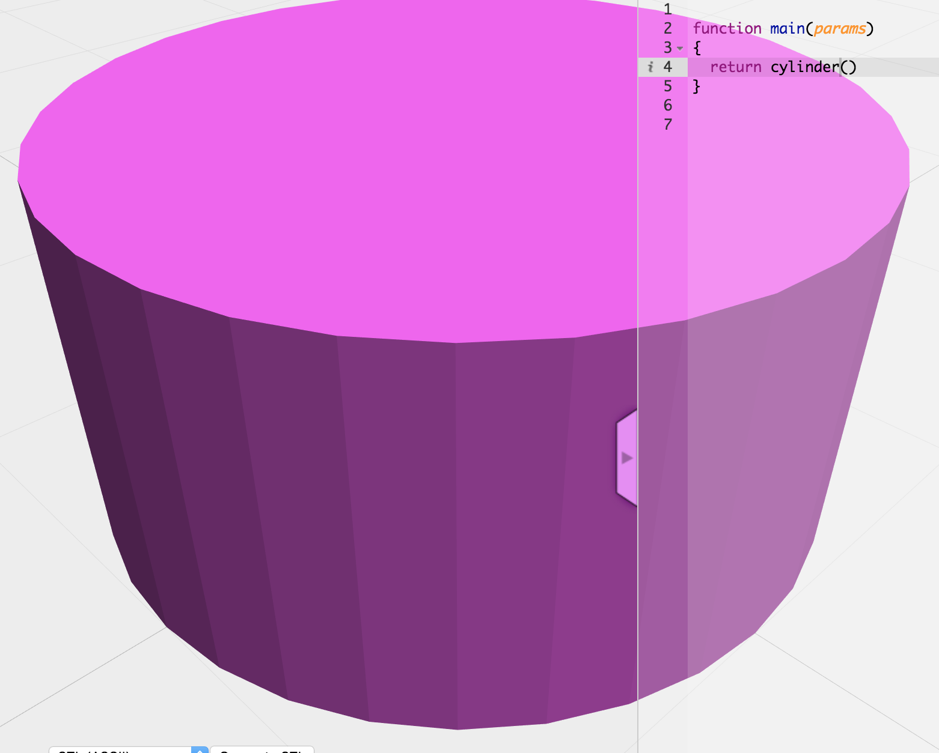
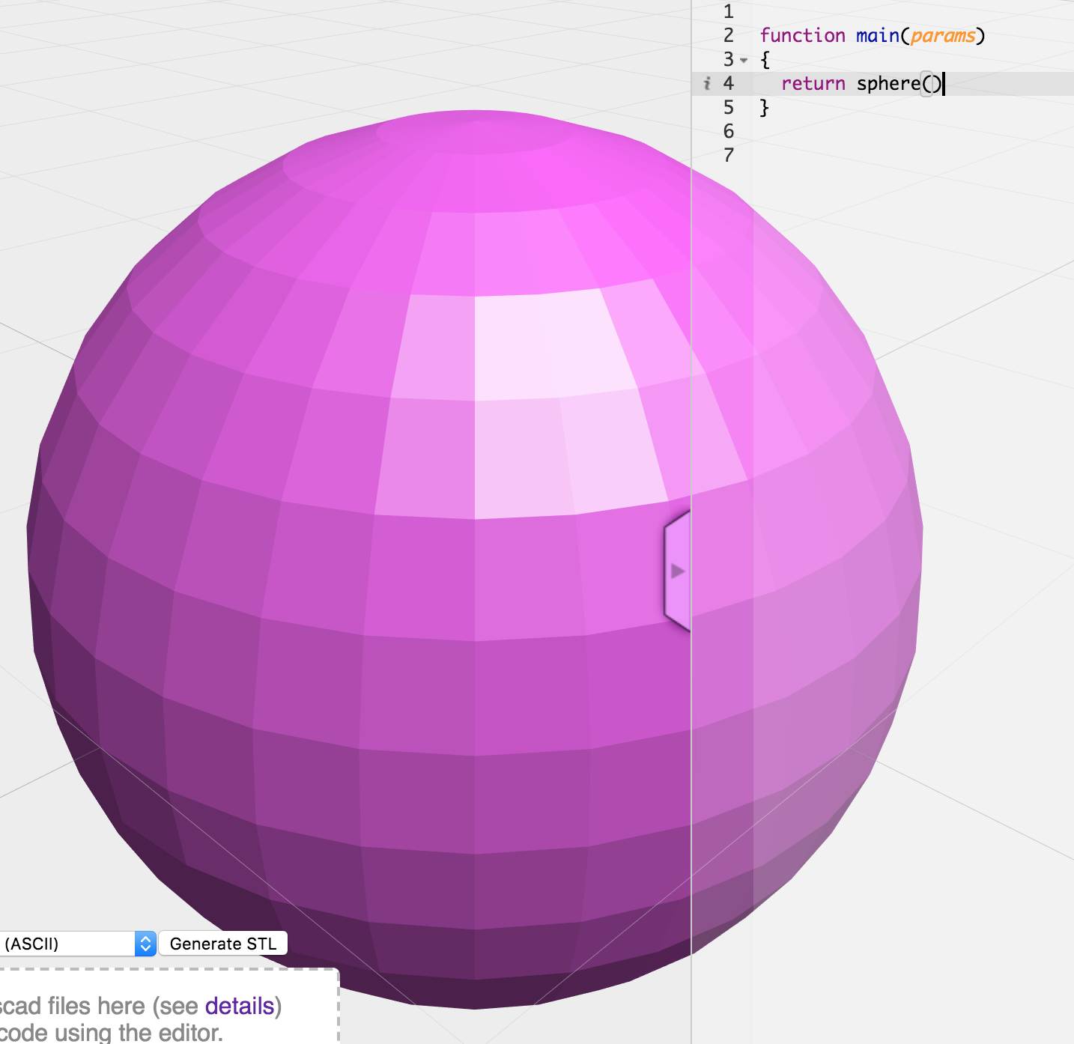
Primitives (3D)
- cube
- sphere
- cylinder
- torus
- etc

Slide 6
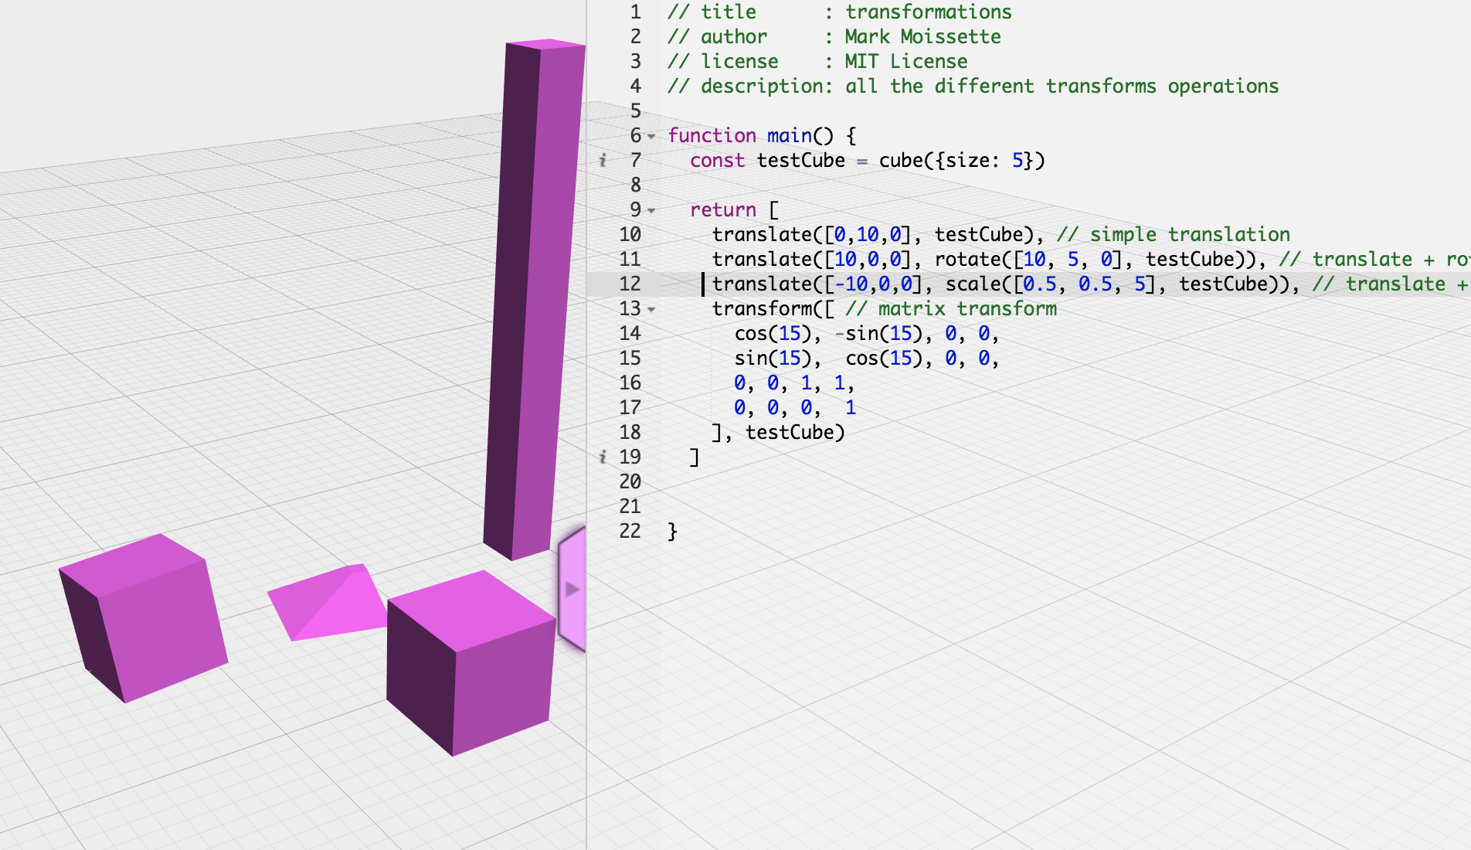
Transformations
- translate (move)
- rotate()
- scale()
- immutable operations !

Slide 7
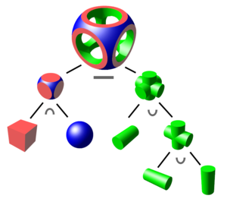
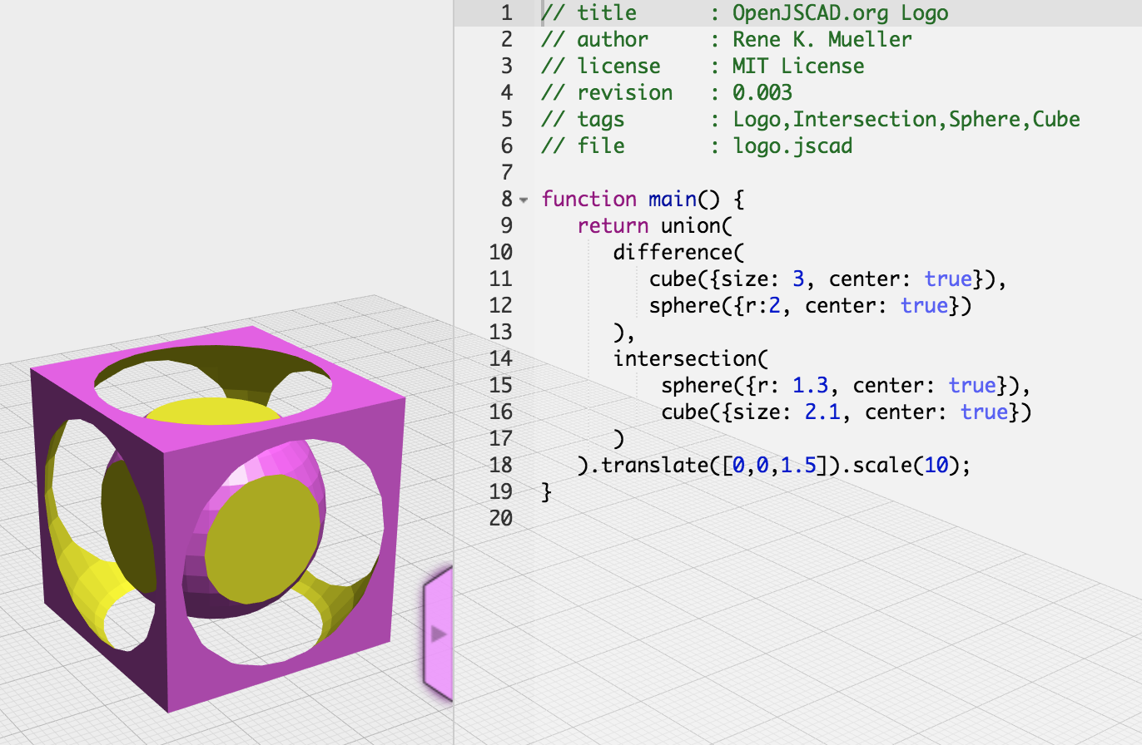
Boolean operations (csg)
- union
- difference
- intersection
- immutable in JSCAD

Slide 8
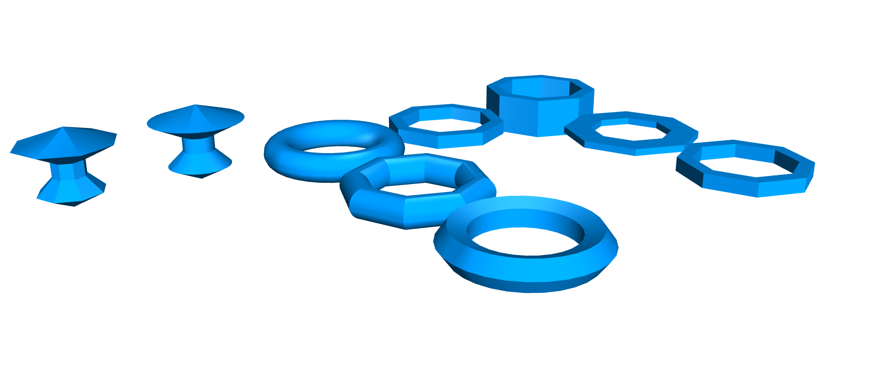
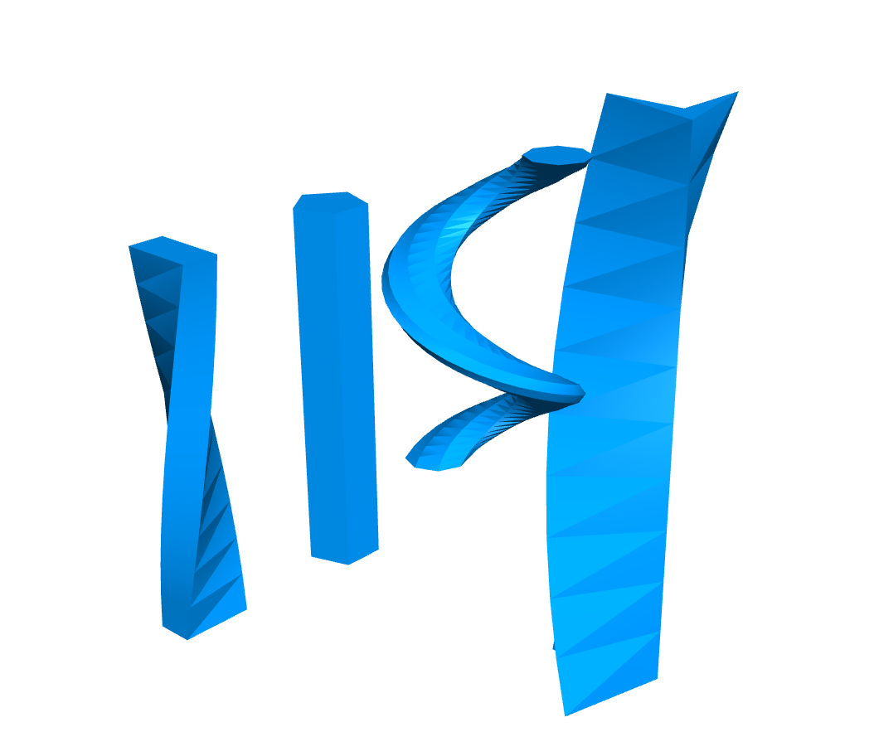
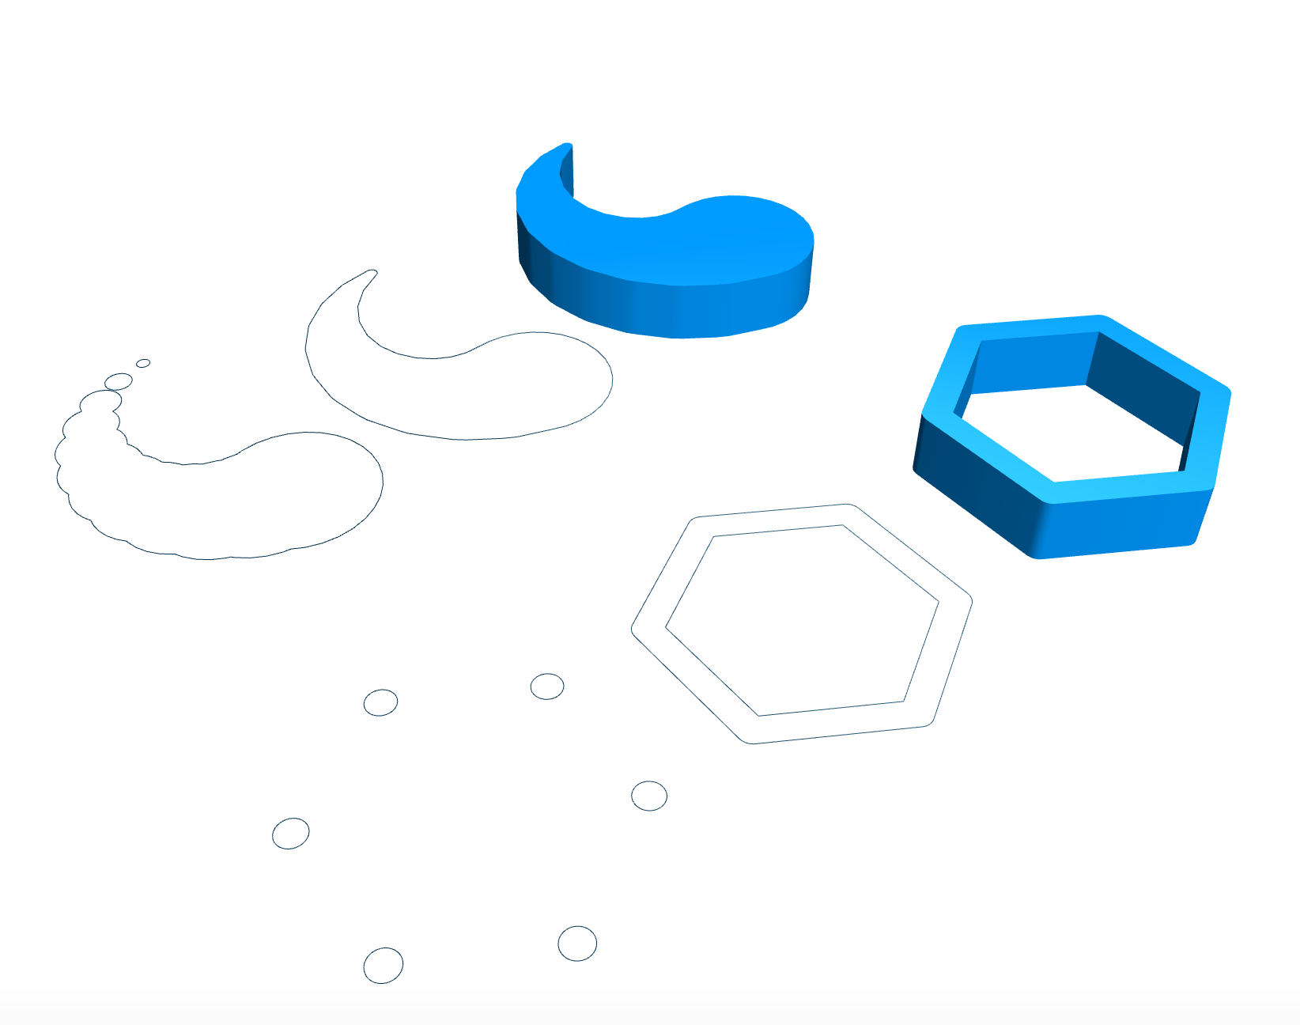
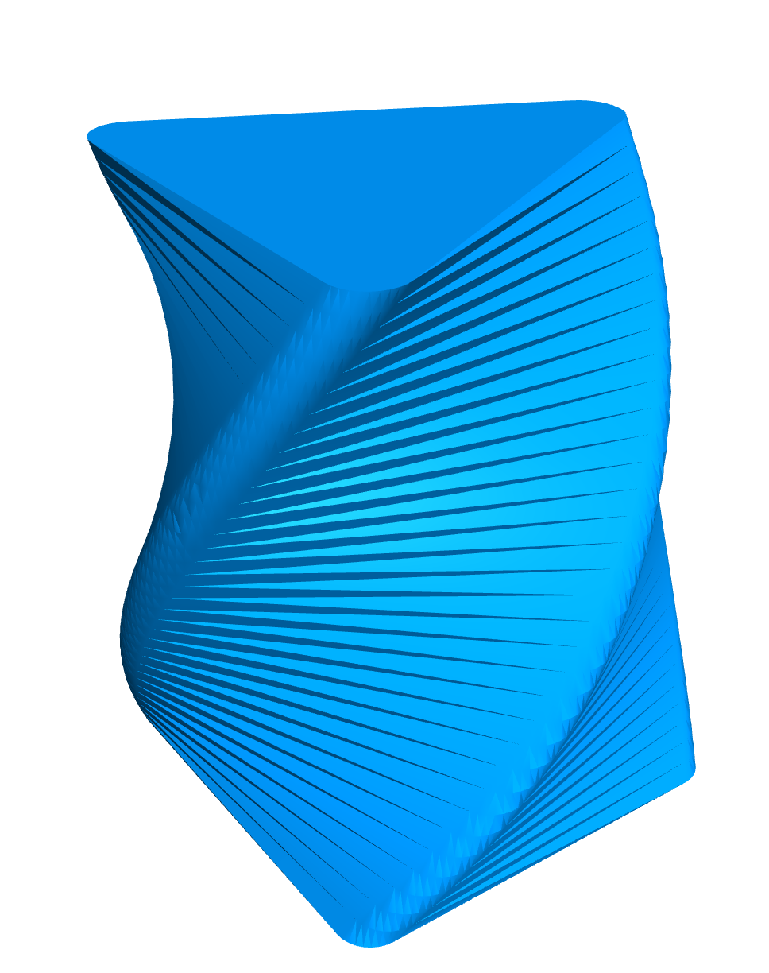
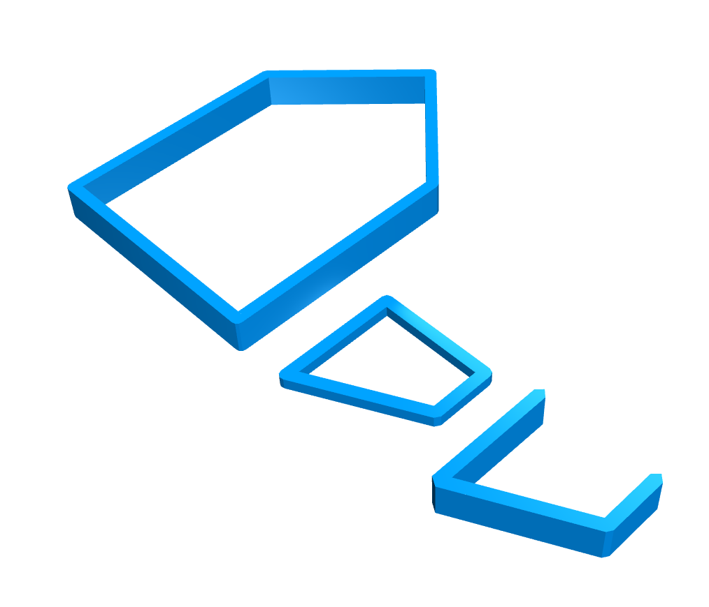
Other operations/ functions
- extrusions (2D => 3D)
- hull() / chain hull()
- connectors
- a lot more !

Slide 9
- simplicity : it is ’just javaScript’
- very low amount of dependencies
- functions, functions functions !

Slide 10
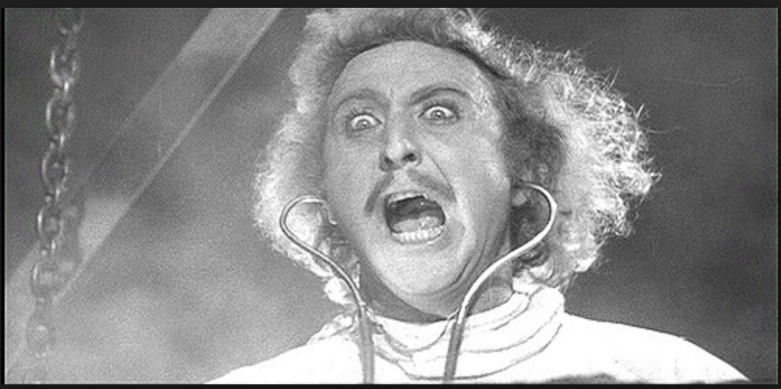
THE CODE IS ALIIIIIVE !!!

Slide 11
Design code
Partial support as inputs (+ other formats)
JSCAD
Export to standard formats
3D
- stl
- amf
- x3d
2D
- svg
- dxf
Other tools

Slide 12
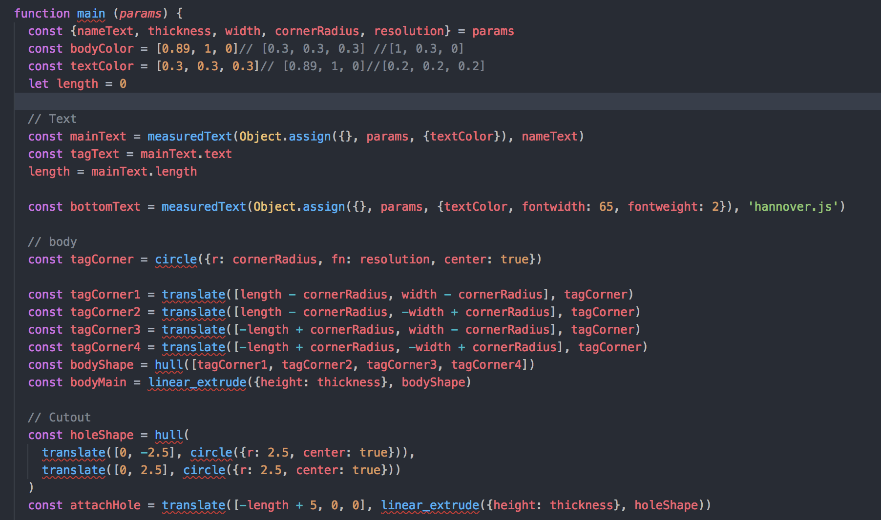
Based on nameTag design originally by Kurt Meister

Slide 13
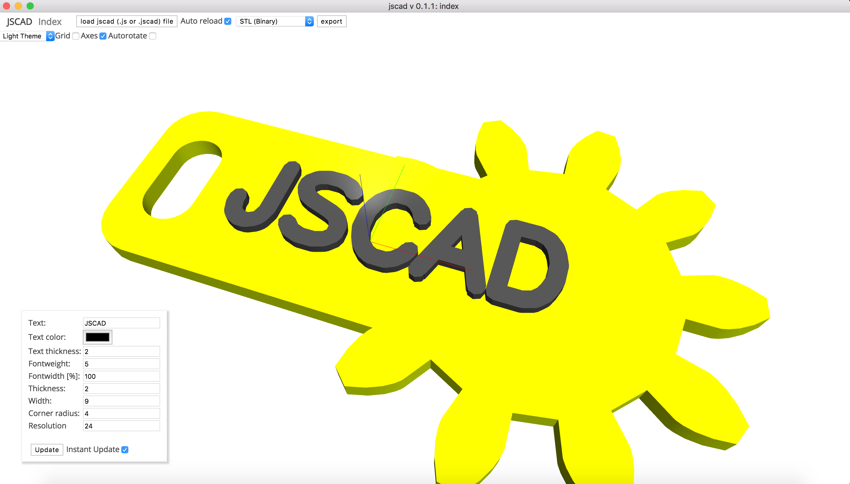

Slide 14
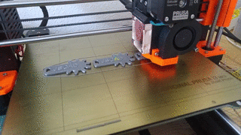

Slide 15
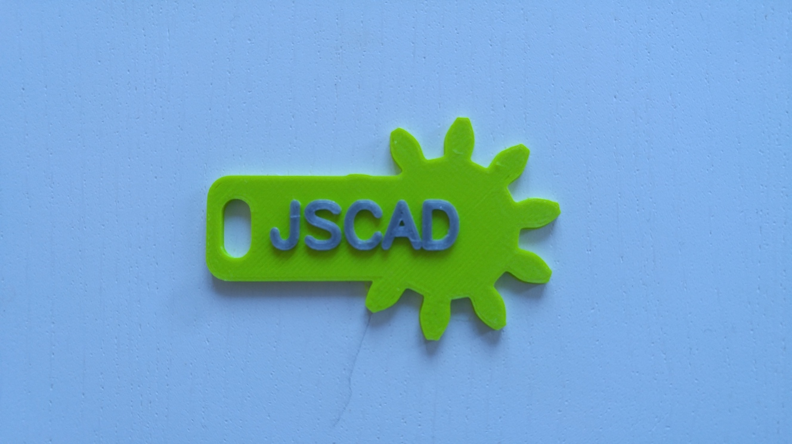

Slide 16
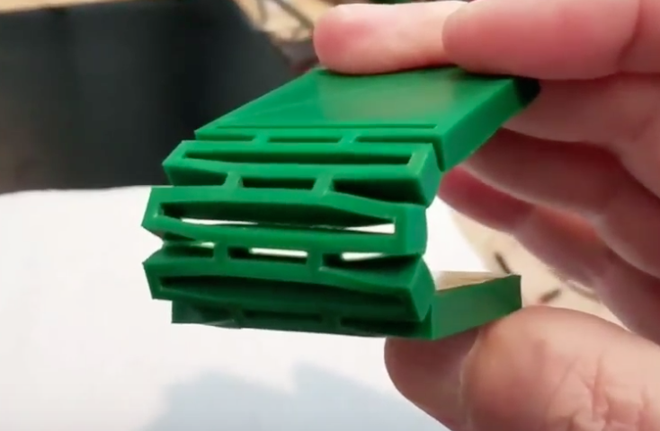
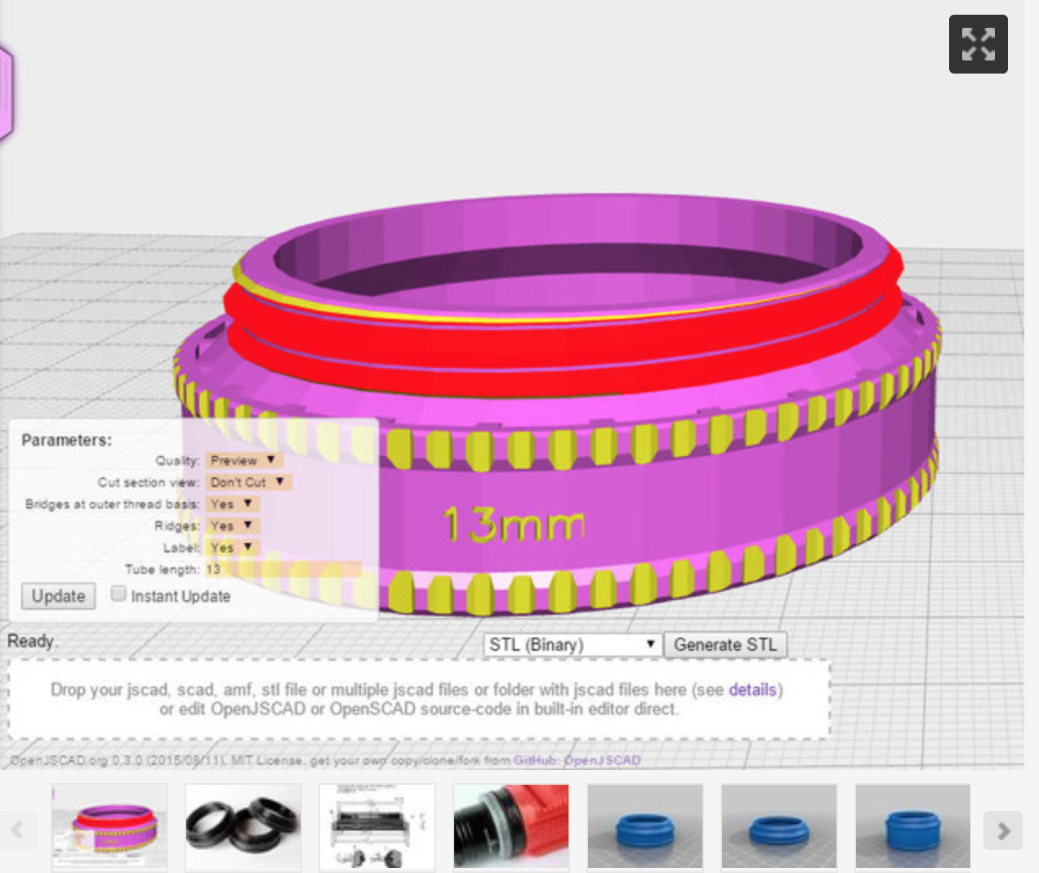
https://www.thingiverse.com/thing:2262665
https://www.thingiverse.com/thing:863055

Slide 17
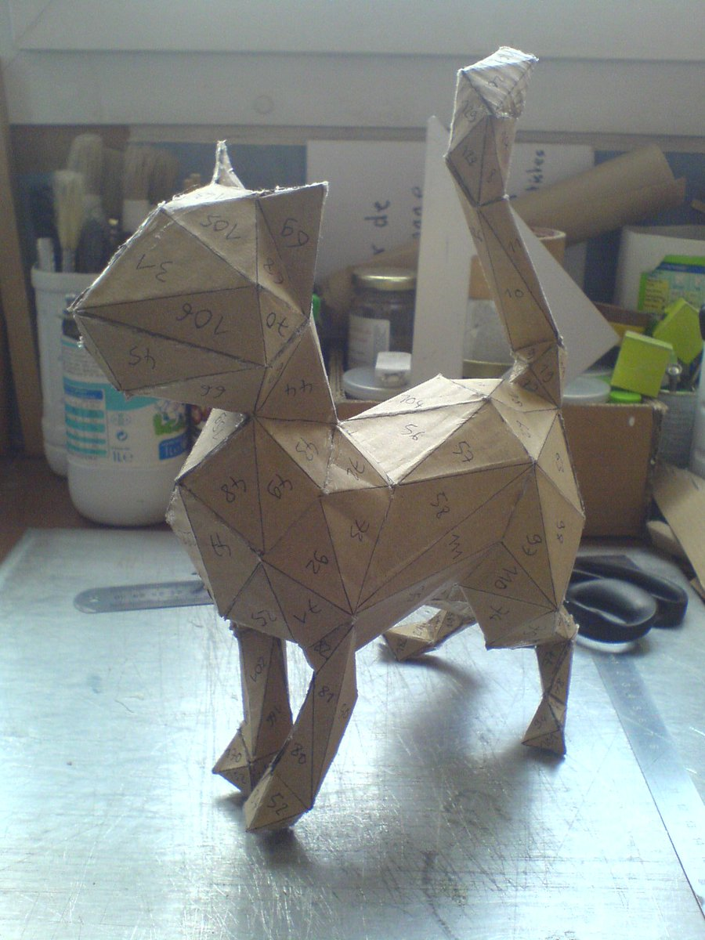
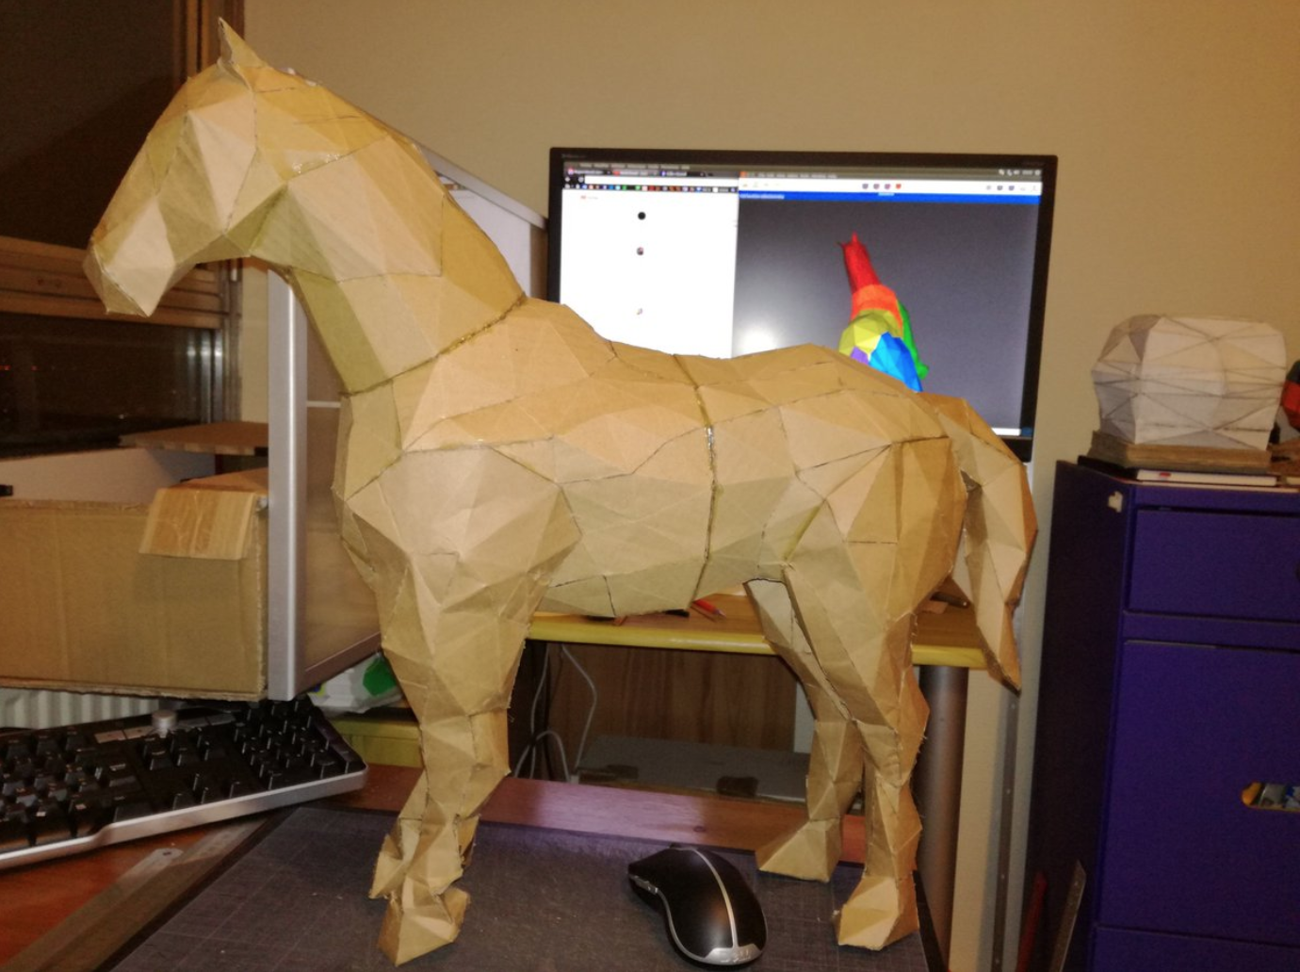
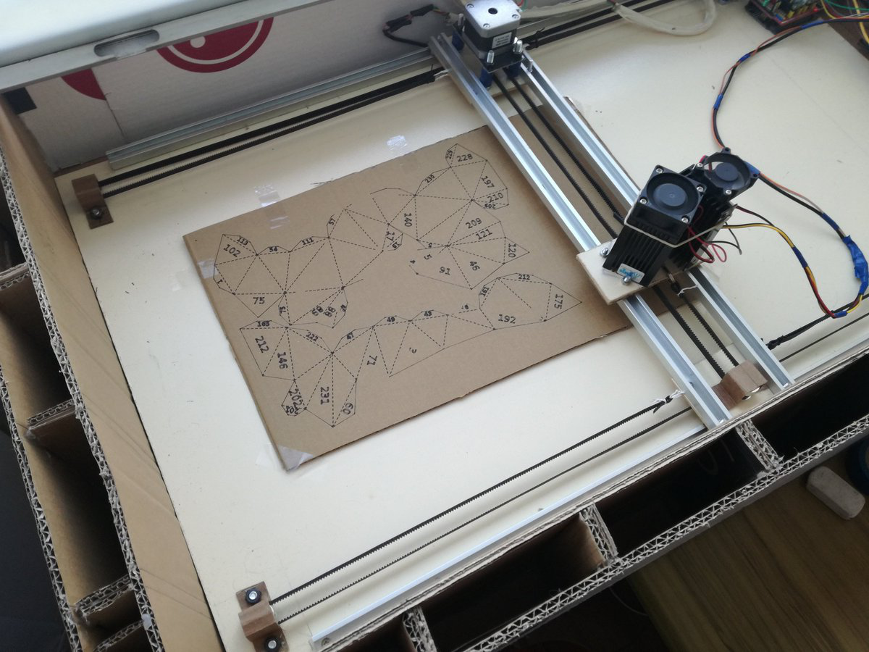
Cardboard Models by Gilbert Duval

Slide 18
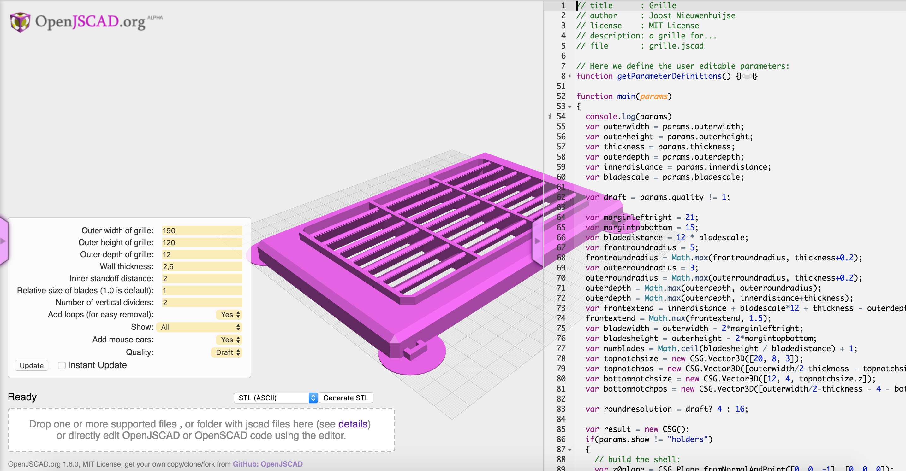
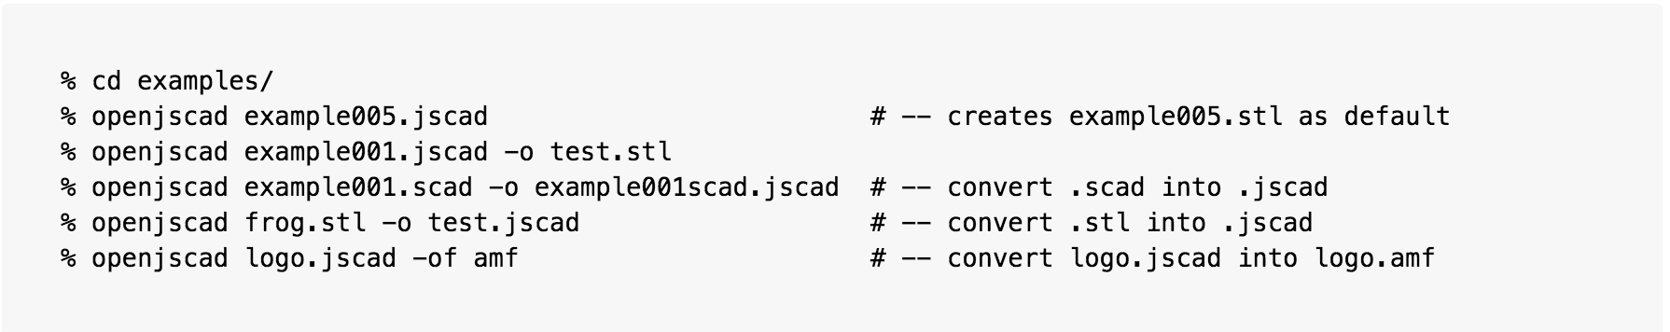
TOOLS, TOOLS, TOOLS !

Slide 19
web: either self hosted, or online (openjscad.org)

Slide 20
Cli (command line interface)

Slide 21
Desktop (experimental)

Slide 22
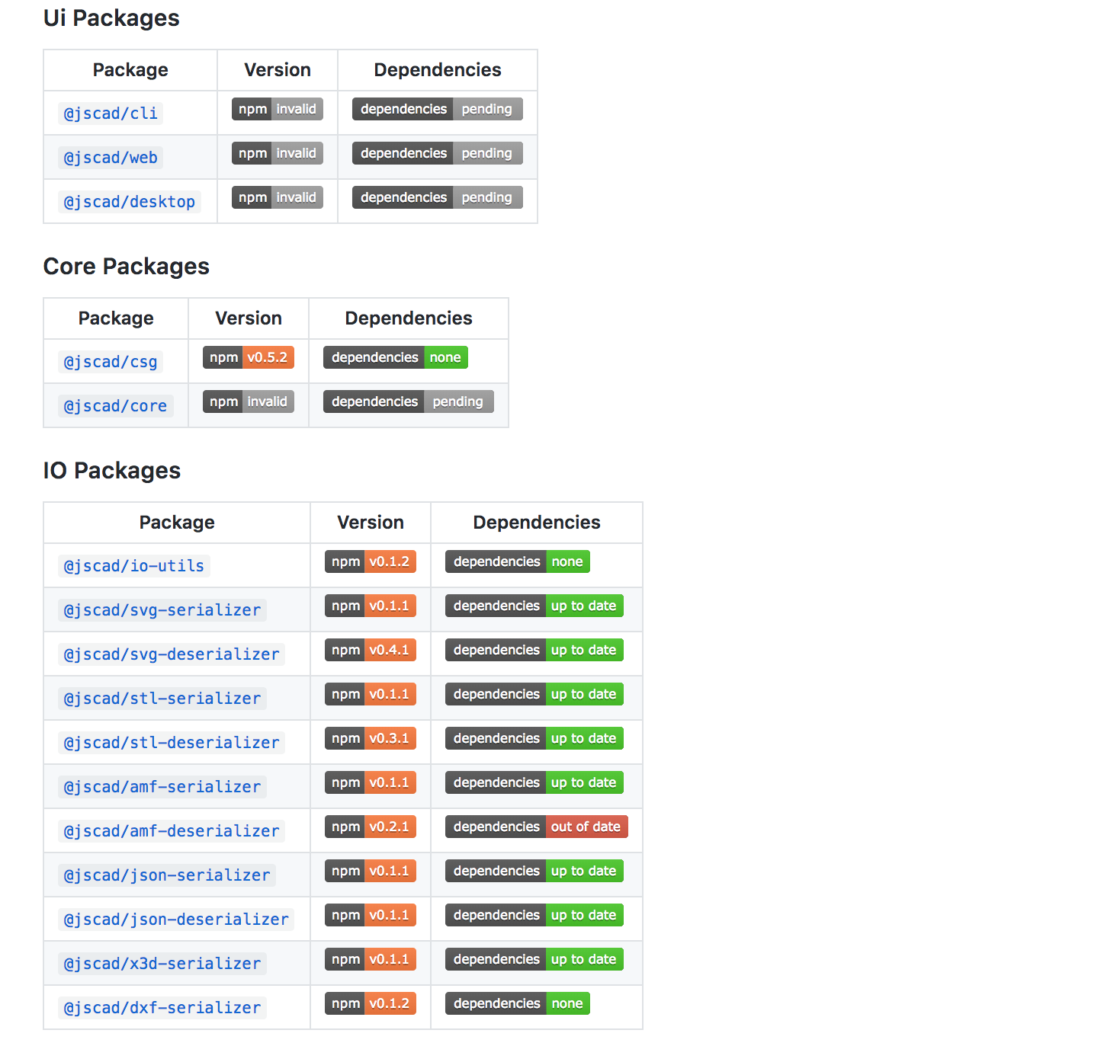
As node.js/npm modules

Slide 23
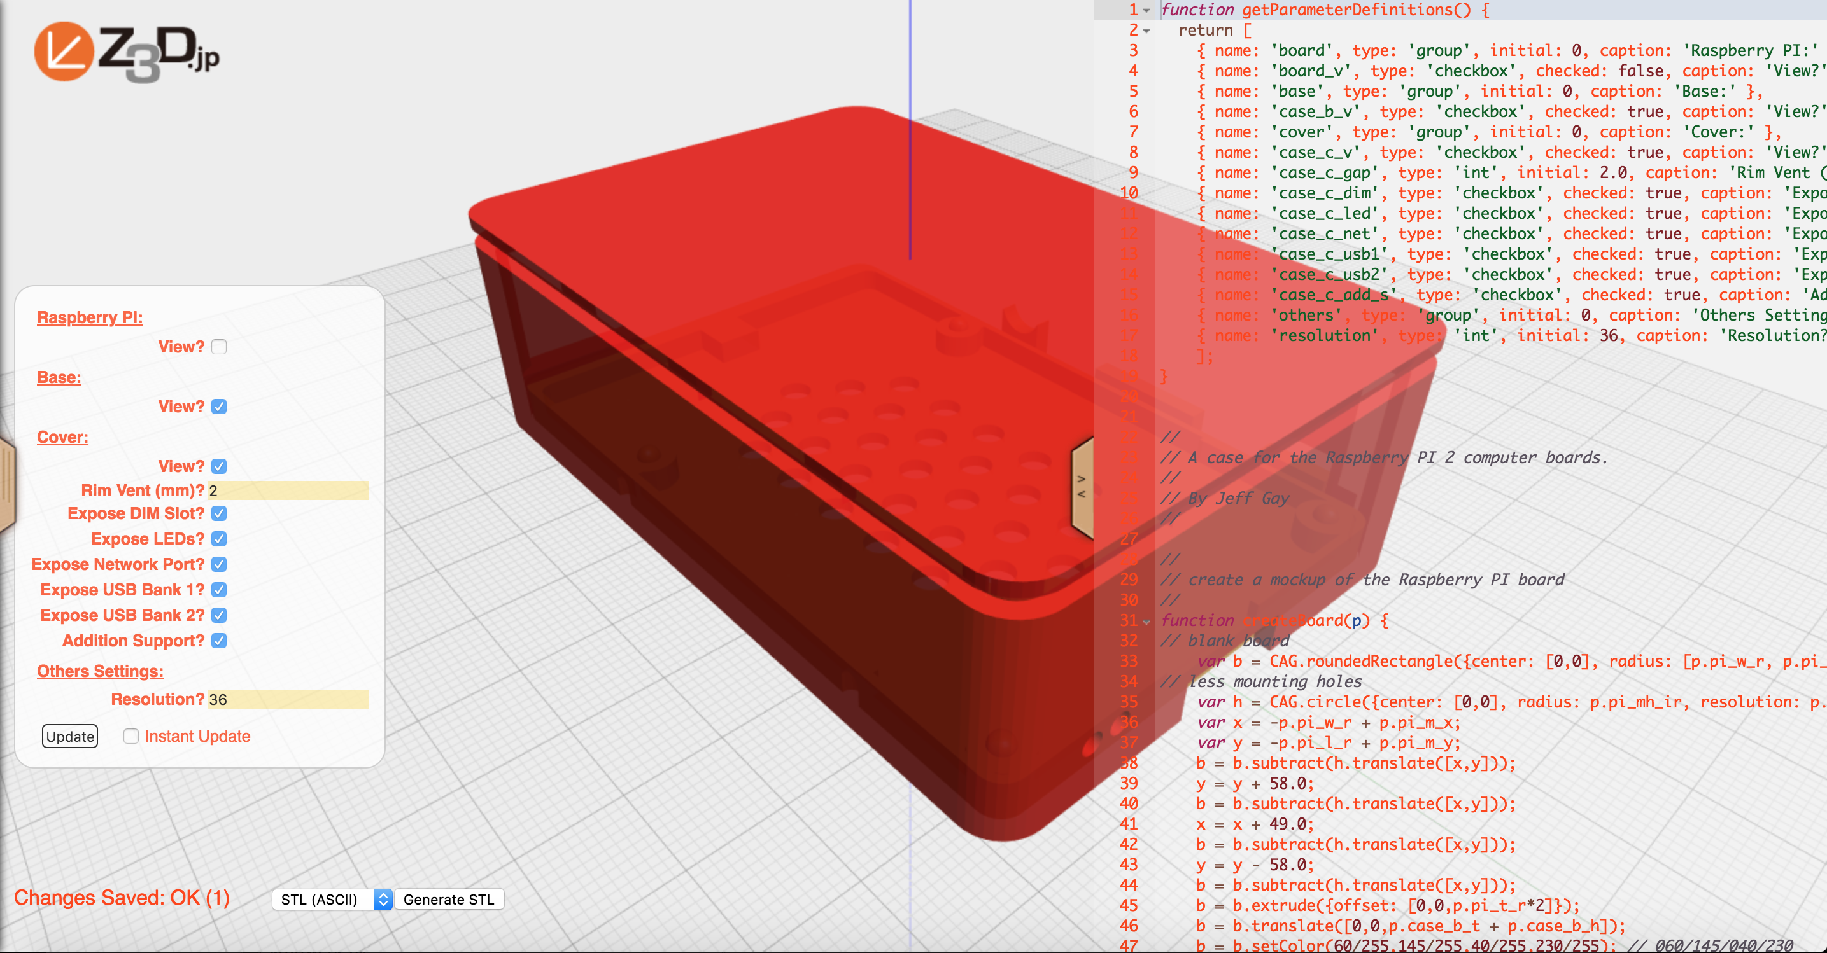
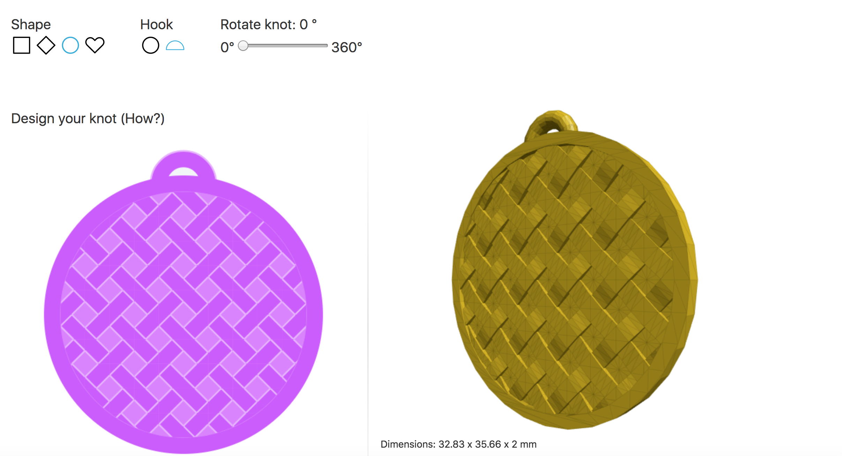
Raspberry-pi case by Jeff Gay (z3d.jp/lab/)
Sertae (https://sertae.com) Jewel Customizer by Wojciech Czerniak

Slide 24
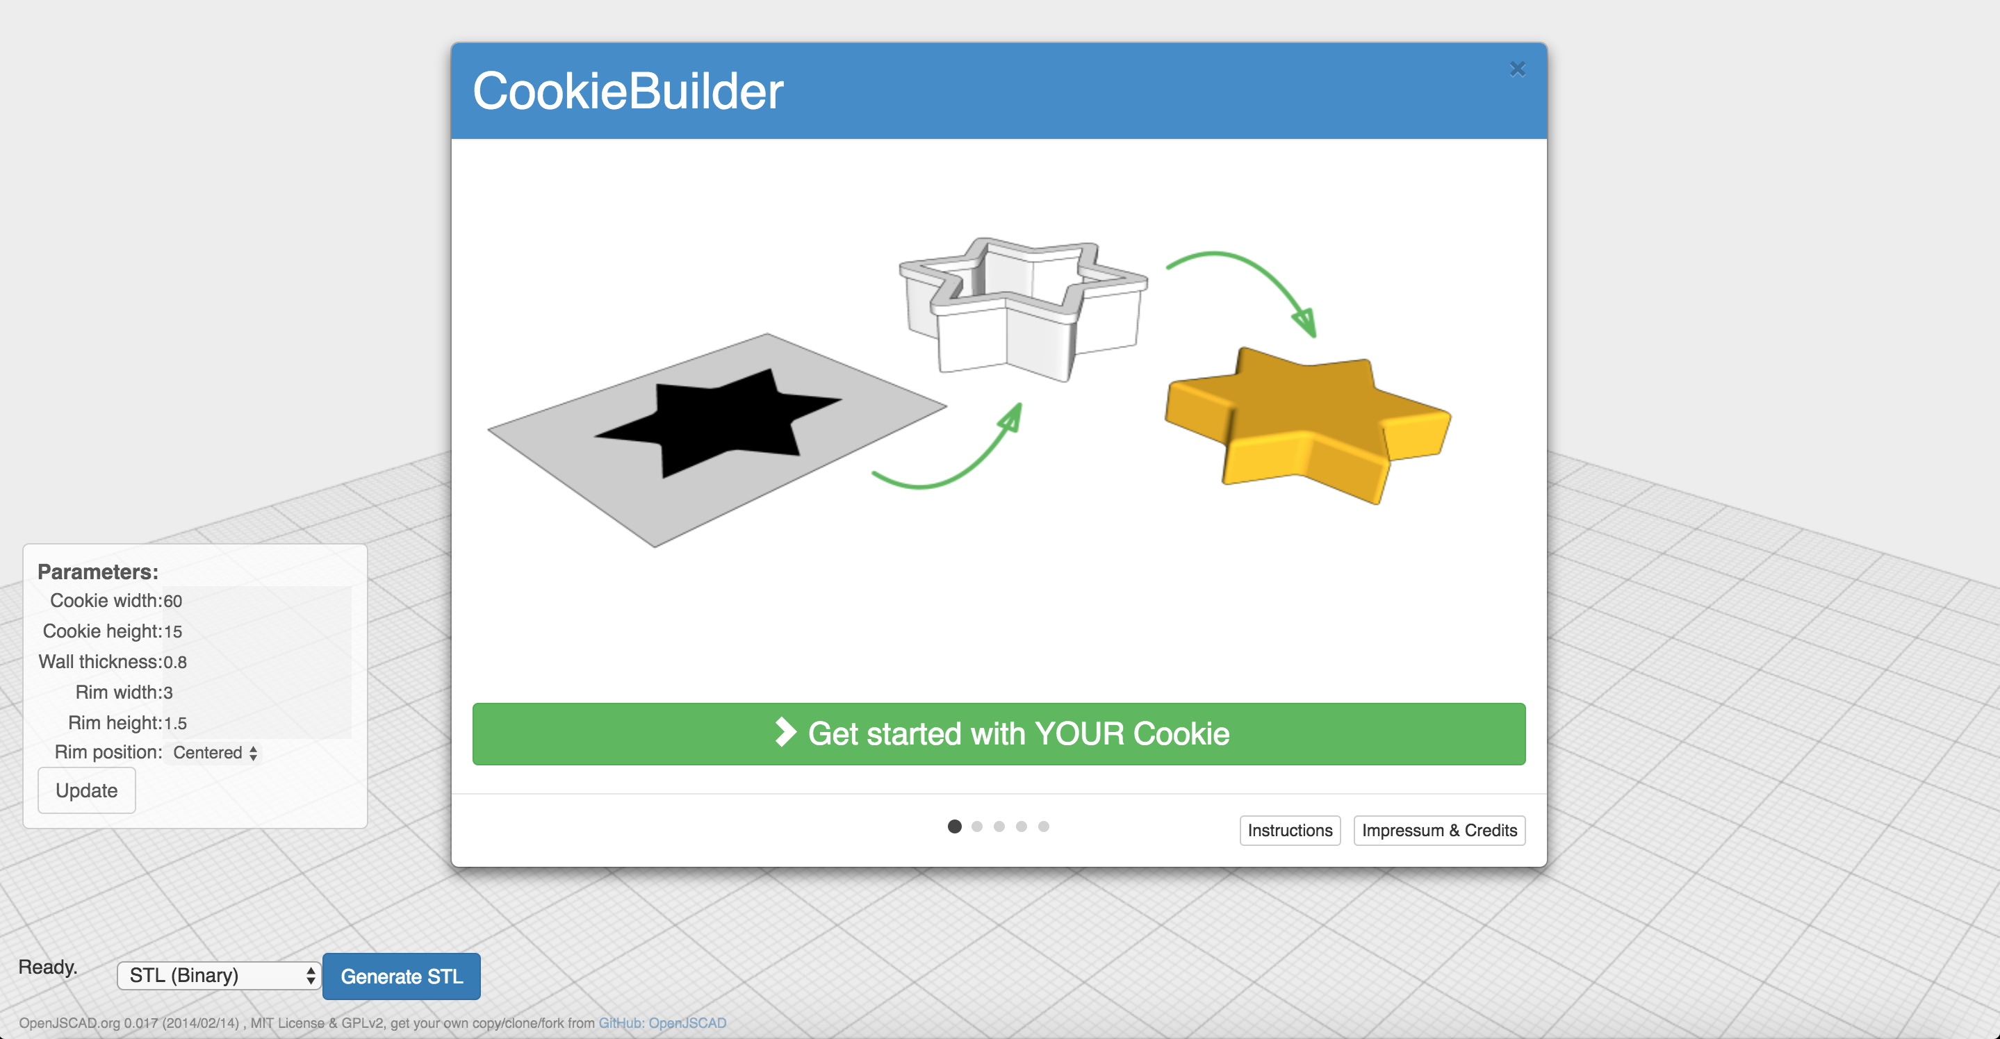
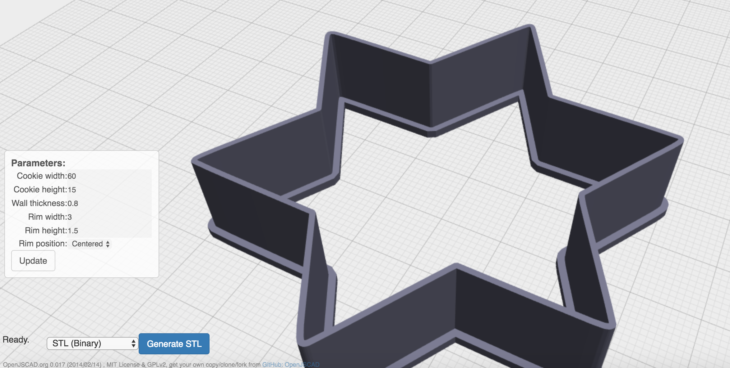
Cookie maker by Kurt Meister http://3km.ch/cookiebuilder/

Slide 25
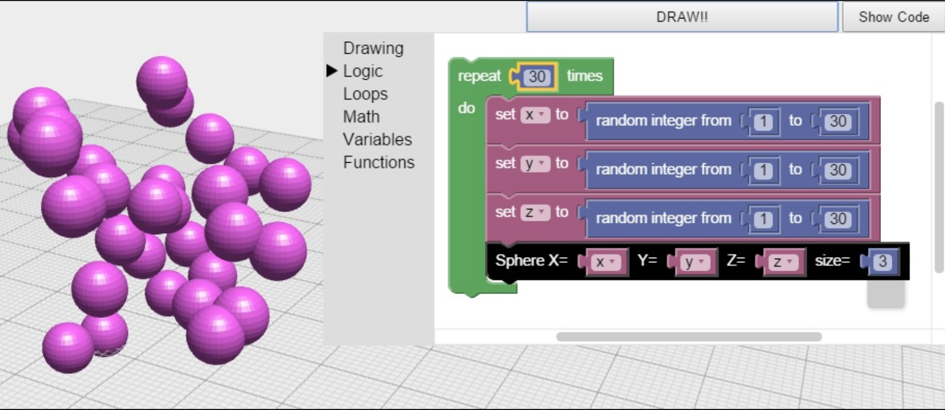
Blockly + OpenJSCAD http://inspiredtoeducate.net/blockly /demos/blockbuilder/

Slide 26
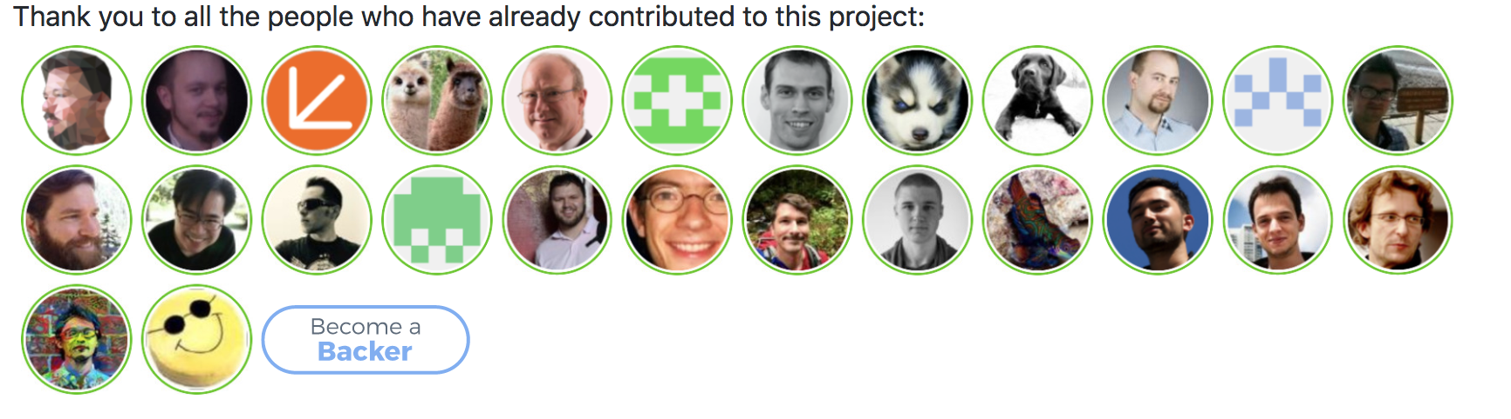
It’s been a long road...
- created in 2012 ! By Joost Nieuwenhuijse based on Evan Wallace's CSG.js
- huge work by Rene K Muller and then Jeff Gay
- currently 2 main developers : Jeff Gay & Mark Moissette
- lots of occasional contributors

Slide 27
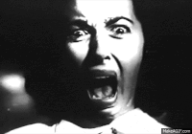
- upgrade old/ legacy code ?
- start from scratch ?
→ no units tests !!?
→ > 1000 loc files !!?
→ no modules ?
→ globals everywhere !

Slide 28
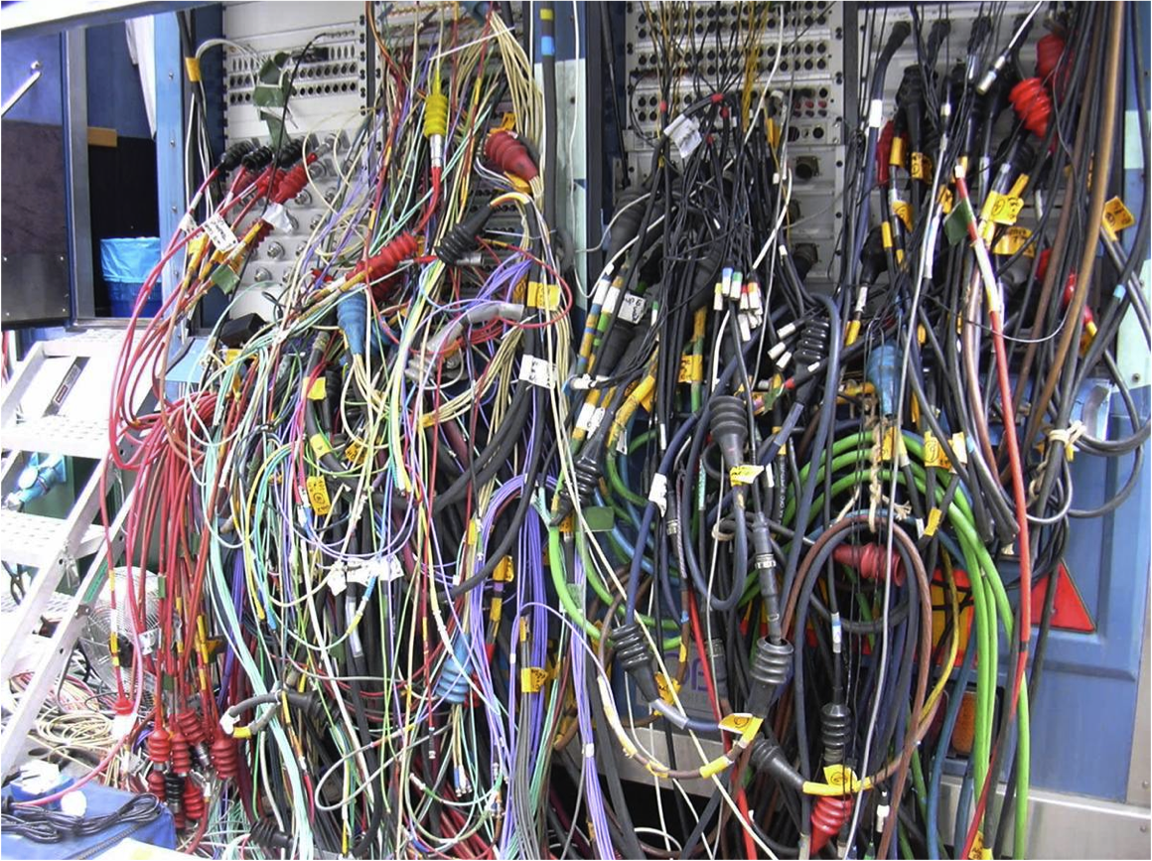

Slide 29
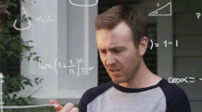
enormous amount of
- splitting up
- cleanup
- unit testing
- ...

Slide 30
- embrace js ecosystem...
- node modules
- browserify
- automation (ci, releases)
- travis
- lerna
- … but keep minimalism
- barebones es6 features
- babel, transpiling rejected
- two core maintainers : limited time

Slide 31
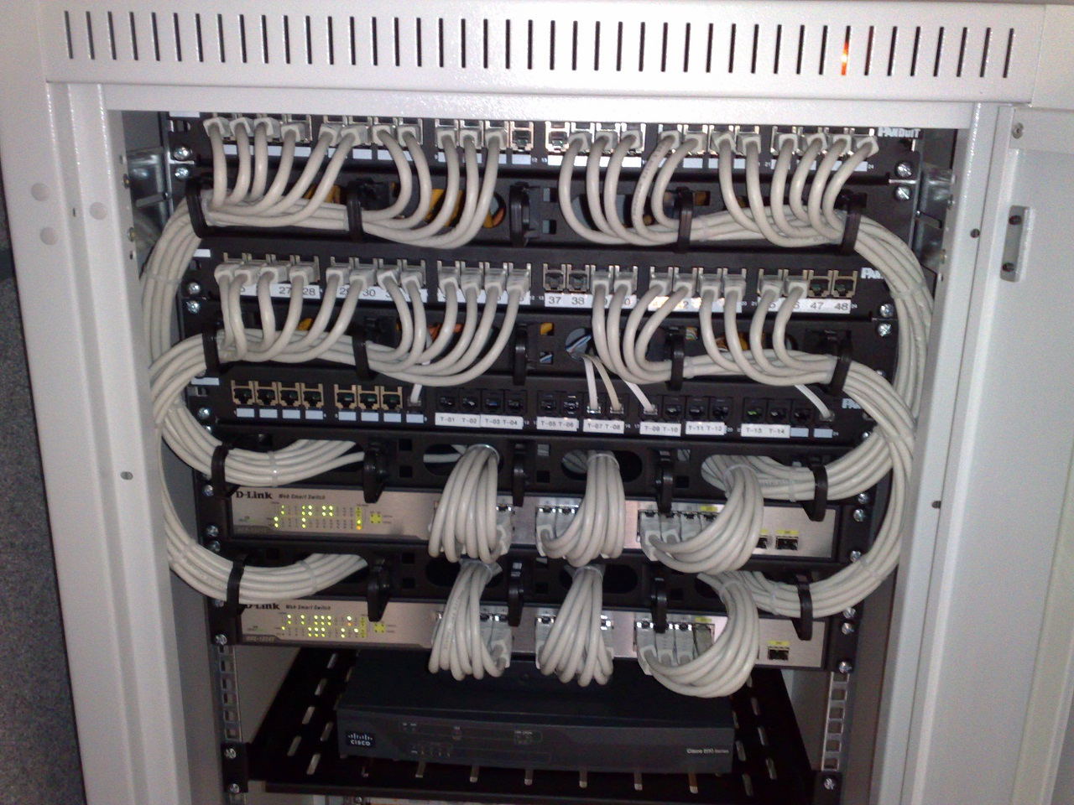
Back to the future !

Slide 32
- originally 100% client side: huge challenges
- how to deal with modular code ?
- how to make it accessible?
- delicate balance between simplicity and features
- very variable user skill level
- we (the devs) have to adapt

Slide 33
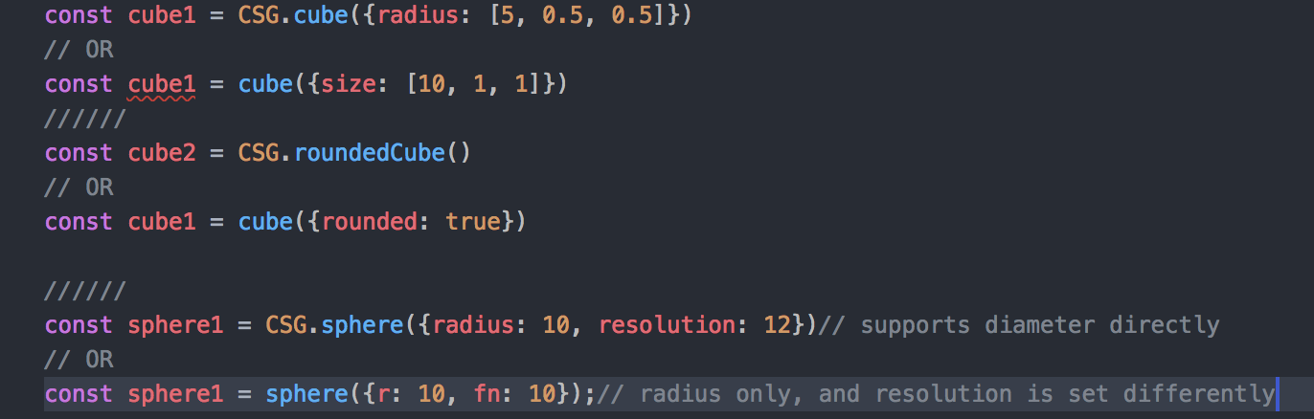
A tale of TWO apis
- evolution towards a single one
- functional first
- soft deprecation vs hard break
- semantic versioning

Slide 34
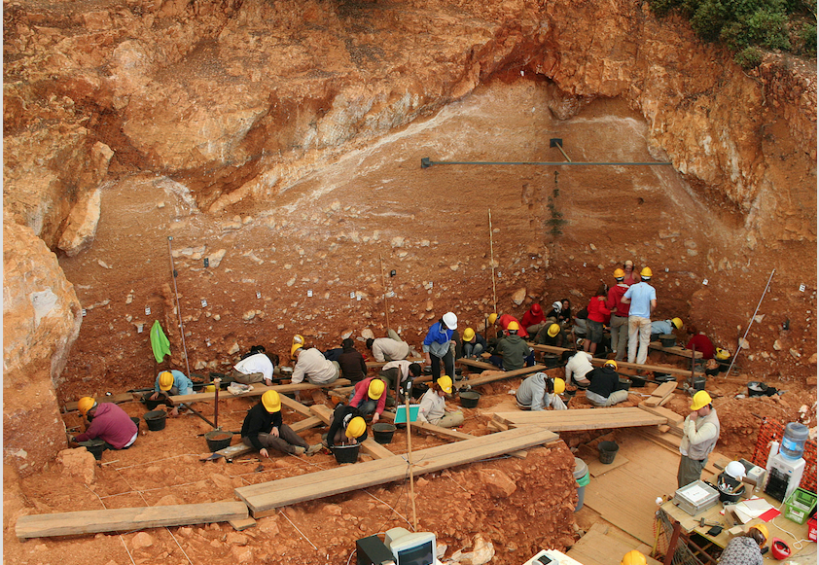

Slide 35
Performance issues
* geometric complexity
* numeric precision
* algorithmic quality
* blunt force vs diff/incremental re-eval (ast)
* cpu: wasm
* gpu: limits of webgl(2)

Slide 36
Community, reusability
* reusable designs : node module support
* do not reinvent the wheel
* reuse the js ecosystem

Slide 37
LESS IS MORE !
EXPLICIT IS BETTER THAN IMPLICIT !!

Slide 38
Questions ?

Slide 39
Acknowledgments and thanks
A HUUGE thanks to all the members of the JSCAD community, past, present and future!
https://plus.google.com/communities/114958480887231067224
Also & particularly:
- the authors & contributors of OpenSCAD
- the original authors of OpenJSCAD
- Jeff Gay for his awesome work & being a great open minded developer to work with !
Last but not least , the organizers of Hannover.js , vielen Dank ! :)

