Slide 1
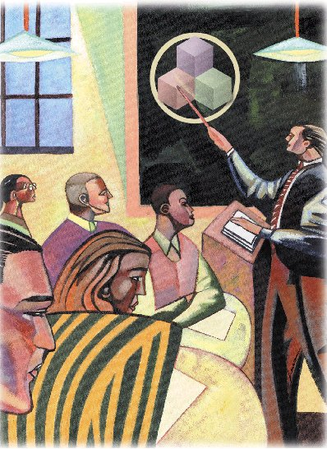
Ten Principles of Economics

Slide 2
Economy. . .
. . . The word economy comes from a Greek word ‘Oikonomos’ for “one who manages a household.”

Slide 3
A household and an economy face many decisions:
Who will work?
What goods and how many of them should be produced?
What resources should be used in production?
At what price should the goods be sold?

Slide 4
Society and Scarce Resources:
The management of society’s resources is important because resources are scarce.

Slide 5
Scarcity . . .
. . . means that society has limited resources and therefore cannot produce all the goods and services people wish to have.

Slide 6
Economics
Economics is the study of how society manages its scarce resources.
Economists seek to understand how well the market economy works, and to identify where governments may need to intervene to correct specific aspects of market failure.

Slide 7
Economists study. . .
How people make decisions.
How people interact with each other.
The forces and trends that affect the economy as a whole.

Slide 8
Ten Principles of Economics
How People Make Decisions
1. People face tradeoffs.
2. The cost of something is what you give up to get it.
3. Rational people think at the margin.
4. People respond to incentives.
Notes:
7

Slide 9
Ten Principles of Economics
How People Interact
5. Trade can make everyone better off.
6. Markets are usually a good way to organize economic activity.
7. Governments can sometimes improve economic outcomes.
Notes:
7

Slide 10
Ten Principles of Economics
How the Economy as a Whole Works
8. The standard of living depends on a country’s production.
9. Prices rise when the government prints too much money.
10. Society faces a short-run tradeoff between inflation and unemployment.
Notes:
7

Slide 11
1. People face tradeoffs.
“There is no such thing as a free lunch!”

Slide 12
1. People face tradeoffs.
To get one thing, we usually have to give up another thing.
Guns v. butter
Food v. clothing
Leisure time v. work
Efficiency v. equity
Making decisions requires trading
off one goal against another.

Slide 13
1. People face tradeoffs.
Efficiency v. Equity
Efficiency means society gets the most that it can from its scarce resources.
Equity means the benefits of those resources are distributed fairly among the members of society.
Notes:
9

Slide 14
2. The cost of something is what you give up to get it.
Decisions require comparing costs and benefits of alternatives.
Whether to go to college or to work?
Whether to study or go out on a date?
Whether to go to class or sleep in?
Notes:
10

Slide 15
2. The cost of something is what you give up to get it.
The opportunity cost of an item is what you give up to obtain that item.
Notes:
10

Slide 16
3. Rational people think at the margin.
Marginal changes are small, incremental adjustments to an existing plan of action.
People make decisions by comparing costs and benefits at the margin.
Notes:
11

Slide 17
4. People respond to incentives.
Marginal changes in costs or benefits motivate people to respond.
The decision to choose one alternative over another occurs when that alternative’s marginal benefits exceed its marginal costs!
Notes:
12

Slide 18
5. Trade can make everyone better off.
People gain from their ability to trade with one another.
Competition results in gains from trading.
Trade allows people to specialize in what they do best.
Notes:
15

Slide 19
6. Markets are usually a good way to organize economic activity.
In a market economy, households decide what to buy and who to work for.
Firms decide who to hire and what to produce.
Notes:
16

Slide 20
6. Markets are usually a good way to organize economic activity.
Adam Smith made the observation that households and firms interacting in markets act as if guided by an “invisible hand.”
Notes:
16

Slide 21
6. Markets are usually a good way to organize economic activity.
Because households and firms look at prices when deciding what to buy and sell, they unknowingly take into account the social costs of their actions.
As a result, prices guide decision makers to reach outcomes that tend to maximize the welfare of society as a whole.
Notes:
16

Slide 22
7. Governments can sometimes improve market outcomes.
When the market fails (breaks down) government can intervene to promote efficiency and equity.
Notes:
17

Slide 23
7. Governments can sometimes improve market outcomes.
Market failure occurs when the market fails to allocate resources efficiently.
Notes:
17

Slide 24
7. Governments can sometimes improve market outcomes.
Market failure may be caused by an externality, which is the impact of one person or firm’s actions on the well-being of a bystander.
Notes:
18

Slide 25
7. Governments can sometimes improve market outcomes.
Market failure may also be caused by market power, which is the ability of a single person or firm to unduly influence market prices.
Notes:
17

Slide 26
8. The standard of living depends on a country’s production.
Standard of living may be measured in different ways:
By comparing personal incomes.
By comparing the total market value of a nation’s production.
Notes:
21

Slide 27
8. The standard of living depends on a country’s production.
Almost all variations in living standards are explained by differences in countries’ productivities.
Notes:
21

Slide 28
8. The standard of living depends on a country’s production.
Productivity is the amount of goods and services produced from each hour of a worker’s time.
Higher productivity ⇨ Higher standard of living
Notes:
22

Slide 29
9. Prices rise when the government prints too much money.
Inflation is an increase in the overall level of prices in the economy.
One cause of inflation is the growth in the quantity of money.
When the government creates large quantities of money, the value of the money falls.
Notes:
23

Slide 30
10. Society faces a short-run tradeoff between inflation and unemployment.
The Phillips Curve illustrates the tradeoff between inflation and unemployment:
Inflation ⇨ Unemployment
It’s a short-run tradeoff!
Notes:
24

Slide 31
Summary
When individuals make decisions, they face tradeoffs.
Rational people make decisions by comparing marginal costs and marginal benefits.

Slide 32
Summary
People can benefit by trading with each other.
Markets are usually a good way of coordinating trades.
Government can potentially improve market outcomes.

Slide 33
Summary
A country’s productivity determines its living standards.
Society faces a short-run tradeoff between inflation and unemployment.

