Slide 1
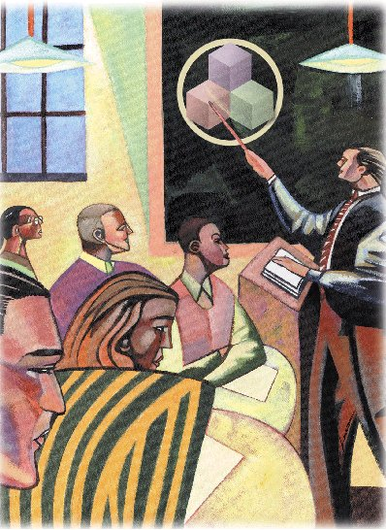
Interdependence and the Gains from Trade
Chapter 3

Slide 2
Interdependence and Trade
Consider your necessary items in a typical day:
Alarm clock
Computer/laptop
Mobile
Dress material
Food
Car/scooter
././././
././////
…and you haven’t been up for more than 5 hours yet!

Slide 3
Interdependence and Trade
Remember, economics is the study of how societies produce and distribute goods in an attempt to satisfy the wants and needs of its members.
Notes:
2

Slide 4
How do we satisfy our wants and needs in a global economy?
We can be economically self-sufficient.
We can specialize and trade with others, leading to economic interdependence.
Notes:
3

Slide 5
Interdependence and Trade
A general observation . . .
Individuals and nations rely on specialized production and exchange as a way to address problems caused by scarcity.
Notes:
4

Slide 6
Interdependence and Trade
But, this gives rise to two questions:
Why is interdependence the norm?
What determines production and trade?
Notes:
4

Slide 7
Why is interdependence the norm?
Interdependence occurs because people are better off when they specialize and trade with others.

Slide 8
What determines the pattern of production and trade?
Patterns of production and trade are based upon differences in opportunity costs.

Slide 9
A Parable for the Modern Economy
Imagine . . .
  only two goods: potatoes and meat
  only two people: a potato farmer and a cattle rancher
What should each produce?
Why should they trade?

Slide 10
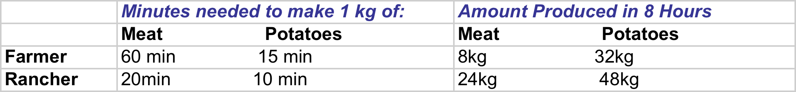
The Production Opportunities of the Farmer and the Rancher

Slide 11
Self-Sufficiency
By ignoring each other:
Each consumes what they each produce.
The production possibilities frontier is also the consumption possibilities frontier.
Without trade, economic gains are diminished.
Notes:
8

Slide 12
Production Possibilities Frontiers
Meat (kgs)
(a) The Farmer’s Production
Possibilities Frontier
8
A
4
0
16
32
Potatoes (kgs)
Notes:
7

Slide 13
Production Possibilities Frontiers
Meat (kgs)
24
(b) The Rancher’s Production
Possibilities Frontier
B
12
0
24
48
Potatoes (kgs)
Notes:
7

Slide 14
The Farmer and the Rancher Specialize and Trade
Each would be better off if they specialized in producing the product they are more suited to produce, and then trade with each other.
The farmer should produce potatoes.
The rancher should produce meat.
Notes:
10

Slide 15
The Principle of
Comparative Advantage
Differences in the costs of production determine the following:
Who should produce what?
How much should be traded for each product?
Who can produce potatoes at a lower cost--the farmer or the rancher?
Notes:
11

Slide 16
Differences in Costs of Production
Two ways to measure differences in costs of production:
The number of hours required to produce a unit of output. (for example, one kg potatoes)
The opportunity cost of sacrificing one good for another.

Slide 17
Absolute Advantage
Describes the productivity of one person, firm, or nation compared to that of another.
The producer that requires a smaller quantity of inputs to produce a good is said to have an absolute advantage in producing that good.
Notes:
13

Slide 18
Comparative Advantage
Compares producers of a good according to their opportunity cost.
The producer who has the smaller opportunity cost of producing a good is said to have a comparative advantage in producing that good.
Notes:
14

Slide 19
Specialization and Trade
Who has the absolute advantage?
The farmer or the rancher?
Who has the comparative advantage?
The farmer or the rancher?
Notes:
15

Slide 20
Absolute Advantage
The Rancher needs only 10 minutes to produce a kg of potatoes, whereas the Farmer needs 15min.
The Rancher needs only 20 min to produce a kg of meat, whereas the Farmer needs 60min.
The Rancher has an absolute advantage in the production of both meat and potatoes: Input cost is low.

Slide 21
The Opportunity Cost of Meat and Potatoes
Opportunity cost of
1kg of Meat 1kg of potatoes
Farmer 4kg P ¼ kg M
Rancher 2kg P ½ kg M

Slide 22
Comparative Advantage
…so, the Rancher has a comparative advantage in the production of meat but the Farmer has a comparative advantage in the production of potatoes.

Slide 23
The Principle of
Comparative Advantage
Comparative advantage and differences in opportunity costs are the basis for specialized production and trade.
Whenever potential trading parties have differences in opportunity costs, they can each benefit from trade.
Notes:
16

Slide 24
Benefits of Trade
Trade can benefit everyone in a society because it allows people to specialize in activities in which they have a comparative advantage.
Notes:
17

Slide 25
Adam Smith and Trade
In his 1776 book An Inquiry into the Nature and Causes of the Wealth of Nations, Adam Smith performed a detailed analysis of trade and economic interdependence, which economists still adhere to today.

Slide 26
David Ricardo and Trade
In his 1816 book Principles of Political Economy and Taxation, David Ricardo developed the principle of comparative advantage as we know it today.

Slide 27

Should SRK Mow His Own Lawn?
?
?
?

Slide 28
Summary
Interdependence and trade allow people to enjoy a greater quantity and variety of goods and services.

Slide 29
Summary
The person who can produce a good with a smaller quantity of inputs has an absolute advantage.
The person with a smaller opportunity cost has a comparative advantage.

Slide 30
Summary
The gains from trade are based on comparative advantage, not absolute advantage.
Comparative advantage applies to countries as well as to people.

