Slide 1

Consumers, Producers, and the Efficiency of Markets
Chapter 7

Slide 2
Revisiting the Market Equilibrium
Do the equilibrium price and quantity maximize the total welfare of buyers and sellers?
Market equilibrium reflects the way markets allocate scarce resources.
Whether the market allocation is desirable is determined by welfare economics.
Notes:
2
3

Slide 3
Welfare Economics
Welfare economics is the study of how the allocation of resources affects economic well-being.
Buyers and sellers receive benefits from taking part in the market.
The equilibrium in a market maximizes the total welfare of buyers and sellers.
Notes:
3
4

Slide 4
Welfare Economics
Equilibrium in the market results in maximum benefits, and therefore maximum total welfare for both the consumers and the producers of the product.
Notes:
4
5

Slide 5
Welfare Economics
Consumer surplus measures economic welfare from the buyer’s side.
Producer surplus measures economic welfare from the seller’s side.
Notes:
5
5

Slide 6
Consumer Surplus
Willingness to pay is the maximum price that a buyer is willing and able to pay for a good.
It measures how much the buyer values the good or service.
Notes:
6
9

Slide 7
Consumer Surplus
Consumer surplus is the amount a buyer is willing to pay for a good minus the amount the buyer actually pays for it.
Notes:
9
10

Slide 8
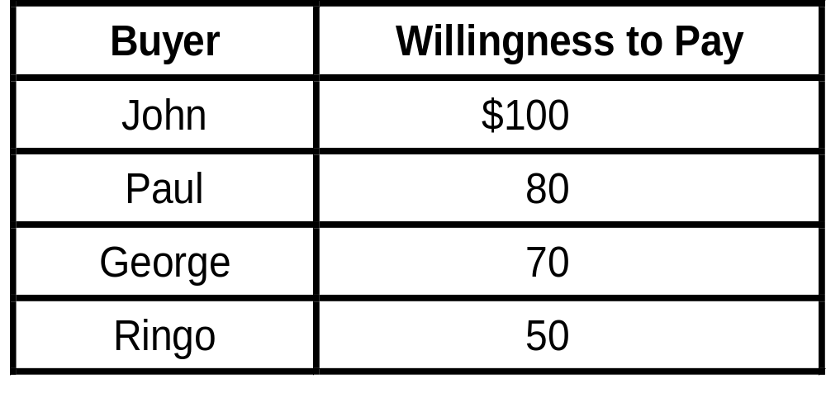
Four Possible Buyers’ Willingness to Pay...
Notes:
10
11

Slide 9
Consumer Surplus
The market demand curve depicts the various quantities that buyers would be willing and able to purchase at different prices.
Notes:
8
6

Slide 10
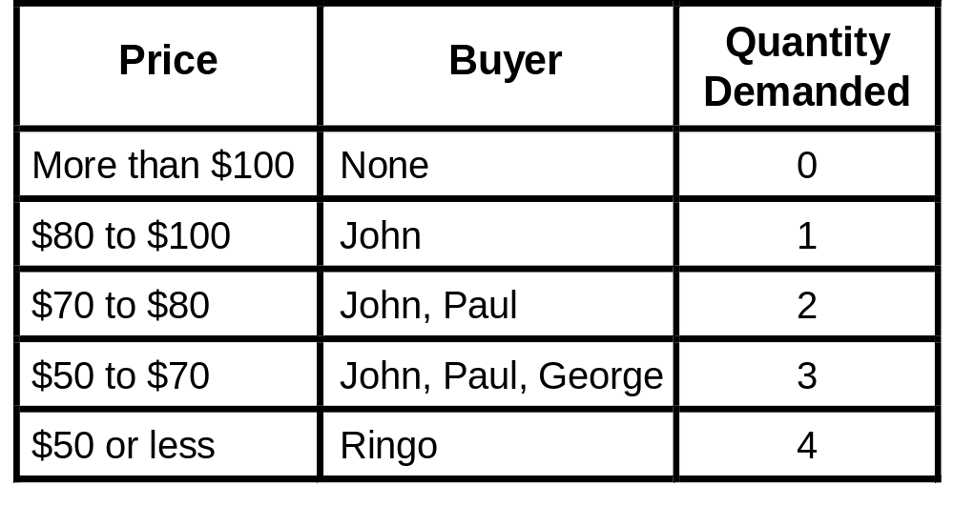
Four Possible Buyers’ Willingness to Pay...
Notes:
11
11

Slide 11
Measuring Consumer Surplus with the Demand Curve...
Price of
Album
$100
John’s willingness to pay
Paul’s willingness to pay
80
70
George’s willingness to pay
Ringo’s willingness to pay
50
Demand
0
1
2
3
4
Quantity of
Albums
Notes:
13
13

Slide 12
Measuring Consumer Surplus with the Demand Curve...
Price of
Album
Price = $80
$100
John’s consumer surplus ($20)
80
70
50
Demand
0
1
2
3
4
Quantity of
Albums
Notes:
13
13

Slide 13
Measuring Consumer Surplus with the Demand Curve...
Price of
Album
Price = $70
$100
John’s consumer surplus ($30)
80
Paul’s consumer surplus ($10)
70
50
Total consumer surplus ($40)
Demand
0
1
2
3
4
Quantity of
Albums
Notes:
13
13

Slide 14
Measuring Consumer Surplus with the Demand Curve
The area below the demand curve and above the price measures the consumer surplus in the market.
Notes:
13
13

Slide 15
How the Price Affects Consumer Surplus...
Price
A
Initial
consumer
surplus
Consumer surplus to new consumers
P₁
C
B
P₂
F
D
E
Additional consumer surplus to initial consumers
Demand
0
Q₁
Q₂
Quantity
Notes:
21
17

Slide 16
Consumer Surplus and Economic Well-Being
Consumer surplus, the amount that buyers are willing to pay for a good minus the amount they actually pay for it, measures the benefit that buyers receive from a good as the buyers themselves perceive it.
Notes:
5
5

Slide 17
Producer Surplus
Producer surplus is the amount a seller is paid minus the cost of production.
It measures the benefit to sellers participating in a market.
Notes:
34
24

Slide 18
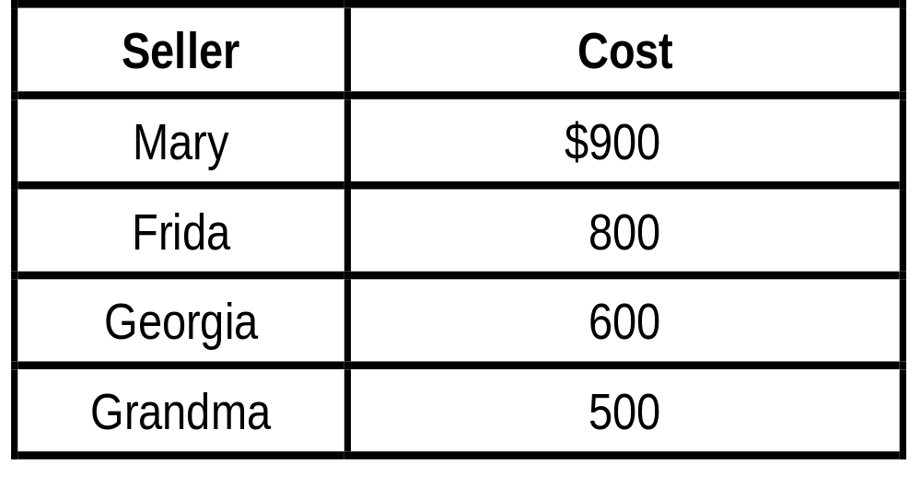
The Costs of Four Possible Sellers...
Notes:
35
11

Slide 19
Producer Surplus and the Supply Curve
Just as consumer surplus is related to the demand curve, producer surplus is closely related to the supply curve.
At any quantity, the price given by the supply curve shows the cost of the marginal seller, the seller who would leave the market first if the price were any lower.
Notes:
32
22

Slide 20
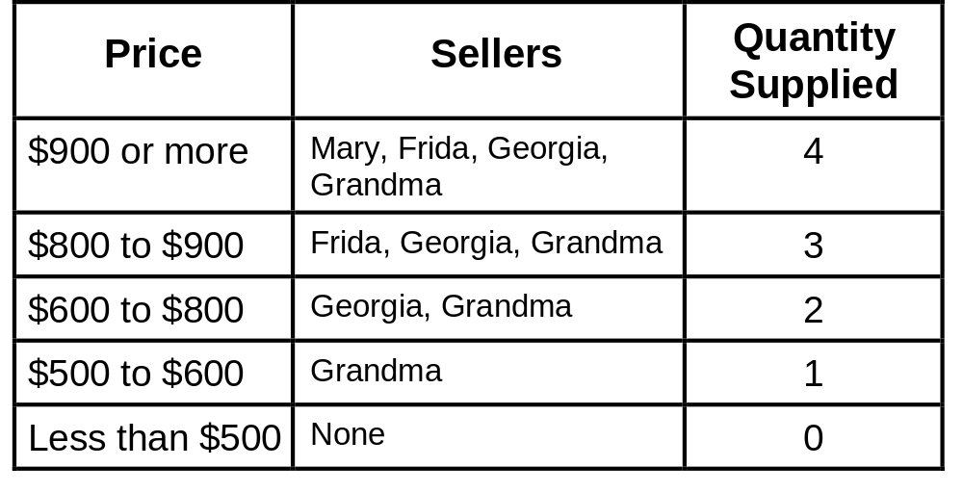
Supply Schedule for the Four Possible Sellers...
Notes:
36
11

Slide 21
Producer Surplus and the
Supply Curve...
Price of
House
Painting
Supply
$900
Mary’s cost
Frida’s cost
800
600
Georgia’s cost
Grandma’s cost
500
0
1
2
3
4
Quantity of
Houses Painted
Notes:
38
26

Slide 22
Producer Surplus and the
Supply Curve
The area below the price and above the supply curve measures the producer surplus in a market.

Slide 23
Measuring Producer Surplus with the Supply Curve...
Price of
House
Painting
Price = $600
Supply
$900
800
600
500
Grandma’s producer
surplus ($100)
0
1
2
3
4
Quantity of
Houses Painted
Notes:
38
26

Slide 24
Measuring Producer Surplus with the Supply Curve...
Price of
House
Painting
Price = $800
Supply
Total
producer
surplus ($500)
$900
800
Georgia’s producer
surplus ($200)
600
500
Grandma’s producer
surplus ($300)
0
1
2
3
4
Quantity of
Houses Painted
Notes:
38
26

Slide 25
How Price Affects Producer Surplus...
Price
Supply
Additional producer
surplus to initial
producers
P₂
D
E
F
P₁
B
Initial Producer
surplus
C
Producer surplus
to new producers
A
0
Q₁
Q₂
Quantity
Notes:
45
26

Slide 26
Market Efficiency
Consumer surplus and producer surplus may be used to address the following question:
  Is the allocation of resources determined by free markets in any way desirable?
Notes:
53
32

Slide 27
Economic Well-Being and Total Surplus
Consumer Surplus
Value to buyers
_
Amount paid by buyers
=
and
Producer Surplus
Amount received by sellers
_
Cost to sellers
=

Slide 28
Economic Well-Being and Total Surplus
Total Surplus
Consumer Surplus
+
Producer Surplus
=
or
Total Surplus
Value to
buyers
_
Cost to sellers
=

Slide 29
Market Efficiency
Market efficiency is achieved when the allocation of resources maximizes total surplus.
Notes:
54
32

Slide 30
Market Efficiency
In addition to market efficiency, a social planner might also care about equity – the fairness of the distribution of well-being among the various buyers and sellers.
Notes:
54
32

Slide 31
Evaluating the Market Equilibrium...
Price
A
D
Supply
Equilibrium
price
E
B
Demand
C
0
Equilibrium
quantity
Quantity
Notes:
56
33

Slide 32
Consumer and Producer Surplus in the Market Equilibrium...
Price
A
D
Supply
Consumer
surplus
Equilibrium
price
E
Producer
surplus
B
Demand
C
0
Equilibrium
quantity
Quantity
Notes:
56
33

Slide 33
Three Insights Concerning Market Outcomes
Free markets allocate the supply of goods to the buyers who value them most highly.
Free markets allocate the demand for goods to the sellers who can produce them at least cost.
Free markets produce the quantity of goods that maximizes the sum of consumer and producer surplus.

Slide 34
The Efficiency of the Equilibrium Quantity
Price
Supply
Value to buyers
Cost to sellers
Cost to sellers
Value to buyers
Demand
0
Equilibrium
quantity
Quantity
Value to buyers is greater than cost to sellers.
Value to buyers is less than cost to sellers.
Notes:
8

Slide 35
The Efficiency of the Equilibrium Quantity
Because the equilibrium outcome is an efficient allocation of resources, the social planner can leave the market outcome as he/she finds it.
This policy of leaving well enough alone goes by the French expression laissez faire.

Slide 36
Market Power
If a market system is not perfectly competitive, market power may result.
Market power is the ability to influence prices.
Market power can cause markets to be inefficient because it keeps price and quantity from the equilibrium of supply and demand.
Notes:
67
38

Slide 37
Externalities
Externalities are created when a market outcome affects individuals other than buyers and sellers in that market.
Externalities cause welfare in a market to depend on more than just the value to the buyers and cost to the sellers.
When buyers and sellers do not take externalities into account when deciding how much to consume and produce, the equilibrium in the market can be inefficient.
Notes:
68
39

Slide 38
Summary
Consumer surplus measures the benefit buyers get from participating in a market.
Consumer surplus can be computed by finding the area below the demand curve and above the price.

Slide 39
Summary
Producer surplus measures the benefit sellers get from participating in a market.
Producer surplus can be computed by finding the area below the price and above the supply curve.

Slide 40
Summary
The equilibrium of demand and supply maximizes the sum of consumer and producer surplus.
This is as if the invisible hand of the marketplace leads buyers and sellers to allocate resources efficiently.
Markets do not allocate resources efficiently in the presence of market failures.

Slide 41
Summary
An allocation of resources that maximizes the sum of consumer and producer surplus is said to be efficient.
Policymakers are often concerned with the efficiency, as well as the equity, of economic outcomes.

