Slide 1
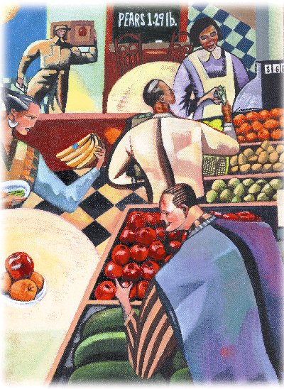
The Market Forces of Supply and Demand
Chapter 4

Slide 2
The Market Forces of
Supply and Demand
Supply and demand are the two words that economists use most often.
Supply and demand are the forces that make market economies work.
Modern microeconomics is about supply, demand, and market equilibrium.
Notes:
2

Slide 3
Markets
A market is a group of buyers and sellers of a particular good or service.
The terms supply and demand refer to the behavior of people . . . as they interact with one another in markets.
Notes:
4

Slide 4
Markets
Buyers determine demand.
Sellers determine supply.
Notes:
4

Slide 5
Market Type:
A Competitive Market
A competitive market is a market. . .
  with many buyers and sellers.
  that is not controlled by any one person.
  in which a narrow range of prices are established that buyers and sellers act upon.
Notes:
5

Slide 6
Competition:
Perfect and Otherwise
Perfect Competition
Products are the same
Numerous buyers and sellers so that each has no influence over price
Buyers and Sellers are price takers
Notes:
6

Slide 7
Competition:
Perfect and Otherwise
Monopoly
  One seller, and seller controls price
Oligopoly
  Few sellers
  Not always aggressive competition
Notes:
6

Slide 8
Competition:
Perfect and Otherwise
Monopolistic Competition
  Many sellers
  Slightly differentiated products
  Each seller may set price for its own product
Notes:
6

Slide 9
Demand
Quantity demanded
is the amount
of a good that buyers are
willing and able
to purchase.
Notes:
8

Slide 10
Law of Demand
The law of demand states that there is an inverse relationship between price and quantity demanded.
Notes:
12

Slide 11
Demand Schedule
The demand schedule is a table
that shows the relationship
between the price of the good
and the quantity demanded.
Notes:
17

Slide 12
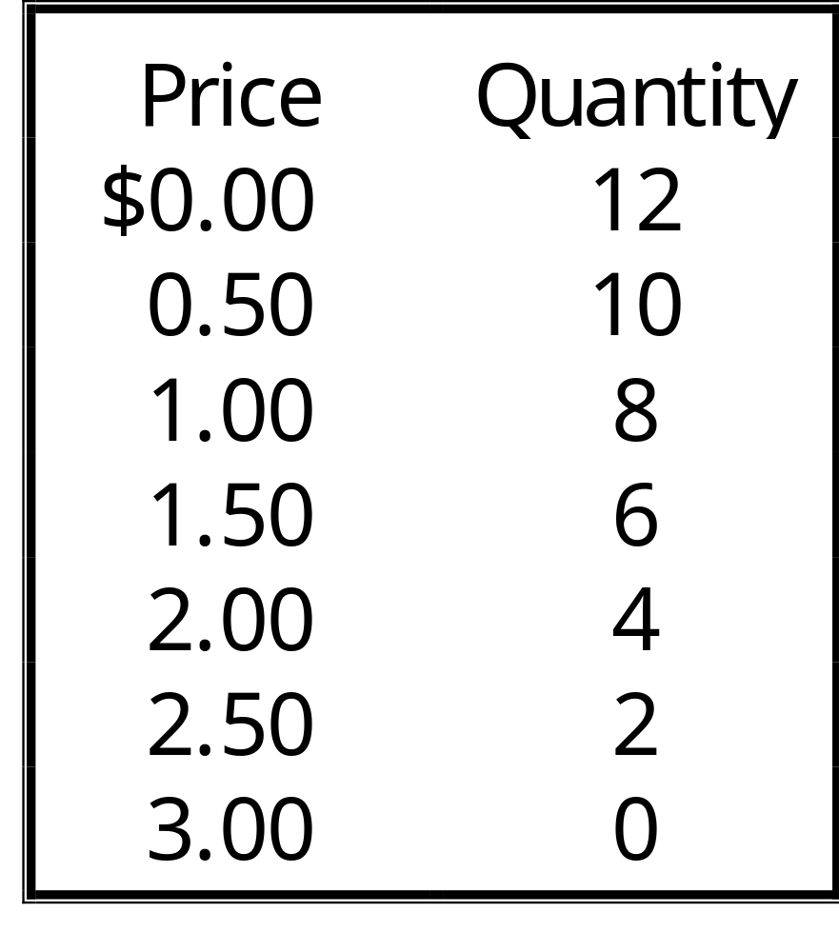
Demand Schedule
Notes:
17

Slide 13
Determinants of Demand
Market price
Consumer income
Prices of related goods
Tastes
Expectations
Notes:
11

Slide 14
Demand Curve
The demand curve is the downward-sloping line relating price to quantity demanded.
Notes:
17

Slide 15
Demand Curve
Price of Ice-Cream Cone
$3.00
2.50
2.00
1.50
1.00
0.50
Quantity of Ice-Cream Cones
0
1
2
3
4
5
6
7
8
9
10
11
12
Notes:
17

Slide 16
Ceteris Paribus
Ceteris paribus is a Latin phrase that means all variables other than the ones being studied are assumed to be constant. Literally, ceteris paribus means “other things being equal.”
The demand curve slopes downward because, ceteris paribus, lower prices imply a greater quantity demanded!
Notes:
18

Slide 17
Market Demand
Market demand refers to the sum of all individual demands for a particular good or service.
Graphically, individual demand curves are summed horizontally to obtain the market demand curve.

Slide 18
Determinants of Demand
Market price
Consumer income
Prices of related goods
Tastes
Expectations
Notes:
11

Slide 19
Change in Quantity Demanded versus Change in Demand
Change in Quantity Demanded
Movement along the demand curve.
Caused by a change in the price of the product.
Notes:
19

Slide 20
Changes in Quantity Demanded
Price of Cigarettes per Pack
A tax that raises the price of cigarettes results in a movement along the demand curve.
C
$4.00
A
2.00
D₁
0
12
20
Number of Cigarettes Smoked per Day

Slide 21
Change in Quantity Demanded versus Change in Demand
Change in Demand
A shift in the demand curve, either to the left or right.
Caused by a change in a determinant other than the price.
Notes:
19

Slide 22
Changes in Demand
Price of Ice-Cream Cone
Increase in demand
Decrease in demand
D₂
D₁
D₃
0
Quantity of Ice-Cream Cones

Slide 23
Consumer Income
As income increases the demand for a normal good will increase.
As income increases the demand for an inferior good will decrease.
Notes:
13

Slide 24
Consumer Income
Normal Good
Price of Ice-Cream Cone
$3.00
An increase in income...
2.50
Increase
in demand
2.00
1.50
1.00
0.50
D₂
D₁
Quantity of Ice-Cream Cones
0
1
2
3
4
5
6
7
8
9
10
11
12

Slide 25
Consumer Income
Inferior Good
Price of Ice-Cream Cone
$3.00
2.50
An increase in income...
2.00
Decrease
in demand
1.50
1.00
0.50
D₂
D₁
Quantity of Ice-Cream Cones
0
1
2
3
4
5
6
7
8
9
10
11
12

Slide 26
Prices of Related Goods
Substitutes & Complements
When a fall in the price of one good reduces the demand for another good, the two goods are called substitutes.
When a fall in the price of one good increases the demand for another good, the two goods are called complements.
Notes:
15

Slide 27
Change in Quantity Demanded versus Change in Demand
Variables that Affect Quantity Demanded
A Change in
This Variable . . .
Price
Represents a movement
along the demand curve
Income
Shifts the demand curve
Prices of related
Shifts the demand curve
goods
Tastes
Shifts the demand curve
Expectations
Shifts the demand curve
Number of
Shifts the demand curve
buyers
Notes:
19

Slide 28
Supply
Quantity supplied is the amount of a good that sellers are willing and able to sell.
Notes:
25

Slide 29
Law of Supply
The law of supply states that there is a direct (positive) relationship between price and quantity supplied.
Notes:
28

Slide 30
Determinants of Supply
Market price
Input prices
Technology
Expectations
Number of producers
Notes:
27

Slide 31
Supply Schedule
The supply schedule is a table that shows the relationship between the price of the good and the quantity supplied.
Notes:
29

Slide 32
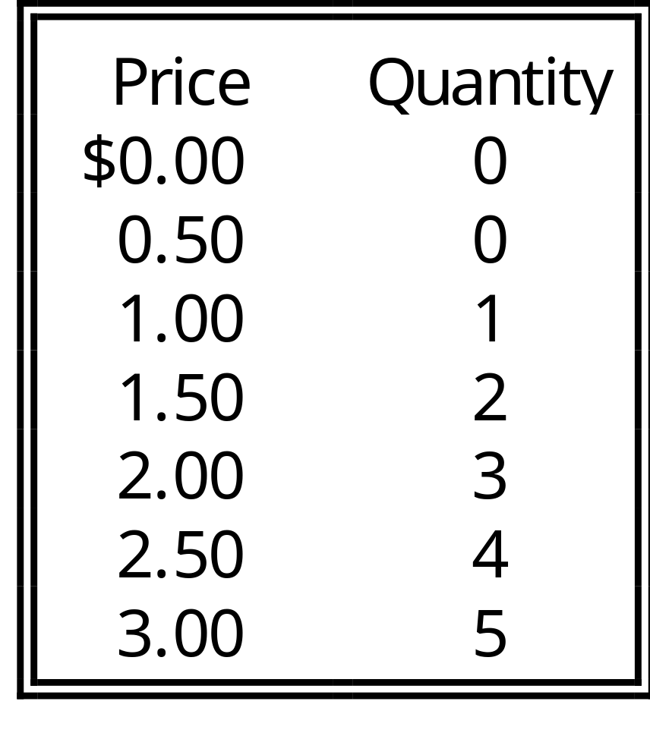
Supply Schedule
Notes:
29

Slide 33
Supply Curve
The supply curve is the upward-sloping line relating price to quantity supplied.
Notes:
29

Slide 34
Supply Curve
Price of Ice-Cream Cone
$3.00
2.50
2.00
1.50
1.00
0.50
Quantity of Ice-Cream Cones
0
1
2
3
4
5
6
7
8
9
10
11
12
Notes:
29

Slide 35
Market Supply
Market supply refers to the sum of all individual supplies for all sellers of a particular good or service.
Graphically, individual supply curves are summed horizontally to obtain the market supply curve.

Slide 36
Determinants of Supply
Market price
Input prices
Technology
Expectations
Number of producers
Notes:
27

Slide 37
Change in Quantity Supplied versus Change in Supply
Change in Quantity Supplied
Movement along the supply curve.
Caused by a change in the market price of the product.
Notes:
30

Slide 38
Change in Quantity Supplied
Price of Ice-Cream Cone
S
C
$3.00
A rise in the price of ice cream cones results in a movement along the supply curve.
A
1.00
Quantity of Ice-Cream Cones
0
1
5
Notes:
30

Slide 39
Change in Quantity Supplied versus Change in Supply
Change in Supply
A shift in the supply curve, either to the left or right.
Caused by a change in a determinant other than price.
Notes:
30

Slide 40
Change in Supply
S₃
Price of Ice-Cream Cone
S₁
S₂
Decrease in Supply
Increase in Supply
Quantity of Ice-Cream Cones
0
Notes:
30

Slide 41
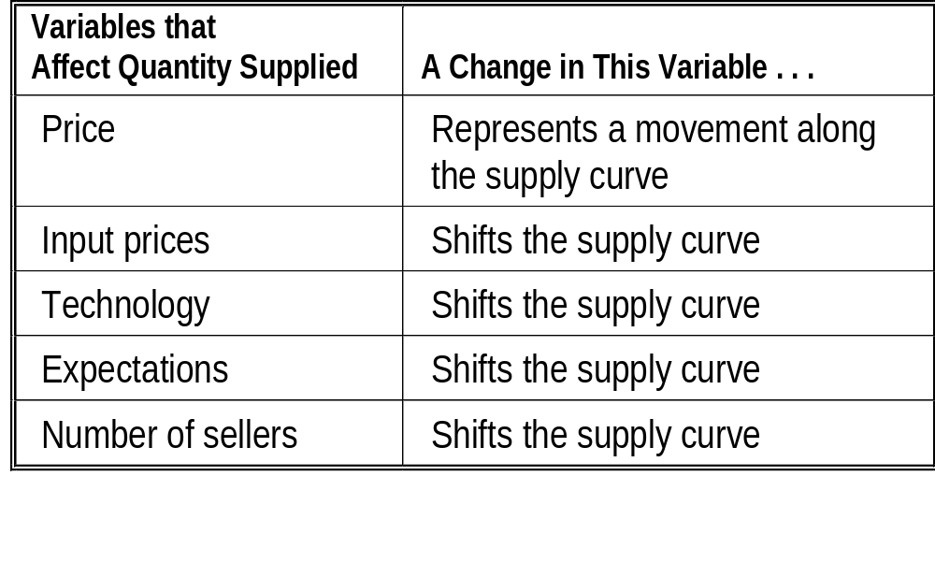
Change in Quantity Supplied versus Change in Supply
Notes:
30

Slide 42
Supply and Demand Together
Equilibrium Price
The price that balances supply and demand. On a graph, it is the price at which the supply and demand curves intersect.
Equilibrium Quantity
The quantity that balances supply and demand. On a graph it is the quantity at which the supply and demand curves intersect. 
Notes:
36

Slide 43
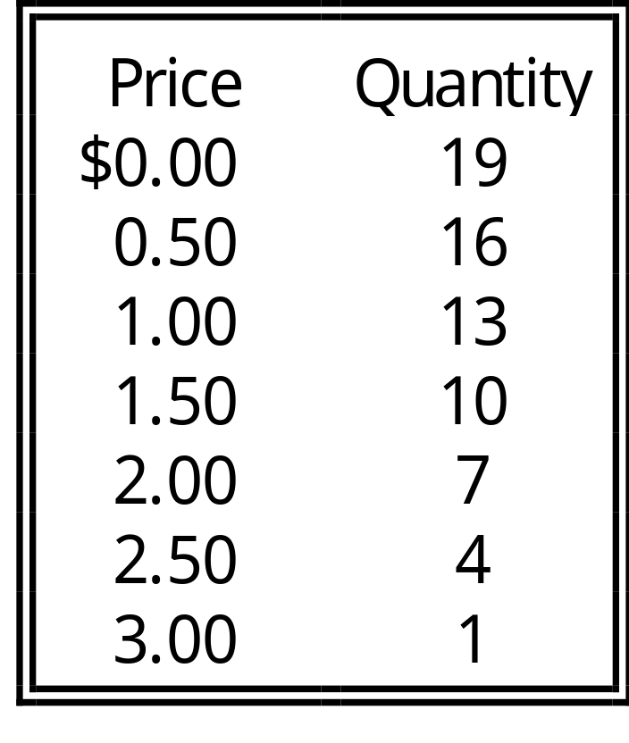
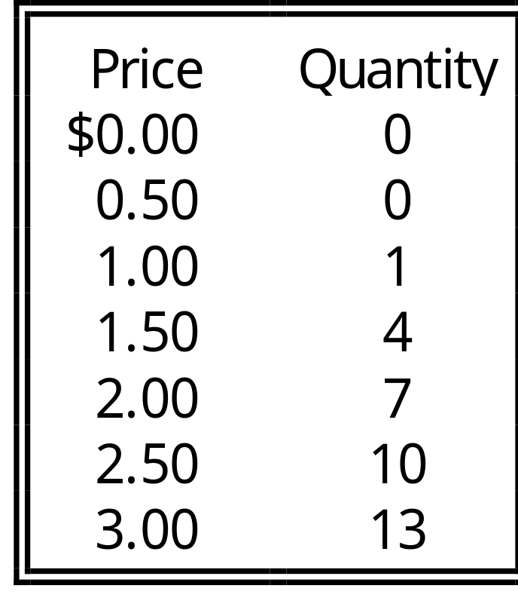
Supply and Demand Together
Demand Schedule
Supply Schedule
At $2.00, the quantity demanded is equal to the quantity supplied!
Notes:
36

Slide 44
Equilibrium of
Supply and Demand
Price of Ice-Cream Cone
Supply
$3.00
Equilibrium
2.50
2.00
1.50
1.00
0.50
Demand
Quantity of Ice-Cream Cones
0
1
2
3
4
5
6
7
8
9
10
11
12
Notes:
30

Slide 45
Excess Supply
Price of Ice-Cream Cone
Supply
$3.00
Surplus
2.50
2.00
1.50
1.00
0.50
Demand
Quantity of Ice-Cream Cones
0
1
2
3
4
5
6
7
8
9
10
11
12
Notes:
30

Slide 46
Surplus
When the price is above the equilibrium price, the quantity supplied exceeds the quantity demanded. There is excess supply or a surplus. Suppliers will lower the price to increase sales, thereby moving toward equilibrium.

Slide 47
Excess Demand
Price of
Ice-Cream
Cone
Supply
$2.00
$1.50
Shortage
Demand
0
1
2
3
4
5
6
7
8
9
10
11
12
13
Quantity of
Ice-Cream Cones
Notes:
37

Slide 48
Shortage
When the price is below the equilibrium price, the quantity demanded exceeds the quantity supplied. There is excess demand or a shortage. Suppliers will raise the price due to too many buyers chasing too few goods, thereby moving toward equilibrium.

Slide 49
Three Steps To Analyzing Changes in Equilibrium
Decide whether the event shifts the supply or demand curve (or both).
Decide whether the curve(s) shift(s) to the left or to the right.
Examine how the shift affects equilibrium price and quantity.
Notes:
45

Slide 50
How an Increase in Demand Affects the Equilibrium
Price of
Ice-Cream
Cone
1. Hot weather increases
the demand for ice cream...
Supply
$2.50
New equilibrium
2.00
2. ...resulting
in a higher
price...
Initial
equilibrium
D₂
D₁
0
7
10
Quantity of
Ice-Cream Cones
3. ...and a higher
quantity sold.
Notes:
46

Slide 51
Shifts in Curves versus Movements along Curves
A shift in the supply curve is called a change in supply.
A movement along a fixed supply curve is called a change in quantity supplied.
A shift in the demand curve is called a change in demand.
A movement along a fixed demand curve is called a change in quantity demanded.

Slide 52
How a Decrease in Supply Affects the Equilibrium
Price of
Ice-Cream
Cone
1. An earthquake reduces
the supply of ice cream...
S₂
S₁
New
equilibrium
$2.50
2.00
Initial equilibrium
2. ...resulting
in a higher
price...
Demand
0
1
2
3
4
7
8
9
10
11
12
13
Quantity of
Ice-Cream Cones
3. ...and a lower
quantity sold.
Notes:
46

Slide 53
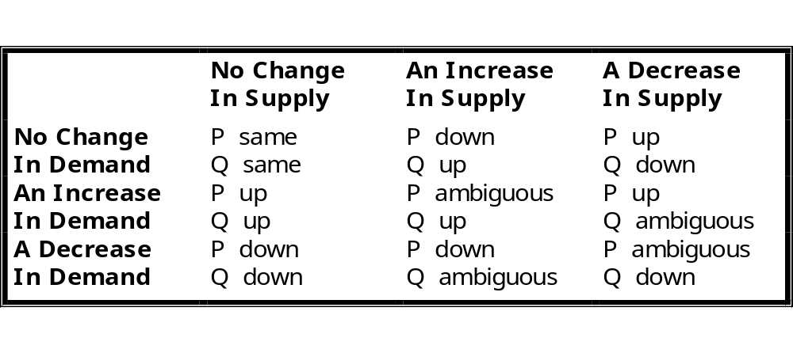
What Happens to Price and Quantity When Supply or Demand Shifts?

Slide 54
Summary
Economists use the model of supply and demand to analyze competitive markets.
The demand curve shows how the quantity of a good depends upon the price.

Slide 55
Summary
According to the law of demand, as the price of a good rises, the quantity demanded falls.
In addition to price, other determinants of quantity demanded include income, tastes, expectations, and the prices of complements and substitutes.

Slide 56
Summary
The supply curve shows how the quantity of a good supplied depends upon the price.
According to the law of supply, as the price of a good rises, the quantity supplied rises.

Slide 57
Summary
In addition to price, other determinants of quantity supplied include input prices, technology, and expectations.
Market equilibrium is determined by the intersection of the supply and demand curves.

Slide 58
Summary
Supply and demand together determine the prices of the economy’s goods and services.
In market economies, prices are the signals that guide the allocation of resources.

