Slide 1

Elasticity and Its Application
Chapter 5
Notes:
1
1

Slide 2
Elasticity . . .
… is a measure of how much buyers and sellers respond to changes in market conditions
… allows us to analyze supply and demand with greater precision.
Notes:
2
2

Slide 3
Price Elasticity of Demand
Price elasticity of demand is the percentage change in quantity demanded given a percent change in the price.
It is a measure of how much the quantity demanded of a good responds to a change in the price of that good.
Notes:
4
5

Slide 4
Determinants of
Price Elasticity of Demand
Necessities versus Luxuries
Availability of Close Substitutes
Definition of the Market
Time Horizon
Notes:
13
8

Slide 5
Determinants of
Price Elasticity of Demand
Demand tends to be more elastic :
if the good is a luxury.
the longer the time period.
the larger the number of close substitutes.
the more narrowly defined the market.
Notes:
13
8

Slide 6

Computing the Price Elasticity of Demand
The price elasticity of demand is computed as the percentage change in the quantity demanded divided by the percentage change in price.
Notes:
16
10

Slide 7
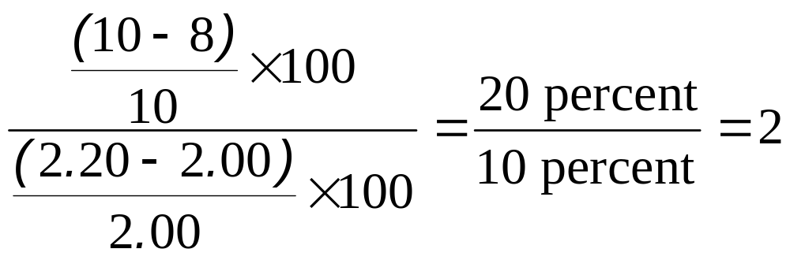
Computing the Price Elasticity of Demand
Example: If the price of an ice cream cone increases from $2.00 to $2.20 and the amount you buy falls from 10 to 8 cones then your elasticity of demand would be calculated as:

Slide 8
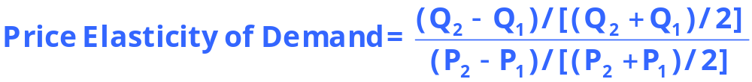
Computing the Price Elasticity of Demand Using the Midpoint Formula
The midpoint formula is preferable when calculating the price elasticity of demand because it gives the same answer regardless of the direction of the change.
Notes:
16
10

Slide 9
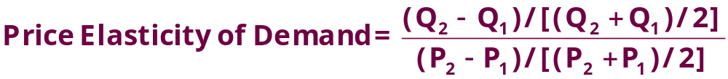
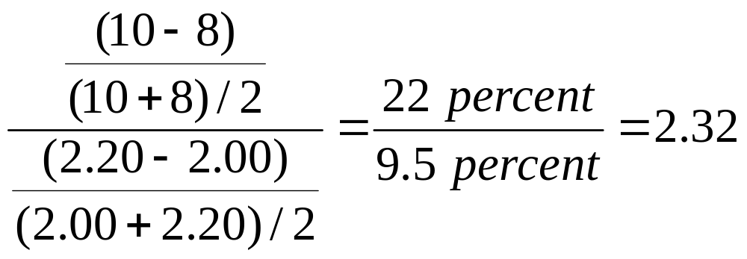
Computing the Price Elasticity of Demand
Example: If the price of an ice cream cone increases from $2.00 to $2.20 and the amount you buy falls from 10 to 8 cones the your elasticity of demand, using the midpoint formula, would be calculated as:

Slide 10
Ranges of Elasticity
Inelastic Demand
Quantity demanded does not respond strongly to price changes.
Price elasticity of demand is less than one.
Elastic Demand
Quantity demanded responds strongly to changes in price.
Price elasticity of demand is greater than one.
Notes:
5
6

Slide 11
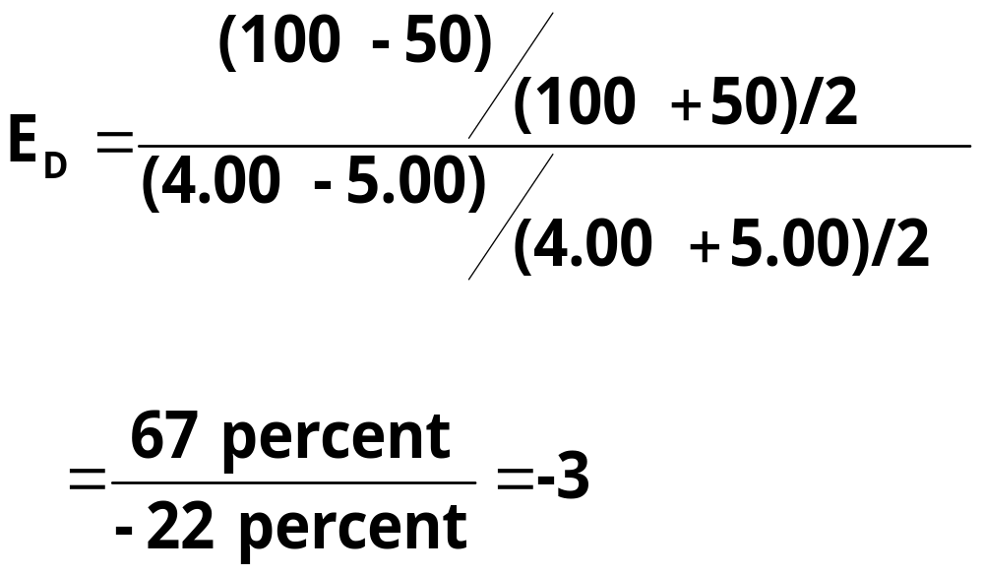
Computing the Price Elasticity of Demand
Price
$5
4
Demand
Demand is price elastic
0
50
100
Quantity
Notes:
20
11

Slide 12
Ranges of Elasticity
Perfectly Inelastic
Quantity demanded does not respond to price changes.
Perfectly Elastic
Quantity demanded changes infinitely with any change in price.
Unit Elastic
Quantity demanded changes by the same percentage as the price.
Notes:
6
6

Slide 13
A Variety of Demand Curves
Because the price elasticity of demand measures how much quantity demanded responds to the price, it is closely related to the slope of the demand curve.
Notes:
7
7

Slide 14
Perfectly Inelastic Demand
- Elasticity equals 0
Price
Demand
1. An
increase
in price...
$5
4
100
Quantity
2. ...leaves the quantity demanded unchanged.
Notes:
8
7

Slide 15
Inelastic Demand
- Elasticity is less than 1
Price
1. A 22%
increase
in price...
$5
4
Demand
90
100
Quantity
2. ...leads to a 11% decrease in quantity.
Notes:
8
7

Slide 16
Unit Elastic Demand
- Elasticity equals 1
Price
1. A 22%
increase
in price...
$5
4
Demand
80
100
Quantity
2. ...leads to a 22% decrease in quantity.
Notes:
8
7

Slide 17
Elastic Demand
- Elasticity is greater than 1
Price
$5
1. A 22%
increase
in price...
4
Demand
50
100
Quantity
2. ...leads to a 67% decrease in quantity.
Notes:
8
7

Slide 18
Perfectly Elastic Demand
- Elasticity equals infinity
Price
1. At any price
above $4, quantity
demanded is zero.
$4
Demand
2. At exactly $4,
consumers will
buy any quantity.
Quantity
3. At a price below $4,
quantity demanded is infinite.
Notes:
8
7

Slide 19
Elasticity and Total Revenue
Total revenue is the amount paid by buyers and received by sellers of a good.
Computed as the price of the good times the quantity sold.
TR = P x Q
Notes:
21
15

Slide 20
Elasticity and Total Revenue
Price
$4
P x Q = $400
P
(total revenue)
Demand
0
100
Quantity
Q
Notes:
22
15

Slide 21
Elasticity and Total Revenue
With an inelastic demand curve, an increase in price leads to a decrease in quantity that is proportionately smaller. Thus, total revenue increases.
Notes:
26
15

Slide 22
Elasticity and Total Revenue: Inelastic Demand
Price
Price
…leads to an increase in total revenue from$100 to $240
An increase in price from $1 to $3...
$3
Revenue = $240
$1
Demand
Demand
Revenue = $100
0
100
Quantity
0
80
Quantity
Notes:
27
15

Slide 23
Elasticity and Total Revenue
With an elastic demand curve, an increase in the price leads to a decrease in quantity demanded that is proportionately larger. Thus, total revenue decreases.
Notes:
25
15

Slide 24
Elasticity and Total Revenue: Elastic Demand
…leads to a decrease in total revenue from$200 to $100
Price
Price
An increase in price from $4 to $5...
$5
$4
Demand
Demand
Revenue = $200
Revenue = $100
0
50
Quantity
0
20
Quantity
Notes:
28
15

Slide 25
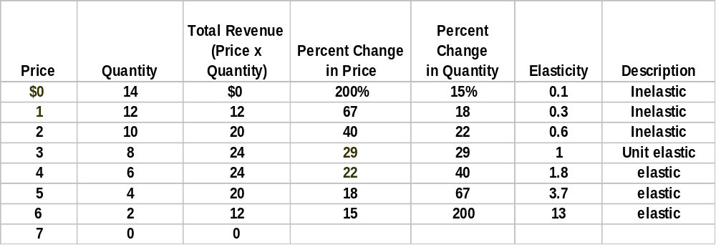
Computing the Elasticity of a Linear Demand Curve

Slide 26
Income Elasticity of Demand
Income elasticity of demand measures how much the quantity demanded of a good responds to a change in consumers’ income.
It is computed as the percentage change in the quantity demanded divided by the percentage change in income.
Notes:
29
19

Slide 27
Computing Income Elasticity
Percentage Change
in Quantity Demanded
Income Elasticity
of Demand
=
Percentage Change
in Income
Notes:
31
20

Slide 28
Income Elasticity
- Types of Goods -
Normal Goods
Inferior Goods
Higher income raises the quantity demanded for normal goods but lowers the quantity demanded for inferior goods.
Notes:
32
21

Slide 29
Income Elasticity
- Types of Goods -
Goods consumers regard as necessities tend to be income inelastic
Examples include food, fuel, clothing, utilities, and medical services.
Goods consumers regard as luxuries tend to be income elastic.
Examples include sports cars, furs, and expensive foods.
Notes:
32
21

Slide 30
Price Elasticity of Supply
Price elasticity of supply is the percentage change in quantity supplied resulting from a percent change in price.
It is a measure of how much the quantity supplied of a good responds to a change in the price of that good.
Notes:
37

Slide 31
Ranges of Elasticity
Perfectly Elastic
E_{S} = ∞
Relatively Elastic
E_{S} > 1
Unit Elastic
E_{S} = 1
Notes:
38
26

Slide 32
Ranges of Elasticity
Relatively Inelastic
E_{S} < 1
Perfectly Inelastic
E_{S} = 0
Notes:
39
26

Slide 33
Perfectly Inelastic Supply
- Elasticity equals 0
Price
Supply
1. An
increase
in price...
$5
4
100
Quantity
2. ...leaves the quantity supplied unchanged.
Notes:
8
7

Slide 34
Inelastic Supply
- Elasticity is less than 1
Price
Supply
1. A 22%
increase
in price...
$5
4
100
110
Quantity
2. ...leads to a 10% increase in quantity.
Notes:
8
7

Slide 35
Unit Elastic Supply
- Elasticity equals 1
Price
Supply
1. A 22%
increase
in price...
$5
4
100
125
Quantity
2. ...leads to a 22% increase in quantity.
Notes:
8
7

Slide 36
Elastic Supply
- Elasticity is greater than 1
Price
Supply
1. A 22%
increase
in price...
$5
4
100
200
Quantity
2. ...leads to a 67% increase in quantity.
Notes:
8
7

Slide 37
Perfectly Elastic Supply
- Elasticity equals infinity
Price
1. At any price
above $4, quantity
supplied is infinite.
$4
Supply
2. At exactly $4,
producers will
supply any quantity.
Quantity
3. At a price below $4,
quantity supplied is zero.
Notes:
8
7

Slide 38
Determinants of
Elasticity of Supply
Ability of sellers to change the amount of the good they produce.
  Beach-front land is inelastic.
  Books, cars, or manufactured goods are elastic.
Time period.
  Supply is more elastic in the long run.
Notes:
45
28

Slide 39
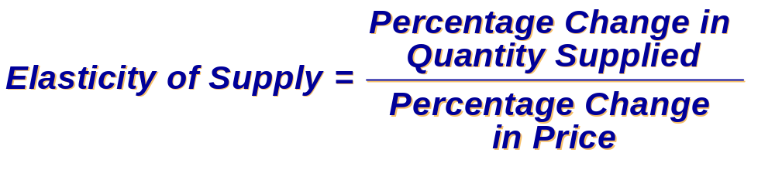
Computing the Price Elasticity of Supply
The price elasticity of supply is computed as the percentage change in the quantity supplied divided by the percentage change in price.
Notes:
46
29

Slide 40
Application of Elasticity
Can good news for farming be bad news for farmers?
What happens to wheat farmers and the market for wheat when university agronomists discover a new wheat hybrid that is more productive than existing varieties?
Notes:
50
31

Slide 41
Application of Elasticity
Examine whether the supply or demand curve shifts.
Determine the direction of the shift of the curve.
Use the supply-and-demand diagram to see how the market equilibrium changes.
Notes:
51
32

Slide 42
An Increase in Supply in the Market for Wheat
Price of
Wheat
S₁
$3
Demand
0
100
Quantity of Wheat
Notes:
52
33

Slide 43
An Increase in Supply in the Market for Wheat
Price of
Wheat
1. When demand is inelastic,
an increase in supply...
S₁
S₂
2. ...leads
to a large
fall in
price...
$3
2
Demand
0
100
110
Quantity of Wheat
3. ...and a proportionately smaller
increase in quantity sold. As a result,
revenue falls from $300 to $220.
Notes:
54
33

Slide 44
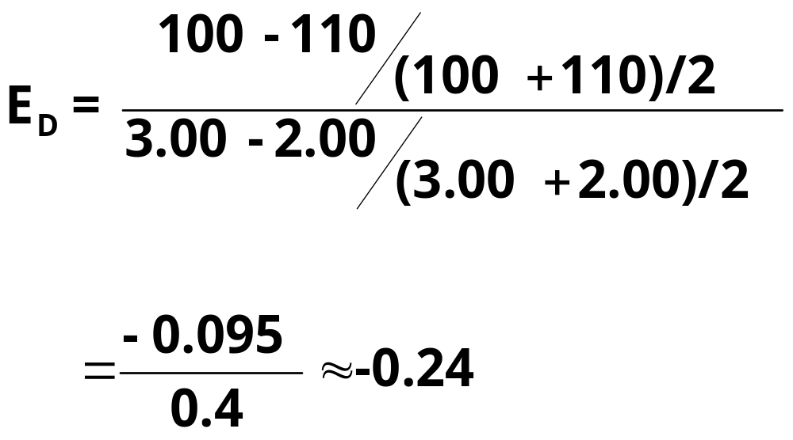
Compute Elasticity
Notes:
59
36

Slide 45
Compute Elasticity
Demand is inelastic
Notes:
59
36

Slide 46
Summary
Price elasticity of demand measures how much the quantity demanded responds to changes in the price.
If a demand curve is elastic, total revenue falls when the price rises.
If it is inelastic, total revenue rises as the price rises.

Slide 47
Summary
The price elasticity of supply measures how much the quantity supplied responds to changes in the price.
In most markets, supply is more elastic in the long run than in the short run.

Slide 48
Elasticity and Total Revenue: Inelastic Demand
Price
Price
…leads to an increase in total revenue from$100 to $240
An increase in price from $1 to $3...
$3
Revenue = $240
$1
Demand
Demand
Revenue = $100
0
100
Quantity
0
80
Quantity
Notes:
27
15

Slide 49
Elasticity and Total Revenue: Elastic Demand
…leads to a decrease in total revenue from$200 to $100
Price
Price
An increase in price from $4 to $5...
$5
$4
Demand
Demand
Revenue = $200
Revenue = $100
0
50
Quantity
0
20
Quantity
Notes:
28
15

Slide 50
Perfectly Inelastic Supply
- Elasticity equals 0
Price
Supply
1. An
increase
in price...
$5
4
100
Quantity
2. ...leaves the quantity supplied unchanged.
Notes:
8
7

Slide 51
Inelastic Supply
- Elasticity is less than 1
Price
Supply
1. A 22%
increase
in price...
$5
4
100
110
Quantity
2. ...leads to a 10% increase in quantity.
Notes:
8
7

Slide 52
Unit Elastic Supply
- Elasticity equals 1
Price
Supply
1. A 22%
increase
in price...
$5
4
100
125
Quantity
2. ...leads to a 22% increase in quantity.
Notes:
8
7

Slide 53
Elastic Supply
- Elasticity is greater than 1
Price
Supply
1. A 22%
increase
in price...
$5
4
100
200
Quantity
2. ...leads to a 67% increase in quantity.
Notes:
8
7

Slide 54
Perfectly Elastic Supply
- Elasticity equals infinity
Price
1. At any price
above $4, quantity
supplied is infinite.
$4
Supply
2. At exactly $4,
producers will
supply any quantity.
Quantity
3. At a price below $4,
quantity supplied is zero.
Notes:
8
7

Slide 55
An Increase in Supply in the Market for Wheat
.
Price of
Wheat
S₁
$3
Demand
0
100
Quantity of Wheat
Notes:
52
33

Slide 56
An Increase in Supply in the Market for Wheat
Price of
Wheat
1. When demand is inelastic,
an increase in supply...
S₁
S₂
2. ...leads
to a large
fall in
price...
$3
2
Demand
0
100
110
Quantity of Wheat
3. ...and a proportionately smaller
increase in quantity sold. As a result,
revenue falls from $300 to $220.
Notes:
54
33

