Slide 1
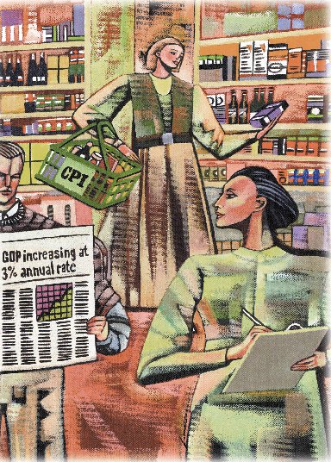
Measuring a Nation’s Income
Chapter 23

Slide 2
Microeconomics
Microeconomics is the study of how individual households and firms make decisions and how they interact with one another in markets.

Slide 3
Macroeconomics
Macroeconomics is the study of the economy as a whole.
  Its goal is to explain the economic changes that affect many households, firms, and markets at once.

Slide 4
Macroeconomics
Macroeconomics answers questions like the following:
  Why is average income high in some countries and low in others?
  Why do prices rise rapidly in some time periods while they are more stable in others?
  Why do production and employment expand in some years and contract in others?

Slide 5
The Economy’s
Income and Expenditure
When judging whether the economy is doing well or poorly, it is natural to look at the total income that everyone in the economy is earning.

Slide 6
The Economy’s
Income and Expenditure
For an economy as a whole, income must equal expenditure because:
  Every transaction has a buyer and a seller.
  Every dollar of spending by some buyer is a dollar of income for some seller.

Slide 7
Gross Domestic Product
Gross domestic product (GDP) is a measure of the income and expenditures of an economy.
It is the total market value of all final goods and services produced within a country in a given period of time.

Slide 8
The Circular-Flow Diagram
The equality of income and expenditure can be illustrated with the circular-flow diagram.

Slide 9
The Circular-Flow Diagram
Revenue
Market for
Goods
and Services
Spending
Goods & Services sold
Goods & Services bought
Firms
Households
Inputs for production
Labor, land, and capital
Market for
Factors
of Production
Wages, rent, and profit
Income
Notes:
7

Slide 10
The Measurement of GDP
GDP is the market value of all final goods and services produced within a country in a given period of time.

Slide 11
The Measurement of GDP
Output is valued at market prices.
It records only the value of final goods, not intermediate goods (the value is counted only once).
It includes both tangible goods (food, clothing, cars) and intangible services (haircuts, housecleaning, doctor visits).

Slide 12
The Measurement of GDP
It includes goods and services currently produced, not transactions involving goods produced in the past.
It measures the value of production within the geographic confines of a country.

Slide 13
The Measurement of GDP
It measures the value of production that takes place within a specific interval of time, usually a year or a quarter (three months).

Slide 14
What Is Counted in GDP?
GDP includes all items produced in the economy and sold legally in markets.

Slide 15
What Is Not Counted in GDP?
GDP excludes most items that are produced and consumed at home and that never enter the marketplace.
It excludes items produced and sold illicitly, such as illegal drugs.

Slide 16
Other Measures of Income
Gross National Product (GNP)
Net National Product (NNP)
National Income
Personal Income
Disposable Personal Income

Slide 17
Gross National Product
Gross national product (GNP) is the total income earned by a nation’s permanent residents (called nationals).
It differs from GDP by including income that our citizens earn abroad and excluding income that foreigners earn here.

Slide 18
Net National Product (NNP)
Net National Product (NNP) is the total income of the nation’s residents (GNP) minus losses from depreciation.
Depreciation is the wear and tear on the economy’s stock of equipment and structures.

Slide 19
National Income
National Income is the total income earned by a nation’s residents in the production of goods and services.
It differs from NNP by excluding indirect business taxes (such as sales taxes) and including business subsidies.

Slide 20
Personal Income
Personal income is the income that households and noncorporate businesses receive.
Unlike national income, it excludes retained earnings, which is income that corporations have earned but have not paid out to their owners.
In addition, it includes household’s interest income and government transfers.

Slide 21
Disposable Personal Income
Disposable personal income is the income that household and noncorporate businesses have left after satisfying all their obligations to the government.
It equals personal income minus personal taxes and certain nontax payments.

Slide 22
The Components of GDP
GDP (Y ) is the sum of the following:
   Consumption (C)
   Investment (I)
   Government Purchases (G)
   Net Exports (NX)
Y = C + I + G + NX

Slide 23
The Components of GDP
Consumption (C):
  The spending by households on goods and services, with the exception of purchases of new housing.
Investment (I):
  The spending on capital equipment, inventories, and structures, including new housing.

Slide 24
The Components of GDP
Government Purchases (G):
  The spending on goods and services by local, state, and federal governments.
  Does not include transfer payments because they are not made in exchange for currently produced goods or services.
Net Exports (NX):
  Exports minus imports.

Slide 25
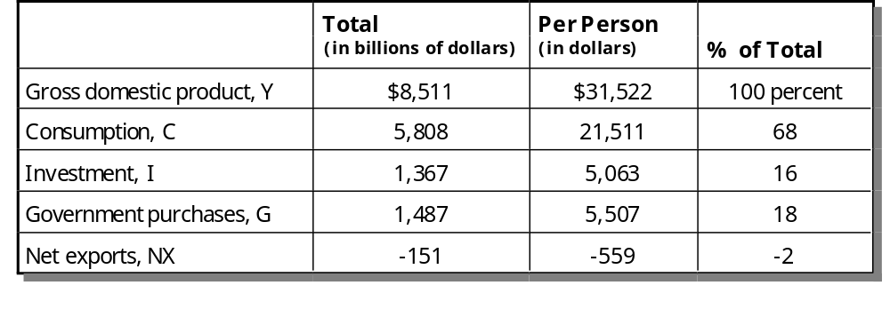
GDP and Its Components

Slide 26
GDP and Its Components

Slide 27
GDP and Its Components
Consumption

Slide 28
GDP and Its Components
Investment
Consumption

Slide 29
GDP and Its Components
Government
Purchases
Investment
Consumption

Slide 30
GDP and Its Components
Government Purchases
Investment
Net Exports
Consumption

Slide 31
Real versus Nominal GDP
Nominal GDP values the production of goods and services at current prices.
Real GDP values the production of goods and services at constant prices.

Slide 32
Real versus Nominal GDP
An accurate view of the economy requires adjusting nominal to real GDP by using the GDP deflator.

Slide 33
GDP Deflator
The GDP deflator measures the current level of prices relative to the level of prices in the base year.
It tells us the rise in nominal GDP that is attributable to a rise in prices rather than a rise in the quantities produced.

Slide 34

GDP Deflator
The GDP deflator is calculated as follows:

Slide 35
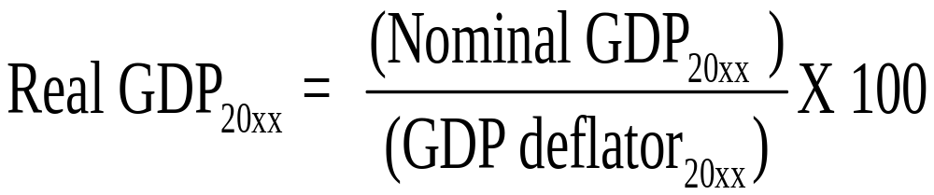
Converting Nominal GDP to Real GDP
Nominal GDP is converted to real GDP as follows:

Slide 36
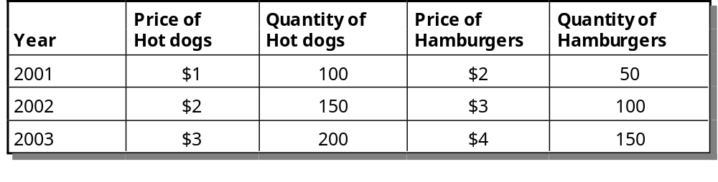
Real and Nominal GDP

Slide 37
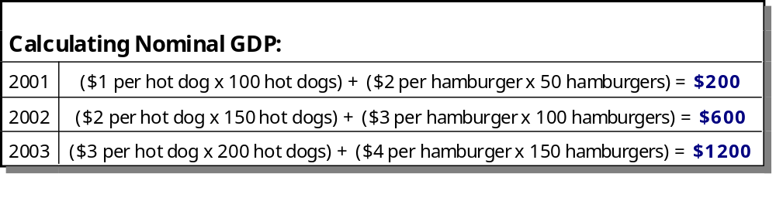
Real and Nominal GDP

Slide 38
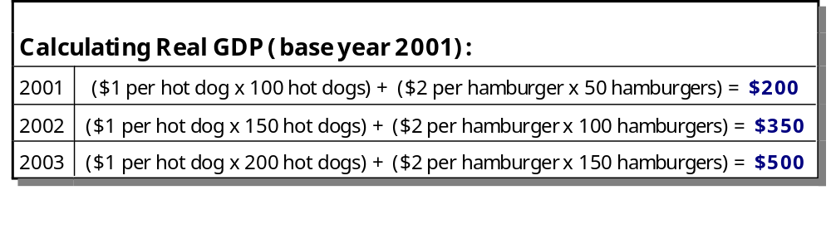
Real and Nominal GDP

Slide 39
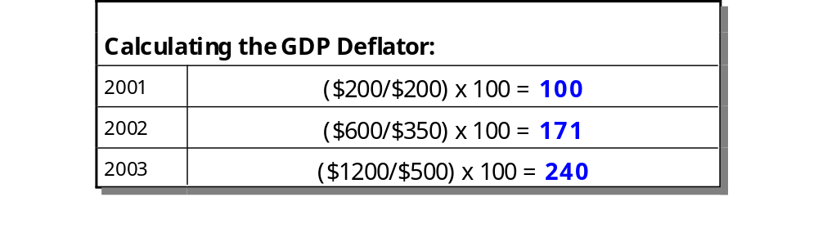
Real and Nominal GDP

Slide 40
GDP and Economic
Well-Being
GDP is the best single measure of the economic well-being of a society.
GDP per person tells us the income and expenditure of the average person in the economy.

Slide 41
GDP and Economic
Well-Being
Higher GDP per person indicates a higher standard of living.
GDP is not a perfect measure of the happiness or quality of life, however.

Slide 42
GDP and Economic
Well-Being
Some things that contribute to well-being are not included in GDP.
  The value of leisure.
  The value of a clean environment.
  The value of almost all activity that takes place outside of markets, such as the value of the time parents spend with their children and the value of volunteer work.

Slide 43
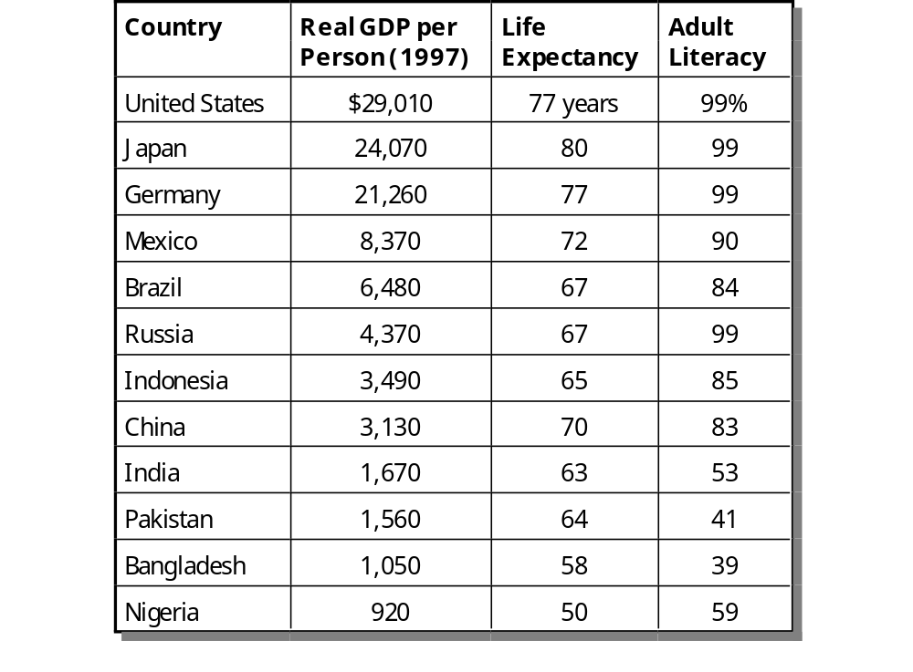
GDP, Life Expectancy, and Literacy

Slide 44
Summary
Because every transaction has a buyer and a seller, the total expenditure in the economy must equal the total income in the economy.
Gross Domestic Product (GDP) measures an economy’s total expenditure on newly produced goods and services and the total income earned from the production of these goods and services.

Slide 45
Summary
GDP is the market value of all final goods and services produced within a country in a given period of time.
GDP is divided among four components of expenditure: consumption, investment, government purchases, and net exports.

Slide 46
Summary
Nominal GDP uses current prices to value the economy’s production. Real GDP uses constant base-year prices to value the economy’s production of goods and services.
The GDP deflator--calculated from the ratio of nominal to real GDP--measures the level of prices in the economy.

Slide 47
Summary
GDP is a good measure of economic well-being because people prefer higher to lower incomes.
It is not a perfect measure of well-being because some things, such as leisure time and a clean environment, aren’t measured by GDP.

