Slide 1

The Costs of Production
Chapter 13

Slide 2
The Costs of Production
The Law of Supply:
  Firms are willing to produce and sell a greater quantity of a good when the price of the good is high.
  This results in a supply curve that slopes upward.

Slide 3

The Firm’s Objective
The economic goal of the firm is to maximize profits.
Maximum Profits

Slide 4
A Firm’s Total Revenue and Total Cost
Total Revenue
  The amount that the firm receives for the sale of its output.
Total Cost
  The amount that the firm pays to buy inputs.

Slide 5
A Firm’s Profit
Profit is the firm’s total revenue minus its total cost.
Profit = Total revenue - Total cost

Slide 6
Costs as Opportunity Costs
A firm’s cost of production includes all the opportunity costs of making its output of goods and services.

Slide 7
Explicit and Implicit Costs
A firm’s cost of production include explicit costs and implicit costs.
  Explicit costs involve a direct money outlay for factors of production.
  Implicit costs do not involve a direct money outlay.

Slide 8
Economic Profit versus Accounting Profit
Economists measure a firm’s economic profit as total revenue minus total cost (all the explicit and implicit cost).
Accountants measure the accounting profit as the firm’s total revenue minus only the firm’s explicit costs. In other words, they ignore the implicit costs.

Slide 9
Economic Profit versus Accounting Profit
When total revenue exceeds both explicit and implicit costs, the firm earns economic profit.
  Economic profit is smaller than accounting profit.

Slide 10
Economic Profit versus Accounting Profit
How an Economist
How an Accountant
Views a Firm
Views a Firm
Economic
profit
Accounting
profit
Implicit
Revenue
costs
Revenue
Total
opportunity
costs
Explicit
Explicit
costs
costs

Slide 11
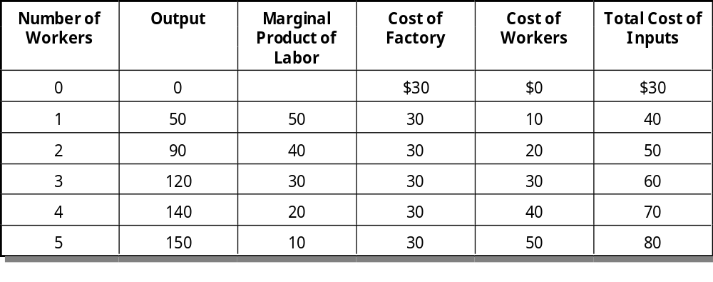
A Production Function and Total Cost

Slide 12
The Production Function
The production function shows the relationship between quantity of inputs used to make a good and the quantity of output of that good.

Slide 13
Marginal Product
The marginal product of any input in the production process is the increase in the quantity of output obtained from an additional unit of that input.

Slide 14
Marginal Product
Marginal
product
Additional output
=
Additional input

Slide 15
Diminishing Marginal Product
Diminishing marginal product is the property whereby the marginal product of an input declines as the quantity of the input increases.
Example: As more and more workers are hired at a firm, each additional worker contributes less and less to production because the firm has a limited amount of equipment.

Slide 16
A Production Function...
Quantity of
Output
(cookies
per hour)
150
Production function
140
130
120
110
100
90
80
70
60
50
40
30
20
10
0
1
2
3
4
5
Number of Workers Hired

Slide 17
Diminishing Marginal Product
The slope of the production function measures the marginal product of an input, such as a worker.
When the marginal product declines, the production function becomes flatter.

Slide 18
From the Production Function to the Total-Cost Curve
The relationship between the quantity a firm can produce and its costs determines pricing decisions.
The total-cost curve shows this relationship graphically.

Slide 19
A Production Function and Total Cost
Hungry Helen’s Cookie Factory

Slide 20
Total-Cost Curve...
Total
Cost
Total-cost
$80
curve
70
60
50
40
30
20
10
0
20
40
60
80
100
120
140
Quantity of Output
(cookies per hour)

Slide 21
The Various Measures of Cost
Costs of production may be divided into fixed costs and variable costs.

Slide 22
Fixed and Variable Costs
Fixed costs are those costs that do not vary with the quantity of output produced.
Variable costs are those costs that do change as the firm alters the quantity of output produced.

Slide 23
Family of Total Costs
Total Fixed Costs (TFC)
Total Variable Costs (TVC)
Total Costs (TC)
TC = TFC + TVC

Slide 24
Family of Total Costs
Quantity
Total Cost
Fixed Cost
Variable Cost
0
$ 3.00
$3.00
$ 0.00
1
3.30
3.00
0.30
2
3.80
3.00
0.80
3
4.50
3.00
1.50
4
5.40
3.00
2.40
5
6.50
3.00
3.50
6
7.80
3.00
4.80
7
9.30
3.00
6.30
8
11.00
3.00
8.00
9
12.90
3.00
9.90
10
15.00
3.00
12.00

Slide 25
Average Costs
Average costs can be determined by dividing the firm’s costs by the quantity of output produced.
The average cost is the cost of each typical unit of product.

Slide 26
Family of Average Costs
Average Fixed Costs (AFC)
Average Variable Costs (AVC)
Average Total Costs (ATC)
ATC = AFC + AVC

Slide 27
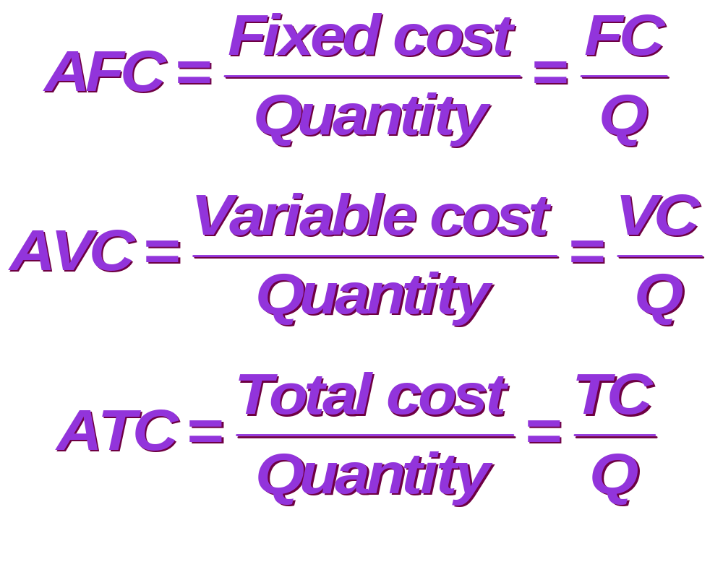
Family of Average Costs

Slide 28
Family of Average Costs
Quantity
AFC
AVC
ATC
0
—
—
—
1
$3.00
$0.30
$3.30
2
1.50
0.40
1.90
3
1.00
0.50
1.50
4
0.75
0.60
1.35
5
0.60
0.70
1.30
6
0.50
0.80
1.30
7
0.43
0.90
1.33
8
0.38
1.00
1.38
9
0.33
1.10
1.43
10
0.30
1.20
1.50

Slide 29
Marginal Cost
Marginal cost (MC) measures the amount total cost rises when the firm increases production by one unit.
Marginal cost helps answer the following question:
  How much does it cost to produce an additional unit of output?

Slide 30
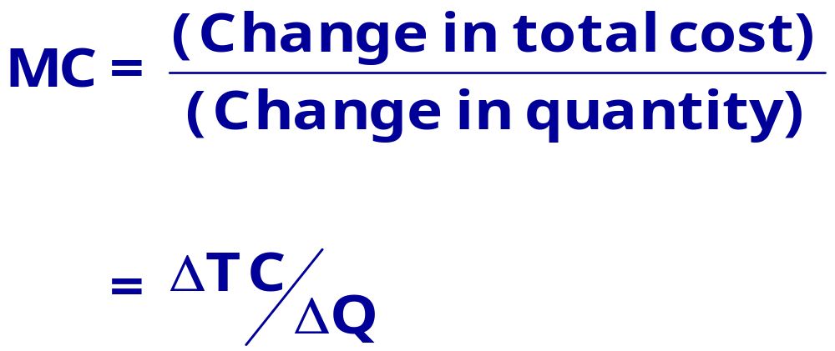
Marginal Cost

Slide 31
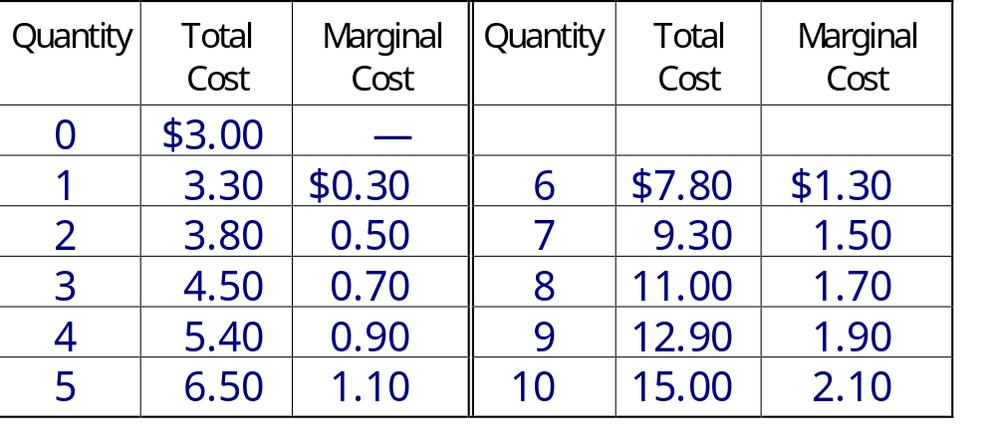
Marginal Cost

Slide 32
Total-Cost Curve...
$16.00
Total-cost curve
$14.00
$12.00
$10.00
Total Cost
$8.00
$6.00
$4.00
$2.00
$0.00
0
2
4
6
8
10
12
Quantity of Output
(glasses of lemonade per hour)

Slide 33
Average-Cost and Marginal-Cost Curves...
$3.50
$3.00
$2.50
MC
$2.00
Costs
ATC
$1.50
AVC
$1.00
$0.50
AFC
$0.00
0
2
4
6
8
10
12
Quantity of Output
(glasses of lemonade per hour)

Slide 34
Cost Curves and Their Shapes
Marginal cost rises with the amount of output produced.
  This reflects the property of diminishing marginal product.

Slide 35
Cost Curves and Their Shapes
$2.50
MC
$2.00
$1.50
Costs
$1.00
$0.50
$0.00
0
2
4
6
8
10
12
Quantity of Output
(glasses of lemonade per hour)

Slide 36
Cost Curves and Their Shapes
The average total-cost curve is U-shaped.
At very low levels of output average total cost is high because fixed cost is spread over only a few units.
Average total cost declines as output increases.
Average total cost starts rising because average variable cost rises substantially.

Slide 37
Cost Curves and Their Shapes
The bottom of the U-shape occurs at the quantity that minimizes average total cost. This quantity is sometimes called the efficient scale of the firm.

Slide 38
Cost Curves and Their Shapes
$3.50
$3.00
$2.50
$2.00
Total Costs
ATC
$1.50
$1.00
$0.50
$0.00
0
2
4
6
8
10
12
Quantity of Output
(glasses of lemonade per hour)

Slide 39
Relationship Between Marginal Cost and Average Total Cost
Whenever marginal cost is less than average total cost, average total cost is falling.
Whenever marginal cost is greater than average total cost, average total cost is rising.

Slide 40
Relationship Between Marginal Cost and Average Total Cost
The marginal-cost curve crosses the average-total-cost curve at the efficient scale.
  Efficient scale is the quantity that minimizes average total cost.

Slide 41
Relationship Between Marginal Cost and Average Total Cost
$3.50
$3.00
$2.50
MC
$2.00
Costs
ATC
$1.50
$1.00
$0.50
$0.00
0
2
4
6
8
10
12
Quantity of Output
(glasses of lemonade per hour)

Slide 42
The Various Measures of Cost
It is now time to examine the relationships that exist between the different measures of cost.

Slide 43
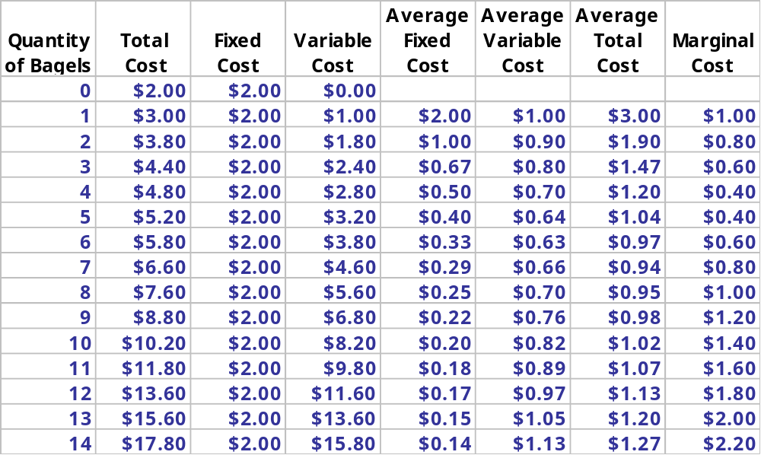
The Various Measures of Cost Big Bob’s Bagel Bin

Slide 44
Big Bob’s Cost Curves...
$20.00
$18.00
Total Cost Curve
$16.00
$14.00
$12.00
Total Cost
$10.00
$8.00
$6.00
$4.00
$2.00
$0.00
0
2
4
6
8
10
12
14
16
Quantity of Output
(bagels per hour)

Slide 45
Big Bob’s Cost Curves...
3.5
3
2.5
MC
2
Costs
1.5
ATC
AVC
1
0.5
AFC
0
0
2
4
6
8
10
12
14
16
Quantity of Output

Slide 46
Three Important Properties of Cost Curves
Marginal cost eventually rises with the quantity of output.
The average-total-cost curve is U-shaped.
The marginal-cost curve crosses the average-total-cost curve at the minimum of average total cost.

Slide 47
Costs in the Long Run
For many firms, the division of total costs between fixed and variable costs depends on the time horizon being considered.
  In the short run some costs are fixed.
  In the long run fixed costs become variable costs.

Slide 48
Costs in the Long Run
Because many costs are fixed in the short run but variable in the long run, a firm’s long-run cost curves differ from its short-run cost curves.
Notes:
54
24

Slide 49
Average Total Cost in the Short and Long Runs...
Average
ATC in short
run with
small factory
ATC in short
run with
medium factory
ATC in short
run with
large factory
Total
Cost
ATC in long run
0
Quantity of
Cars per Day

Slide 50
Economies and Diseconomies of Scale
Economies of scale occur when long-run average total cost declines as output increases.
Diseconomies of scale occur when long-run average total cost rises as output increases.
Constant returns to scale occur when long-run average total cost does not vary as output increases.

Slide 51
Economies and Diseconomies of Scale
Average
Total
Cost
ATC in long run
Economies
of scale
Constant Returns
to scale
Diseconomies
of scale
0
Quantity of
Cars per Day

Slide 52
Summary
The goal of firms is to maximize profit, which equals total revenue minus total cost.
When analyzing a firm’s behavior, it is important to include all the opportunity costs of production.
Some opportunity costs are explicit while other opportunity costs are implicit.

Slide 53
Summary
A firm’s costs reflect its production process.
A typical firm’s production function gets flatter as the quantity of input increases, displaying the property of diminishing marginal product.
A firm’s total costs are divided between fixed and variable costs. Fixed costs don’t vary with quantities produced; variable costs do.

Slide 54
Summary
Average total cost is total cost divided by the quantity of output.
Marginal cost is the amount by which total cost would rise if output were increased by one unit.
The marginal cost always rises with the quantity of output.

Slide 55
Summary
The average-total-cost curve is U-shaped.
The marginal-cost curve always crosses the average-total-cost curve at the minimum of ATC.
A firm’s costs often depend on the time horizon being considered.

