Slide 1
Firms in Competitive Markets
Chapter 14

Slide 2
The Meaning of Competition
A perfectly competitive market has the following characteristics:
  There are many buyers and sellers in the market.
  The goods offered by the various sellers are largely the same.
  Firms can freely enter or exit the market.

Slide 3
The Meaning of Competition
As a result of its characteristics, the perfectly competitive market has the following outcomes:
  The actions of any single buyer or seller in the market have a negligible impact on the market price.
  Each buyer and seller takes the market price as given.

Slide 4
The Meaning of Competition
Buyers and sellers in competitive markets are said to be price takers.
  Buyers and sellers must accept the price determined by the market.

Slide 5
Revenue of a Competitive Firm
Total revenue for a firm is the selling price times the quantity sold.
TR = (P X Q)

Slide 6
Revenue of a Competitive Firm
Total revenue is proportional to the amount of output.

Slide 7
Revenue of a Competitive Firm
Average revenue tells us how much revenue a firm receives for the typical unit sold.

Slide 8
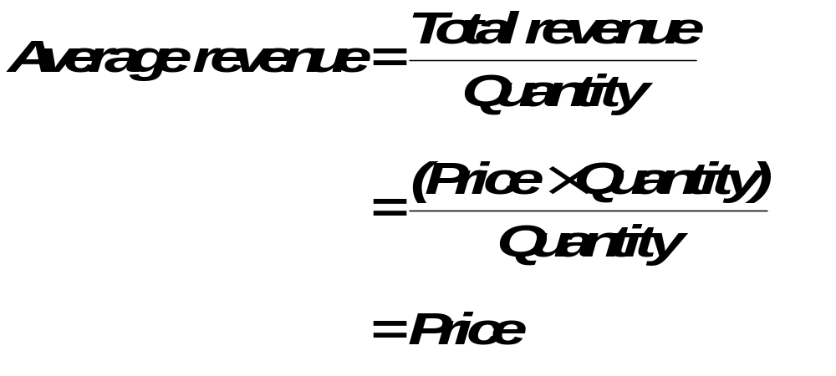
Revenue of a Competitive Firm
Average revenue equals the price of the good.

Slide 9
Revenue of a Competitive Firm
Marginal revenue is the change in total revenue from an additional unit sold.
MR =ΔTR/ ΔQ

Slide 10
Revenue of a Competitive Firm
For competitive firms, marginal revenue equals the price of the good.

Slide 11
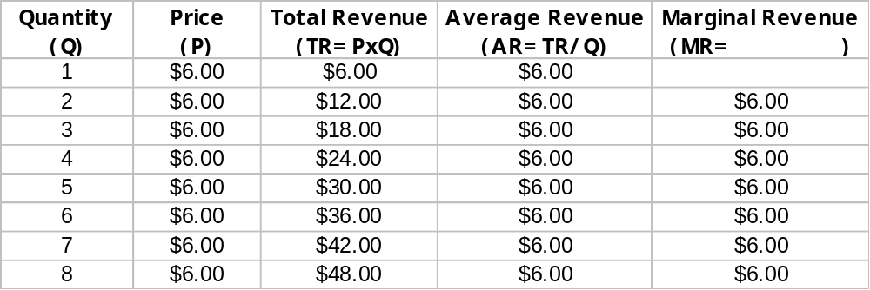
Total, Average, and Marginal Revenue for a Competitive Firm

Slide 12
Profit Maximization for the Competitive Firm
The goal of a competitive firm is to maximize profit.
This means that the firm will want to produce the quantity that maximizes the difference between total revenue and total cost.

Slide 13
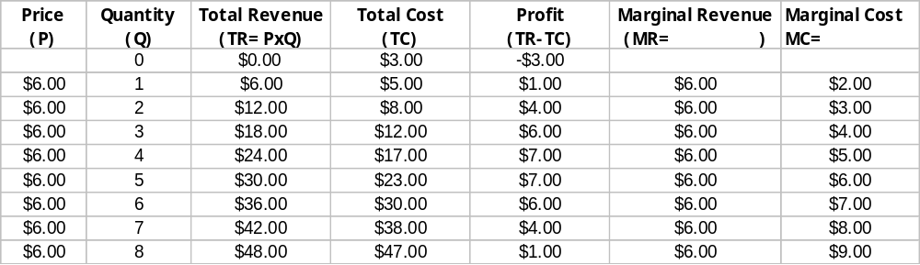
Profit Maximization:
A Numerical Example

Slide 14
Profit Maximization for the Competitive Firm...
Costs
The firm maximizes profit by producing the quantity at which marginal cost equals marginal revenue.
and
Revenue
MC
MC₂
ATC
P=MR₁
P = AR = MR
AVC
MC₁
0
Q₁
Q_{MAX}
Q₂
Quantity

Slide 15
Profit Maximization for the Competitive Firm
Profit maximization occurs at the quantity where marginal revenue equals marginal cost.

Slide 16
Profit Maximization for the Competitive Firm
When MR > MC ⬇ increase Q
When MR < MC ⬇ decrease Q
When MR = MC ⬇ Profit is maximized.

Slide 17
The Marginal-Cost Curve and the Firm’s Supply Decision...
Costs
This section of the firm’s MC curve is also the firm’s supply curve.
and
Revenue
MC
P₂
P₁
ATC
AVC
0
Q₁
Q₂
Quantity

Slide 18
The Firm’s Short-Run Decision to Shut Down
A shutdown refers to a short-run decision not to produce anything during a specific period of time because of current market conditions.
Exit refers to a long-run decision to leave the market.

Slide 19
The Firm’s Short-Run Decision to Shut Down
The firm considers its sunk costs when deciding to exit, but ignores them when deciding whether to shut down.
  Sunk costs are costs that have already been committed and cannot be recovered.

Slide 20
The Firm’s Short-Run Decision to Shut Down
The firm shuts down if the revenue it gets from producing is less than the variable cost of production.
Shut down if TR < VC
Shut down if TR/Q < VC/Q
Shut down if P < AVC

Slide 21
The Firm’s Short-Run Decision to Shut Down...
Costs
Firm’s short-run supply curve.
MC
If P > ATC,
keep producing
at a profit.
ATC
If P > AVC,
keep producing
in the short run.
AVC
If P < AVC,
shut down.
0
Quantity

Slide 22
The Firm’s Short-Run Decision to Shut Down
The portion of the marginal-cost curve that lies above average variable cost is the competitive firm’s short-run supply curve.

Slide 23
The Firm’s Long-Run Decision to Exit or Enter a Market
In the long-run, the firm exits if the revenue it would get from producing is less than its total cost.
Exit if TR < TC
Exit if TR/Q < TC/Q
Exit if P < ATC

Slide 24
The Firm’s Long-Run Decision to Exit or Enter a Market
A firm will enter the industry if such an action would be profitable.
Enter if TR > TC
Enter if TR/Q > TC/Q
Enter if P > ATC

Slide 25
The Competitive Firm’s Long-Run Supply Curve...
Costs
MC = Long-run S
Firm enters
if P > ATC
ATC
Firm exits
if P < ATC
0
Quantity

Slide 26
The Competitive Firm’s Long-Run Supply Curve
The competitive firm’s long-run supply curve is the portion of its marginal-cost curve that lies above average total cost.

Slide 27
The Competitive Firm’s Long-Run Supply Curve...
Costs
Firm’s long-run supply curve
MC
ATC
0
Quantity

Slide 28
The Firm’s Short-Run and Long-Run Supply Curves
Short-Run Supply Curve
  The portion of its marginal cost curve that lies above average variable cost.
Long-Run Supply Curve
  The marginal cost curve above the minimum point of its average total cost curve.

Slide 29
Measuring Profit in the Graph for the Competitive Firm...
a. A Firm with Profits
Price
MC
ATC
Profit
P
P = AR = MR
ATC
0
Q
Quantity
Profit-maximizing quantity

Slide 30
Measuring Profit in the Graph for the Competitive Firm...
b. A Firm with Losses
Price
MC
ATC
ATC
P
P = AR = MR
Loss
0
Q
Quantity
Loss-minimizing quantity

Slide 31
Supply in a Competitive Market
Market supply equals the sum of the quantities supplied by the individual firms in the market.

Slide 32
The Short Run: Market Supply with a Fixed Number of Firms
For any given price, each firm supplies a quantity of output so that its marginal cost equals price.
The market supply curve reflects the individual firms’ marginal cost curves.
Notes:
43

Slide 33
The Short Run: Market Supply with a Fixed Number of Firms...
(a) Individual Firm Supply
(b) Market Supply
Price
Price
MC
Supply
$2.00
$2.00
1.00
1.00
0
100
200
0
100,000
200,000
Quantity
(firm)
Quantity
(market)

Slide 34
The Long Run: Market Supply with Entry and Exit
Firms will enter or exit the market until profit is driven to zero.
In the long run, price equals the minimum of average total cost.
The long-run market supply curve is horizontal at this price.

Slide 35
The Long Run: Market Supply with Entry and Exit...
(a) Firm’s Zero-Profit Condition
(b) Market Supply
Price
Price
MC
ATC
P =
minimum
ATC
Supply
0
Quantity
(firm)
0
Quantity
(market)

Slide 36
The Long Run: Market Supply with Entry and Exit
At the end of the process of entry and exit, firms that remain must be making zero economic profit.
The process of entry & exit ends only when price and average total cost are driven to equality.
Long-run equilibrium must have firms operating at their efficient scale.

Slide 37
Firms Stay in Business with Zero Profit
Profit equals total revenue minus total cost.
Total cost includes all the opportunity costs of the firm.
In the zero-profit equilibrium, the firm’s revenue compensates the owners for the time and money they expend to keep the business going.

Slide 38
Increase in Demand in the Short Run
An increase in demand raises price and quantity in the short run.
Firms earn profits because price now exceeds average total cost.

Slide 39
Increase in Demand in the Short Run...
(a) Initial Condition
Firm
Market
Price
Price
ATC
MC
S
1
A
P₁
P
P₁
Long-run
supply
D₁
0
Quantity
(firm)
0
Q₁
Quantity
(market)

Slide 40
Increase in Demand in the Short Run...
(b) Short-Run Response
Firm
Market
Price
Price
Profit
S₁
MC
ATC
B
P₂
P₂
A
P₁
P₁
Long-run
supply
D₂
D₁
0
Quantity
(firm)
0
Q₁
Q₂
Quantity
(market)

Slide 41
Increase in Demand in the Short Run...
(c) Long-Run Response
Firm
Market
Price
Price
S₁
MC
ATC
S₂
B
P₂
A
C
P₁
P₁
Long-run
supply
D₂
D₁
0
Quantity
(firm)
0
Q₁
Q₂
Q₃
Quantity
(market)

Slide 42
Why the Long-Run Supply Curve Might Slope Upward
Some resources used in production may be available only in limited quantities.
Firms may have different costs.

Slide 43
Marginal Firm
The marginal firm is the firm that would exit the market if the price were any lower.

Slide 44
Summary
Because a competitive firm is a price taker, its revenue is proportional to the amount of output it produces.
The price of the good equals both the firm’s average revenue and its marginal revenue.

Slide 45
Summary
To maximize profit a firm chooses the quantity of output such that marginal revenue equals marginal cost.
This is also the quantity at which price equals marginal cost.
Therefore, the firm’s marginal cost curve is its supply curve.

Slide 46
Summary
In the short run when a firm cannot recover its fixed costs, the firm will choose to shut down temporarily if the price of the good is less than average variable cost.
In the long run when the firm can recover both fixed and variable costs, it will choose to exit if the price is less than average total cost.

Slide 47
Summary
In a market with free entry and exit, profits are driven to zero in the long run and all firms produce at the efficient scale.
Changes in demand have different effects over different time horizons.

