Slide 1

Oligopoly
Chapter 16

Slide 2
Imperfect Competition
Imperfect competition refers to those market structures that fall between perfect competition and pure monopoly.
Notes:
7

Slide 3
Imperfect Competition
Imperfect competition includes industries in which firms have competitors but do not face so much competition that they are price takers.
Notes:
7

Slide 4
Types of Imperfectly Competitive Markets
Oligopoly
  Only a few sellers, each offering a similar or identical product to the others.
Monopolistic Competition
  Many firms selling products that are similar but not identical.
Notes:
8

Slide 5
The Four Types of Market Structure
Number of Firms?
Many firms
One firm
Type of Products?
Few firms
Differentiated products
Identical products
Monopoly
Oligopoly
Monopolistic Competition
Perfect Competition
Tap water
Cable TV
Tennis balls
Crude oil
Novels
Movies
Wheat
Milk

Slide 6
Markets With Only a
Few Sellers
Because of the few sellers, the key feature of oligopoly is the tension between cooperation and self-interest.
Notes:
9

Slide 7
Characteristics of an Oligopoly Market
Few sellers offering similar or identical products
Interdependent firms
Best off cooperating and acting like a monopolist by producing a small quantity of output and charging a price above marginal cost
Notes:
10

Slide 8
A Duopoly Example
A duopoly is an oligopoly with only two members. It is the simplest type of oligopoly.

Slide 9
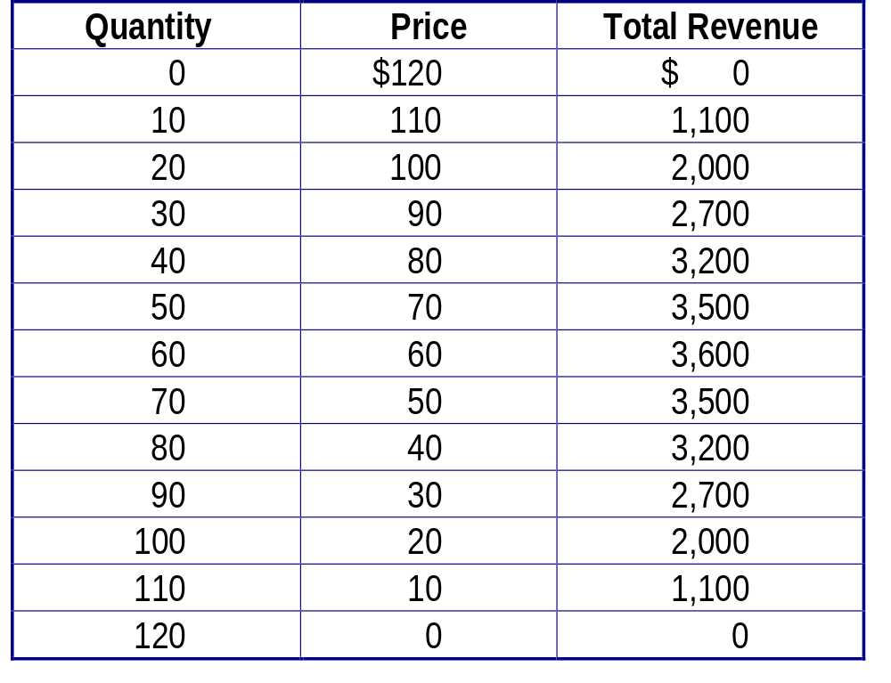
A Duopoly Example: Demand
Schedule for Water

Slide 10
A Duopoly Example: Price and
Quantity Supplied
The price of water in a perfectly competitive market would be driven to where the marginal cost is zero:
P = MC = $0
Q = 120 gallons
The price and quantity in a monopoly market would be where total profit is maximized:
P = $60
Q = 60 gallons

Slide 11
A Duopoly Example: Price and
Quantity Supplied
The socially efficient quantity of water is 120 gallons, but a monopolist would produce only 60 gallons of water.
So what outcome then could be expected from duopolists?

Slide 12
Competition, Monopolies, and Cartels
The duopolists may agree on a monopoly outcome.
  Collusion
    The two firms may agree on the quantity to produce and the price to charge.
  Cartel
    The two firms may join together and act in unison.
Notes:
11

Slide 13
Competition, Monopolies, and Cartels
Although oligopolists would like to form cartels and earn monopoly profits, often that is not possible. Antitrust laws prohibit explicit agreements among oligopolists as a matter of public policy.
Notes:
11

Slide 14
The Equilibrium for an Oligopoly
A Nash equilibrium is a situation in which economic actors interacting with one another each choose their best strategy given the strategies that all the others have chosen.
Notes:
13

Slide 15
The Equilibrium for an Oligopoly
When firms in an oligopoly individually choose production to maximize profit, they produce quantity of output greater than the level produced by monopoly and less than the level produced by competition.
Notes:
13

Slide 16
The Equilibrium for an Oligopoly
The oligopoly price is less than the monopoly price but greater than the competitive price (which equals marginal cost).
Notes:
13

Slide 17
Summary of Equilibrium for an Oligopoly
Possible outcome if oligopoly firms pursue their own self-interests:
  Joint output is greater than the monopoly quantity but less than the competitive industry quantity.
  Market prices are lower than monopoly price but greater than competitive price.
  Total profits are less than the monopoly profit.
Notes:
12

Slide 18
A Duopoly Example: Demand
Schedule for Water

Slide 19
How the Size of an Oligopoly Affects the Market Outcome
How increasing the number of sellers affects the price and quantity:
  The output effect: Because price is above marginal cost, selling more at the going price raises profits.
  The price effect: Raising production lowers the price and the profit per unit on all units sold.
Notes:
14

Slide 20
How the Size of an Oligopoly Affects the Market Outcome
As the number of sellers in an oligopoly grows larger, an oligopolistic market looks more and more like a competitive market.
The price approaches marginal cost, and the quantity produced approaches the socially efficient level.

Slide 21
Game Theory and the Economics of Cooperation
Game theory is the study of how people behave in strategic situations.
Strategic decisions are those in which each person, in deciding what actions to take, must consider how others might respond to that action.
Notes:
16

Slide 22
Game Theory and the Economics of Cooperation
Because the number of firms in an oligopolistic market is small, each firm must act strategically.
Each firm knows that its profit depends not only on how much it produced but also on how much the other firms produce.
Notes:
16

Slide 23
The Prisoners’ Dilemma
The prisoners’ dilemma provides insight into the difficulty in maintaining cooperation.
Often people (firms) fail to cooperate with one another even when cooperation would make them better off.
Notes:
17

Slide 24
The Prisoners’ Dilemma
X’s Decision
Confess
Remain Silent
X gets
8 years
X gets
20 years
Confess
Y gets
8 years
Y goes free
Y’s Decision
X goes free
X gets
1 year
Remain Silent
Y gets
20 years
Y gets
1 year
Notes:
17

Slide 25
The Prisoners’ Dilemma
The dominant strategy is the best strategy for a player to follow regardless of the strategies pursued by other players.
Notes:
19

Slide 26
The Prisoners’ Dilemma
Cooperation is difficult to maintain, because cooperation is not in the best interest of the individual player.
Notes:
19

Slide 27
Oligopolies as a
Prisoners’ Dilemma
Iraq’s Decision
High Production
Low Production
Iraq gets
$40 billion
Iraq gets
$30 billion
High Production
Iran gets
$40 billion
Iran gets $60 billion
Iran’s Decision
Iraq gets $60 billion
Iraq gets
$50 billion
Low Production
Iran gets
$30 billion
Iran gets
$50 billion
Notes:
17

Slide 28
Oligopolies as a
Prisoners’ Dilemma
Self-interest makes it difficult for the oligopoly to maintain a cooperative outcome with low production, high prices, and monopoly profits.
Notes:
20

Slide 29
An Arms-Race Game
Decision of the United States (U.S.)
Arm
Disarm
U.S. at risk and weak
U.S. at risk
Arm
Decision of the Soviet Union (USSR)
USSR safe and powerful
USSR at risk
U.S. safe and powerful
U.S. safe
Disarm
USSR at risk and weak
USSR safe
Notes:
17

Slide 30
An Advertising Game
Marlboro’s Decision
Advertise
Don’t Advertise
Marlboro gets $3 billion profit
Marlboro gets $2 billion profit
Advertise
Camel gets $3 billion profit
Camel gets $5 billion profit
Camel’s Decision
Marlboro gets $5 billion profit
Marlboro gets $4 billion profit
Don’t Advertise
Camel gets $2 billion profit
Camel gets $4 billion profit
Notes:
17

Slide 31
A Common-Resources Game
Exxon’s Decision
Drill Two Wells
Drill One Well
Exxon gets $4 million profit
Exxon gets $3 million profit
Drill Two Wells
Arco gets $4 million profit
Arco gets $6 million profit
Arco’s Decision
Exxon gets $6 million profit
Exxon gets $5 million profit
Drill One Well
Arco gets $3 million profit
Arco gets $5 million profit
Notes:
17

Slide 32
Why People Sometimes Cooperate
Firms that care about future profits will cooperate in repeated games rather than cheating in a single game to achieve a one-time gain.
Notes:
21

Slide 33
Jack and Jill’s Oligopoly Game
Jack’s Decision
Sell 40 gallons
Sell 30 gallons
Jack gets $1,600 profit
Jack gets $1,500 profit
Sell 40 gallons
Jill gets $1,600 profit
Jill gets $2,000 profit
Jill’s Decision
Jack gets $2,000 profit
Jack gets $1,800 profit
Sell 30 gallons
Jill gets $1,500 profit
Jill gets $1,800 profit
Notes:
17

Slide 34
Public Policy Toward Oligopolies
Cooperation among oligopolists is undesirable from the standpoint of society as a whole because it leads to production that is too low and prices that are too high.
Notes:
22

Slide 35
Restraint of Trade and the Antitrust Laws
Antitrust laws make it illegal to restrain trade or attempt to monopolize a market.
  Sherman Antitrust Act of 1890
  Clayton Act of 1914
Notes:
23

Slide 36
Controversies over Antitrust Policy
Antitrust policies sometimes may not allow business practices that have potentially positive effects:
  Resale price maintenance
  Predatory pricing
  Tying
Notes:
24

Slide 37
Resale Price Maintenance
Resale price maintenance (or fair trade) occurs when suppliers (like wholesalers) require the retailers that they sell to, to charge customers a specific amount.

Slide 38
Predatory Pricing
Predatory pricing occurs when a large firm begins to cut the price of its product(s) with the intent of driving its competitor(s) out of the market.

Slide 39
Tying
Tying refers to when a firm offers two (or more) of its products together at a single price, rather than separately.

Slide 40
Summary
Oligopolists maximize their total profits by forming a cartel and acting like a monopolist.
If oligopolists make decisions about production levels individually, the result is a greater quantity and a lower price than under the monopoly outcome.

Slide 41
Summary
The prisoners’ dilemma shows that self-interest can prevent people from maintaining cooperation, even when cooperation is in their mutual self-interest.
The logic of the prisoners’ dilemma applies in many situations, including oligopolies.

Slide 42
Summary
Policymakers use the antitrust laws to prevent oligopolies from engaging in behavior that reduces competition.

