Slide 1
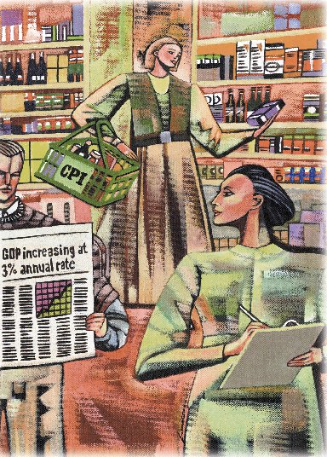
Measuring the Cost of Living
Chapter 23

Slide 2
Measuring the Cost of Living
Inflation refers to a situation in which the economy’s overall price level is rising.
The inflation rate is the percentage change in the price level from the previous period.

Slide 3
The Consumer Price Index
The consumer price index (CPI) is a measure of the overall cost of the goods and services bought by a typical consumer.
The Bureau of Labor Statistics reports the CPI each month.
It is used to monitor changes in the cost of living over time.
Notes:
2

Slide 4
The Consumer Price Index
When the CPI rises, the typical family has to spend more rupees to maintain the same standard of living.
Notes:
3

Slide 5
How the Consumer Price Index Is Calculated
Fix the Basket: Determine what prices are most important to the typical consumer.
  The Bureau of Labor Statistics (BLS) identifies a market basket of goods and services the typical consumer buys.
Notes:
4

Slide 6
How the Consumer Price Index Is Calculated
Find the Prices: Find the prices of each of the goods and services in the basket for each point in time.
Notes:
5

Slide 7
How the Consumer Price Index Is Calculated
Compute the Basket’s Cost: Use the data on prices to calculate the cost of the basket of goods and services at different times.
Notes:
6

Slide 8
How the Consumer Price Index Is Calculated
Choose a Base Year and Compute the Index:
  Designate one year as the base year, making it the benchmark against which other years are compared.
  Compute the index by dividing the cost of the basket in one year by the cost in the base year and multiplying by 100.
Notes:
7

Slide 9
How the Consumer Price Index Is Calculated
Compute the inflation rate: The inflation rate is the percentage change in the price index from the preceding period.
Notes:
8

Slide 10
The Inflation Rate
The inflation rate is calculated as follows:

Slide 11

Calculating the Consumer Price Index and the Inflation Rate: An Example
Step 1:Survey Consumers to Determine a Fixed Basket of Goods

Slide 12
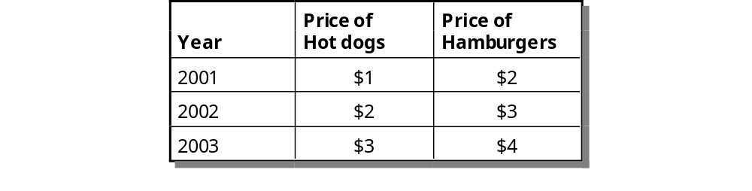
Calculating the Consumer Price Index and the Inflation Rate: An Example
Step 2: Find the Price of Each Good in Each Year

Slide 13
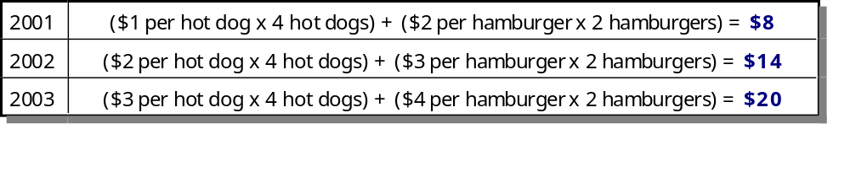
Calculating the Consumer Price Index and the Inflation Rate: An Example
Step 3: Compute the Cost of the Basket of Goods in Each Year

Slide 14

Calculating the Consumer Price Index and the Inflation Rate: An Example
Step 4: Choose One Year as the Base Year (2001) and Compute the Consumer Price Index in Each Year

Slide 15

Calculating the Consumer Price Index and the Inflation Rate: An Example
Step 5: Use the Consumer Price Index to Compute the Inflation Rate from Previous Year

Slide 16
Calculating the Consumer Price Index and the Inflation Rate: Another Example
Base Year is 1998.
Basket of goods in 1998 costs $1,200.
The same basket in 2000 costs $1,236.
CPI = ($1,236/$1,200) X 100 = 103.
Prices increased 3 percent between 1998 and 2000.
Notes:
9

Slide 17

GDP Deflator
The GDP deflator is calculated as follows:

Slide 18
Other Price Indexes
The BLS calculates other prices indexes:
  The index for different regions within the country(CPI for rural India and urban India).
  Whole sale price index(WPI), which measures the cost of a basket of goods and services sold by whole sellers.
  The producer price index(PPI), which measures the cost of a basket of goods and services bought by firms rather than consumers(European countries).
Notes:
11

Slide 19
What’s in the CPI’s Basket?
5%
5%
Housing
6%
5%
Food/Beverages
6%
Transportation
Medical Care
40%
17%
Apparel
Recreation
16%
Other
Education and
communication
Notes:
10

Slide 20
Problems in Measuring The Cost of Living
The CPI is an accurate measure of the selected goods that make up the typical bundle, but it is not a perfect measure of the cost of living.
Notes:
12

Slide 21
Problems in Measuring The Cost of Living
Substitution bias
Introduction of new goods
Unmeasured quality changes
Notes:
13

Slide 22
Substitution Bias
The basket does not change to reflect consumer reaction to changes in relative prices.
  Consumers substitute toward goods that have become relatively less expensive.
  The index overstates the increase in cost of living by not considering consumer substitution.
Notes:
14

Slide 23
Introduction of New Goods
The basket does not reflect the change in purchasing power brought on by the introduction of new products.
  New products result in greater variety, which in turn makes each dollar more valuable.
  Consumers need fewer dollars to maintain any given standard of living.
Notes:
15

Slide 24
Unmeasured Quality Changes
If the quality of a good rises from one year to the next, the value of a dollar rises, even if the price of the good stays the same.
If the quality of a good falls from one year to the next, the value of a dollar falls, even if the price of the good stays the same.
Notes:
16

Slide 25
Unmeasured Quality Changes
The BLS tries to adjust the price for constant quality, but such differences are hard to measure.
Notes:
17

Slide 26
Problems in Measuring the Cost of Living
The substitution bias, introduction of new goods, and unmeasured quality changes cause the CPI to overstate the true cost of living.
  The issue is important because many government programs use the CPI to adjust for changes in the overall level of prices.
  The CPI overstates inflation by about 1 percentage point per year.
Notes:
18

Slide 27
The GDP Deflator versus the Consumer Price Index
Economists and policymakers monitor both the GDP deflator and the consumer price index to gauge how quickly prices are rising.
There are two important differences between the indexes that can cause them to diverge.
Notes:
19

Slide 28
The GDP Deflator versus the Consumer Price Index
The GDP deflator reflects the prices of all goods and services produced domestically, whereas...
…the consumer price index reflects the prices of all goods and services bought by consumers.
Notes:
20

Slide 29
The GDP Deflator versus the Consumer Price Index
The consumer price index compares the price of a fixed basket of goods and services to the price of the basket in the base year (only occasionally does the BLS change the basket)...
…whereas the GDP deflator compares the price of currently produced goods and services to the price of the same goods and services in the base year.
Notes:
20

Slide 30
Two Measures of Inflation
Percent
per Year
15
CPI
10
5
GDP deflator
0
2000
1965
1970
1975
1980
1985
1990
1995
Notes:
2

Slide 31
Dollar Figures from Different Times
Price indexes are used to correct for the effects of inflation when comparing dollar figures from different times.
Notes:
23

Slide 32
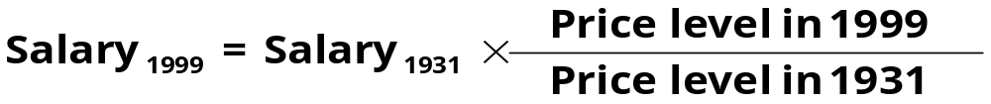
Dollar Figures from Different Times
Do the following to convert (inflate) person X’s wages in 1931 to dollars in 1995:
Notes:
26

Slide 33
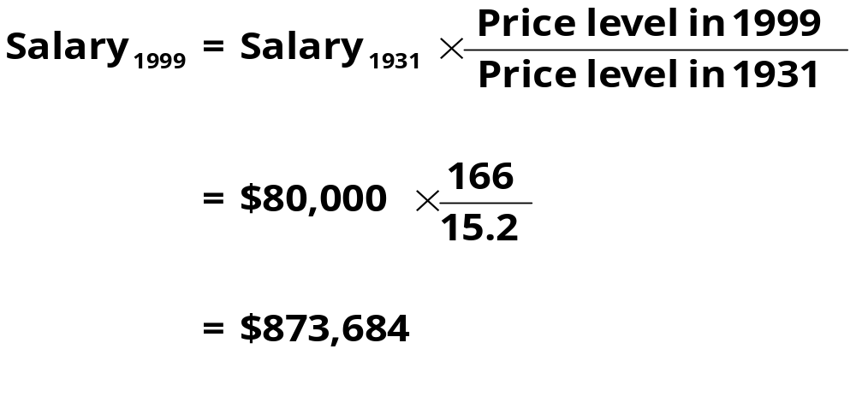
Dollar Figures from Different Times
Do the following to convert (inflate) person X’s wages in 1931 to dollars in 1995:
Notes:
28

Slide 34
Indexation
When some dollar amount is automatically corrected for inflation by law or contract the amount is said to be indexed for inflation.
Cost of Living Allowance (COLA): automatically raising wages when CPI rises.
Notes:
24

Slide 35
Real and Nominal Interest Rates
Interest represents a payment in the future for a transfer of money in the past.
Notes:
29

Slide 36
Real and Nominal Interest Rates
The nominal interest rate is the interest rate not corrected for inflation.
  It is the interest rate that a bank pays.
The real interest rate is the nominal interest rate that is corrected for inflation.
Real interest rate = (Nominal interest rate – Inflation rate)
Notes:
30

Slide 37
Real and Nominal Interest Rates
You borrowed $1,000 for one year.
Nominal interest rate was 15%.
During the year inflation was 10%.
Real interest rate = Nominal interest rate – Inflation
= 15% - 10% = 5%
Notes:
31

