Slide 1

Production and Growth
Chapter 24

Slide 2
Production and Growth
A country’s standard of living depends on its ability to produce goods and services.

Slide 3
Production and Growth
Within a country there are large changes in the standard of living over time.

Slide 4
Production and Growth
Productivity refers to the amount of goods and services produced for each hour of a worker’s time.
A nation’s standard of living is determined by the productivity of its workers.

Slide 5
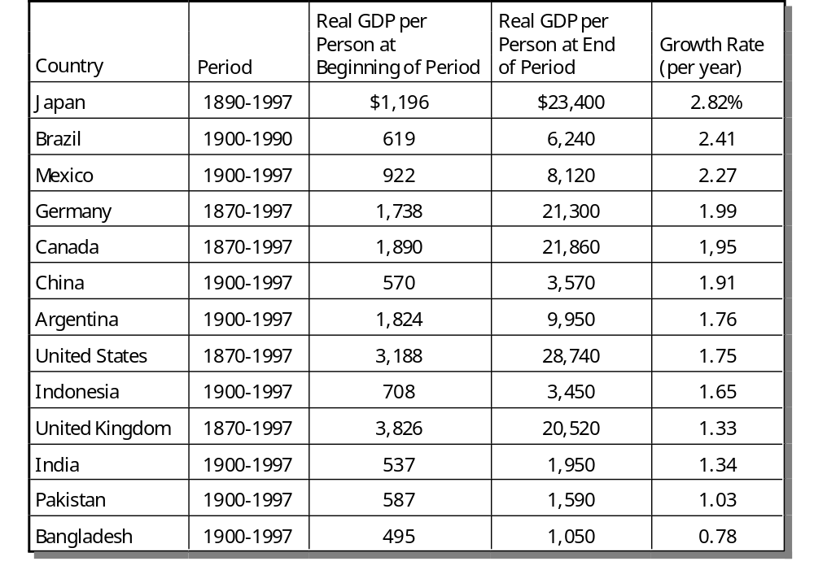
The Variety of Growth Experiences

Slide 6
Economic Growth Around the World
Living standards, as measured by real GDP per person, vary significantly among nations.

Slide 7
Economic Growth Around the World
The poorest countries have average levels of income that have not been seen in the United States for many decades.

Slide 8
Compounding and the
Rule of 70
Annual growth rates that seem small become large when compounded for many years.
Compounding refers to the accumulation of a growth rate over a period of time.

Slide 9
Compounding and the
Rule of 70
According to the rule of 70, if some variable grows at a rate of x percent per year, then that variable doubles in approximately 70/x years.

Slide 10
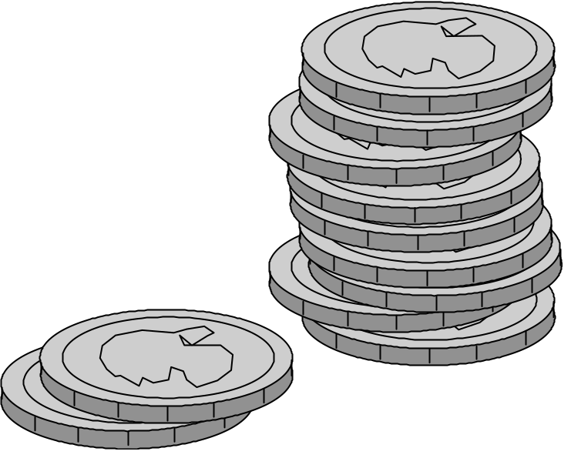
An Example of the Rule of 70
$5,000 invested at 7 percent interest per year, will double in size in 10 years
70/ 7 = 10

Slide 11
Why Productivity Is So Important
Productivity plays a key role in determining living standards for all nations in the world.

Slide 12
Why Productivity Is So Important
Productivity refers to the quantity of goods and services that a worker can produce from each hour of work.

Slide 13
Why Productivity Is So Important
To understand the large differences in living standards across countries, we must focus on the production of goods and services.

Slide 14
How Productivity is Determined
The inputs used to produce goods and services are called the factors of production.
The factors of production directly determine productivity.

Slide 15
The Factors of Production
Physical capital
Human capital
Natural resources
Technological knowledge

Slide 16
The Factors of Production
Capital is a produced factor of production.
It is an input into the production process that in the past was an output from the production process.

Slide 17
Physical Capital
Physical capital is the stock of equipment and structures that are used to produce goods and services.
  Tools used to build or repair automobiles.
  Tools used to build furniture.
  Office buildings, schools, etc.

Slide 18
Human Capital
Human capital is the economist’s term for the knowledge and skills that workers acquire through education, training, and experience.
  Like physical capital, human capital raises a nation’s ability to produce goods and services.

Slide 19
Natural Resources
Natural resources are inputs used in production that are provided by nature, such as land, rivers, and mineral deposits.
  Renewable resources include trees and forests.
  Nonrenewable resources include petroleum and coal.

Slide 20
Natural Resources
Natural resources can be important but are not necessary for an economy to be highly productive in producing goods and services.

Slide 21
Technological Knowledge
Technological knowledge is the understanding of the best ways to produce goods and services.
Human capital refers to the resources expended transmitting this understanding to the labor force.

Slide 22
The Production Function
Economists often use a production function to describe the relationship between the quantity of inputs used in production and the quantity of output from production.

Slide 23
The Production Function
Y = A F(L, K, H, N)
  Y = quantity of output
  A = available production technology
  L = quantity of labor
  K = quantity of physical capital
  H = quantity of human capital
  N = quantity of natural resources
  F( ) is a function that shows how the inputs are combined.

Slide 24
The Production Function
A production function has constant returns to scale if, for any positive number x,
xY = A F(xL, xK, xH, xN)
That is, a doubling of all inputs causes the amount of output to double as well.

Slide 25
The Production Function
Production functions with constant returns to scale have an interesting implication.
Setting x = 1/L,
Y/ L = A F(1, K/ L, H/ L, N/ L)
Where:
  Y/L = output per worker
  K/L = physical capital per worker
  H/L = human capital per worker
  N/L = natural resources per worker

Slide 26
The Production Function
The preceding equation says that productivity (Y/L) depends on physical capital per worker (K/L), human capital per worker (H/L), and natural resources per worker (N/L), as well as the state of technology, (A).

Slide 27
Economic Growth and
Public Policy
Governments can do many things to raise productivity and living standards.

Slide 28
Government Policies That Raise Productivity and Living Standards
Encourage saving and investment.
Encourage investment from abroad
Encourage education and training.
Establish secure property rights and maintain political stability.

Slide 29
Government Policies That Raise Productivity and Living Standards
Promote free trade.
Control population growth.
Promote research and development.

Slide 30
The Importance of Saving and Investment
One way to raise future productivity is to invest more current resources in the production of capital.

Slide 31
The Importance of Saving and Investment
As the stock of capital rises, the extra output produced from an additional unit of capital falls; this property is called diminishing returns.
Because of diminishing returns, an increase in the saving rate leads to higher growth only for a while.

Slide 32
The Importance of Saving and Investment
In the long run, the higher saving rate leads to a higher level of productivity and income, but not to higher growth in these areas.

Slide 33
The Importance of Saving and Investment
The catch-up effect refers to the condition that, other things being equal, it is easier for a country to grow fast if it starts out relatively poor.

Slide 34
Investment from Abroad
Governments can increase capital accumulation and long-term economic growth by encouraging investment from foreign sources.

Slide 35
Investment from Abroad
Investment from abroad takes several forms:
Foreign Direct Investment
  Capital investment owned and operated by a foreign entity.
Foreign Portfolio Investment
  Investments financed with foreign money but operated by domestic residents.

Slide 36
Education
For a country’s long-run growth, education is at least as important as investment in physical capital.
  In the United States, each year of schooling raises a person’s wage on average by about 10 percent.
  Thus, one way the government can enhance the standard of living is to provide schools and encourage the population to take advantage of them.

Slide 37
Education
An educated person might generate new ideas about how best to produce goods and services, which in turn, might enter society’s pool of knowledge and provide an external benefit to others.

Slide 38
Education
One problem facing some poor countries is the brain drain--the emigration of many of the most highly educated workers to rich countries.

Slide 39
Property Rights and Political Stability
Property rights refer to the ability of people to exercise authority over the resources they own.
  An economy-wide respect for property rights is an important prerequisite for the price system to work.
  It is necessary for investors to feel that their investments are secure.

Slide 40
Free Trade
Trade is, in some ways, a type of technology.
A country that eliminates trade restrictions will experience the same kind of economic growth that would occur after a major technological advance.

Slide 41
Free Trade
Some countries engage in . . .
. . . inward-orientated trade policies, avoiding interaction with other countries.
. . . outward-orientated trade policies, encouraging interaction with other countries.

Slide 42
Control of Population Growth
Population is a key determinant of a country’s labor force.
  Large populations tend to produce greater total GDP.
  However, GDP per person is a better measure of economic well-being, and high population growth reduces GDP per person.

