Slide 1
Fuzzy Wiki
Search
Nick Du, Christian Martinez, Xing Ling
CS 230
Mar. 18, 2025
A distributed indexer and searcher for English Wikipedia

Slide 2

Goal and Motivation
Nick Du, Christian Martinez, Xing Ling
CS 230
Mar. 18, 2025
Building a distributed search engine based on Lucene
Lucene's Powerful Capabilities
Lucene offers efficient indexing and querying algorithms.
Performance
A single-node search engine has performance limitations when handling large-scale data.
Availability
A distributed search engine can guarantee availability even if some nodes fail.
Load balancing
In distributed system, a load balancer can dynamically distribute query.

Slide 3
Project Design
Nick Du, Christian Martinez, Xing Ling
Mar. 18, 2025
Indexing
Searching
Serving
Dump conversion and Storage – transformed into JSONL format and stored on HDFS
Distributed indexing – line-by-line indexing on Yarn nodes
Index sharding - distributed across nodes
Coordinator - any node can act as the query coordinator depending on the load balancer
Result merging - Reranking
Load balancer - round robin
Caching - multi-level cache
Fault tolerance - Replication and fault recovery

Slide 4
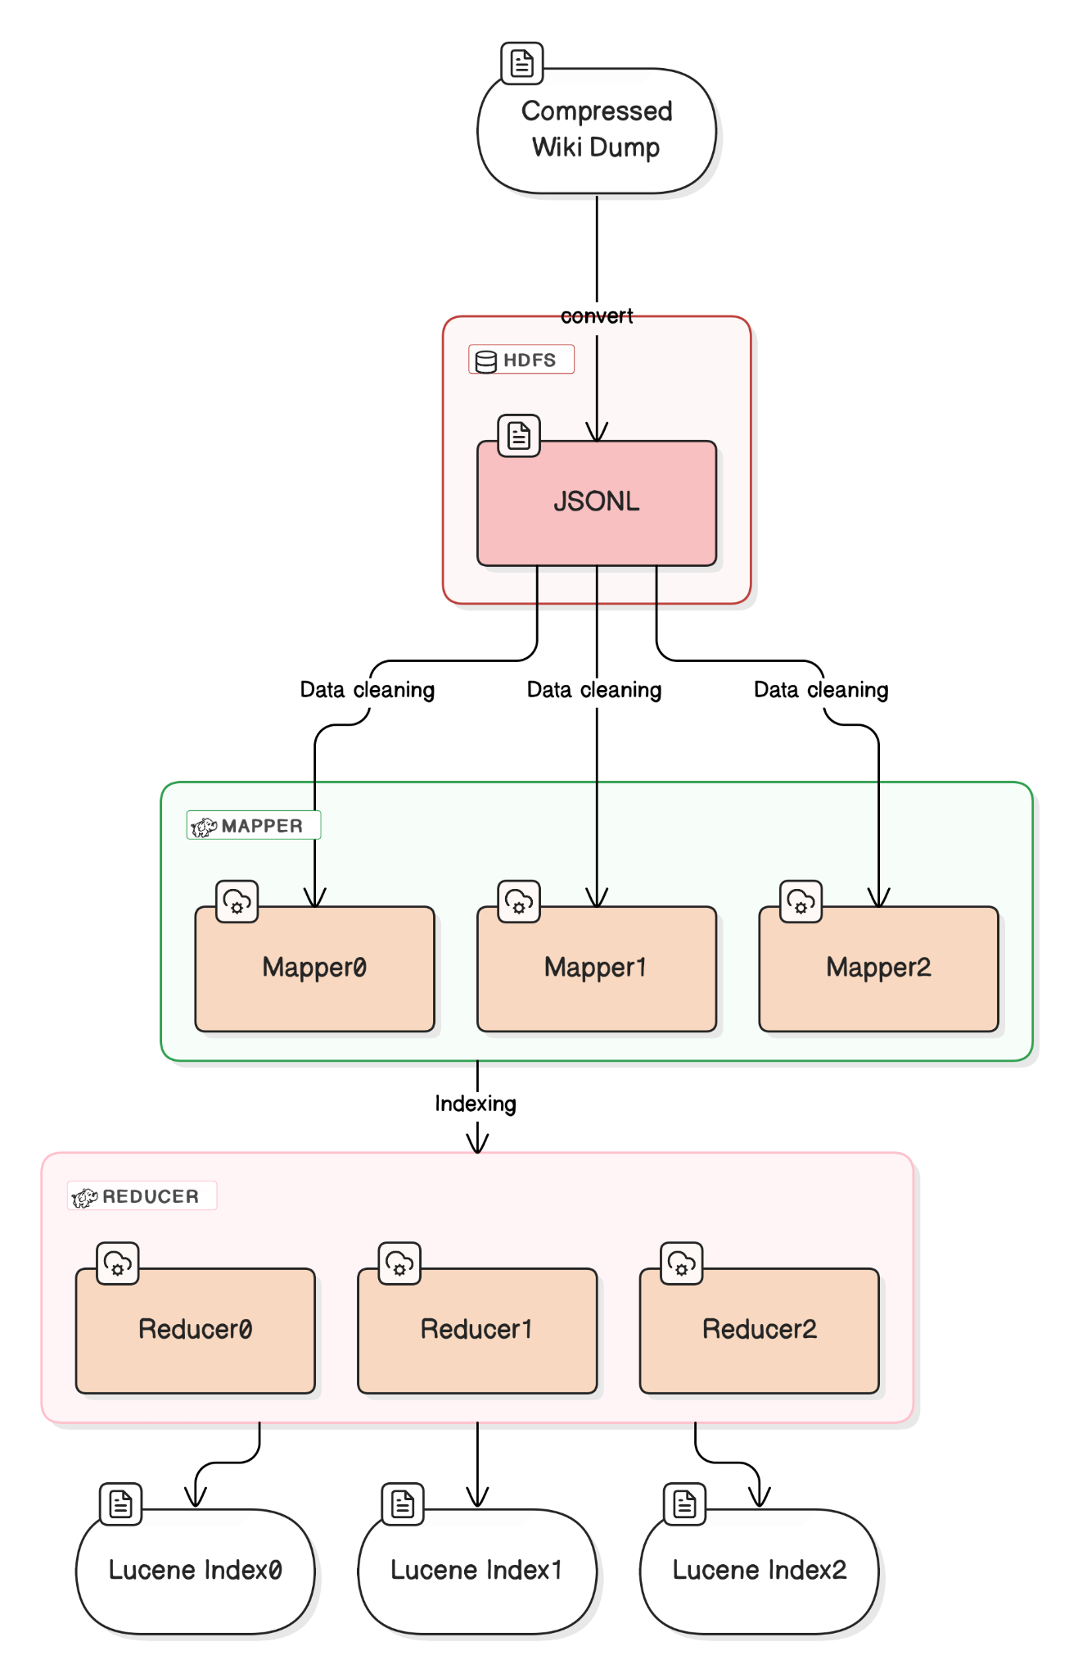
Indexing
Nick Du, Christian Martinez, Xing Ling
Mar. 18, 2025
Central node fetches the compressed wiki dump with bittorrent and upload the converted JSONL to HDFS.
Mapper: text stemming; stop words removal; general data cleaning;
Json => Lucene Document
Reducer: Parsed documents are collected to Index;
Document=>Lucene Index
Map & Reduce

Slide 5
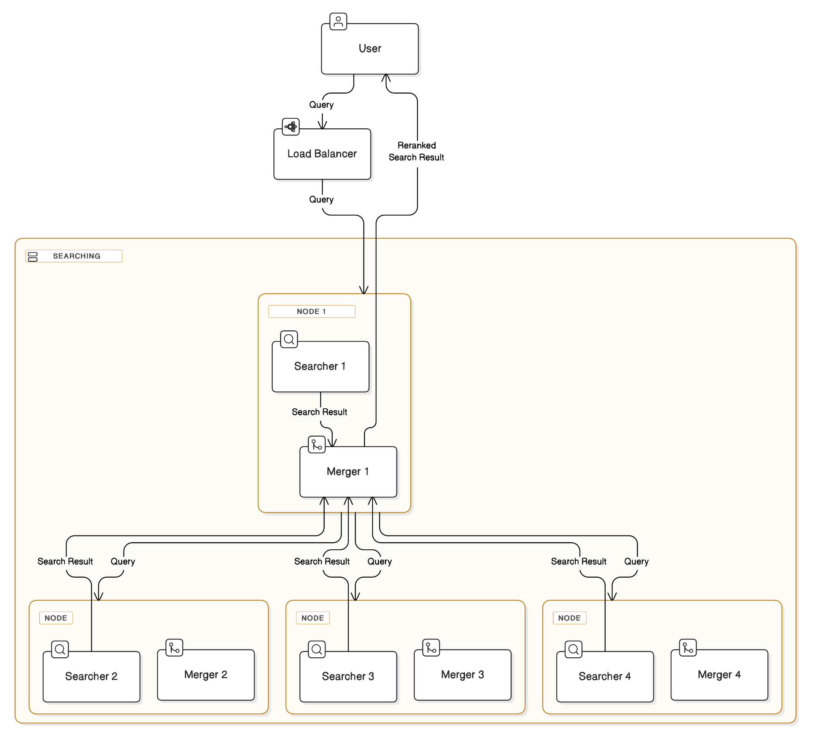
Searching
Nick Du, Christian Martinez, Xing Ling
Mar. 18, 2025
Coordinator node (depending on load balancer) will broadcast query to all other worker nodes.
Search: Parsing query into terms; Searching with the terms in local indexing record by BM25 algorithm; Ranking and sending top 10 results to coordinator node.
Merge: Coordinator reranks all the results by normalizing the IDF(Inverse document frequency), and sends reranked results back to user.
Score=IDF*TF*BOOST
Search & Merge

Slide 6

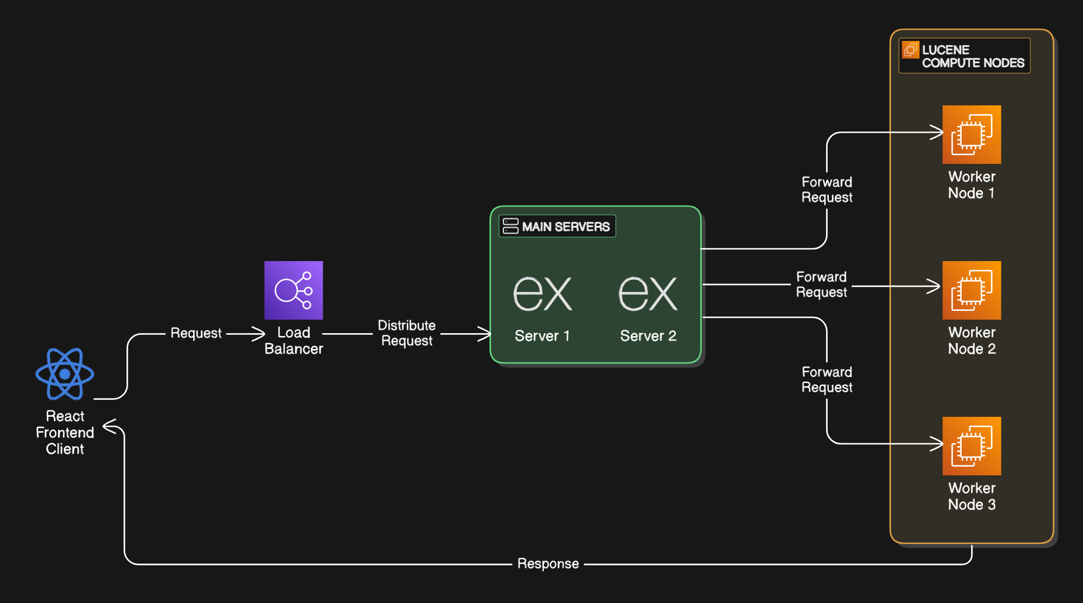

Serving
Nick Du, Christian Martinez, Xing Ling
Mar. 18, 2025
The Application begins on the Client-side. The frontend is implemented in React.
Once the user begins to type in the Searchbar, request are made and received by the load-balancer. The load-balancer determines which server from the server group to select and forwards the request.
The selected server will then fulfill the user's request by interacting with Lucene EC2 Worker Nodes. During this process, it directly pin a client to a Worker Node, however, it will indirectly work with others. This is done for performance related reasons: caching purposes since users will generally search for similar related topics Lucene can better serve request.
The Worker Nodes compute our request
The results are then packaged back to the user
REST API
3
2
1
4
5

Slide 7



Multi-layer Caching
Nick Du, Christian Martinez, Xing Ling
Mar. 19, 2025
Frontend: request cache
Worker: queries and article cache
Lucene: phrase cache
Notes:
Frontend: our frontend implemented in React and will cache each page sent from the workers. If the user hit the same page or search the query again, it will skip requesting the worker and load from the local browser cache.
Worker: implement two types of caching mechanism: query level and article level. When a query or artucle hits a worker, the worker will maintain a memory mapping between the query and the results.. Later on, for the same request, the cluster may load the results directly from the mapping instead of looping it up in the harddisk. Using temporal locality, this level provide better performance for the similar queries from different users.
The lucene engine under the hood also maintain a memory cache of each query phraes, providing low level performance boost to the speed of searching.

Slide 8
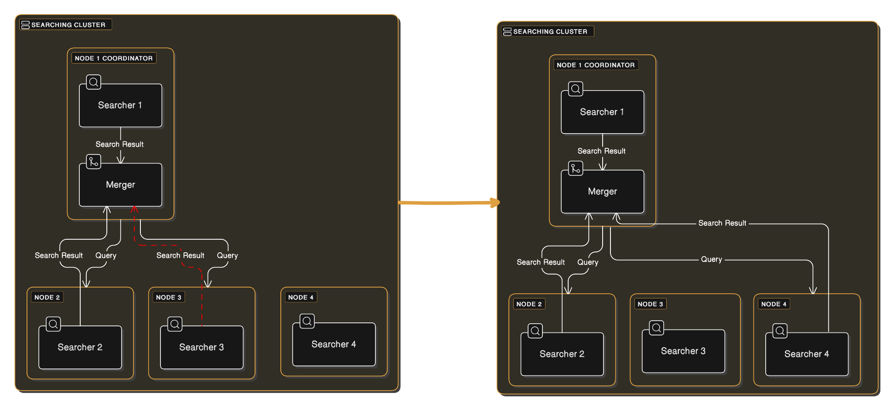
Fault tolerance
Nick Du, Christian Martinez, Xing Ling
Mar. 19, 2025
Recompute Peers
Connection Failure
Recovery

Slide 9
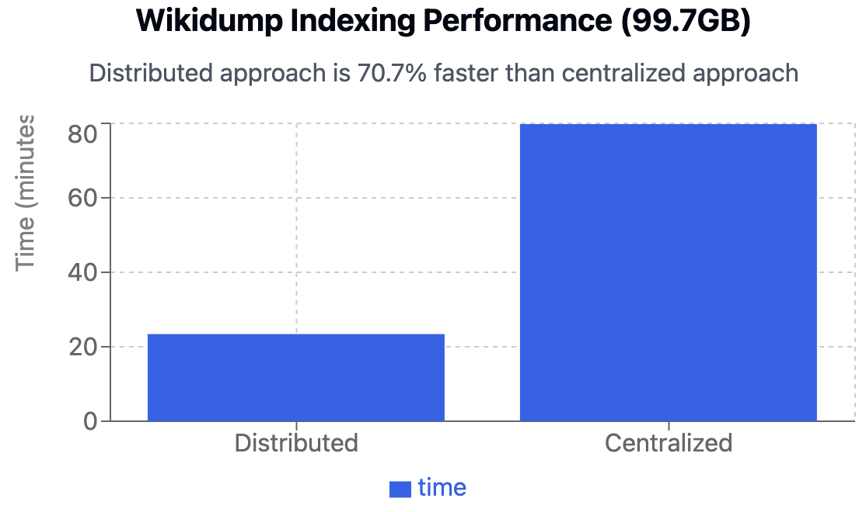
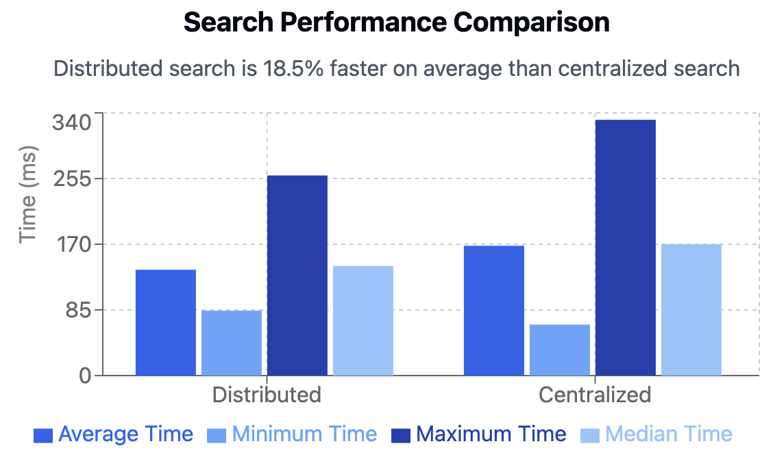
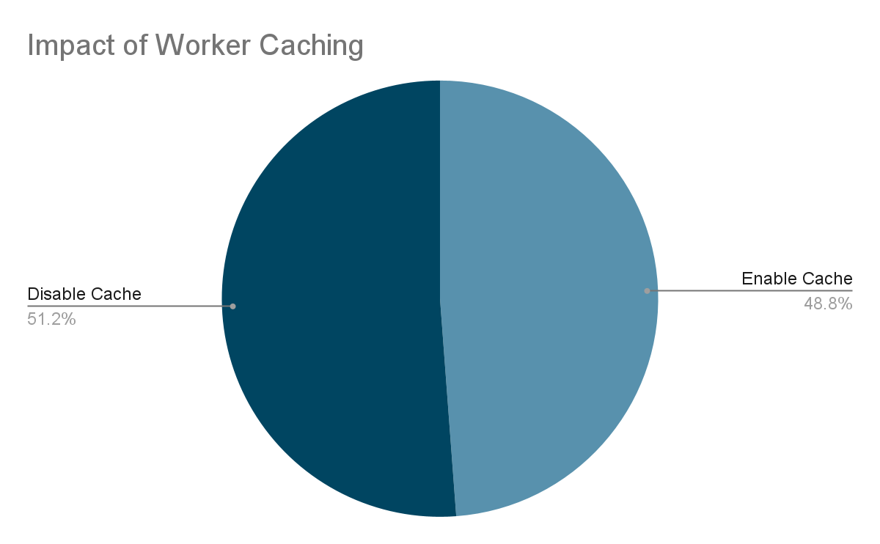
Performance
Nick Du, Christian Martinez, Xing Ling
Mar. 18, 2025
time taken for indexing the 2025-02-01 wikidump (99.7GB)
time to search and fetch the top 100 wiki pages (December 1, 2007 – January 1, 2023)
Fetching top 100 hit keywords with/without caching

