Slide 1

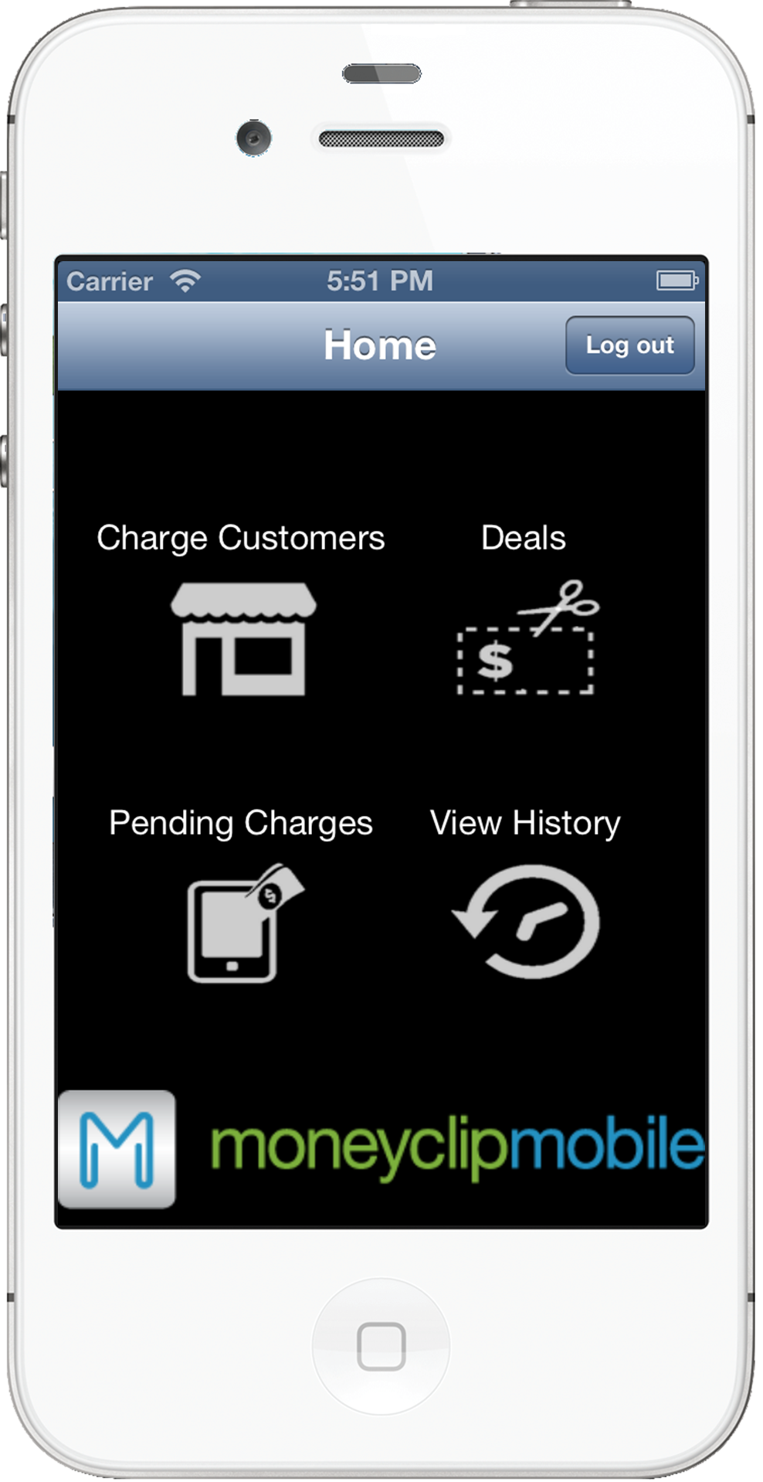
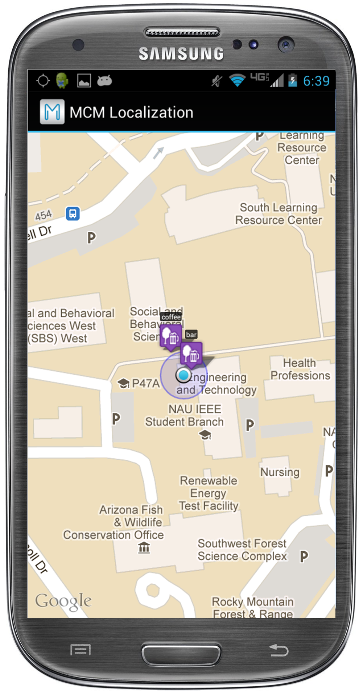

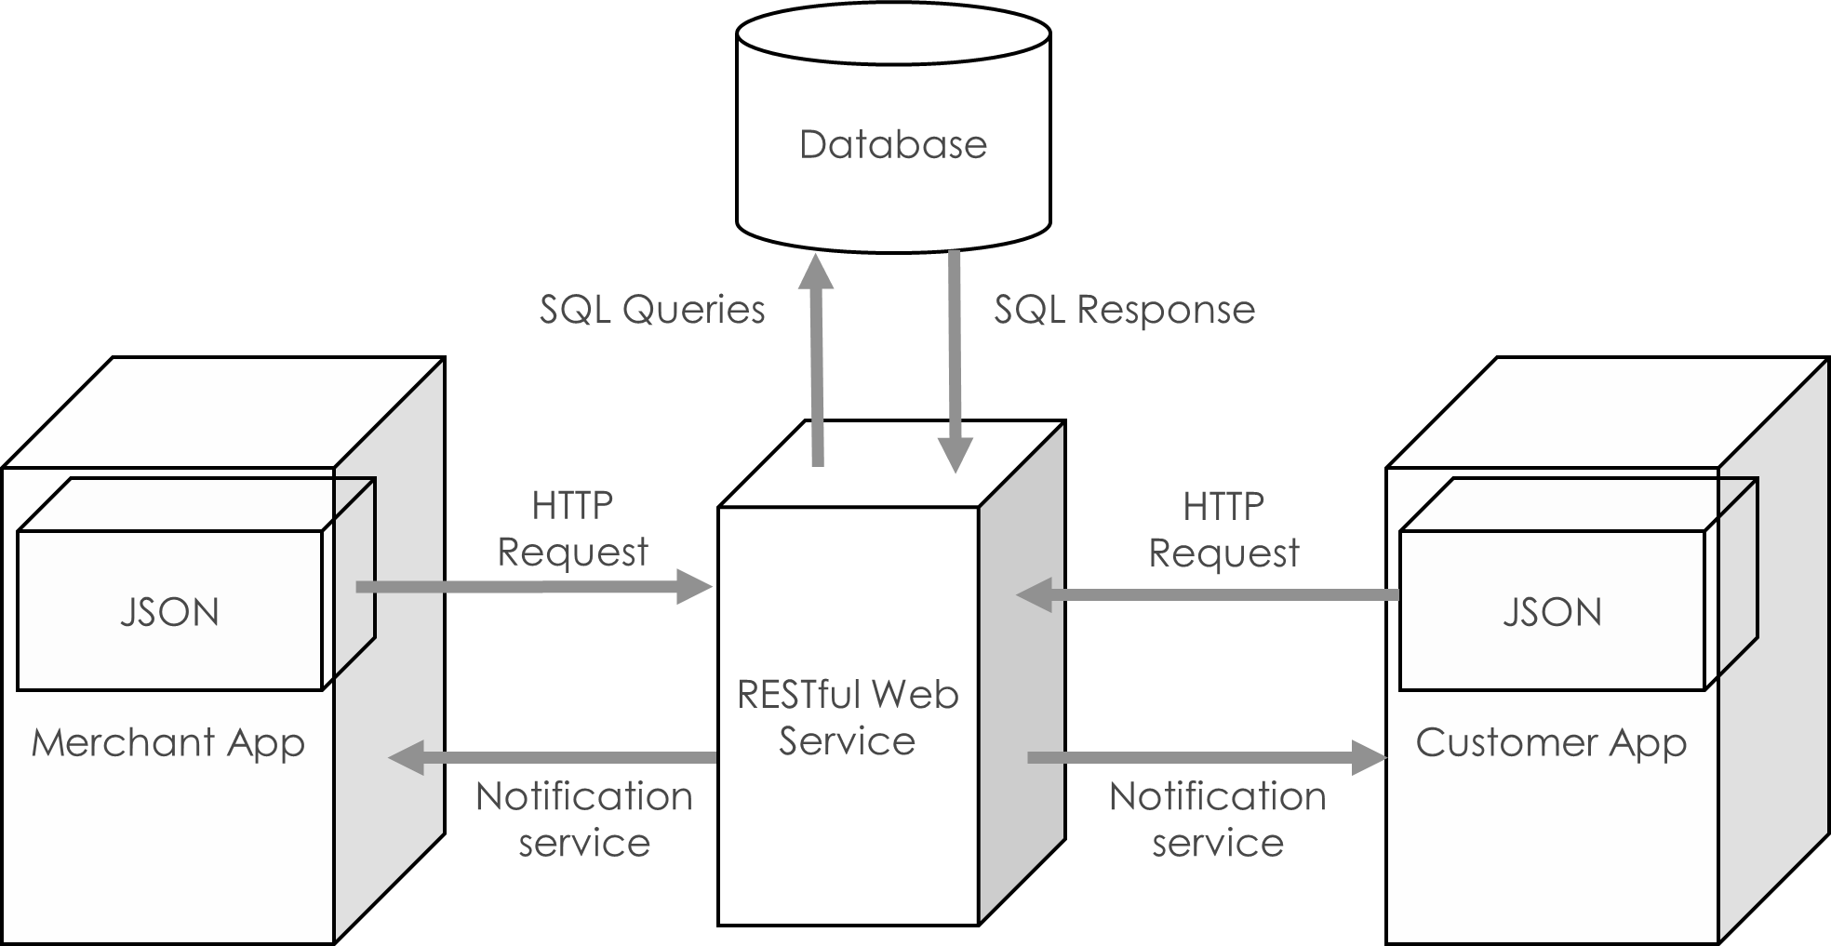
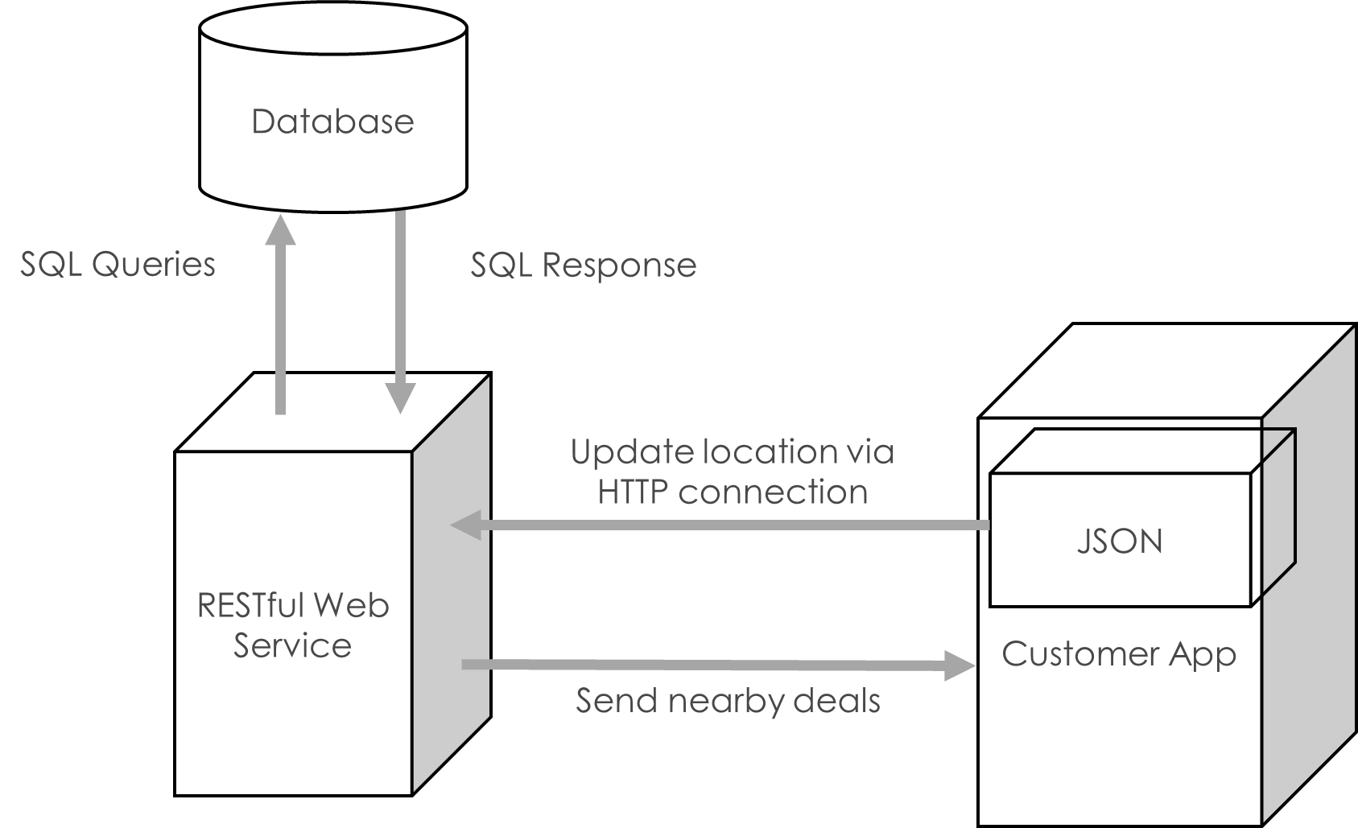
Localization Functionality for MCM, a Mobile Commerce Application
Kimberly Oyama, Blayne Kennedy, Daren Rodhouse, Chihiro Sasaki
Department of Computer Science, Northern Arizona University
Background and Problem
Testing
MoneyClip Mobile (MCM) is a web-based payments infrastructure providing fee-free transactions to customers and merchants through the use of mobile devices. Dr. Joshua Cross of Hermes Commerce, Inc. is planning to make this mobile payment system more robust by providing targeted advertisements, coupons, and management of customer’s loyalty programs.
User Testing
Over 40 people from diverse groups were tested using three different versions of each app.
Common issues found were:
Expected functionality for map page
Shortcut/navigation
Poor feedback for user
Error messages
Confirmation for important user actions
Explanation of empty lists
Our Solution
Unit Testing
Our localization function provides the ability for MCM merchants to interact with their customer when they are in their vicinity, allowing for true moneyless transactions.
Directed advertisements and coupons based on the customer’s location is also provided, based on the customer’s location and their transaction history.
The backend software was unit-tested for correct functionality. As individual functions were developed for the app, they were also manually tested.
Figure 3: The left image shows an iPhone screenshot of the home page of the merchant app. The right image shows an Android screenshot of the merchant map page of the customer app.
Statistics
Architecture
Table 1: Data transfer, in bytes, between the apps and the server. Data transferred depends on the length of the specific record.
The localization functionalities are implemented on the Android, iOS, and website platforms.
Action | Android (KB) |  | iPhone (KB)
 | Receive | Transmit | Receive | Transmit
Log in | 2.322 | 3.100 | 0.433 | 0.592
Merchant Map | 1.942 | 1.912 | 1.804 | 1.703
Deals | 3.328 | 1.002 | 1.692 | 0.571
Pay Charge | 0.942 | 1.740 | 0.298 | 0.283
View History | 2.070 | 0.872 | 4.226 | 0.570
Logout | 0.000 | 0.000 | 0.000 | 0.000
Acknowledgments
Dr. Joshua Cross of Hermes Commerce, Inc.
Dr. John Georgas of Northern Arizona University
Dr. Wolf-Dieter Otte of Northern Arizona University
User Testing Volunteers
Figure 1: Architecture for the localization functionality between customer and merchant.
Figure 2: Architecture for the localization functionality of directed ads and coupons.
Engineering Design

