Slide 1

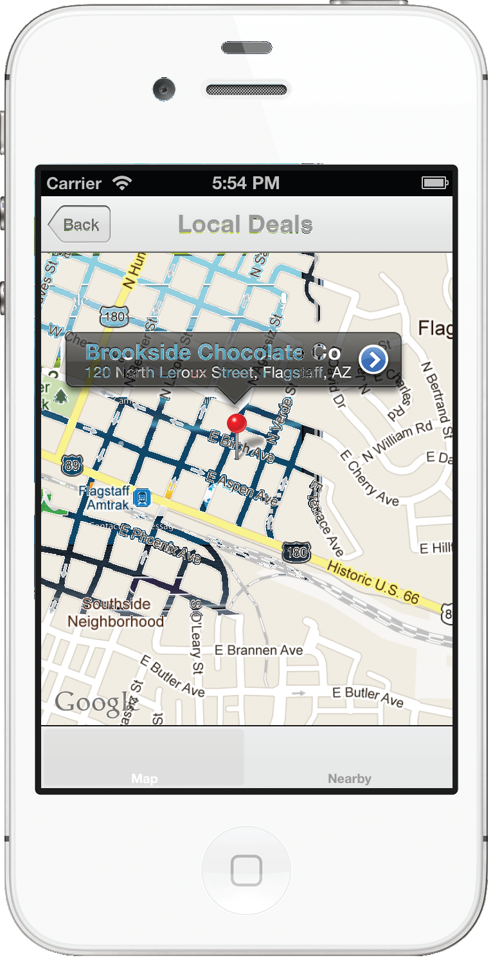
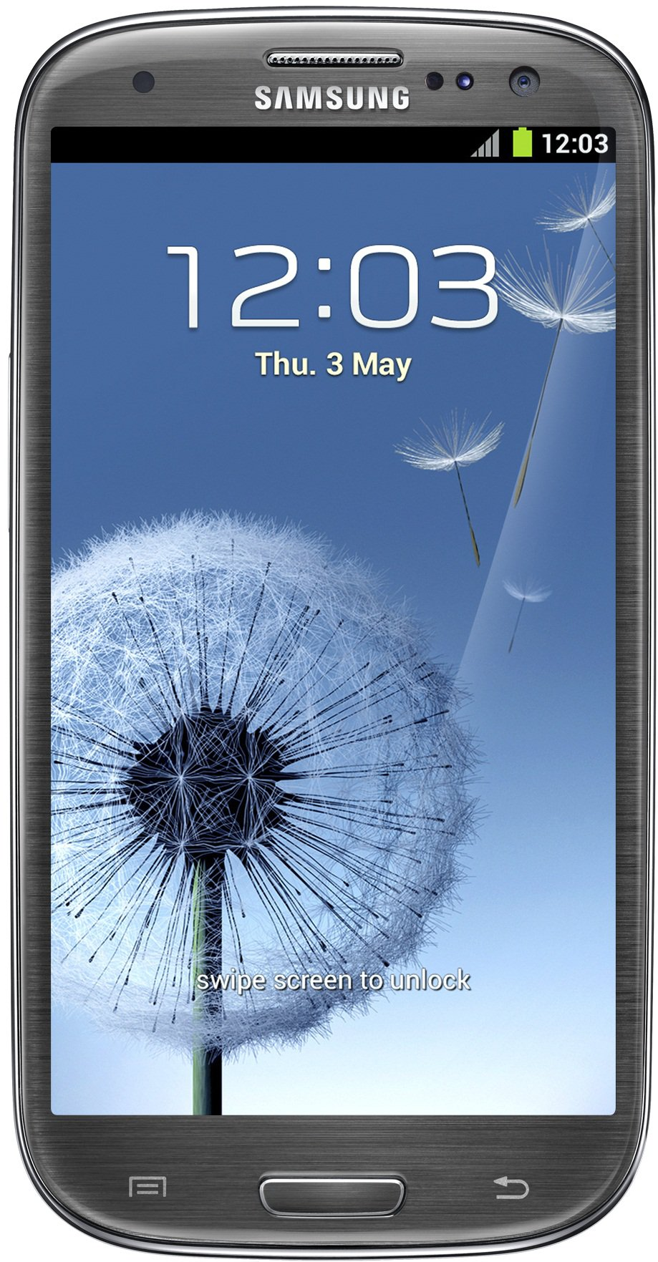

Localization Functionality for MCM, a Mobile Commerce Application
Kimberly Oyama, Blayne Kennedy, Daren Rodhouse, Chihiro Sasaki
Department of Computer Science, Northern Arizona University
Background and Problem
Testing
MoneyClip Mobile (MCM) is a web-based payments infrastructure providing fee-free transactions to customers and merchants through the use of mobile devices. Dr. Joshua Cross of Hermes Commerce, Inc. is planning to make this mobile payment system more robust by providing targeted advertisements, coupons, and management of customer’s loyalty programs.
The following testing was performed for the localization functions:
Functional
Timing
User
Table1: Test results from _____
Our Solution
Our localization function provides the ability for MCM merchants to interact with their customer when they are in their vicinity, allowing for true moneyless transactions.
Directed advertisements and coupons based on the customer’s location is also provided, based on the customer’s location and their transaction history.
Architecture
Figure 3: Caption goes here for both phones.
The localization functionalities are implemented on the Android, iOS, and website platforms.
Statistics
Database
Database
Memory Usage
On phone
On server
Data Usage (transfer sizes)
Processor Usage?
 | Usages
Platforms | Memory | Data Transfer | Processor
iPhone
Android
Server
SQL Queries
SQL Response
SQL Queries
SQL Response
Merchant App
RESTful Web Service
Customer App
RESTful Web Service
Customer App
JSON
HTTP Request
HTTP Request
JSON
Update location via HTTP connection
JSON
Notification service
Notification service
Send nearby deals
Acknowledgments
Dr. Joshua Cross of Hermes Commerce, Inc.
Dr. John Georgas of Northern Arizona University
Dr. Wolf-Dieter Otte of Northern Arizona University
Figure 1: Architecture for the first localization functionality between customer and merchant.
Figure 2: Architecture for the second localization functionality of directed ads and coupons.
Engineering Design

