Slide 1
A Case Study of software development life cycle Efficiency
Richard Kapalko
Colorado State University Global
MIS581-M8: capstone Project
Dr. Lisa Bryan
October 10, 2021
Notes:
File: rKapalko_MIS543-M8_PortfolioProject_(slides).pptx
A Case Study of Software Development Life Cycle Efficiency
Richard Kapalko
Colorado State University Global
MIS581-M8: Capstone Project
October 10, 2021

Slide 2
Agenda
Orientation
SDLC
State of the Art
Research Questions
Project Management
Deliverables
Data Pipeline
pgAdmin – Dimensional Model
Tableau – Interactive Visualization
SAS – Correlation Testing
R – Linear Regression
GitHub – Asset Management
Conclusions
Notes:
This briefing sets the stage with an organizational overview, the Software Development Life Cycle (SDLC), and a state-of-the-art description. The specific research questions are stated with the project management and approach. The deliverables are elaborated concluding with insights and recommendations.

Slide 3

Orientation
AFH teams develop software components for conservation efforts
The mission is to do this efficiently
Existing processes collect data
Can data analytics tools help?
Figure 1. From Highlands, by F. Gunn, 2015, Unsplash (https://unsplash.com/photos/QcBAZ7VREHQ). In the public domain.
Notes:
For over twenty years and based in Fort Collins, Colorado, established company AFH has provided IT support services for the development of software solutions for a U.S. government agency with the goal of providing land conservation initiatives. This is a multimillion-dollar annual operation that lives under the umbrella of U.S. regulatory and contract compliance guardrails including quality control and process innovation expectations.
With approximately 250 full-time employees, there is a topology of twenty software development teams that are collectively managed with a common Application Lifecycle management (ALM) tool. The AFH mission is to efficiently move thousands of software components, “Stories,” through their Software Development Life Cycle (SDLC).
As demonstrated by a substantial and consistent annual increase of conservation agriculture practice worldwide (Kassam et al., 2018), the conservation mission is easy to understand and support.

Slide 4
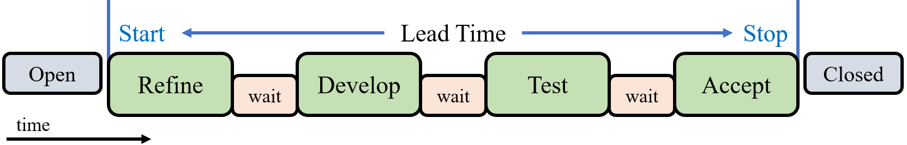
Software Development Life Cycle (SDLC)
SDLC sequence of states from ideation to completion
Value-Added activities
Wait times
Key performance Indicators (KPIs)
Lead-Time = Stop - Start
Activity-Ratio = Σ non-Wait / Lead-Time
Figure 2. Screenshot snip of R. Kapalko PowerPoint on August 19, 2021.
Notes:
The local SDLC consists of refine, develop, test, and accept states. Although not always the case these states are meant to be executed sequentially for each Story. The twenty AFH teams shepherd thousands of Stories through this pipeline per calendar quarter.
The study of this transactional data can provide insight into SDLC process optimization (Mahmood & Beg, 2012). The data is comprised of the activity state changes captured by the ALM as each Story moving through the SDLC from ideation to completion has a sequence of value-added activities. These transactional facts are the most basic view of AFH’s business operations (Kimball & Ross, 2002).
The primary KPIs for SDLC productivity are Lead-Time and Activity-Ratio (Yadav et al., 2018). Lead-Time is the length of time between Story start and Story stop. Activity-Ratio is a measure of efficiency, calculated as value-added time divided by Lead-Time, and typically presented as a percentage. Both KPIs are measured per Story and average Lead-Time and average Activity-Ratio apply to the responsible teams. Some teams have more experience than others as measured by the number of Stories finished. Each Story has several initial characteristics that may be contributing factors to Lead-Time.
The project objective is to identify the influencers of and the inefficiencies within the given SDLC. The project results may benefit the management of the AFH high-variance SDLC processes because machine learning and process mining can generate Lead-Times (Welsing et al., 2020). The business intelligence achieved through the analysis of these KPIs is expected to increase SDLC decisioning efficacy. AFH would like to shorten Lead-Time which allows for timelier feedback from end users and familiarity with the Activity-Ratio can help guide process improvement initiatives.

Slide 5
State of the Art
Literature supports the intended research
The SDLC resembles a Lean Manufacturing (LM) pipeline
Value Stream Mapping (VSM) techniques may be applied
Activity-Ratio and Lead-Time are proven KPIs
The study of these quality related costs lends to SDLC optimization
Notes:
The SDLC resembles a manufacturing pipeline and Lean Manufacturing (LM) principles may be applied to the process (Yadav et al., 2018). For example, Value Stream Mapping (VSM) is a LM technique used to differentiate waste from value-added activities (Sweeney, 2017). Therefore, VSM and other LM principles may be applied to the analysis of SDLC efficiency with respect to value-added activities separated by time waiting for the next activity.
As Stories move through the SDLC, the ALM transactional log is maintained in a way that captures the state of each Story. This log, as viewed through the lens of LM, is the source of inspiration for analytics research to identify the inefficiencies within and the influencers of the given SDLC.
The project results may benefit the management of the AFH high-variance SDLC processes because machine learning and process mining can generate Lead-Times (Welsing et al., 2020). The study of these quality-related costs can provide insight toward SDLC process optimization (Mahmood & Beg, 2012).

Slide 6
Research Questions (RQ) and Hypotheses
RQ₁: Where is the largest portion of wait time?
RQ₂: Do longer running teams have better efficiency?
H₂0: There is no positive correlation between teams’ Count and Activity-Ratio.
H₂A: There is a statistical significance in this positive correlation.
RQ₃: Does initial Story characteristics explain SDLC efficiency?
H₃0: Initial Story characteristics do not contribute to associated Lead-Time.
H₃A: Some portion of Lead-Time is explained by initial Story characteristics.
Notes:
Some AFH personnel were assigned as SMEs for the project for requirements elicitation, analysis, and specification and remained engaged to define the SDLC states, confirmation of LM approach, and KPIs. The following research questions (RQ) are aligned with business goals:
RQ1: Where is the largest portion of wait time?
RQ2: Do longer running teams have better efficiency?
RQ3: Does initial Story characteristics explain SDLC efficiency?
Note that the interactive visualization deliverable answers RQ1 and therefore does not have hypotheses.
The project will follow a typical management plan. The scope is to address the research questions with respective hypotheses. Research results are expected to create immediate benefit to AFH decisioning and enable the possibility of permanent automation of KPI reporting and visualization.

Slide 7
Project Management
One analyst for eight weeks
Success is identified influencers of and inefficiencies within the SDLC
As applied to Stories, not groups of Stories
Limited to the available dataset, resources, and chosen analytics tools
SMEs retained ethical oversight
Leveraged an industry standard SEMMA approach
Notes:
The project was executed over eight weeks in 2021 with a single analyst and a focus group of SMEs. Project success was the identified influencers of and the inefficiencies within the given SDLC. The business intelligence achieved through analysis of Lead-Time and Activity-Ratio has raised AFH decisioning efficacy. AFH would like to shorten Lead-Time which allows for timelier feedback and familiarity of Activity-Ratio can help process improvement initiatives.
The project is limited to the efficacy of the sampled raw data. The results are beholden to this data and the business interpretation given by the SMEs. For example, the study analyzes Stories, not “Features” which are groups of related Stories. Therefore, the results do not address the situation where one team’s Story has a dependency on another team’s Story and Stories are considered independent phenomena.
The project was limited to the chosen pgAdmin, SAS, Tableau, and R analytics tools and the AFH provided equipment.
SMEs were given ethical oversight needed to ensure proper balance of potential misuse and analytical benefits (Hand, 2018).
The project loosely followed the sample, explore, modify, model, and assess steps of SEMMA. The dataset is a sample taken from a Jira repository. The sample was loaded into pgAdmin PostgreSQL for the techniques of normalization and dimensional data modeling. The project used SAS Studio to explore the dataset statistically. Exploration techniques included summary statistics, correlation, and outlier analysis. Exploring the dataset graphically was accomplished in part with SAS Studio and with the Tableau Public Edition platform. The project then modified the dataset in pgAdmin with data wrangling and calculated field techniques. To model and assess, the project used R Studio as an integrated suite of statistical, graphic, and computing capabilities. The techniques involved included hypothesis analysis, statistical inference, and multiple linear regression.

Slide 8
Project Deliverables
Proof-of-Concept (PoC) and prototypes
Data pipeline
Dimensional model
Interactive visualization
Project asset repository
Project paper, findings, and recommendations
Notes:
Success or failure for actionable business insights, the project I still meant to deliver five things.
The project leveraged a deductive approach to avoid risk of data destruction and honor a short project timeline. The project deduced hypothesis from current SDLC understanding and LM principles, formulated operational hypotheses that proposed variable relationships, executed tests, and translated conclusions into actionable insights. The project did not alter the raw data and all the phenomena are described numerically. Therefore, the project case-study followed a quantitative method using exploration, hypothesis, correlation, and regression qualitative methods.

Slide 9
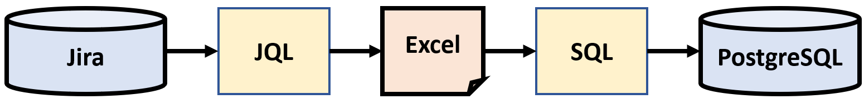
Extract, Transform, and Load (ETL)
Atlassian Jira and JQL extraction of all completed Stories
Microsoft Excel transformation steps under SME guidance
Loaded into the pgAdmin and PostgreSQL database
Figure 3. Screenshot snip of R. Kapalko PowerPoint on September 3, 2021.
Notes:
Existing relationships were leveraged because AFH operates locally, therefore the project had access to Subject Matter Experts (SMEs) who are essential to the elicitation, elaboration, and accommodation of unique business rules (Ploder & Kohlegger, 2018).
The original dataset was acquired on August 17, 2021. The in-house Jira transactional log is accurate and consistent, therefore, there is a strong readiness-level. The data was Extracted, Transformed, and Loaded (ETL) from the access-controlled repository into a PostgreSQL database.
The study of transactional data can provide insight into SDLC process optimization (Mahmood & Beg, 2012). These transactional facts are the most basic view of AFH’s business operations (Kimball & Ross, 2002).

Slide 10
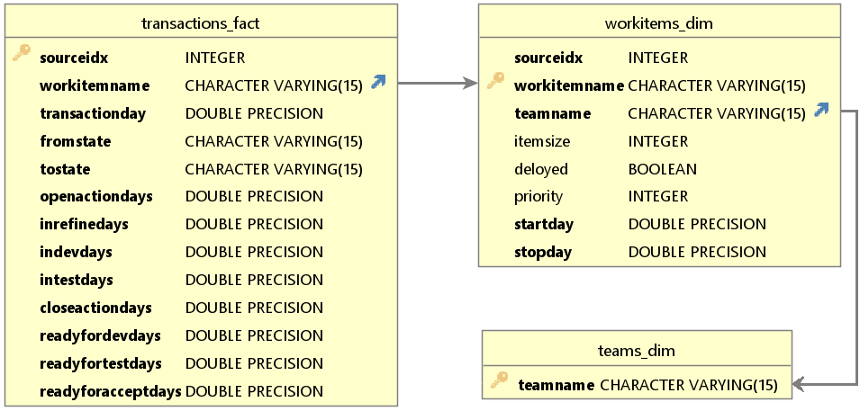
pgAdmin – dimensional modeling
Structured data
Calculated fields
Datamart schema
For future scalability
Dimension tables
Work Items
Teams
Fact table
State transitions
Figure 4. Screenshot snip of R. Kapalko DbVisualizer on August 25, 2021.
Notes:
Nineteen teams finished 2,037 Stories totaling 12,618 state transitions. Along with calculated fields Lead-Time and Activity-Ratio, this data was organized in a PostgreSQL database. The WorkItems dimension table is a static look-up with four Story characteristics. The Transactions fact table houses SDLC state changes with FromState, ToState, and DateTime. This datamart schema is a vital component to allow for future scalability across the business with big data in a distributed environment (Patel, 2019). The project used structured data only because security is more difficult with unstructured data (Islam & Islam, 2014).

Slide 11
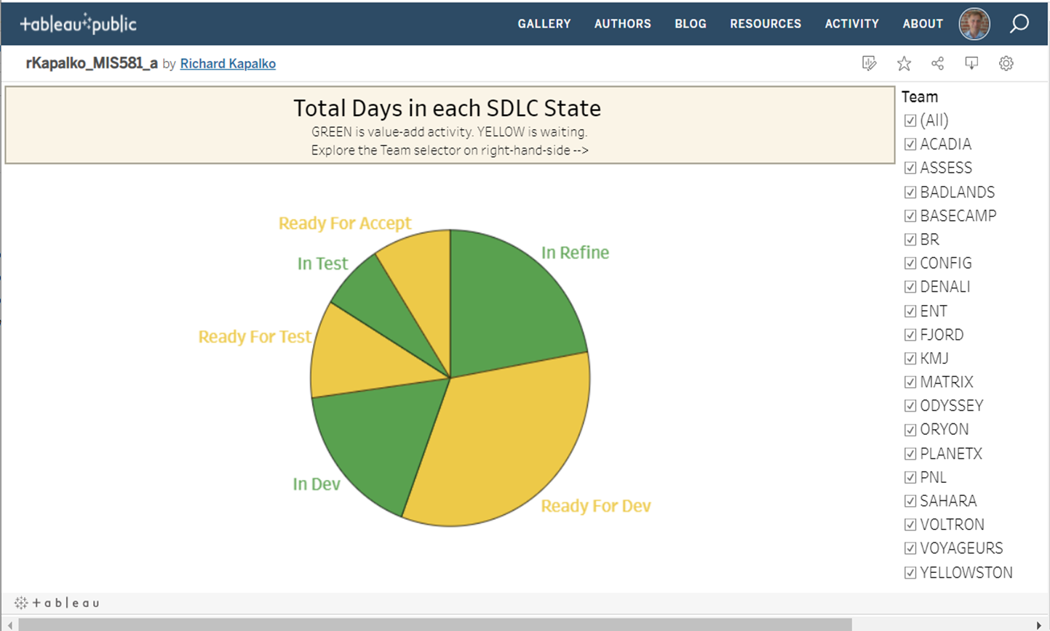
Tableau – interactive visualization
Identifying areas of waste
Exploratory analysis
Waiting for development is largest contributor to waste
Result is team agnostic
Figure 5. Screenshot snip of R. Kapalko Tableau on September 10, 2021.
Notes:
Research Question 1 was answered by SMEs interacting with a Tableau visualization. The visualization was designed to use filters that allow ad-hoc exploration of different combinations of teams and activity states. This method enabled identification of significant areas of inactivity in the SDLC.
Question 1 about significant waste activity was satisfied by graphical exploration in Tableau Public with SAS used for some summary statistics.
Individual and group exploratory analysis using the project created interactive visualization (Kapalko, 2021) determined that delay waste obviously centers around waiting for development activity. The research question is answered. This result applies to all teams. The SMEs gained immediate and actionable insight and therefore required no further analysis.

Slide 12
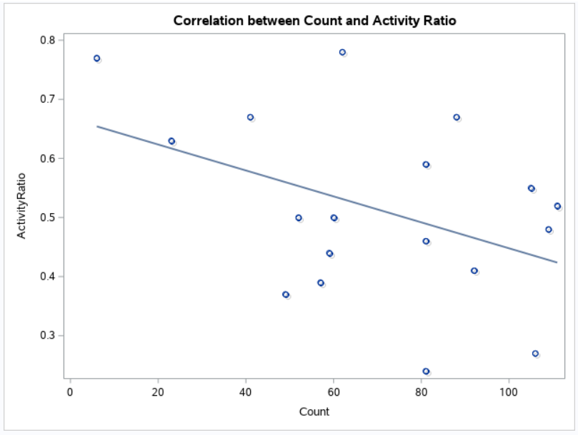
SAS – Correlation Analysis
Comparing team efficiency
Teams’ Story count and Activity-Ratio linear relationship
Pearson Correlation test
A fair correlation, but in the opposite direction!
Figure 6. Screenshot snip of R. Kapalko SAS Studio on September 12, 2021.
Notes:
Research Question 2 was answered by reviewing the association between the two variables Story count and average Activity-Ratio per team. SAS was used to perform relevant summary statistics, identification of outliers, and a Pearson Correlation test. This method enables quantification of the strength of relationship.
Hypothesis pair 2 addressed the correlation, a measure of linear relationship, between Story Count and Activity-Ratio. Correlation is defined as the statistical association between two variables. The technique of analysis was a simple Pearson Correlation test, with 5% confidence, on the related pairs. The Count variable was considered as continuous, outliers were removed, and the assumption of linearity was reviewed.
The expectation was that teams with longer track record would have a higher average Activity-Ratio. The data had an approximately normal distribution, are continuous, and one outlier was removed leaving 18 related pairs that meet the assumptions of the Pearson Correlation method. The correlation coefficient of -0.43 indicated that an average strength of relationship exists with 7.5% confidence, but the relationship is opposite the stakeholders’ expectation and therefore extremely insightful. The null hypothesis is not rejected that there is no positive correlation between teams’ Count and Activity-Ratio. With this surprising analytical result, the more Stories a team completes does not statistically lend to higher Activity-Ratio.

Slide 13
R – linear regression
Predicting Story Lead-Time
Multiple logistic regression test
Dependent Lead-Time
Independent Story size, priority, deploy status, and assigned team
Results indicate that Lead-Time cannot be predicted a-priori
Notes:
Research Question 3 was answered by modeling the dataset’s three independent variables against the dependent variable Lead-Time with a multiple logistic regression per Story. R was used to show that the assumptions were met, develop a regression model, and analyze the strength of results.
Hypothesis pair 3 addressed the functional relationship between independent variables StoryPts, Deployed, and Priority and dependent variable Lead-Time. The method used was multiple logistic regression. During the analysis, the assumptions of logistic regression were reviewed including linear relationship between dependent and independent variables, normally distributed residuals, and no indication of multicollinearity.
The Story records have several initial characteristics including estimated size, given priority, team assignment, and whether the Story was eventually deployed. The project made reasonable assumptions that the relationships are linear, the variance of residuals are the same, observations are independent, and the respective data was normally distributed. The generated linear model had the characteristics of extremely small p-value and R-squared of 2% which indicated that nearly none of Lead-Time is explained by initial characteristics of a Story.
The analysis was extended by including team name with the result of 14% R-squared, but that was still much less than what was considered valuable in this context. The null hypothesis is not rejected with no further review of the model or its variations. This result importantly confirms that Lead-Time is not a forgone conclusion and should be managed independently of initial Story characteristics

Slide 14
Conclusions
Project success
Some influencers of and inefficiencies within the SDLC were identified.
The ETL process, data mart model, and interactive visualization prototypes have been delivered.
Business Insights for AFH
Initiatives to shorten Lead-Time should focus on idle time between refine and development states without targeting any specific team.
Longer-lived teams should have higher efficiency. Suggest further study.
Notes:
The project is a success because some important influencers of and the inefficiencies within the given SDLC have been identified. Forthcoming AFH initiatives are more likely to positively shorten Lead-Time which allows for timelier feedback and a new familiarity of Activity-Ratio can generally support process improvement
Business insights have been attained by analyzing the AFH software development lifecycle. This case study determined that the significant delay in Story Lead-Time occurs between Story refinement and development states. This result is team agnostic. The created interactive visualization deliverable is a permanent asset to the organization. Importantly, teams that stay together longer do not have an improved average Activity-Ratio and as expected, Lead-Time cannot be predetermined by initial Story characteristics. Collectively, AFH decision-makers are expected to immediately benefit from this deeper understanding of the influencers of and the inefficiencies within their SDLC
The benefit of the one-time Tableau visualization can be extended to a real-time (R/T) dashboard through automated ETL connectivity. Further research should be conducted as to the reasons for the abnormal time between refine and development states. Company SMEs would like to know more about long-lived teams not producing better Activity-Ratios which is generally considered essential for productivity. Without consideration of initial Story characteristics, effects of Lead-Time and Activity-Ratio should be further studied. Finally, the project team remains mindful that state changes can move backwards in the SDLC, and these are potentially interesting events for further review

Slide 15
References
Hand, D. J. (2018). Aspects of data ethics in a changing world: Where are we now? Big Data, 6(3), 176-190. https://doi.org/10.1089/big.2018.0083
Islam, R., & Islam, E. (2014). An approach to provide security to unstructured big data. The 8th International Conference on Software, Knowledge, Information Management and Applications (SKIMA 2014). https://doi.org/10.1109/skima.2014.7083392
Kapalko, R. (2021, August). Total Days in each SDLC State. Free Data Visualization Software | Tableau Public. https://public.tableau.com/app/profile/richard.kapalko8595/viz/rKapalko_MIS581_a/MIS581a
Kapalko, R. (2021, September). Kapalkor/MIS581. GitHub. https://github.com/kapalkor/MIS581
Kassam, A., Friedrich, T., & Derpsch, R. (2018). Global spread of conservation agriculture. International Journal of Environmental Studies, 76(1), 29-51. https://doi.org/10.1080/00207233.2018.1494927
Kimball, R., & Ross, M. (2002). The data warehouse toolkit: The complete guide to dimensional modeling. John Wiley & Sons.
Mahmood, P., & Beg, M. (2012). Measuring cost of quality(coq)- on SDLC projects is indispensible for effective software quality assurance. International Journal of Soft Computing and Software Engineering, 2(9), 1-15. https://doi.org/10.7321/jscse.v2.n9.1
Notes:
References page one of two.

Slide 16
References (Continued)
Patel, J. (2019). An effective and scalable data modeling for enterprise big data platform. 2019 IEEE International Conference on Big Data (Big Data). https://doi.org/10.1109/bigdata47090.2019.9005614
Ploder, C., & Kohlegger, M. (2018). A model for data analysis in SMEs based on process importance. Communications in Computer and Information Science, 26-35. https://doi.org/10.1007/978-3-319-95204-8_3
Sweeney, B. (2017). Lean QuickStart guide: The simplified beginner's guide to lean. ClydeBank Media LLC.
Welsing, M., Maetschke, J., Thomas, K., Gützlaff, A., Schuh, G., & Meusert, S. (2020). Combining process mining and machine learning for lead time prediction in high variance processes. Lecture Notes in Production Engineering, 528-537. https://doi.org/10.1007/978-3-662-62138-7_53
Yadav, R., Mittal, M., & Jain, R. (2018). Adoption of lean principles in software development projects. International Journal of Lean Six Sigma, 11(2), 285-308. https://doi.org/10.1108/ijlss-03-2018-0031
Notes:
References page two of two.

