Slide 1
FPDS Data Dissemination
Atom Feed

Slide 2
Agenda
Introduction
FPDS Atom Feeds
How To
FAQs
Feedback & Questions

Slide 3
Introduction
Evolution of Data Dissemination Methods
  2000 and earlier – Flat files with fixed positions (for ex. CSV and fixed length files)
  2001 to 2004 – Flat files with flexible formats (for ex. XML formats)
  2004 to 2008 – Data feeds using web-services
  2008 onwards – Data Feeds using Atom

Slide 4
Definition of Atom Feed
Web feeds allow software programs to check for updates published on a website. To provide a web feed, a site owner may use specialized software (such as a content management system) that publishes a list (or "feed") of recent articles or content in a standardized, machine-readable format. The feed can then be downloaded by programs that use it, like websites that syndicate content from the feed, or by feed reader programs that allow Internet users to subscribe to feeds and view their content. (from Wikipedia)

Slide 5
FPDS Atom Feed
FPDS Atom Feeds are based on industry Standard Atom 1.0 format
Detailed Atom Feed specifications defined at: https://www.fpds.gov/wiki/index.php/Atom_Feed_Specifications_V_1.5.2

Slide 6
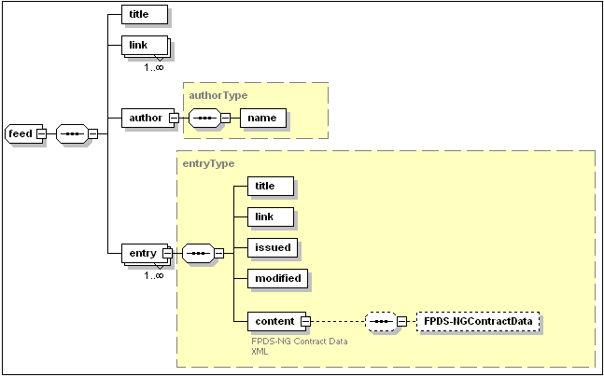
FPDS Atom Feed Format

Slide 7
FPDS Atom Feed
Atom Feeds are configurable to search using all the data elements defined in the FPDS V1.5 Data Dictionary
Payload includes the detailed contract information
Data is paginated
  10 Complete Award/IDVs per page
  Next and previous URLs available on each page
Those syncing data on a daily basis should first consume the Deleted Feed (contracts that were deleted) and then the Public Feed
The recommend timing of Atom Feed data pulls is between 9 a.m. – 5 p.m.

Slide 8
FPDS Atom Feed
The public Atom Feed URL is https://www.fpds.gov/ezsearch/FEEDS/ATOM?FEEDNAME=PUBLIC&q=
The Deleted Atom Feed URL is https://www.fpds.gov/ezsearch/FEEDS/ATOM?FEEDNAME=DELETED&q=
Your search criteria would be appended to the URL. If you want data for Agency 4740 that was last updated in FY14, then you could enter: https://www.fpds.gov/ezsearch/FEEDS/ATOM?FEEDNAME=PUBLIC&q=LAST_MOD_DATE:[2013/10/01,2014/09/30] AGENCY_CODE:"4740"
If you are unsure of the data element tags, you can use the ezSearch advanced search function to assist you.
  Go to https://www.fpds.gov and activate the ezSearch function.
  Click the Advanced Search button and then click on Add (see slide 9)
  Select the data element(s) and provide the criteria for those elements (see slide 10)

Slide 9
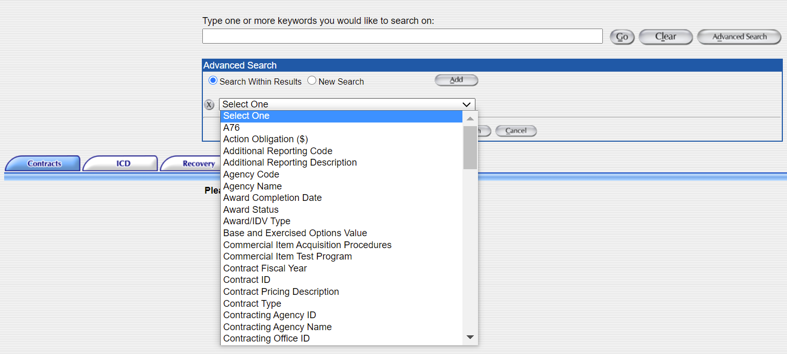
FPDS ezSearch

Slide 10
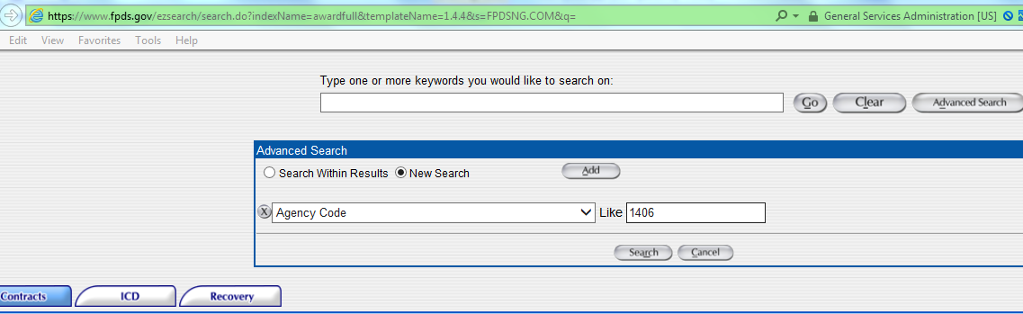
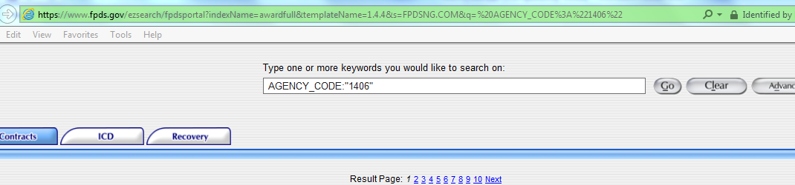
FPDS ezSearch
Copy the search criteria (see below) and append to Atom Feed URL

Slide 11
FPDS Atom Feed
Paste that criteria in public Atom Feed URL:
  Public Atom Feed: https://www.fpds.gov/ezsearch/FEEDS/ATOM?FEEDNAME=PUBLIC&q=
  Example of a Public atom feed with the criteria pasted in: https://www.fpds.gov/ezsearch/FEEDS/ATOM?FEEDNAME=PUBLIC&q=AGENCY_CODE:"1406"
Readers:
Any feed reader can be used to pull the XML results
Use ‘wget’ to pull the data

Slide 12
FPDS Atom Feed references
The Atom Feed FAQ section: https://www.fpds.gov/wiki/index.php/ATOM_Feed_FAQ
Data element search criteria examples: https://www.fpds.gov/wiki/index.php/Atom_Feed_Usage

Slide 13
General steps for Atom feeds
Determine your criteria for the Atom Feed
Subscribe to the Atom Feed
Write code to handle the number of threads you want to use and to repeat the process until all data is downloaded
Maximum number of threads allowed is 10
Load your downloaded data into your database

