Slide 1
Interagency Contract Directory
(ICD)

Slide 2
What is the Interagency Contract Directory?
ICD is:
  A search tool used to find active interagency contracts that an agency may be able to use. It is based on ezSearch and its capabilities.
  It retrieves the latest final IDV record in order to give the user the most current data for each IDV.
  Helps agencies save time and money by helping locate active Indefinite Delivery Vehicles (FSS, GWACs, BOAs, BPAs and IDCs) that an agency can use to create a delivery/task order or BPA Call with the IDV as the reference IDV.

Slide 3
Interagency Contract Directory Limitations
Only searches IDVs with a date signed beginning with October 1, 2006
You need to look at the Who Can Use field to see if your agency can use the IDV
You must login to FPDS-NG. After July 18th the ICD will be available without logging into FPDS-NG

Slide 4
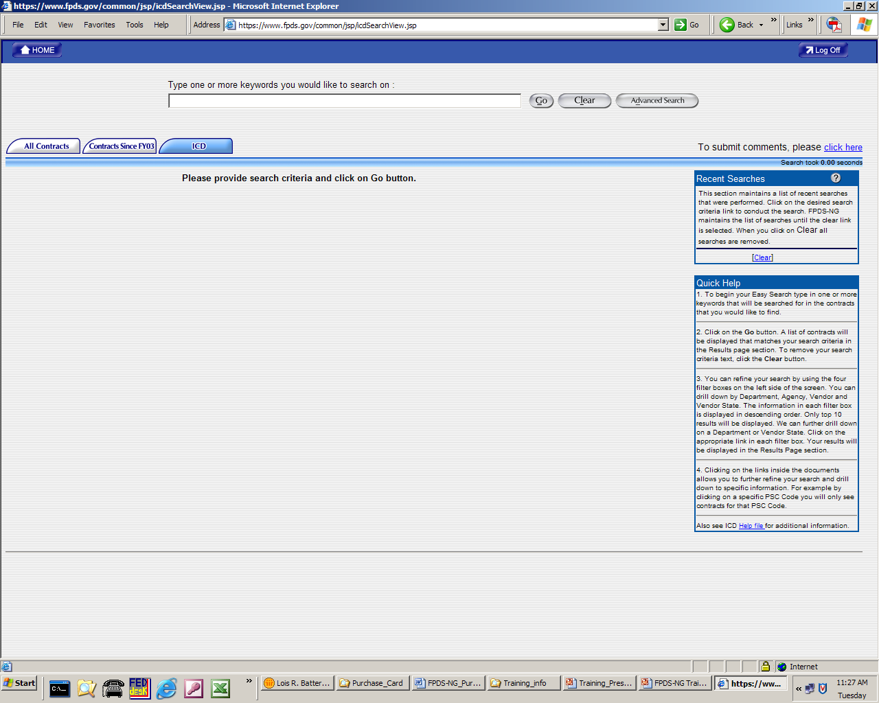
Initial ICD Screen

Slide 5
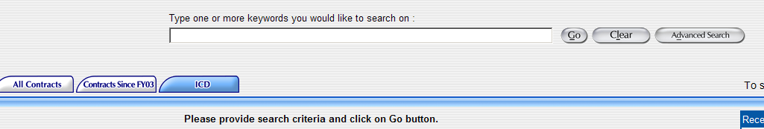
ICD tabs and keyword search
ICD tab should be highlighted. Other tabs are: All contracts and Contracts since FY03

Slide 6
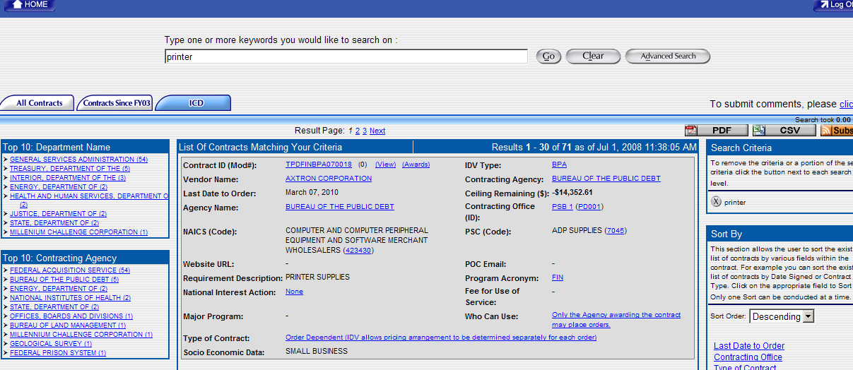
Simple search on keyword: printer

Slide 7
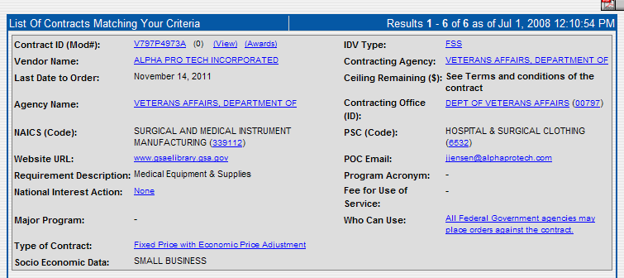
ICD Summary Record (20 data elements shown)

Slide 8
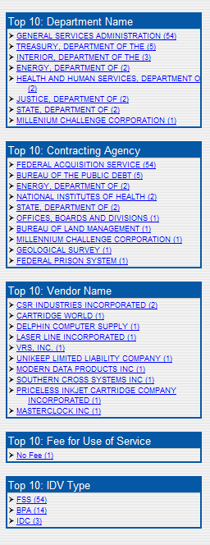
The left side (Top 10)
On the left will be four boxes showing the Top 10 results by each of five categories based on the search results. These are Department Name, Contracting Agency, Vendor Name, Fee for Use of Service and IDV Type. After each entry are the number of records found for that entry within your search criteria.
You can limit your results further by selecting one of these items.

Slide 9
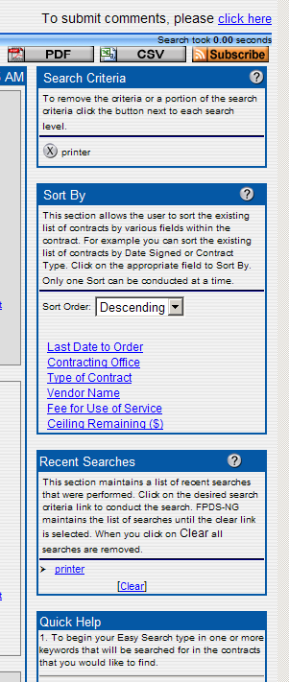
What is on the right side?
Your options to save and print your search results in either PDF or CSV formats.
Your search criteria for this session.
Your option to sort by one of 6 fields.
A list of recent searches which remains from session to session until you clear them.
Quick Help with a link to more detailed help.
Ability to select from 5 to 30 records per screen.

Slide 10
Viewing IDVs, associated awards and Drilling Down
To view the full record for an IDV click on View
To view all the awards associated with one IDV, if any, click on Awards
Click on any of the data element values highlighted in blue to drill down by that value and further limit the search results
Or click on one of the data elements listed in the Top 10 to drill down by that value and further limit the search results

Slide 11
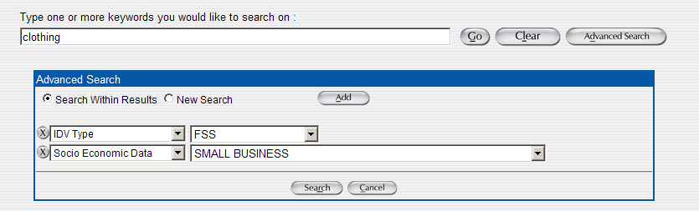
Sample Advanced Search

