Slide 1
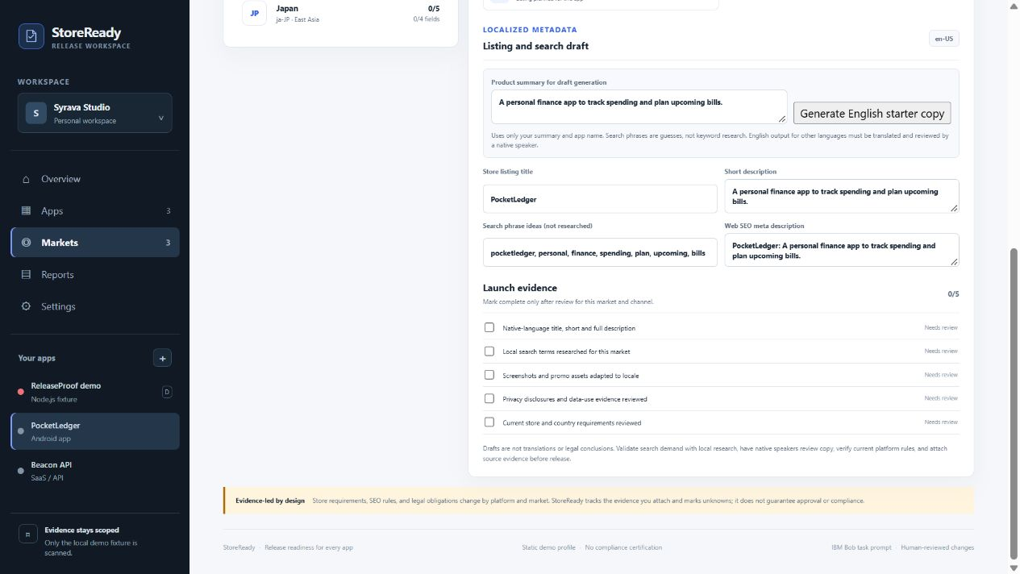
IBM BOB 2.0 HACKATHON
Global Release
Passport
StoreReady / ReleaseProof
One workspace for every app in your portfolio and each market it ships into.
RELEASE BLOCKED
43
LOCAL WORKING PROTOTYPE
2 blockers | 3 warnings
/ 100
Evidence first. Human review at every fix.
This score belongs only to the deliberately broken local fixture. Other apps remain unaudited.
Notes:
Introduce StoreReady as a portfolio release workspace. The photo on the right shows a real local market-plan screen, while the score summarizes a separate broken-fixture audit. Tests and builds were not executed by this profile.

Slide 2
THE PROBLEM
Release checks are fragmented
A green signal is hard to trust when tools cover different parts of the repository.
01 / SCATTERED SIGNALS
02 / HIDDEN UNKNOWNS
03 / COSTLY HANDOFFS
Many check surfaces
Gaps resemble passes
Advice lacks context
Security, dependencies, tests, builds, CI, deployment, docs and licensing each leave a different trail.
Unavailable or unconfigured checks can be overlooked when results lack a shared status model.
Teams still need the file, rule, evidence and verification step to make a safe change.
STOREREADY
One workspace, separate app evidence, and visible coverage limits.
Notes:
Explain the multi-product release problem: signals must be tied to the correct app and unknown areas must stay visible. StoreReady is not a replacement for specialist scanning or full CI.

Slide 3
THE WORKFLOW
Every app gets its own market launch plan
A portfolio view keeps each product’s store, SEO, asset, and review work in the right context.
01
02
03
04
Choose app
Choose market
Prepare plan
Verify release
Keep listing tasks, release findings, and evidence separated by product.
Set a country and locale across Play, App Store, Galaxy, web, and GitHub.
Draft English listing copy; review search ideas, artwork, privacy, and policy.
Inspect source-backed static findings; keep unknown checks visible.
6 starter locales
Plan by app × country × channel
Apps without a scanner stay unaudited
Notes:
Demonstrate switching to PocketLedger, opening Markets, reviewing US/India/Japan launch plans, using the English starter-copy generator, and showing Apple as not applicable to an Android app. These plans are editable templates; search phrases are not researched and drafts need native translation. Next, return to ReleaseProof demo and inspect its static security finding.

Slide 4
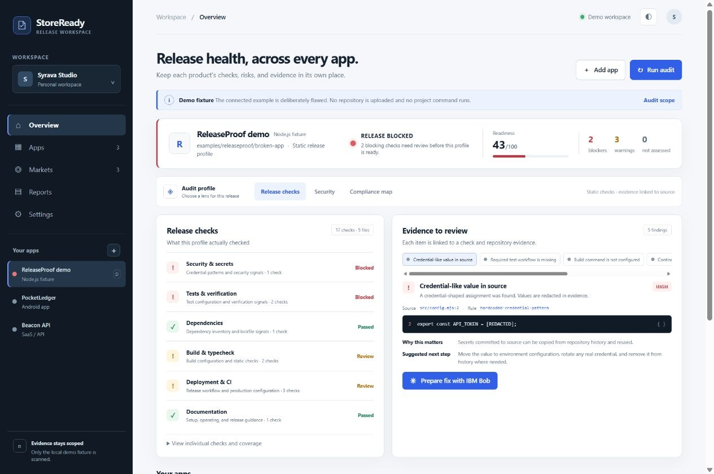
THE PRODUCT
A decision that shows its work
The readiness score is paired with findings, check areas and explicit limits.
DECISION
RELEASE
BLOCKED
43 / 100
2 blockers · 3 warnings
17 checks | 5 files
Tests and builds are not executed. Compliance is manual review or not assessed.
Notes:
Point out the blocked decision, source evidence and explicit unknowns. These counts describe the current local broken fixture only. Tests and builds did not run and compliance is not certified.

Slide 5
IBM BOB 2.0
A human-reviewed remediation handoff
ReleaseProof prepares the context; the developer owns the review and release decision.
01
Give Bob evidence
Use the finding, source location, rule and remediation context to frame a focused task.
SUBMISSION EVIDENCE
Real Bob sessions still need to be captured.
02
Review the proposal
Inspect Bob’s actual changes in the repository before accepting a patch.
Task prompts and this prototype do not count as session proof. Add authentic session summaries for each participating team member before submission.
03
Verify again
Run the checks that apply, inspect unresolved coverage and keep results evidence-backed.
SESSION SCREENSHOTS: PENDING
Notes:
Describe how the product is designed to work with IBM Bob. Do not claim an IBM Bob session happened. The current package contains task prompts and a handoff UI but lacks authentic session screenshots and usage records. Update this section after genuine sessions.

Slide 6
WHY IT MATTERS
Built around the four judging dimensions
The prototype demonstrates a working loop and keeps what remains visible.
APPLICATION OF TECHNOLOGY
PRESENTATION
Deterministic static checks, source evidence, redaction and portable reports.
A live broken fixture to audit to review to re-audit product walkthrough.
BUSINESS VALUE
ORIGINALITY
Less context switching; a shared, explainable release review for a team.
A portfolio release passport tying app, country, storefront, and evidence together.
BEFORE SUBMISSION
Publish MIT-scoped source | deploy demo | capture Bob sessions | record narrated video
Notes:
Close by tying the working prototype to each judging dimension. The value statement is qualitative; there are no customer or productivity measurements. Before final submission, publish only the MIT-scoped additions, deploy the demo, obtain genuine IBM Bob session evidence, and record the narrated video.

