Slide 1
Task 3: Dashboard Design
Data Analyst Internship
DataX Labs

Slide 2
Dataset Used
Columns Used:
• Sales
• Profit
• Quantity
• Category
• Region
• Segment
• Order Date
• Product Name

Slide 3
Key Performance Indicators (KPIs)
Total Sales: 2.30M
Total Profit: 286.40K
Total Orders: 9.99K
Total Quantity: 38K

Slide 4
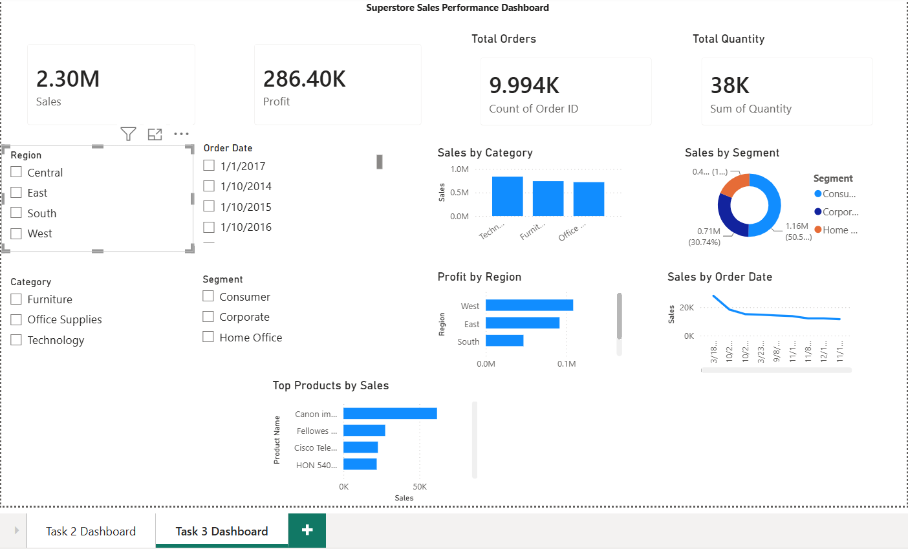
Dashboard Overview

Slide 5
Key Insights
Technology category generated the highest sales.
Consumer segment contributed the largest revenue share.
West region achieved the highest profit.
Sales trends varied across different time periods.
Interactive filters improve business analysis.

