Slide 1
Recommending best suitable venues for food lovers
March 20th 2020

Slide 2
Identifying best suit try out venue is important
All the venues (restaurants) are evaluated by local media advertisements, word of mouths from friends or family or via various medias or likes / ratings published by past customers
Understanding customer’s test and identifying best suitable venues increase odds on customer having highly satisfactory experience during his/her first visit
Venue owner may have interest as well

Slide 3
Data acquisition and preparation
Wikipedia – List the major cities of Oklahoma
Foursquare APIS
“Explore” – Venues list from point of interest locations
“Venue” – Venue’s details
“Likes” – User likes counts for a point of interest venues
Some of the unwanted categories and duplicate venues are ignored, default values are populated for missing key features
7 features are used by recommender systems
Total 840 venues representing 74 categories are selected from 5 major cities of Oklahoma
23,557 user likes records from 7,390 users are considered for analysis
One of the user e.g. user id = 85997014 is considered as active user by recommendation systems to identify best suitable venues

Slide 4
Recommendation systems
Content Based
Tightly depends on user test
Collaborative Filter Based
User from the same neighborhood with same common preference
Can suggest Venue from never visited category
Best suitable for conservative customer, who want to explore new venue within same test type
Best suitable for adventurous customer, who want to try out new venue outside of their test
Unable to recommends venue from new category

Slide 5
Venus and Active user likes
Active user’s test and his/her rating to venue play important role for both recommendation systems. However, content-based recommender unable to recommend restaurant in different category if active user is never liked restaurant in that category.
Both systems heavily and positively depend on (higher) rating value. If active user has provided higher rating for a given category, content-based recommender assigns higher weightage to restaurant associated with that category and user based collaborative recommender give higher weightage to users who also highly satisfied with that restaurant.

Slide 6
Venus and user like data availability
User based collaborative recommender unable to recommend venue if there is no like data available from other user for the venue which active users liked.
Active users have not liked venues from other cities, and most of the users in that city also have similar situation, content-based algorithm failed to suggest similar restaurant in other cities.
If some of the other users have liked restaurant in other cities, but very few likes are available, recommender unable to recommend restaurant from other city with high recommendation rank.
In summary user likes data availability, active user and other users common interest and location variety of liked venues played important role for recommender to suggest restaurant from other cities.

Slide 7
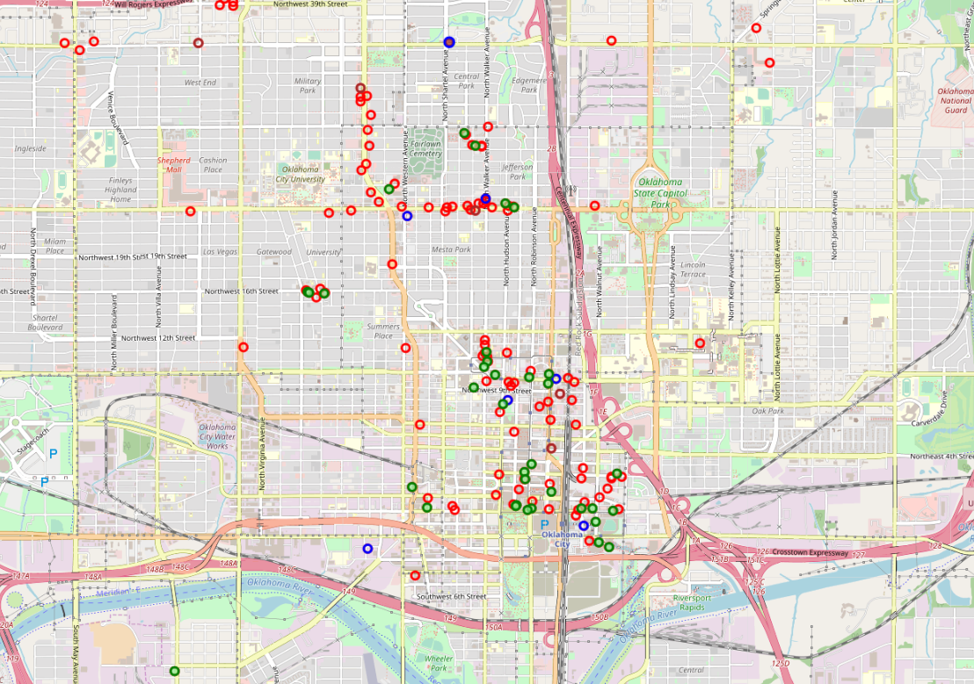
Outcome – Oklahoma City
Blue Circle with Brown fill – suggested by both recommender
Green Circle with green fee – User has rated / liked
Blue Circle with no fill – recommended by user-based collaborative filter recommender
Brown Circle with no fill - recommended by content-based collaborative filter recommender

Slide 8
Key observations
Only two venues are common in top 20 recommended venues by both recommenders
User-based collaborative recommender able to recommend top 2 restaurants from more categories than content-based recommender
User-based collaborative recommender has recommended venues from the category which was not visited by active user before
Top venues were different in both recommender systems
Nature of active user profile and availability other users profile play key role in outcome of both recommendation system. However, content based highly depends on former and collaborative filter bases system highly depends on later

Slide 9
Conclusion and future directions
Build two recommendation systems to identify best suitable recommendation venue list for active user
Both models outcome is highly depends on quality and coverage of available data
Both models suffers performance as you needs to rollout for large number active users. Further consideration e.g. hybrid approach need to made to tackle performance issue
Outcome can be improved by incorporating more futures
Actual rating data
Standardize menu data
Menu’ dishes ingredient data
Rating breakdown to measure various other dimensions e.g. customer service, layout, parking availability, waiting time etc.

