Slide 1
The Role of Technology in Modern Medicine
Janice Kapelevich
CSIT 100 Project Presentation

Slide 2
Introduction
- Technological advancements driving the future of medicine
- Redefining healthcare prospects and possibilities
- Technology surpassing healthcare convenience, becoming integral to modern systems
- Key role of technology in patient care and clinical practices
- Enables healthcare professionals to make educated conclusions and personalize treatment strategies
- Optimization of resources through technology utilization
- Crucial role of technology in shaping healthcare future and enhancing patient outcomes

Slide 3
Medical Imaging
Technological advancements in diagnostics:
Transforming the identification, characterization, and localization of medical disorders.
Essential imaging methods:
MRI (magnetic resonance imaging), CT (computed tomography), PET (positron emission tomography).
Non-invasive imaging machines:
Provide intricate, real-time views of internal structures.
MRI's impact:
Offers specific soft-tissue contrast and multiplanar imaging capabilities.

Slide 4
Continued..
CT imaging:
Constructs photographs of the desired area of the body, similar to X-rays.
PET imaging:
Provides visualization of cellular-level processes within the body.
Revolutionizing personalized medicine:
Diagnoses based on anatomical and physiological data from imaging technologies.
Enhancing patient outcomes:
Facilitating educated conclusions, personalized treatment plans, and improved results.

Slide 5
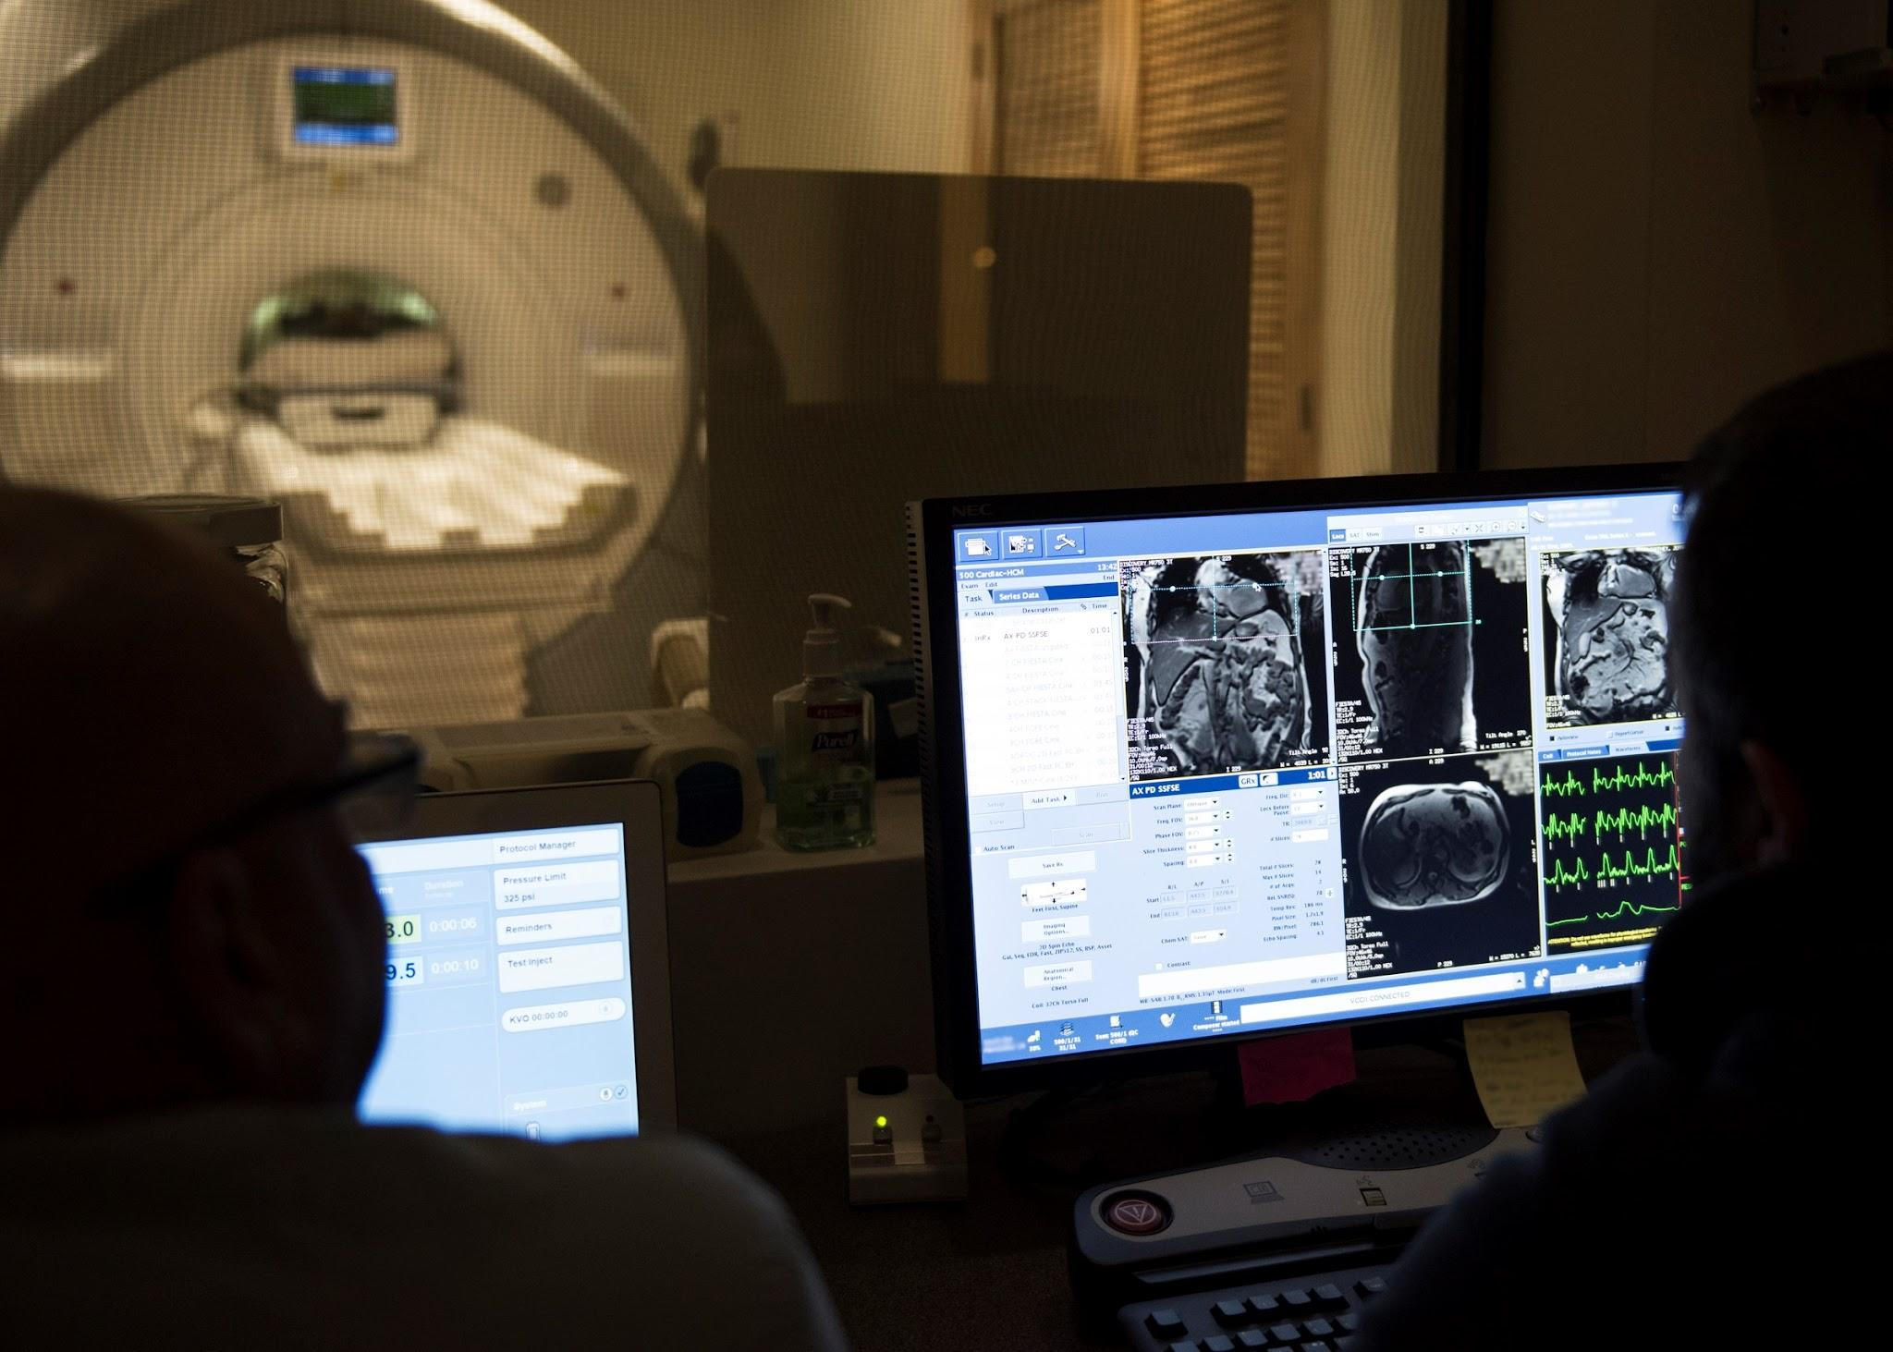
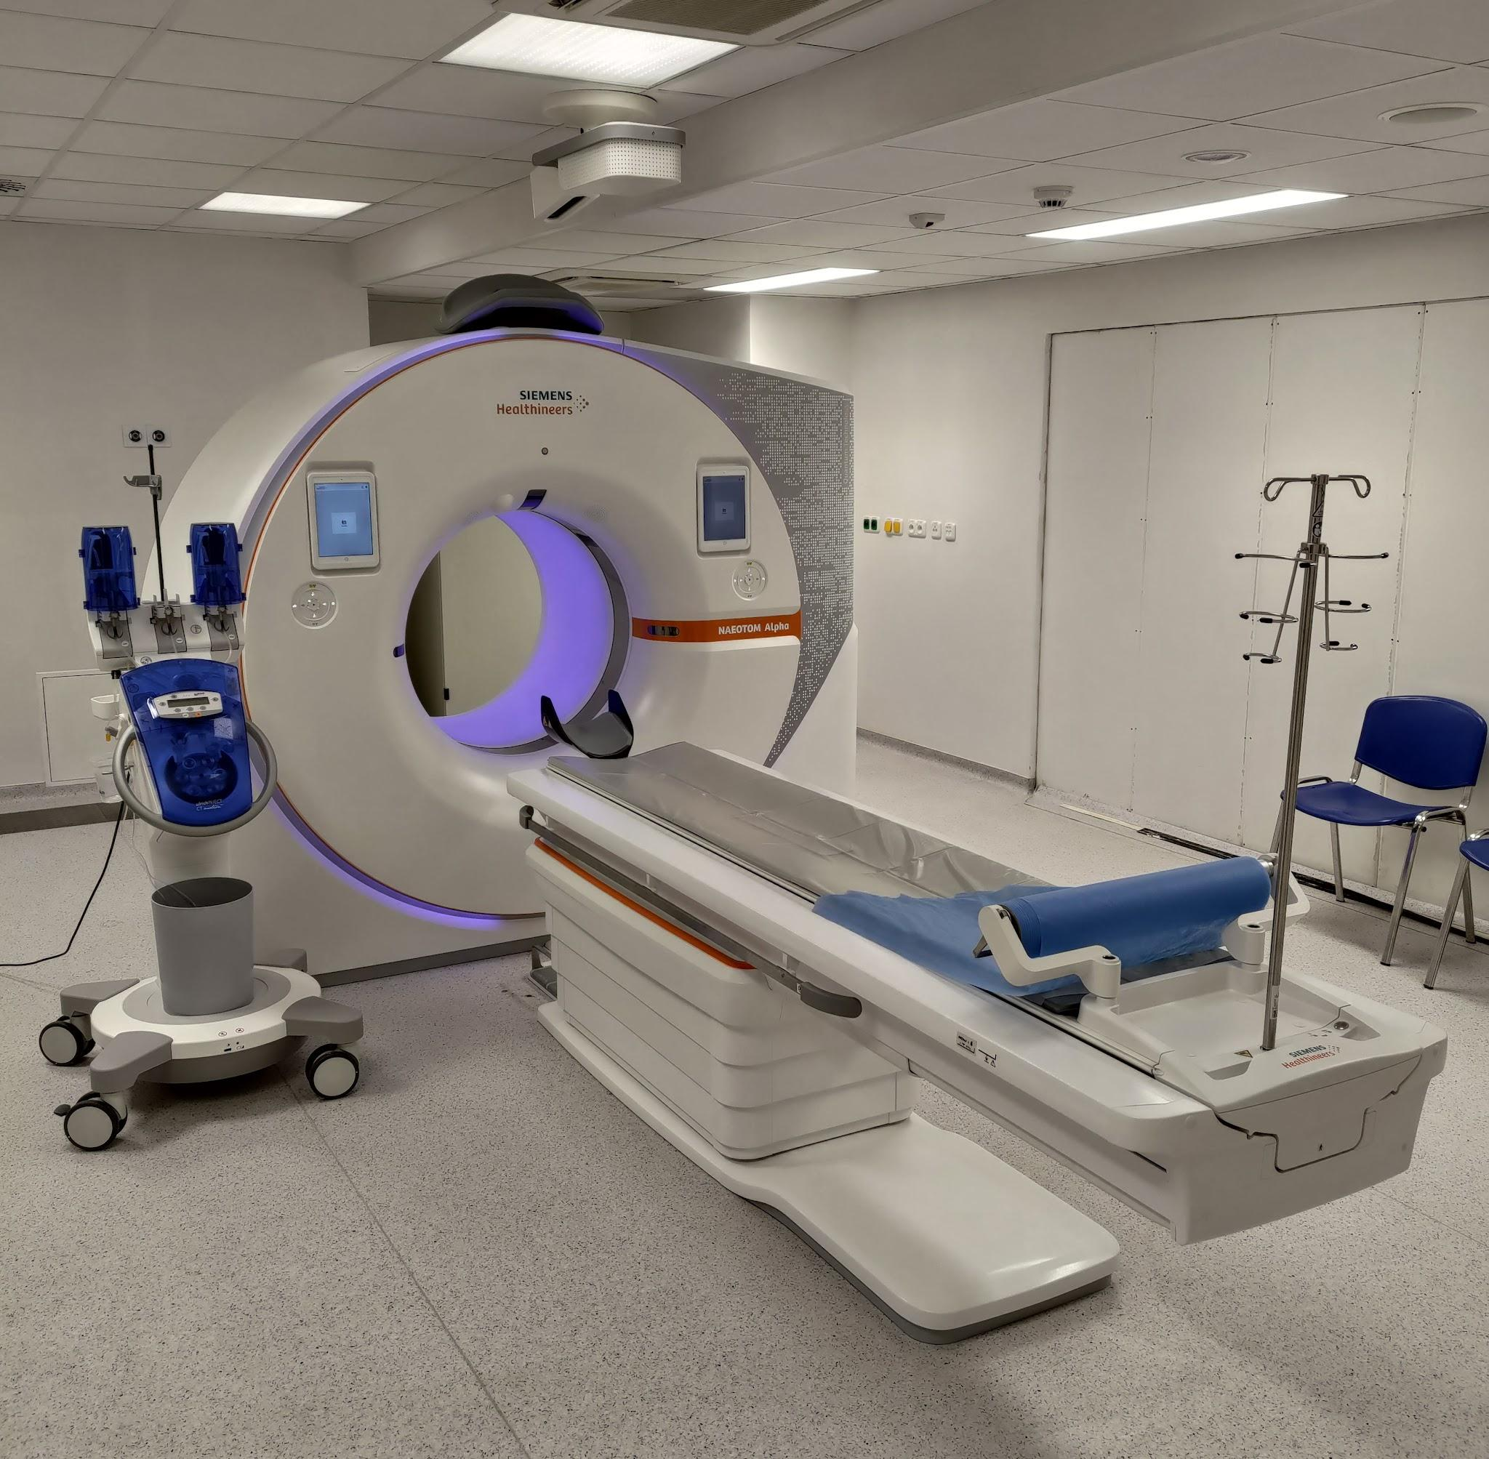
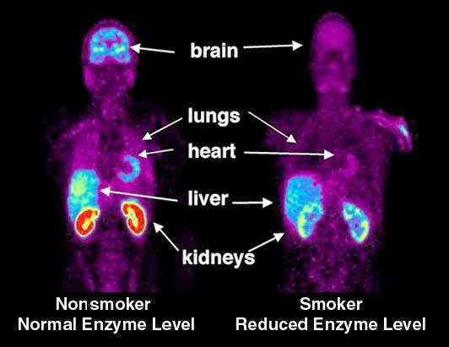
MRI, CT, PET Scan Machines

Slide 6
Telemedicine
Telemedicine Overview:
Contact between healthcare provider and patient through technological mediums like video calls and remote monitoring.
Facilitates access to medical services beyond clinical environments.
Benefits of Telemedicine:
Overcomes distance limitations and minimizes healthcare inequalities.
Encourages patient involvement in well-being.
Technological Advancements:
Progress in drug distribution methods and telemedicine tools revolutionizes healthcare sector.

Slide 7
Continued….
Impact of Telemedicine:
Restructures medical practices and transforms patient access to care.
Enables remote clinical consultations, diagnosis, treatment, and monitoring.
Examples of Telemedicine Platforms:
Zoom, FaceTime, and other digital communication technologies facilitate remote video consultations.
Improving Access to Healthcare:
Particularly beneficial in isolated areas with limited access to quality care.
Eliminates the need for travel, reducing time, cost, and inconvenience for patients.
Enhanced Safety Measures:
Provides a safety mechanism for contagious patients and healthcare workers.
Enables remote treatment without risking infection transmission, contributing to a safer medical environment.

Slide 8
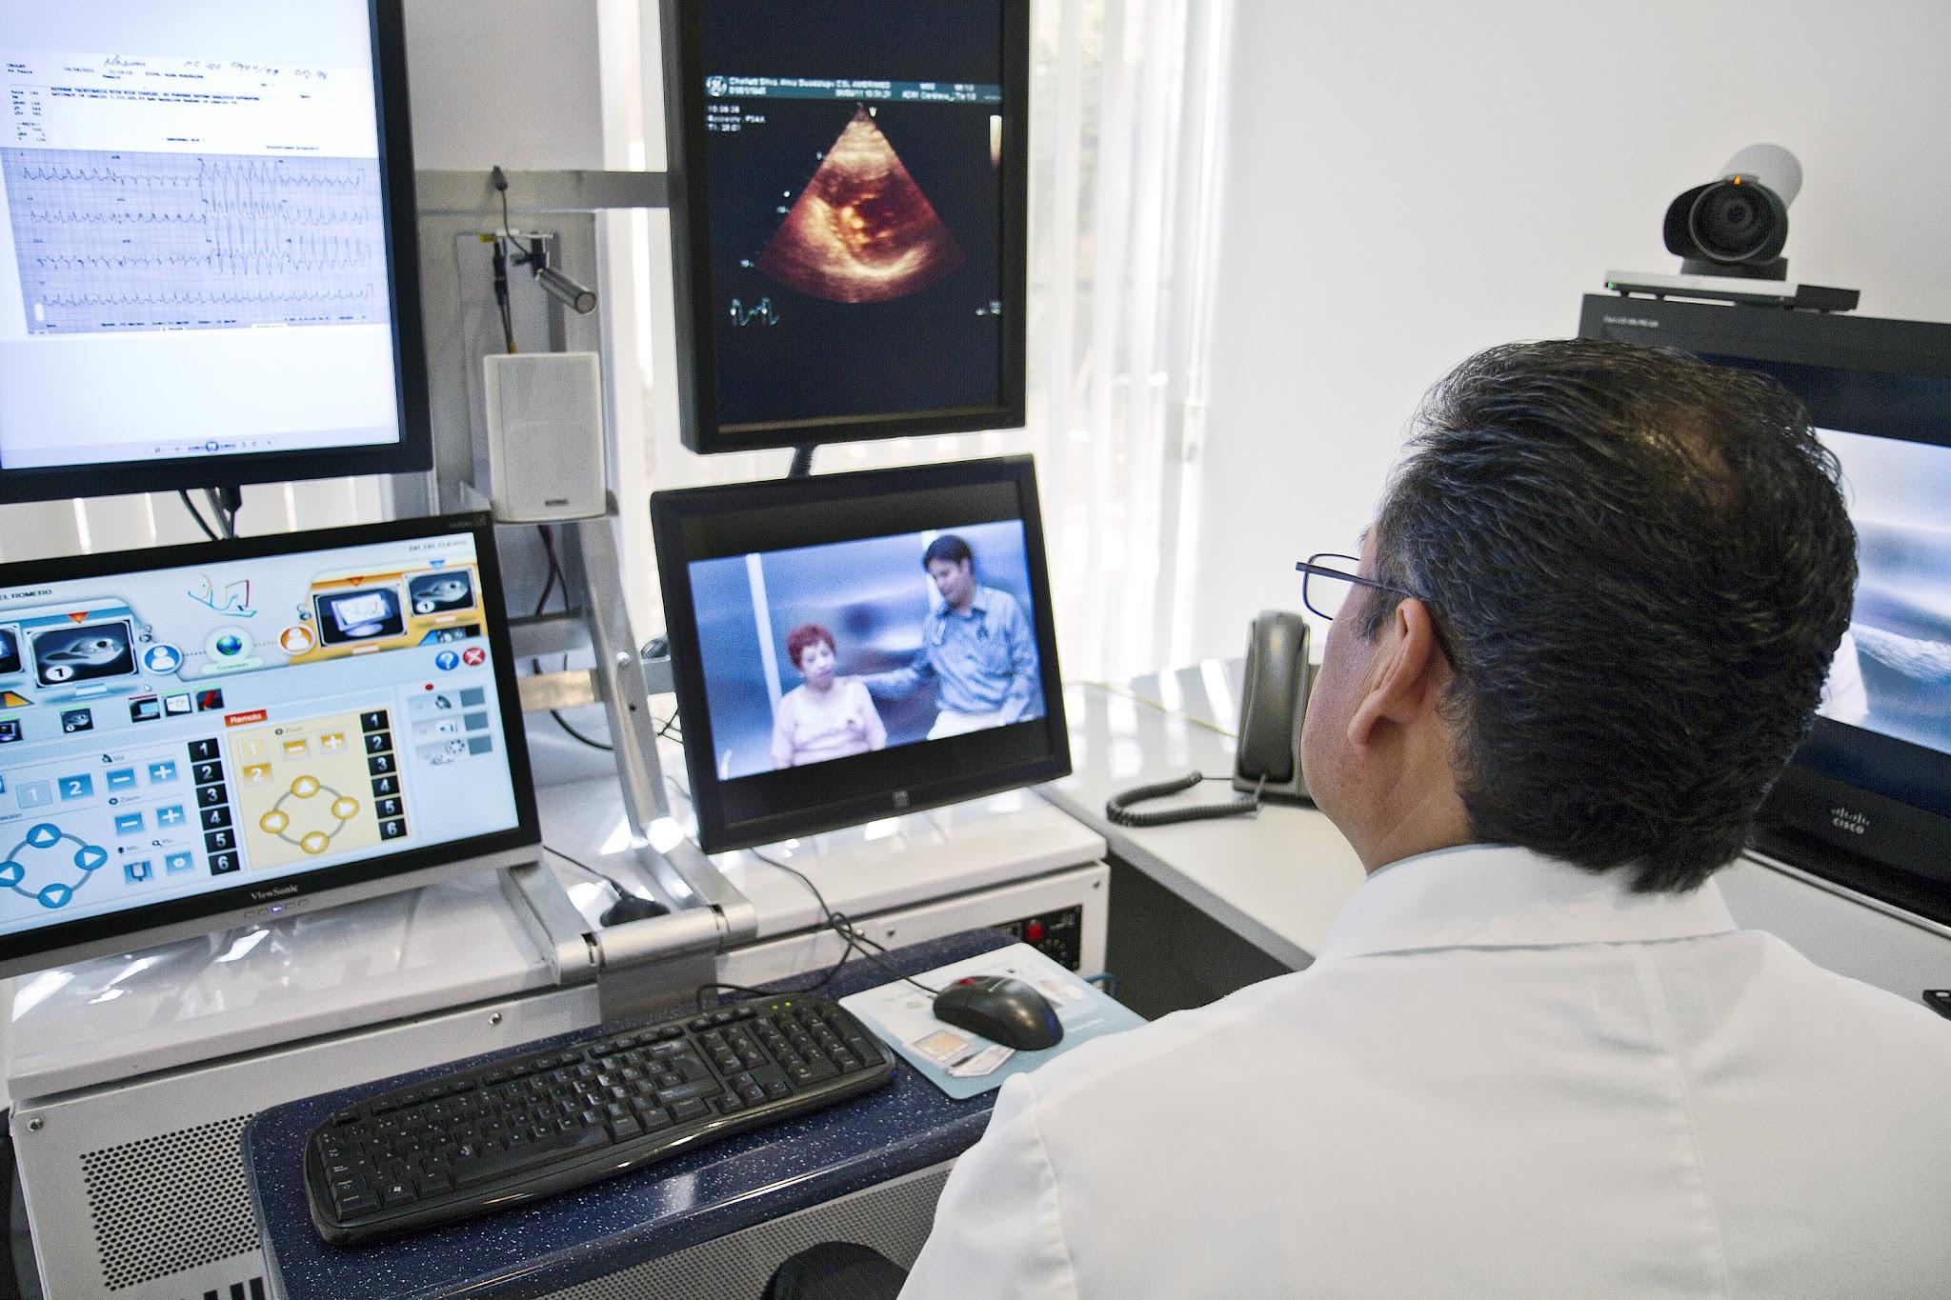

Telemedicine

Slide 9
Wearable Technologies
Introduction to Wearable Health Technology:
Smartwatches, pacemakers, and fitness monitors revolutionize healthcare.
Enables independent health monitoring and improved care delivery.
Technological Features:
Equipped with sensors, data-processing capabilities, and wireless connectivity.
Allows constant monitoring of physiological processes like blood pressure and heart rate.
Remote Patient Monitoring:
Enables healthcare providers to track and monitor patients' health status remotely.
Beneficial for chronic conditions like diabetes, hypertension, and heart disease.

Slide 10
Continued…
Benefits of Wearable Technology:
Facilitates early detection of physiological damage and complications.
Promotes patient engagement and self-management skills.
Encouraging Healthier Lifestyle:
Delivers personalized insights and motivational prompts for healthier living.
Promotes behaviors such as increased physical activity and consistent medication adherence.
Role in Preventive Healthcare:
Allows for early identification of health problems and risk factors.
Examples include wearable electrocardiograms (ECGs) for detecting heart rhythm abnormalities.

Slide 11
Continued…
Identification of Sleep Disorders:
Sleep-tracking devices assist in identifying sleep disorders like sleep apnea.
Enables early intervention and preventive measures to minimize long-term health risks.
Continuous Monitoring and Actionable Advice:
Individuals can monitor physiological limitations continuously.
Healthcare practitioners can provide actionable advice based on wearable device data.

Slide 12
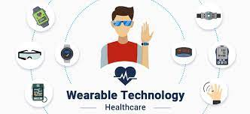
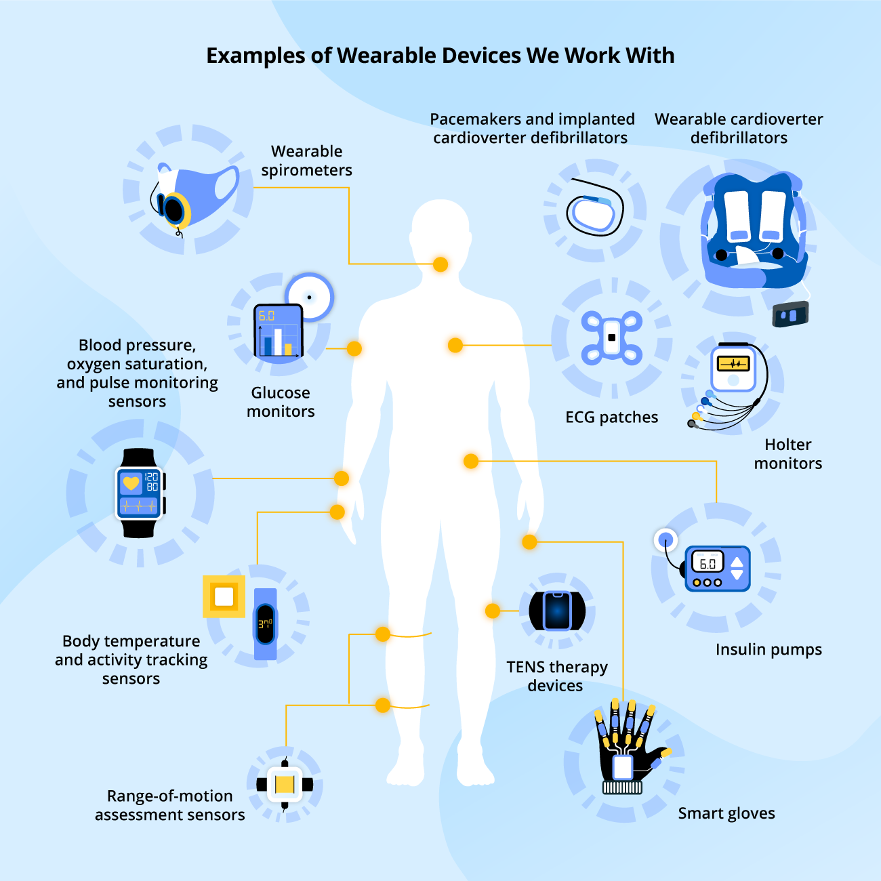
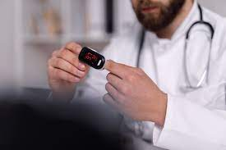

Slide 13
Conclusion
Technology has revolutionized medicine, impacting every aspect of healthcare delivery.
Diagnostic imaging technologies like MRI, CT, and PET have enabled early disease detection with intricate, real-time views of internal structures.
Telemedicine enables remote healthcare delivery, overcoming geographical barriers and reducing infection risks, particularly in isolated areas.
Wearable health technology allows for continuous monitoring of physiological parameters, promoting patient engagement and early detection of health issues.
Wearable devices also play a significant role in preventive healthcare by identifying risk factors and enabling early intervention for conditions like sleep disorders and heart abnormalities.
As technology continues to advance, the future of medicine holds promise for further improving the quality and efficiency of healthcare delivery globally.

Slide 14
Thank You!

