Slide 1
TLS Dashboard
Prickly Squares
Hackathon X
October 3, 2018

Slide 2
The Internet Keeps Changing

Slide 3
TLS has many variations

Slide 4
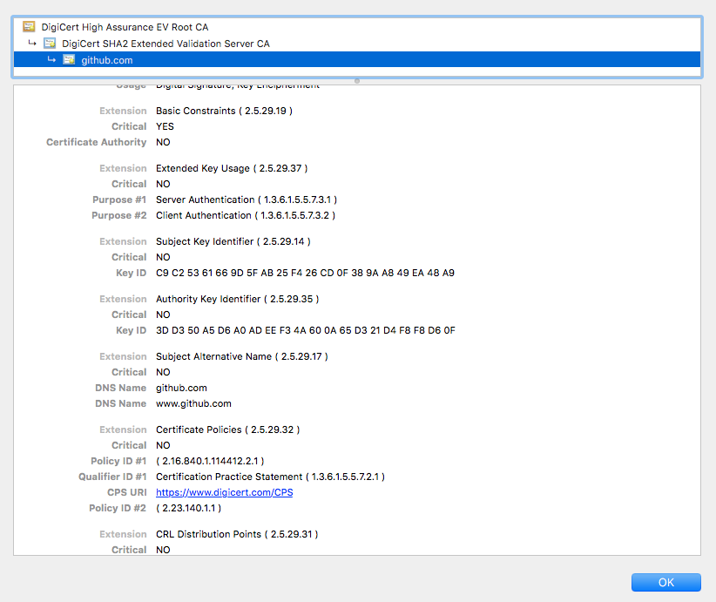
Certificate Extensions

Slide 5
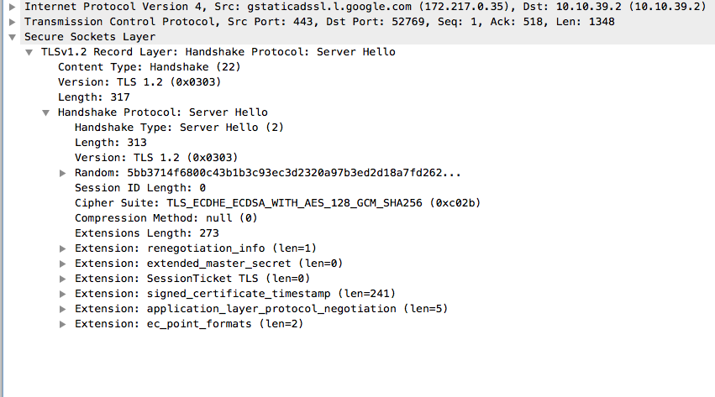
TLS Extensions

Slide 6
We need to keep up

Slide 7
TLS Dashboard

